Slide 1
Predicting gene expression from genomic DNA sequences
Vikram Agarwal
David Kelley
Calico Life Sciences

Slide 2
DNA at different scales

Slide 3
The complex logic of DNA in governing gene expression levels
Gene 1 RNA
Gene 2 RNA
AAAAA
AAAAA
AAAAA
Output: RNA molecules produced (continuous scale)
AAAAA
AAAAA
AAAAA
AAAAA
Input: DNA sequence or biochemical properties embedded in DNA sequences
Promoter (gene 1)
Promoter (gene 2)
Enhancer
Insulator
Enhancers can signal to a promoter 1,000nt-1,000,000 nucleotides away from gene
Gene expression: Number of RNA molecules produced in a given cell type (measured as a continuum)
Promoter: heavily determines RNA molecules produced but depends on enhancers, insulators, and other DNA sequences
Enhancer: switches on a gene to greater levels, can occur at very faraway distances from a promoter
Insulator: blocks an enhancer-promoter interaction so the enhancer has little to no effect

Slide 4
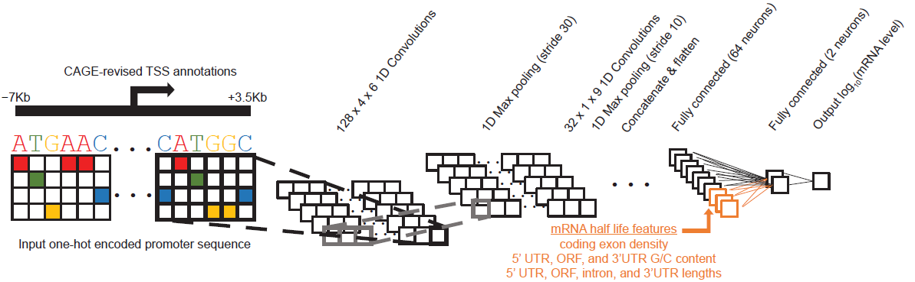
ConvNets to predict expression levels from DNA sequences (Agarwal 2018)
CNNs good at predicting gene expression from promoter sequences
CNNs poor at capturing long-range word dependencies and compelx position-dependent relationships between words

Slide 5
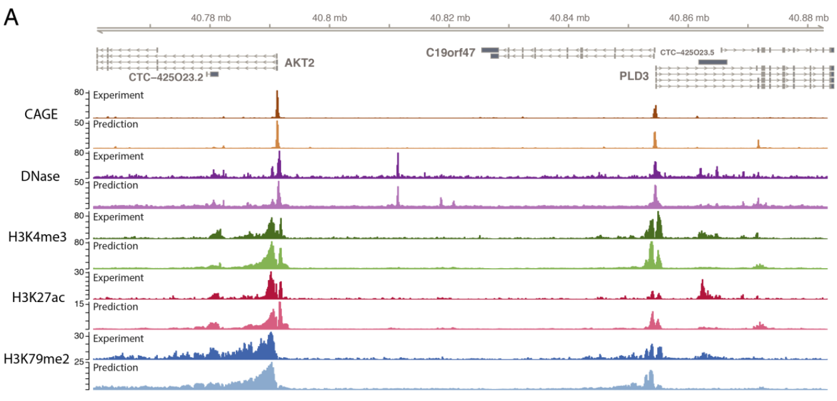
Basenji to predict biochemical features along a chromosome (Kelly 2018)
Promoter
Possible Enhancer
Possible Insulator
Unknown function

Slide 6
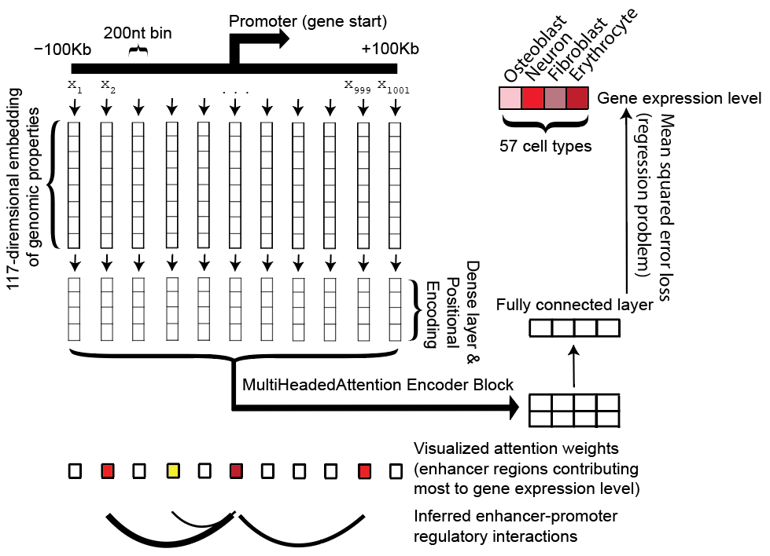
Problem setup w/ TransformerEncoder scheme
Promoter alone is highly predictive of gene
expression levels…want to understand how
faraway sequences influence the promoter

Slide 7
Problem setup & status
Input: [Number examples] x [1,001 positions] x [117 embedding]
Output: [Number examples] x [57 gene expression values]
MSE loss function
Already have TFRecords built for training/eval/test sets
Was able to train TransformerEncoder model but unable to evaluate performance on test set, metrics returning strange results (i.e., Pearson correlation outside of –1 to 1 range)
Goals
search a wide space of hyperparameters and architectures to push the limits of performance on multiGPU or TPU/Google3 setup
compare any other cutting edge learning strategies available that could capture complex positional relationships between words, and long-range word dependencies
Attempt to interpret which faraway words are influencing the promoter, and by how much (i.e., what would happen if word deleted or mutated?)

