Slide 1

Tornado
Prediction
Chris Hoffman

Slide 2




project Outline
Problem
Data
Analysis
Conclusion

Slide 3
Problem

Slide 4
Problem - question
Does the temperature over the course of winter in individual counties of Wisconsin indicate if a tornado will occur during the tornado season?

Slide 5



Problem – Additional Questions
What temperature measurement(s) will be the best predictor(s)?
What other attributes can be used with temperature to give better predictions?
What metrics should be used to evaluate predictions made?

Slide 6
Data

Slide 7


Data – collection
Tornado Data
1950-2020
All tornadoes in Wisconsin
Start location
Date
Temperature Data
1950-2020
Average Temperature
Minimum Temperature
Maximum Temperature
Month

Slide 8
Data – Processing
Temp data reduced to winter months
Menominee county removed from temp data
Temp data grouped by year and county
Tornado data grouped by year and county
Tornado data merged with temp data

Slide 9
Analysis

Slide 10
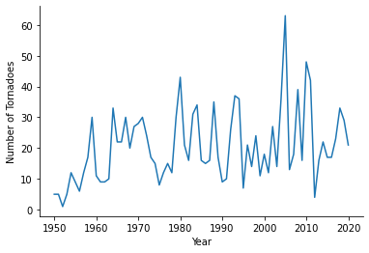
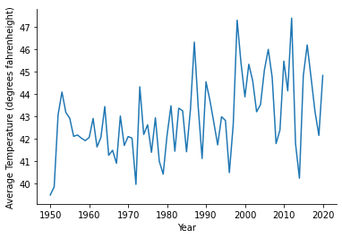
Analysis - Exploratory
Figure 1. Number of tornadoes in Wisconsin per year from 1950-2020.
Figure 2. Average Winter Temperature in Wisconsin from 1950-2020.

Slide 11
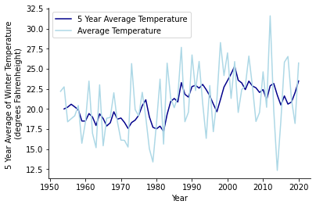
Analysis - Exploratory
Rolling average
1950-1953 excluded
Better indication of climate trends
Can be used to look for future trends
Figure 3. Rolling 5-year average winter temperature in Wisconsin from 1953-2020.

Slide 12
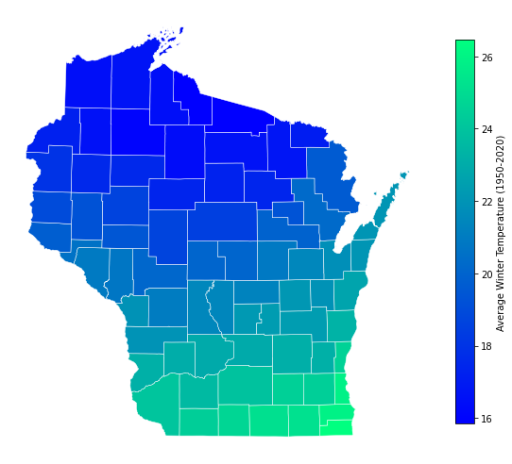
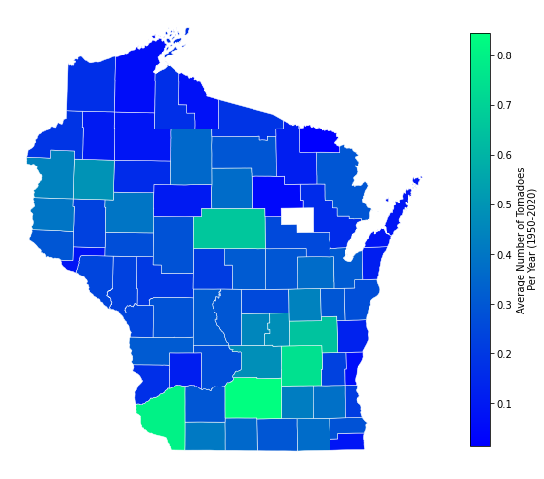
Analysis - Exploratory
Figure 4. Average winter temperature across Wisconsin counties from 1950-2020.
Figure 5. Average number of tornadoes per year in Wisconsin counties from 1950-2020. Menominee county (white) is excluded due to lack of data.

Slide 13
Analysis - Model
Model
Logistic Regression
Standard Scaling
One Hot Encoding
Accuracy
Precision
Recall
F Score
Attributes Explored
All original temperature attributes
Rolling averages for all temperature attributes
County name
If a tornado occurred in previous years

Slide 14
Analysis - Model
Average of the average maximum winter temperature over 5 years
County name
Did a tornado occur last year?
Will a tornado occur this year?
Yes
No

Slide 15
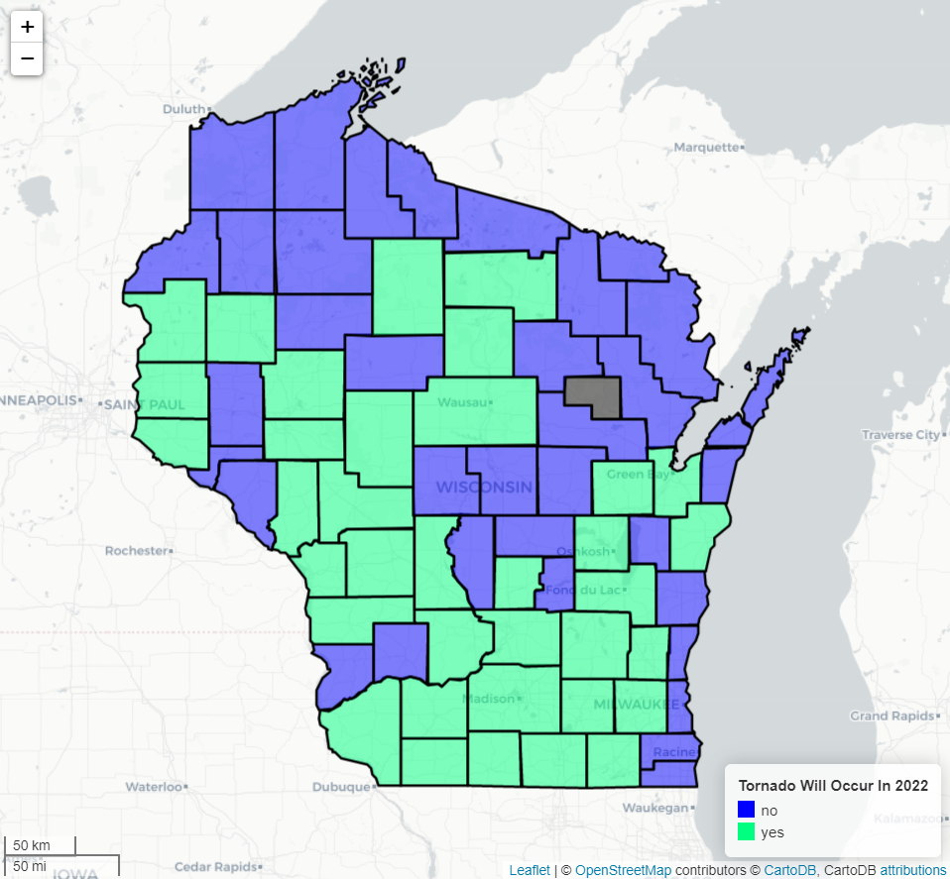
Analysis - Model
Metrics
Accuracy : 0.544
Precision : 0.246
Recall : 0.593
F Score : 0.348

Slide 16

Conclusion

Slide 17
Conclusion - Insights
Winter temperature was not a great predictor of tornadoes in Wisconsin counties.
An accuracy score of 0.544 shows that there is something here, but not much.
A low precision score of 0.246 shows that many counties are being incorrectly predicted to have tornadoes.

Slide 18
Conclusion – Future Work
Other Attributes
Winter snowfall
Winter wind speeds
Global wind patterns
Climate trends across the US
Other Areas to Explore
Tornado magnitude
Spatial tornado distribution
Tornado duration

Slide 19
Questions

