Slide 1

Tornado Prediction
Chris Hoffman

Slide 2




project Outline
Problem
Data
Analysis
Conclusion

Slide 3
Problem

Slide 4
Problem - question
Does the temperature over the course of winter in individual counties of Wisconsin indicate if a tornado will occur during the tornado season?

Slide 5



Problem – Additional Questions
What temperature measurement(s) will be the best predictor(s)?
What other attributes can be used with temperature to give better predictions?
What metrics should be used to evaluate predictions made?

Slide 6
Data

Slide 7


Data – collection
Tornado Data
1950-2020
All tornadoes in Wisconsin
Start location
Date
Temperature Data
1950-2020
Average Temperature
Minimum Temperature
Maximum Temperature
Month

Slide 8
Data – Processing
Temp data reduced to winter months
Menominee county removed from temp data
Temp data grouped by year and county
Tornado data grouped by year and county
Tornado data merged with temp data

Slide 9
Analysis

Slide 10
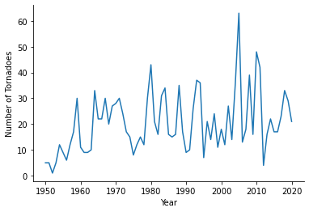
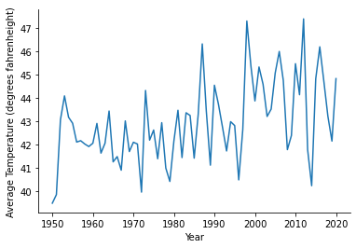
Analysis - Exploratory
Figure 1. Number of tornadoes in Wisconsin per year from 1950-2020.
Figure 2. Average Winter Temperature in Wisconsin from 1950-2020.

Slide 11
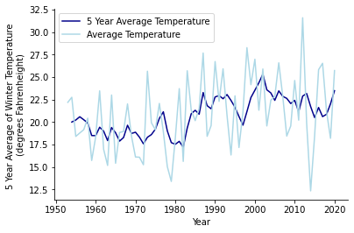
Analysis - Exploratory
Rolling average
1950-1953 excluded
Better indication of climate trends
Can be used to look for future trends
Figure 3. Rolling 5-year average winter temperature in Wisconsin from 1953-2020.

Slide 12
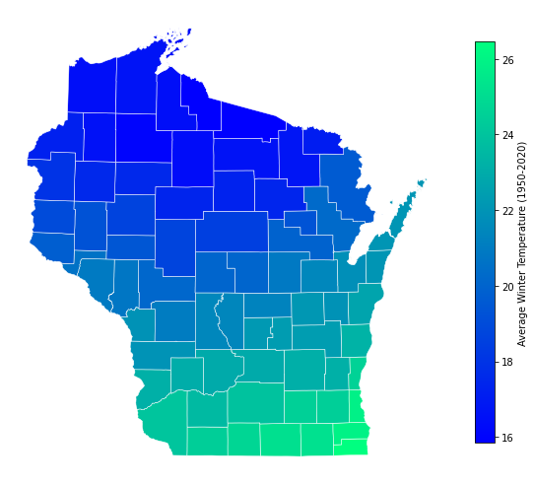
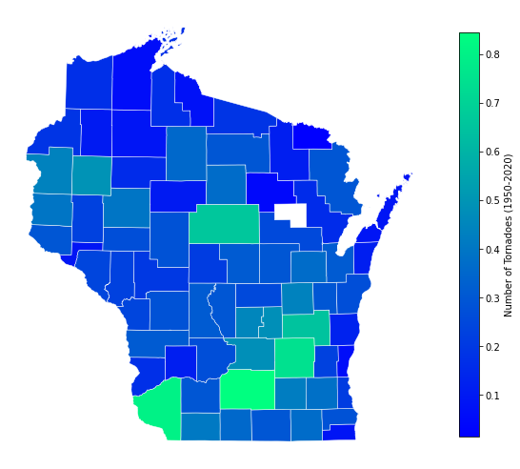
Analysis - Exploratory
Figure 4. Average winter temperature across Wisconsin counties from 1950-2020.
Figure 5. Total number of tornadoes in Wisconsin counties from 1950-2020. Menominee county (white) is excluded due to lack of data.

Slide 13
Analysis - Model

Slide 14

Reflection

Slide 15


Acknowledgments
Nick Schock
Alan Murphy
John Bushman
John Zimmerman
Tung Ouy

