Slide 1
In-VR Animation Editor
Miles Mulet
CIS 4914 Senior Project
8 November 2017

Slide 2
Summary
Motivation
Animation is hard, especially for beginners.
Authoring virtual reality (VR) assets with a monitor is hard.
Problem
Develop an open-source tool to allow a user to animate an arbitrary 3d model in VR.
Solution
Create a VR animation plugin to the Unity game engine.
Specifically, my focus has be on low-level animation data manipulation

Slide 3
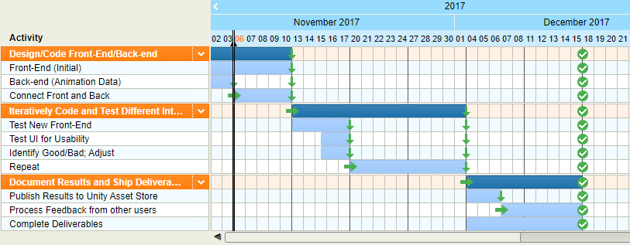
Current Gantt Chart

Slide 4
Literature Sources
Unity Technologies, “Unity User Manual (5.5)”. March 8, 2017. Publication 5.5-001F. https://docs.unity3d.com/Manual/index.html.
Microsoft, “C# Reference”. 2015.
https://msdn.microsoft.com/en-us/library/618ayhy6.aspx.
Jono Forbes, “Animating Inside VR: Mixing motion capture and keyframes”. July 24, 2017.
https://blogs.unity3d.com/2017/07/24/animating-inside-vr-mixing-motion-capture-and-keyframes/

Slide 5
General Program Flowchart

Slide 6
Animation Data System UML

Slide 7
Prototype GUI

Slide 8

Work to Be Performed
Task #1: Adapt editor to work with Humanoid animations
Method: Allow user to work normally and, upon saving animation, transform to humanoid properties
Task #2: Development of “useful” interfaces to further enhance animation workflow
Method: Experiment with innovative interfaces from literature sources; attempt to exploit proprioception

