Slide 1
Doceo

Slide 2
Ideas
Task generation
Checking process simplification
Personalize tasks
Increase pupil involvement
PC & Android applications

Slide 3
Advantages
Individual task compilations
Mobile app
Adaptiveness
Partial teacher work automatization
Data-driven

Slide 4
What we’ve done
Android application (Xamarin)
Desktop application (C#)
Web-backend (Flask)

Slide 5
Android application
For pupils
Basic task solving and reading functionality

Slide 6
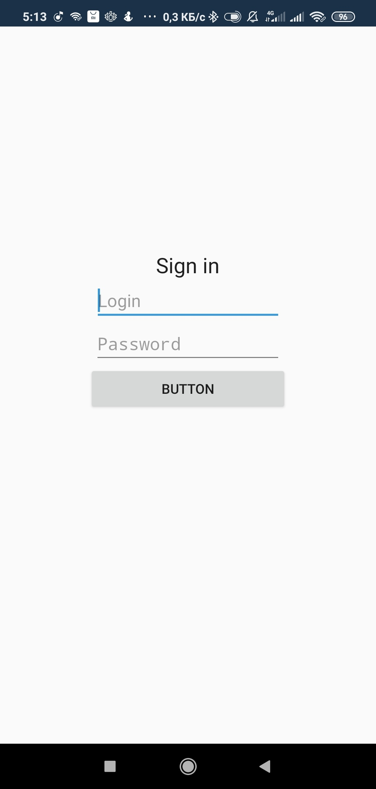
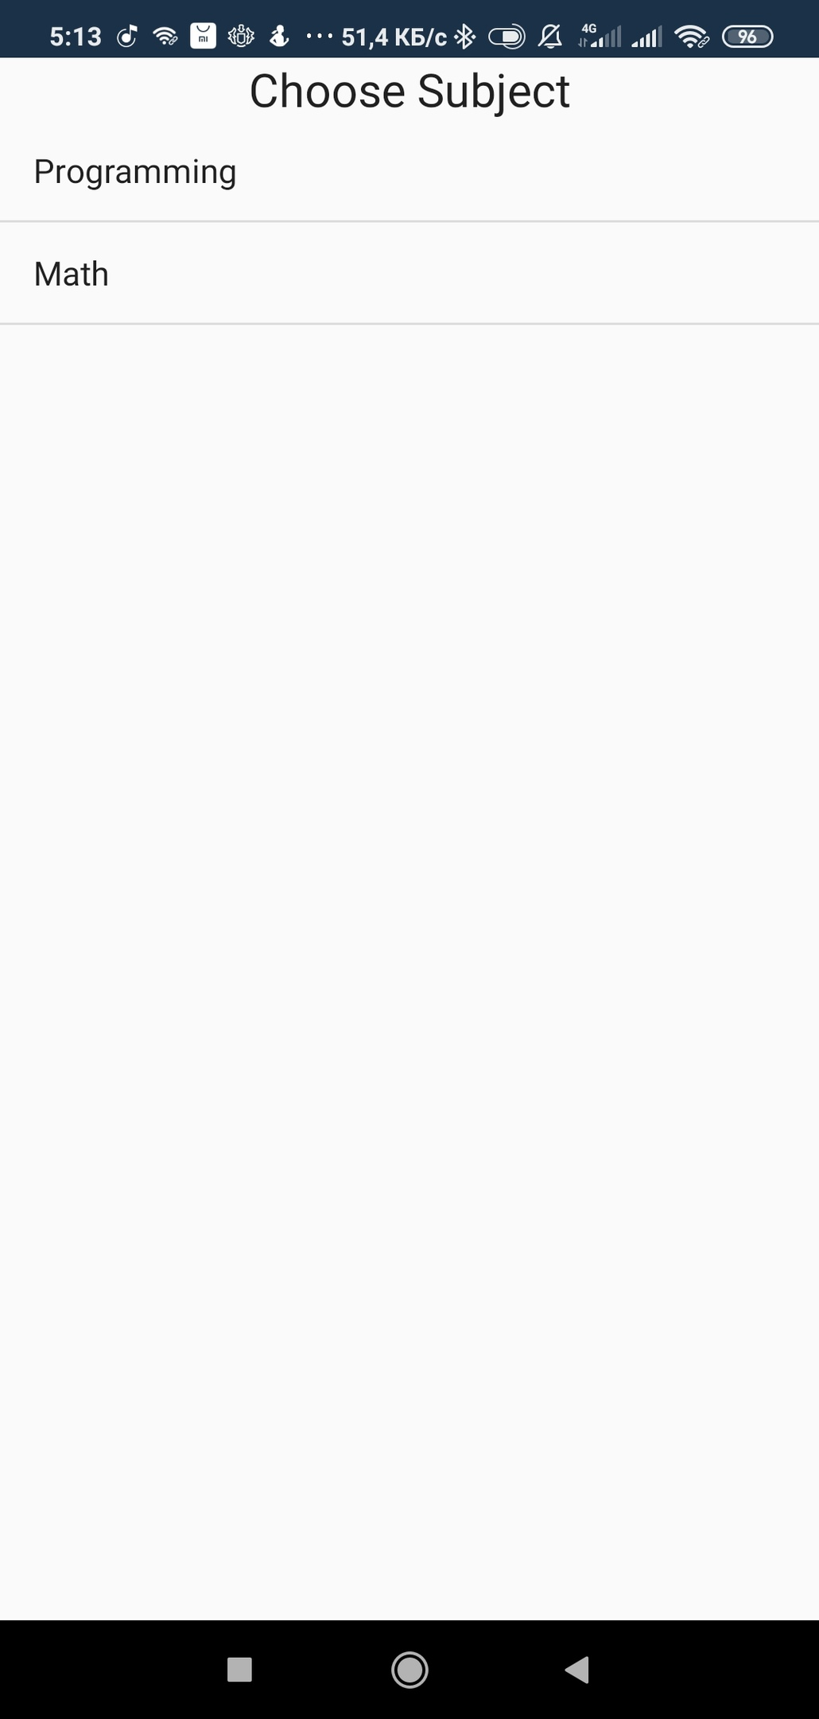
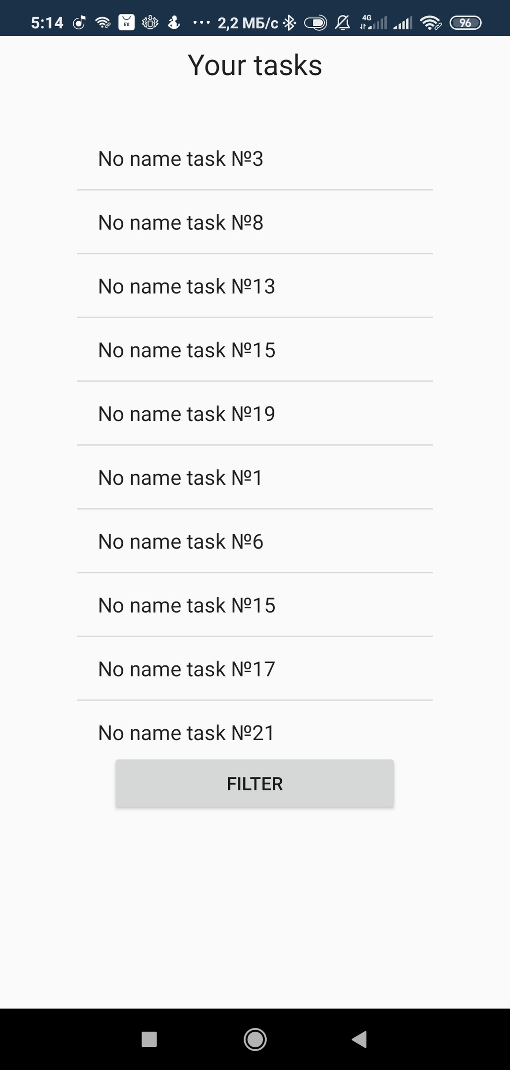
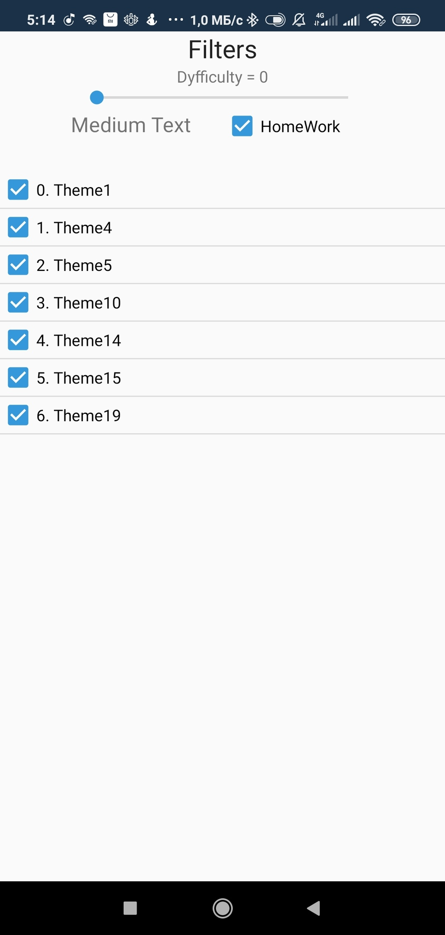
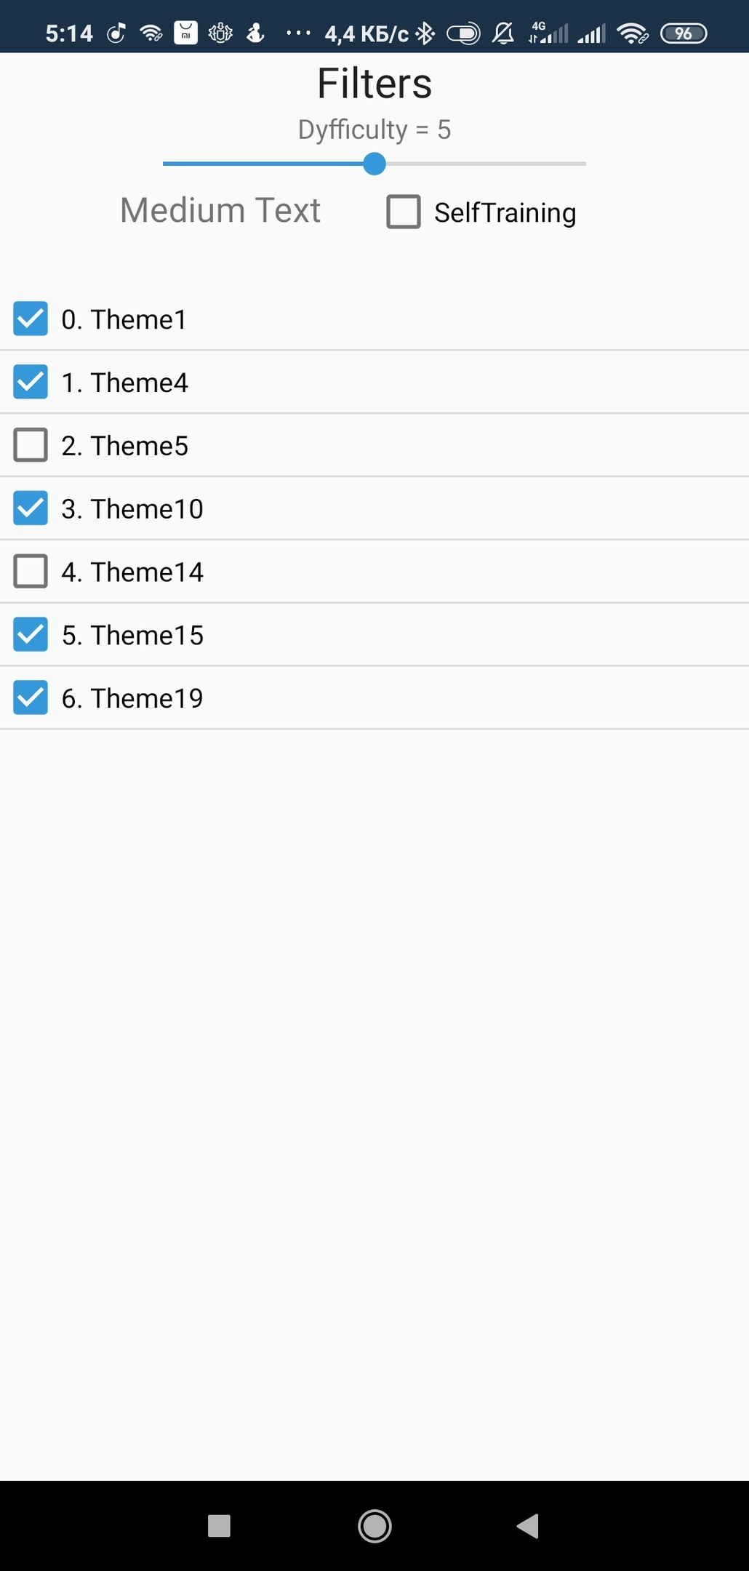
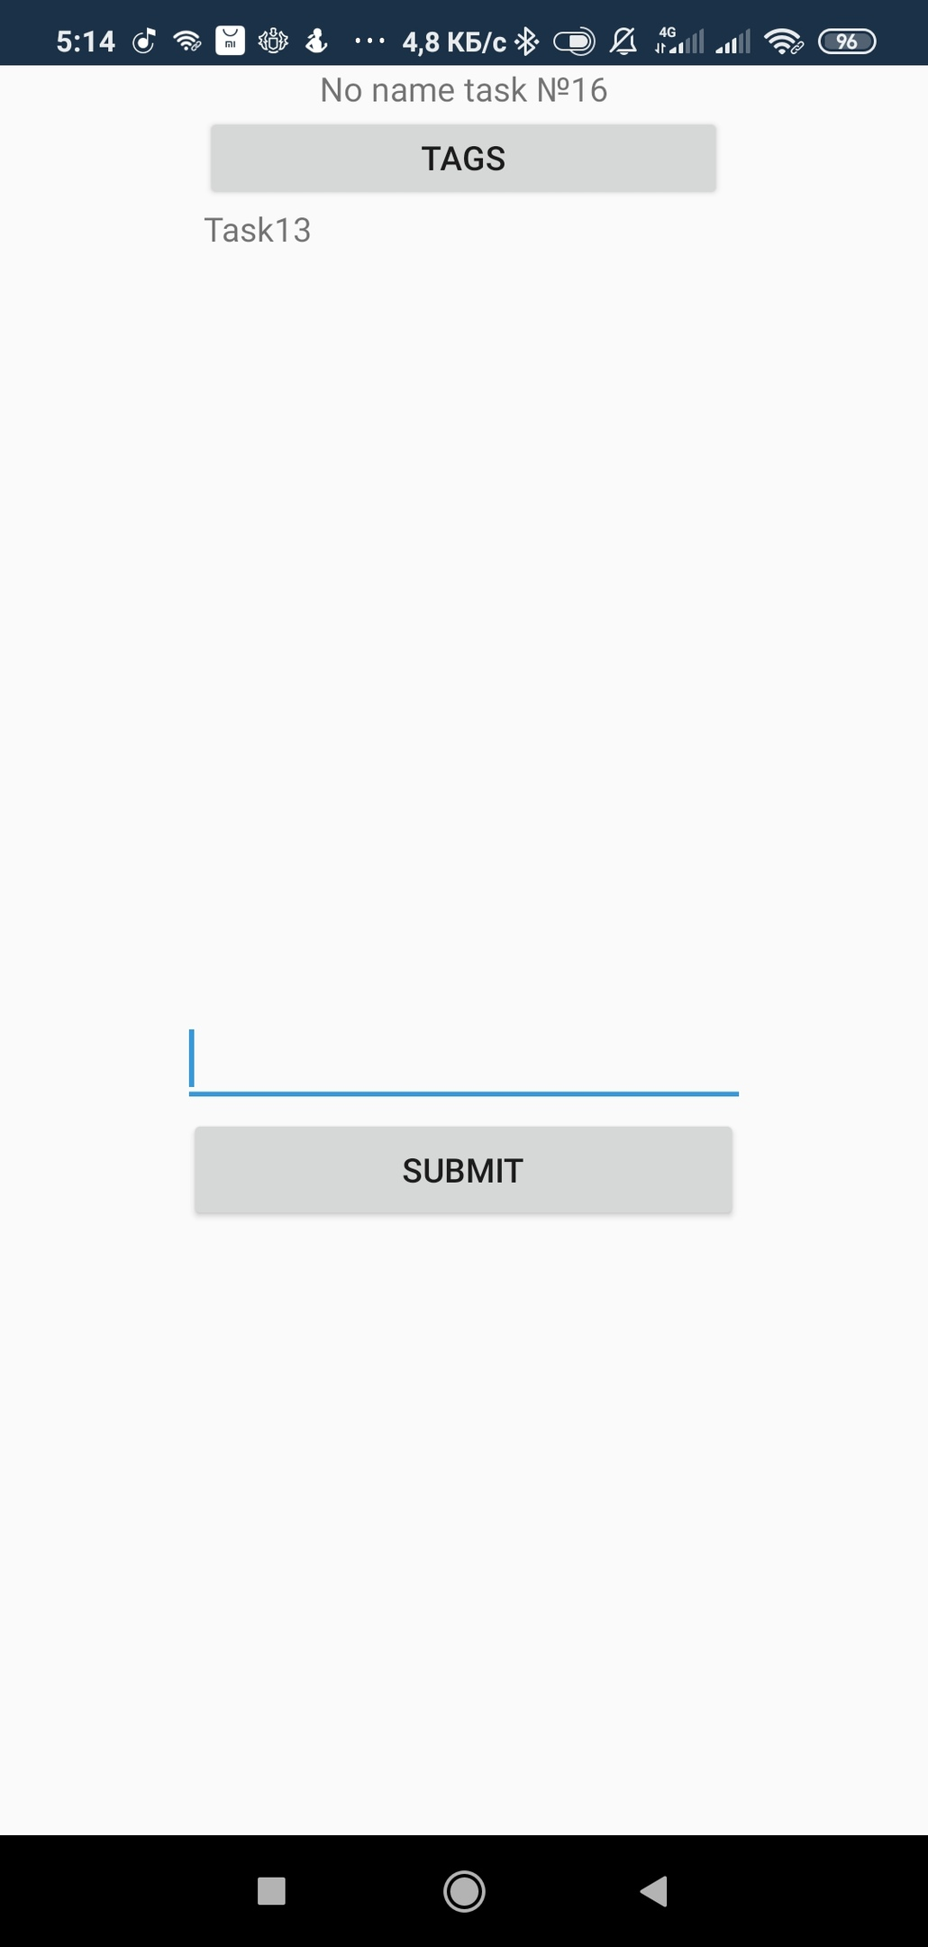

Slide 7
Desktop application
For teacher
Registration
Work viewing
Task creation and assignment
Basic statistics on work results

Slide 8
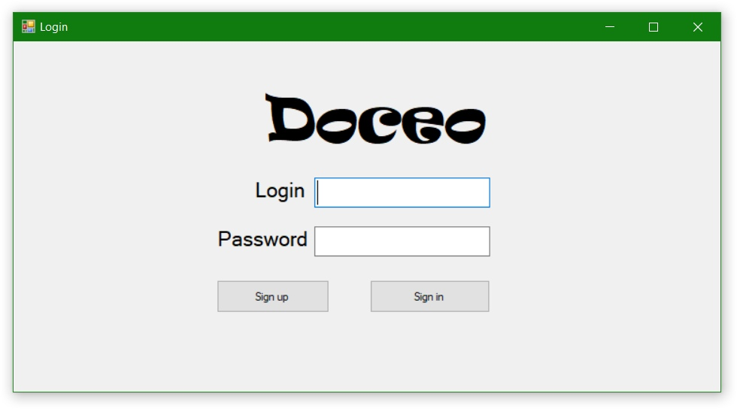
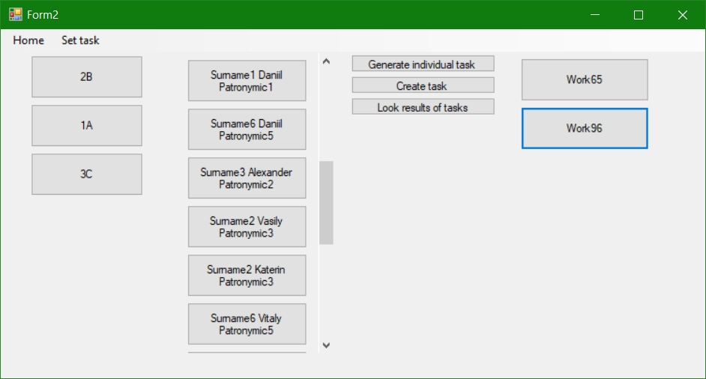
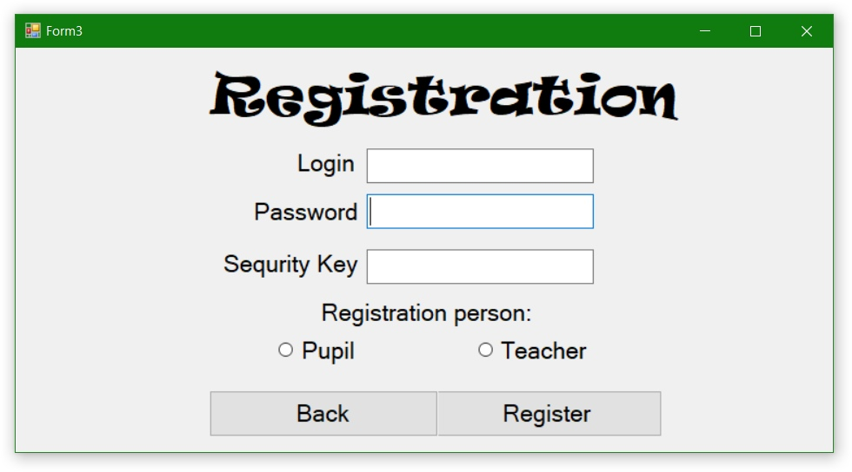
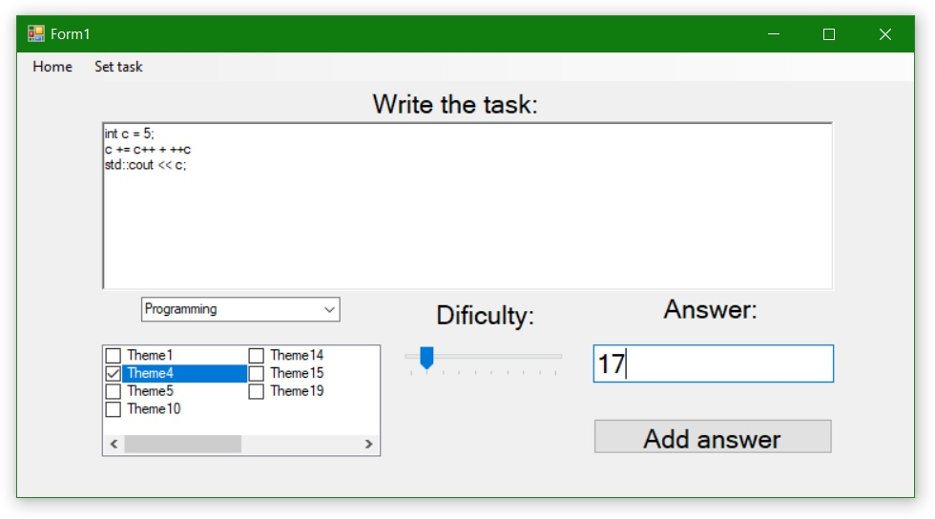

Slide 9
Web backend
Database management
Student performance estimation
Recommendation mechanism

