Slide 1

CSC015 final project
Samuel Criss, Byron Arreaga Sandoval, Joash Partisala

Slide 2


Problem?

Slide 3

Supply and Demand!!!

Slide 4

Supply and Demand
Sucks but it’s a real economic concept
Everything is finite
Things sell out ☹
But…

Slide 5
Shopping today is great!!!
Why?

Slide 6

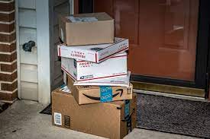
Everything is online!!!
Amazon
eBay
Etsy
Nike
Adidas
Walmart
Target
Hell even you can sell stuff online
But…

Slide 7

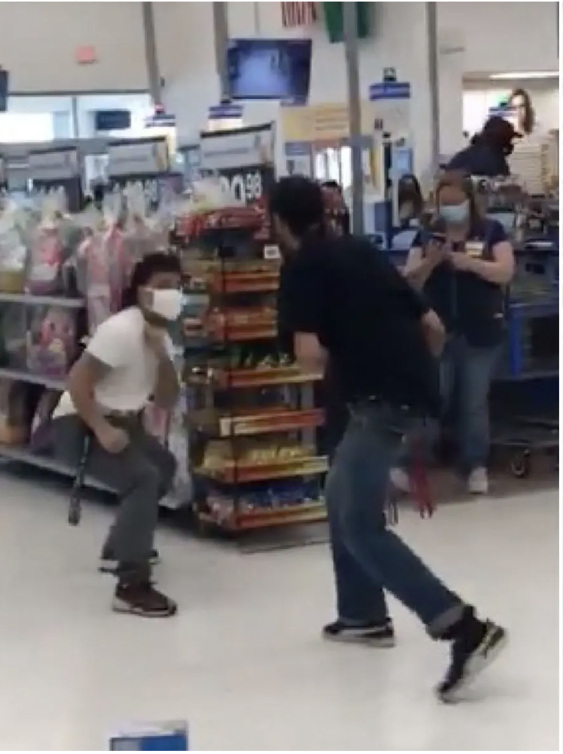
Dang, everything's online
Demand becomes more widespread
Things sell out faster
Can’t fight over stuff online ☹

Slide 8



Solution?

Slide 9

A Python bot!!!

Slide 10
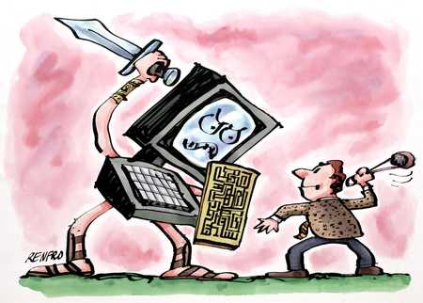
You’re no match for a computer!
Let the computer fight for you!
Computer is faster
Pays more attention
Probably smarter

Slide 11
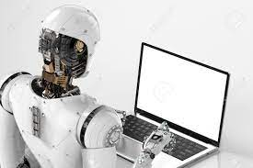
Mission Statement
Create a bot
that can run 24/7
Be used on multiple websites
Can check out items on its own

Slide 12
What do we need
Python Virtual environment
Selenium web driver
Chrome-driver binary
Beautiful Soup
pandas

