Slide 1
AUTO
STBY
OFF
AUTO
STBY
OFF
AUTO
STBY
OFF

Slide 2
PARS
AGCAS
ATF
ALT HOLD
ATT HOLD
OFF
PARS
AGCAS
ATF
ALT HOLD
ATT HOLD
OFF
PARS
AGCAS
ATF
ALT HOLD
ATT HOLD
OFF
PARS
AGCAS
ATF
ALT HOLD
ATT HOLD
OFF
PARS
AGCAS
ATF
ALT HOLD
ATT HOLD
OFF
PARS
AGCAS
ATF
ALT HOLD
ATT HOLD
OFF
PARS
AGCAS
ATF
ALT HOLD
ATT HOLD
OFF
PARS
AGCAS
ATF
ALT HOLD
ATT HOLD
OFF
PARS
AGCAS
ATF
ALT HOLD
ATT HOLD
OFF
PARS
AGCAS
ATF
ALT HOLD
ATT HOLD
OFF
PARS
AGCAS
HDG SEL
ATT HOLD
STRG SEL
OFF
PARS
AGCAS
HDG SEL
ATT HOLD
STRG SEL
OFF
PARS
AGCAS
HDG SEL
ATT HOLD
STRG SEL
OFF
PARS
AGCAS
HDG SEL
ATT HOLD
STRG SEL
OFF
PARS
AGCAS
HDG SEL
ATT HOLD
STRG SEL
OFF
PARS
AGCAS
HDG SEL
ATT HOLD
STRG SEL
OFF
PARS
AGCAS
ATF
ALT HOLD
ATT HOLD
OFF
PARS
AGCAS
ATF
ALT HOLD
ATT HOLD
OFF
PARS
AGCAS
ATF
ALT HOLD
ATT HOLD
OFF
PARS
AGCAS
ATF
ALT HOLD
ATT HOLD
OFF
PARS
AGCAS
ATF
ALT HOLD
ATT HOLD
OFF
PARS
AGCAS
ATF
ALT HOLD
ATT HOLD
OFF
PARS
AGCAS
HDG SEL
ATT HOLD
STRG SEL
OFF
PARS
AGCAS
HDG SEL
ATT HOLD
STRG SEL
OFF
PARS
AGCAS
HDG SEL
ATT HOLD
STRG SEL
OFF
PARS
AGCAS
HDG SEL
ATT HOLD
STRG SEL
OFF
PARS
AGCAS
HDG SEL
ATT HOLD
STRG SEL
OFF
PARS
AGCAS
HDG SEL
ATT HOLD
STRG SEL
OFF
PARS
AGCAS
HDG SEL
ATT HOLD
STRG SEL
OFF
PARS
AGCAS
HDG SEL
ATT HOLD
STRG SEL
OFF
PARS
AGCAS
HDG SEL
ATT HOLD
STRG SEL
OFF
PARS
AGCAS
HDG SEL
ATT HOLD
STRG SEL
OFF

Slide 3
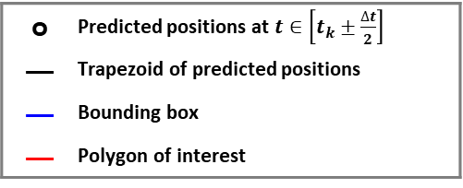
o | Predicted positions at $t∈\left[t_{k}±\frac{∆t}{2}\right]$
— | Trapezoid of predicted positions
— | Bounding box
— | Polygon of interest
 |  |  | o
 |  |  | o
 |  |  |  |  |  |  |  |  |  | o
 |  |  |  |  |  |  |  |  | o
 |  |  |  |  |  |  |  |  | o
 |  |  | o
 |  | o
 |  |  |  |  |  |  | o

Slide 4
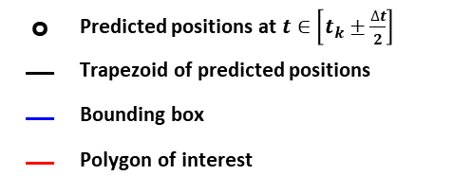
 |  |  | o
 |  |  | o
 |  |  |  |  |  |  |  |  |  | o
 |  |  |  |  |  |  |  |  | o
o | Predicted positions at $t∈\left[t_{k}±\frac{∆t}{2}\right]$
— | Trapezoid of predicted positions
— | Bounding box
— | Polygon of interest

Slide 5


MAP
Map Data
입력
FTG
DTF
결과 시각화
TRN
WTPG
Scenario
FLCC
DYN
Flight & Sensor Data
TRN Output
GCAWS
INS
RALT
GPS
WTPG Output
GCAWS Output
$$z^{−1}$$
+
DTF Output
$$z^{−1}$$
Unit Delay

Slide 6
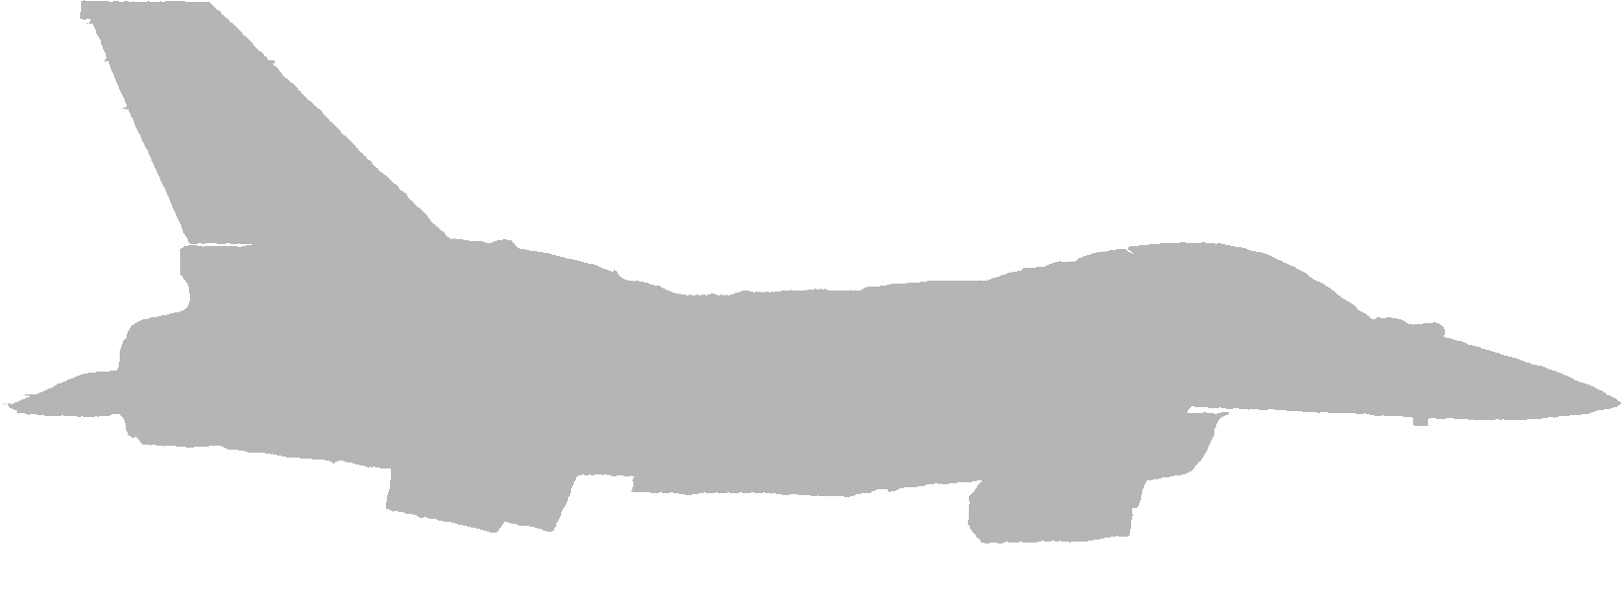
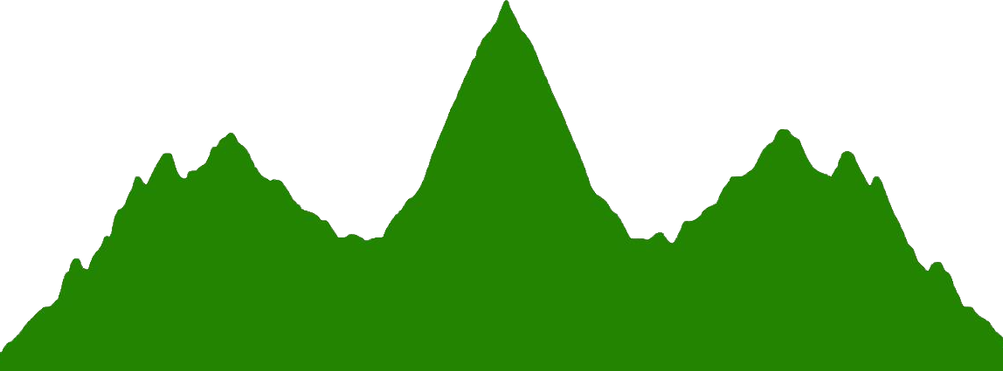
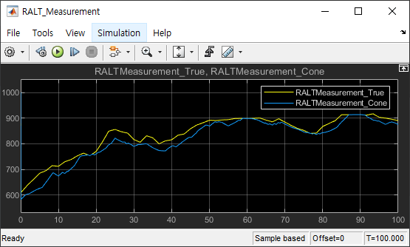
North
$$\left(0, h_{AGL}\tan{15°}, \sim \right)$$
Scan Point
$$30°$$
Shortest range
$$\left(−h_{AGL}\tan{15°}, 0, \sim \right)$$
$$\left(h_{AGL}\tan{15°}, 0, \sim \right)$$
$$\left(0, 0, h_{AGL}\right)$$
East
$$\left(0, −h_{AGL}\tan{15°}, \sim \right)$$

Slide 7
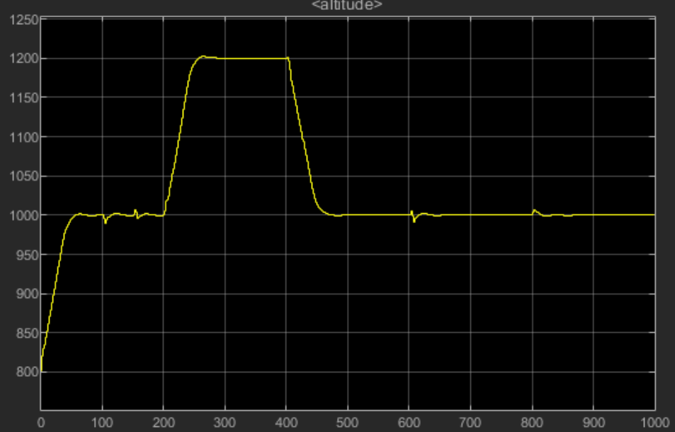
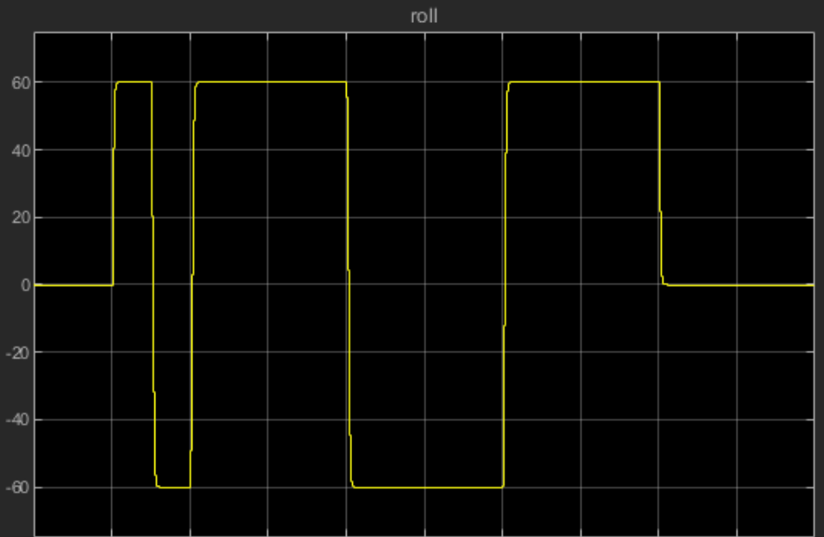

Slide 8
Case: AZ = 0
True North
Platform X
Body X
Body X
Platform Y
Body Y
Body Y
Z축 방향은 오른손 법칙에 의해 결정되므로 (X와 Y 기저의 외적)
Platform Axis Z: 수직 위로
Body Axiz Z: 수직 아래로

Slide 9


변경됨 (V4.1)
OUT_TRUE_STATE
IN_FTG_STICK
FLCC
DYN
SENSORS
IN_FTG_DTFOutput
OUT_RALT_Datapump
IN_FTG_GCAWSOutput
OUT_INS_Datapump
변경됨(V4.0)
IN_FTG_FLIGHT_CMD
OUT_GPS_Datapump
IN_FTG_SENSOR
추가됨 (V4.0)
$$z^{−1}$$
InjectSensor Error
Unit Delay

Slide 10

DYN
SENSORS
$$z^{−1}$$
InjectSensor Error
Unit Delay
FTG
M_MSGPACKER
OUT_RALT_Datapump
BUS_SENSOR_RALT
OUT_INS_Datapump
BUS_SENSOR_INS
OUT_GPS_Datapump
BUS_SENSOR_GPS
IN_FTG_STICK
IN_FTG_TF
IN_FTG_GCAS
IN_FTG_FLIGHT_CMD
IN_FTG_SENSOR
추가됨

Slide 11
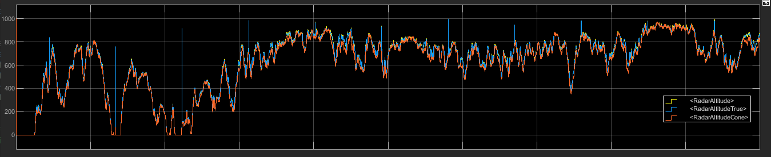
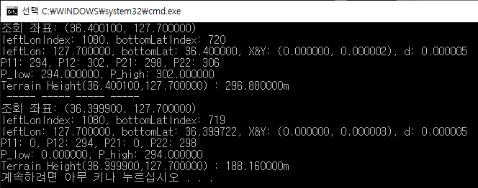
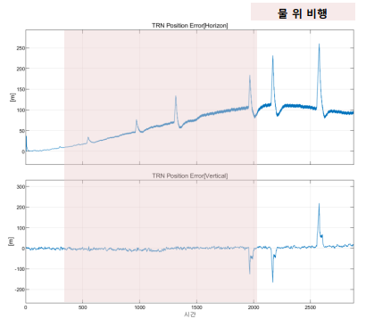
0.2도

Slide 12
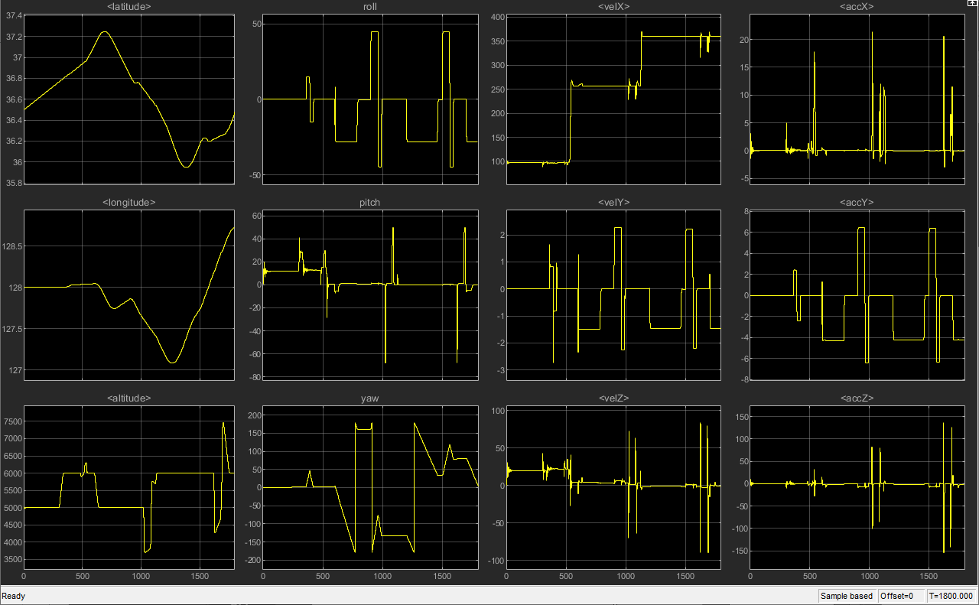
Time | 위도 (deg) | 경도 (deg) | 고도 (m) | 기준 속도 (m/s) | 설정 롤 자세 (deg) | 설정 피치 자세 (deg) | 설정 방위각 (deg) | switchRoll | switchPitch | switchTF | switchGCAS | 비고
00:00 | 36.5 | 128 | 5000 | 100 | 0 | 0 | 0 | 0 | 2 | 1 | 1 | ATT HOLD | ALT HOLD | TF SELECTED | GCAWS SELECTED
05:00 | 36.5 | 128 | 6000 | 100 | 0 | 0 | 0 | 0 | 2 | 1 | 1 | ATT HOLD | ALT HOLD | TF SELECTED | GCAWS SELECTED
06:00 | 36.5 | 128 | 6000 | 100 | 45 | 0 | 0 | 0 | 2 | 1 | 1 | ATT HOLD | ALT HOLD | TF SELECTED | GCAWS SELECTED
06:30 | 36.5 | 128 | 6000 | 100 | -45 | 0 | 0 | 0 | 2 | 1 | 1 | ATT HOLD | ALT HOLD | TF SELECTED | GCAWS SELECTED
07:00 | 36.5 | 128 | 6000 | 100 | 0 | 0 | 0 | 0 | 2 | 1 | 1 | ATT HOLD | ALT HOLD | TF SELECTED | GCAWS SELECTED
08:00 | 36.5 | 128 | 6000 | 100 | 0 | 0 | 0 | 0 | 1 | 1 | 1 | ATT HOLD | ATT HOLD | TF SELECTED | GCAWS SELECTED
08:05 | 36.5 | 128 | 6000 | 100 | 0 | 15 | 0 | 0 | 1 | 1 | 1 | ATT HOLD | ATT HOLD | TF SELECTED | GCAWS SELECTED
08:30 | 36.5 | 128 | 6000 | 100 | 0 | 40 | 0 | 0 | 1 | 1 | 1 | ATT HOLD | ATT HOLD | TF SELECTED | GCAWS SELECTED
08:40 | 36.5 | 128 | 6000 | 100 | 0 | 15 | 0 | 0 | 1 | 1 | 1 | ATT HOLD | ATT HOLD | TF SELECTED | GCAWS SELECTED
08:50 | 36.5 | 128 | 6000 | 257 | 0 | 0 | 0 | 0 | 2 | 1 | 1 | ATT HOLD | ALT HOLD | TF SELECTED | GCAWS SELECTED
10:00 | 36.5 | 128 | 5000 | 257 | 0 | 0 | 0 | 1 | 2 | 1 | 1 | STRG SEL | ALT HOLD | TF SELECTED | GCAWS SELECTED
15:00 | 36.5 | 128 | 5000 | 257 | 45 | 0 | 0 | 0 | 2 | 1 | 1 | ATT HOLD | ALT HOLD | TF SELECTED | GCAWS SELECTED
16:00 | 36.5 | 128 | 5000 | 257 | -45 | 0 | 0 | 0 | 2 | 1 | 1 | ATT HOLD | ALT HOLD | TF SELECTED | GCAWS SELECTED
16:30 | 36.5 | 128 | 5000 | 257 | 0 | 0 | 0 | 0 | 2 | 1 | 1 | ATT HOLD | ALT HOLD | TF SELECTED | GCAWS SELECTED
17:00 | 36.5 | 128 | 5000 | 257 | 0 | -70 | 0 | 0 | 1 | 1 | 1 | ATT HOLD | ATT HOLD | TF SELECTED | GCAWS SELECTED
17:05 | 36.5 | 128 | 5000 | 257 | 0 | 1 | 0 | 0 | 1 | 1 | 1 | ATT HOLD | ATT HOLD | TF SELECTED | GCAWS SELECTED
18:00 | 36.5 | 128 | 5000 | 257 | 0 | 50 | 0 | 0 | 1 | 1 | 1 | ATT HOLD | ATT HOLD | TF SELECTED | GCAWS SELECTED
18:10 | 36.5 | 128 | 5000 | 257 | 0 | 0 | 0 | 0 | 1 | 1 | 1 | ATT HOLD | ATT HOLD | TF SELECTED | GCAWS SELECTED
18:40 | 36.5 | 128 | 6000 | 360 | 0 | 0 | 0 | 0 | 2 | 1 | 1 | ATT HOLD | ALT HOLD | TF SELECTED | GCAWS SELECTED
20:00 | 36.5 | 128 | 6000 | 360 | 0 | 0 | 0 | 1 | 2 | 1 | 1 | STRG SEL | ALT HOLD | TF SELECTED | GCAWS SELECTED
25:00 | 36.5 | 128 | 6000 | 360 | 45 | 0 | 0 | 0 | 2 | 1 | 1 | ATT HOLD | ALT HOLD | TF SELECTED | GCAWS SELECTED
26:00 | 36.5 | 128 | 6000 | 360 | -45 | 0 | 0 | 0 | 2 | 1 | 1 | ATT HOLD | ALT HOLD | TF SELECTED | GCAWS SELECTED
26:30 | 36.5 | 128 | 6000 | 360 | 0 | 0 | 0 | 0 | 2 | 1 | 1 | ATT HOLD | ALT HOLD | TF SELECTED | GCAWS SELECTED
27:00 | 36.5 | 128 | 6000 | 360 | 0 | -70 | 0 | 0 | 1 | 1 | 1 | ATT HOLD | ATT HOLD | TF SELECTED | GCAWS SELECTED
27:05 | 36.5 | 128 | 6000 | 360 | 0 | 1 | 0 | 0 | 1 | 1 | 1 | ATT HOLD | ATT HOLD | TF SELECTED | GCAWS SELECTED
28:00 | 36.5 | 128 | 6000 | 360 | 0 | 50 | 0 | 0 | 1 | 1 | 1 | ATT HOLD | ATT HOLD | TF SELECTED | GCAWS SELECTED
28:10 | 36.5 | 128 | 6000 | 360 | 0 | 0 | 0 | 1 | 2 | 1 | 1 | STRG SEL | ALT HOLD | TF SELECTED | GCAWS SELECTED

