Slide 1
FINANCIAL STATEMENTS OF PUBLIC COMPANIES SEC DATA: 10-K’s 2012 to 2016

Slide 2
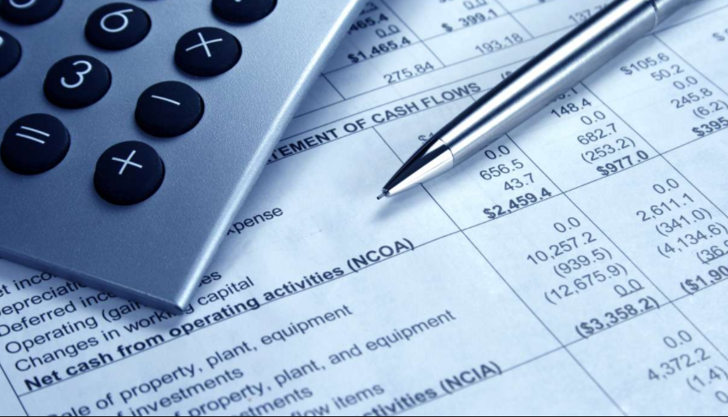
HELLO!
I am Daniel Park
I am here because I love to give presentations.

Slide 3
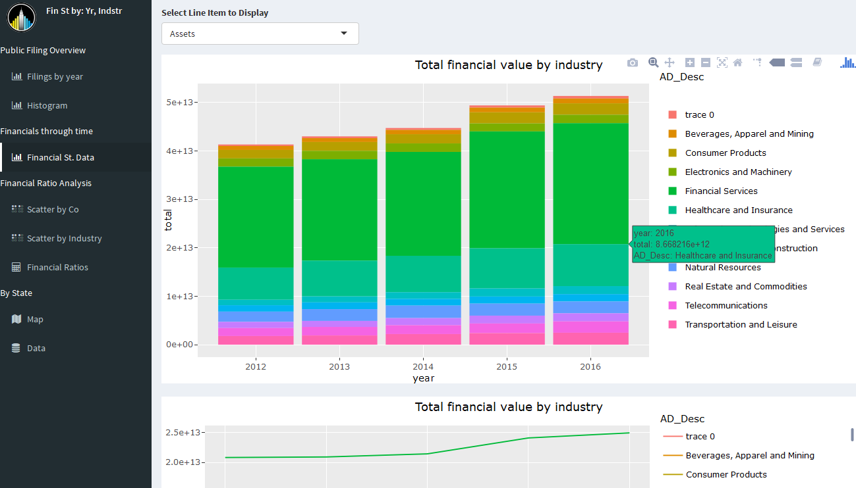
SHINY DASHBOARD: SEC DATA

Slide 4
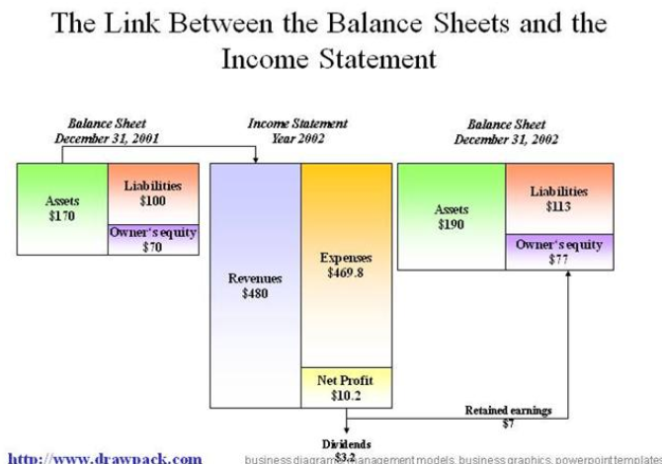

Slide 5

Data cleaning process was not easy
Submissions
Values
Item
Companies
Pain

Slide 6
TOPICS
Overview of filings and public companies
How are industries different?
Which industries grew or shrank?

Slide 7
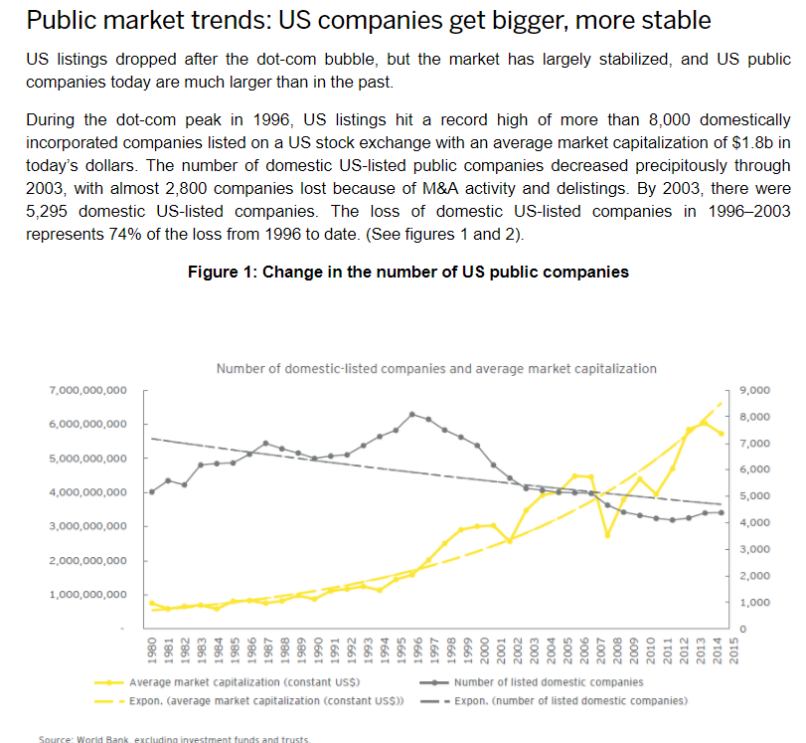
Filings and Public Companies
Down:
The number of public companies is decreasing
Up:
Average company size is increasing

Slide 8
$50+ Trillion
Public Company Assets (and growing)

Slide 9
~4,000 Companies
$7 Trillion in Revenue
~$1.75 Trillion in Profit
Decreasing
Flattish
~$2.25 Trillion in Cash
Growing
~$25 Trillion in Liabilities

Slide 10
Revenue by Industries: 2012 to 2016
Up:
Healthcare & Insurance
Manufacturing & Construction
Transportation & Leisure
Real Estate & Commodities
Down:
Natural Resources
Electronics & Machinery
You can insert graphs from Google Sheets

Slide 11
Revenue by Industries: 2012 to 2016
Up:
Healthcare & Insurance
Manufacturing & Construction
Transportation & Leisure
Real Estate & Commodities
Down:
Natural Resources
Electronics & Machinery
You can insert graphs from Google Sheets

Slide 12
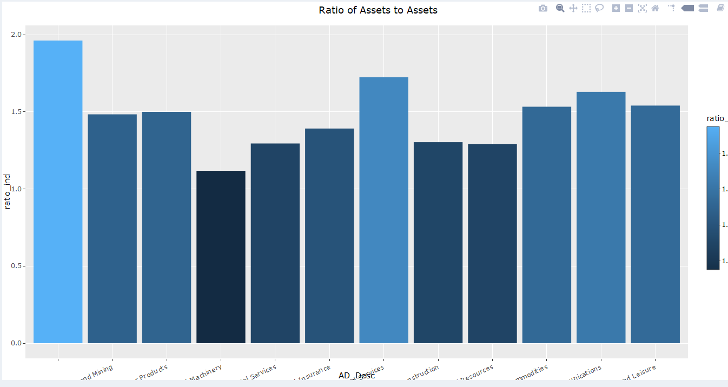
Assets by Industries: 2012 to 2016
You can insert graphs from Google Sheets

Slide 13
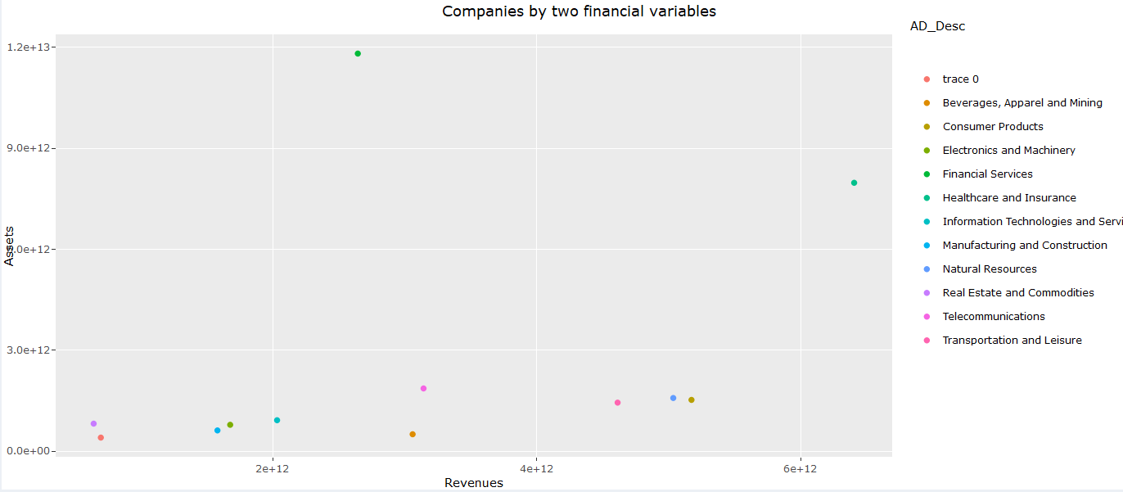
Financial Ratios: Assets vs Revenues
You can insert graphs from Google Sheets

Slide 14
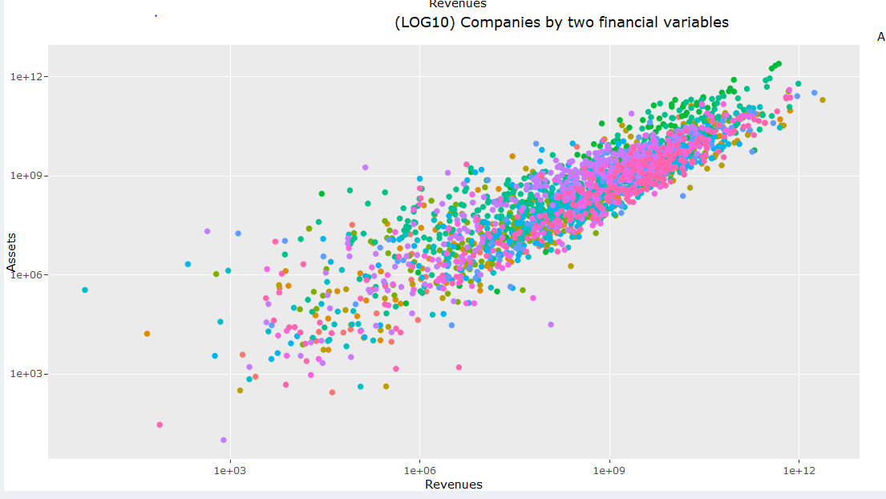
Financial Ratios: Assets vs Revenues
You can insert graphs from Google Sheets

Slide 15
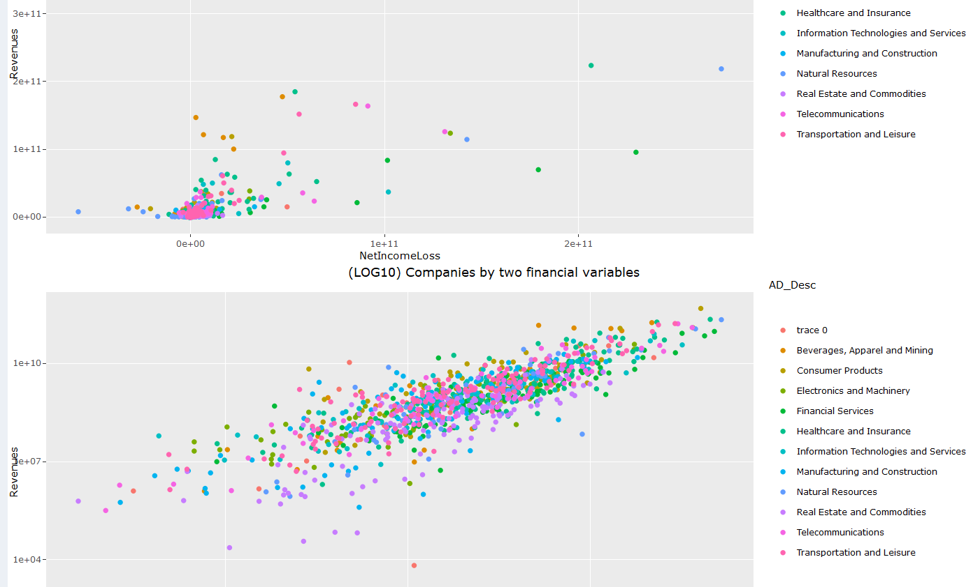
Financial Ratios: Net Income vs Revenues
You can insert graphs from Google Sheets

Slide 16
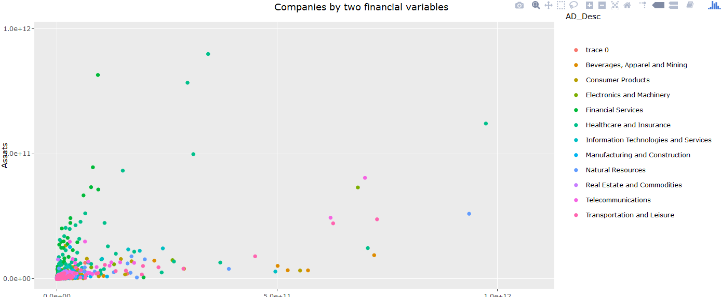
Financial Ratios: Assets vs Revenues
You can insert graphs from Google Sheets

Slide 17
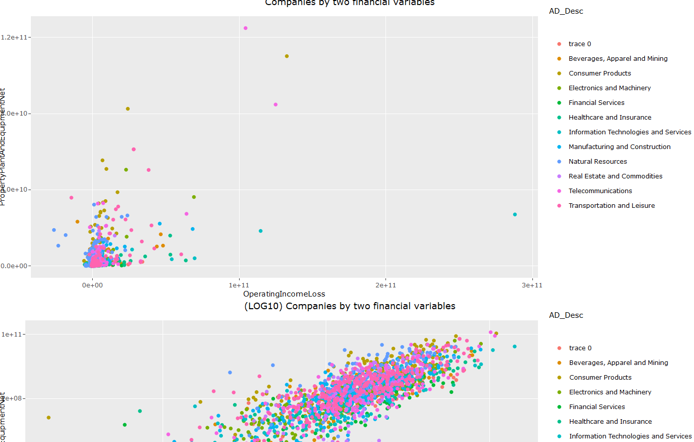
Financial Ratios: Operating Income vs PP&E
You can insert graphs from Google Sheets

Slide 18
THANKS!
https://github.com/dsp2109/NYDS_DataViz

Slide 19
THANKS!
This presentation uses the following typographies and colors:
Titles: Roboto Condensed
Body copy: Roboto Condensed
You can download the fonts on this page:
https://material.io/guidelines/resources/roboto-noto-fonts.html
Navy #3f5378 · Dark navy #263248 · Yellow #ff9800
You don’t need to keep this slide in your presentation. It’s only here to serve you as a design guide if you need to create new slides or download the fonts to edit the presentation in PowerPoint®

Slide 20
SlidesCarnival icons are editable shapes.
This means that you can:
Resize them without losing quality.
Change line color, width and style.
Isn’t that nice? :)
Examples:

Slide 21
😉
Now you can use any emoji as an icon!
And of course it resizes without losing quality and you can change the color.
How? Follow Google instructions https://twitter.com/googledocs/status/730087240156643328
✋👆👉👍👤👦👧👨👩👪💃🏃💑❤😂😉😋😒😭👶😸🐟🍒🍔💣📌📖🔨🎃🎈🎨🏈🏰🌏🔌🔑 and many more...

