Slide 1
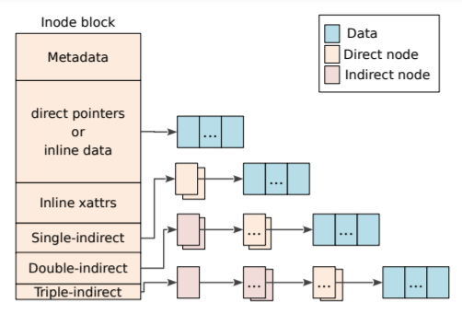
Physical Address: a
inode map
CP
⑧
⑥
⑦
……
②
Update
Physical Address: b
……
⑤
④
③
①

Slide 2
Physical Address: a
Node ID：x
③
NAT
……
②
Update
Physical Address: b
Node ID：x
……
①

Slide 3
NULL
CPR
DATA
INODE
IMAP0
IMAP0
Summary
Segment

Slide 5
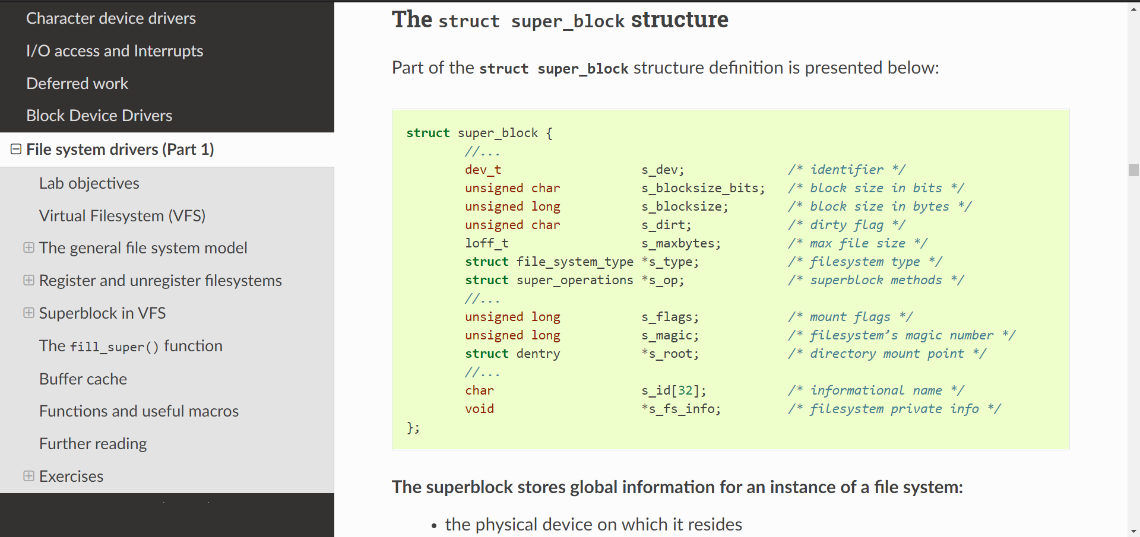
SB
Rootfs
Dentry
Rootfs
SB
Ramfs

Slide 6
开始
nand_init
nand_register
startUp.S
nand_init_chip
bspInit
board_nand_init
halBootThread
nand_scan

Slide 7
DATA
Sector
DATA
Sector
DATA

Slide 8
