Slide 1
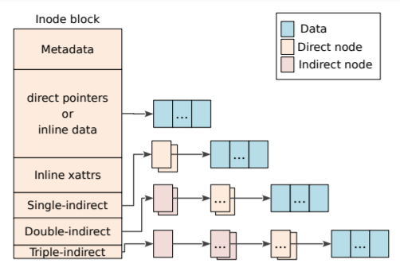
Physical Address: a
inode map
CP
⑧
⑥
⑦
……
②
Update
Physical Address: b
……
⑤
④
③
①

Slide 2
Physical Address: a
Node ID：x
③
NAT
……
②
Update
Physical Address: b
Node ID：x
……
①

