Slide 1
Automatic Generation of Artifacts for Two Web Application Testing Models
Sarah Vessels

Slide 2
The impetus
Lots of web applications
Web applications need testing
Creating artifacts to test is slow work
Artifacts → test cases also slow
Slow, tedious web app testing → no web app testing ☹
So make testing easier

Slide 3
The project
2 web app testing models:
Qian, Miao, Zeng Model (QMZ)
Atomic Section Model (ASM)
Write tools to generate artifacts:
QMZ: test paths
ASM: intermediate output that leads to test paths

Slide 4
About QMZ
Page Flow Diagram (PFD)
Relationship among pages in web app
Pages, transitions
Can have cycles
Page Test Tree (PTT)
Built from PFD
Acyclic
Produces test paths

Slide 5
QMZ PFD v. PTT

Slide 6
QMZ requirements
Input: URI to web app Output: list of test paths
Scrape web pages, extract transitions
Transition = link or form
Construct PFD
Transform to PTT
Extract test paths from PTT

Slide 7
QMZ overview

Slide 8
QMZ implementation details
Ruby 1.8.7 command-line script
Web app language-agnostic
YAML output to save progress
Nokogiri 鋸 for HTML parsing
ERB template for test path output
Limitation: ignores JavaScript, AJAX

Slide 9
QMZ testing
Run tool against known web apps
Manual verification of test paths
Run tool against unknown web apps
Detect defects relating to:
Linked files (PDF, ZIP, non-HTML pages)
Link types (mailto, FTP)

Slide 10
QMZ output
>ruby scraper.rb -u "http://babyhealthlexington.org/"
Got URI http://babyhealthlexington.org/
Getting pages for site at http://babyhealthlexington.org/...
Got 8 new Pages linked from Page / (13 links)
.Got 2 new Pages linked from Page /wp-admin/ (3 links)
...Got error '405 Method Not Allowed' trying to open URI http://babyhealthlexington.org/wp-comments-post.php, skipping...
Got 3 new Pages linked from Page /2009/01/21/hello-world/ (14 links)
..Got 1 new Page linked from Page /2009/01/21/hello-world/comment-page-1/ (14 links)
.Got 6 new Pages linked from Page /es/2009/01/21/hello-world/comment-page-1/ (14 links)
.............Got 21 pages for site at http://babyhealthlexington.org/
Pages in site rooted at http://babyhealthlexington.org/:
/
/wp-admin/
/2009/01/21/hello-world/
/category/updates/
/es/
/links/
/people/
/mission-statement/
/history/
/wp-login.php
/wp-login.php?action=lostpassword
/2009/01/21/hello-world/trackback/
/2009/01/21/hello-world/comment-page-1/
/es/2009/01/21/hello-world/
/es/2009/01/21/hello-world/comment-page-1/
/es/2009/01/21/hello-world/trackback/
/es/category/updates/
/es/links/
/es/people/
/es/mission-statement/
/es/history/
Getting PFD for site http://babyhealthlexington.org/...
Converting PFD to PTT...
Writing HTML file with test paths to http.babyhealthlexington.org/index.html...
File successfully written

Slide 11
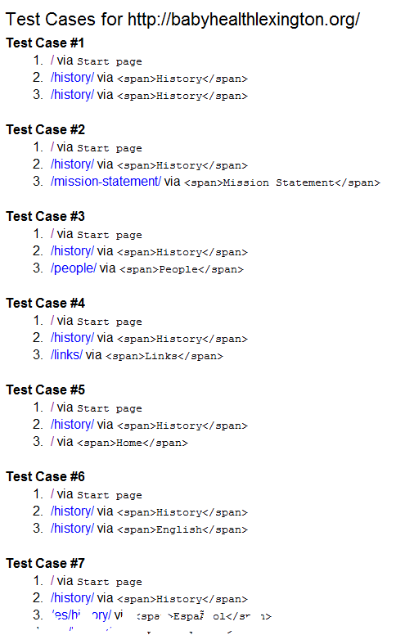
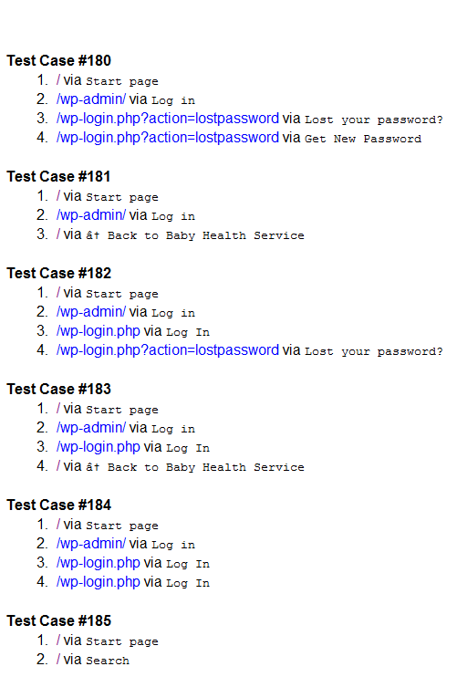
QMZ results

Slide 12
Future work: QMZ
Expand tool to take credentials
Use sessions
Allow further traversal of web app
Take screenshots to partially automate testing
One screenshot per transition
Display alongside test paths

Slide 13
About ASM
Component Interaction Model (CIM)
“Individual HTTP requests to the server”¹ = pages
Application Transition Graph (ATG)
“Model of the entire web application” ¹
ATG outside scope of project, focus on CIM
1 Offutt, Jeff and Wu, Ye, “Modeling Presentation Layers of Web Applications for Testing”, Springer’s Software and Modeling, DOI: 10.1007/s10270-009-0125-4.

Slide 14
About CIM
Atomic sections
Labeled p1…pn
Transitions
Forms, hyperlinks
Component expression
Represents web page
Combines atomic sections:
Selection, sequence, iteration, aggregation
Ex.: (p1|p2).p3.p4*.{p5}

Slide 15
Atomic sections, component expressions
ERB file
Component expression
<% if @list.empty? %>
<p>No values</p>
<% else %>
<h1>Lots of values!</h1>
<% end %>
<h2>Content</h2>
<% @list.each do |value| %>
<%= value %><br/>
<% end %>
<%= render :partial => ‘list_footer’ %>
(p1|p2).p3.p4*.{p5}

Slide 16
ASM requirements
Input: Rails ERB file(s), URI to web app Output: one CIM per file
Identify atomic sections
Construct component expression
Identify transitions
Output CIM(s)

Slide 17
ASM overview

Slide 18
ASM implementation details
Ruby 1.8.7 command-line script
Targets Ruby on Rails web apps
Nokogiri 鋸 for HTML parsing
Treetop for ERB parsing
ruby_parser for Ruby parsing
Limitation: ignores JavaScript, AJAX*
* Except Rails methods form_remote_tag, etc.

Slide 19
ASM testing
Test::Unit unit tests
Mainly for component expressions
Known Rails app
Unknown Rails apps found on Github
Generate CIM for file, manually verify correctness
Wrong component expression → new unit test

Slide 20
ASM single-file output
>ruby single_file_generator.rb app\views\test\_feedback.html.erb "http://example.com"
Parsing ERB file app\views\test\_feedback.html.erb...
Source file: app\views\test\_feedback.html.erb
0: handled_style = feedback.is_handled == 0 ? "unhandled_feedback" : ""
1: Atomic Section #1 (indices 1..3):
1: div id => "feedback_<%= feedback.id.to_s %>", class => "feedback_item <%= handled_style %>"
2: div class => "listed_full_width_object"
3: div class => "listed_feedback_checkbox"
4-10: if feedback.is_handled == 0
Content and sections:
5: Atomic Section #2 (indices 5..7):
5: div class => "handle_feedback_button"
6: <%= link_to "Mark as handled", handle_admin_feedback_path(feedback), :method => :put
7: /div
8: else
Content and sections:
9: Atomic Section #3 (indices 9..9):
9: &nbsp;
Close:
10: end
11: Atomic Section #4 (indices 11..13):
11: /div
12: div class => "listed_feedback_field"
13: b
14-20: if feedback.author_id == "Anonymous"
Content and sections:
15: Atomic Section #5 (indices 15..15):
15: Anonymous
16: elsif feedback.author_id == "virheilmoitus500"
Content and sections:
17: Atomic Section #6 (indices 17..17):
17: Errorpage500
18: else
Content and sections:
19: Atomic Section #7 (indices 19..19):
19: <%= feedback.author_id
Close:
20: end
21: Atomic Section #8 (indices 21..33):
21: /b
22: /div
23: div class => "listed_feedback_field"
24: <%= feedback.created_at.to_formatted_s(:basic_date_format_minutes)
25: /div
26: div class => "listed_feedback_field_wider"
27: <%= feedback.url
28: /div
29: div class => "listed_feedback_content"
30: <%= text_with_line_breaks(feedback.content)
31: /div
32: /div
33: /div
Component Interaction Model
Start page: app\views\test\_feedback.html.erb
Start URL: http://example.com/test/_feedback
Component expression: p1.(p2|p3).p4.(p5|p6|p7).p8
Transitions:

Slide 21
ASM entire-app output
> ruby .\generator.rb draganc-asi-da1935f "http://example.com"
Looking in directory draganc-asi-da1935f/app/views
Looking in directory draganc-asi-da1935f/app/views/user_mailer
Parsing ERB file draganc-asi-da1935f/app/views/user_mailer/ welcome.erb...
---------------------------------
No data in file draganc-asi-da1935f/app/views/messages/ create.erb, skipping
Looking in directory draganc-asi-da1935f/app/views/layouts
Parsing ERB file draganc-asi-da1935f/app/views/layouts/ _version.html.erb...
Component Interaction Model
Start page: draganc-asi-da1935f/app/views/layouts/ _version.html.erb
Start URL: http://example.com/layouts/_version
Component expression: p1.{p2}
Transitions:
---------------------------------
Parsing ERB file draganc-asi-da1935f/app/views/coreui/profile/ new.html.erb...
Component Interaction Model
Start page: draganc-asi-da1935f/app/views/coreui/profile/ new.html.erb
Start URL: http://example.com/coreui/profile/new
Component expression: (p1|NULL).{p2}.p3
Transitions:
Form Transition
---------------------------------
Parsing ERB file draganc-asi-da1935f/app/views/coreui/profile/ link.html.erb...
Component Interaction Model
Start page: draganc-asi-da1935f/app/views/coreui/profile/ link.html.erb
Start URL: http://example.com/coreui/profile/link
Component expression: p1
Transitions:
---------------------------------
Parsing ERB file draganc-asi-da1935f/app/views/coreui/profile/ edit.html.erb...
Component Interaction Model
Start page: draganc-asi-da1935f/app/views/coreui/profile/ edit.html.erb
Start URL: http://example.com/coreui/profile/edit
Component expression: p1.p2.(p3|p4).p5.p6.p7.p8.p9.(p10|p11).p12
---------------------------------
Parsing ERB file draganc-asi-da1935f/app/views/coreui/profile/ destroy.html.erb...
Component Interaction Model
Start page: draganc-asi-da1935f/app/views/coreui/profile/ destroy.html.erb
Start URL: http://example.com/coreui/profile/destroy
Component expression: p1
Transitions:
---------------------------------
Parsing ERB file draganc-asi-da1935f/app/views/application/ index.html.erb...
Component Interaction Model
Start page: draganc-asi-da1935f/app/views/application/ index.html.erb
Start URL: http://example.com/application/index
Component expression: p1.(p2|NULL).p3
Transitions:
Link Transition
<http://example.com/application/index> --> <http://example.com/test>
Underlying code:
<a href="/test">
---------------------------------
Link Transition
<http://example.com/application/index> --> <http://example.com/doc/sms>
Underlying code:
<a href="/doc/sms">
Looking in directory draganc-asi-da1935f/app/views/application/doc
Parsing ERB file draganc-asi-da1935f/app/views/application/doc/ tutorial.html.erb...
Component Interaction Model
Start page: draganc-asi-da1935f/app/views/application/doc/ tutorial.html.erb
Start URL: http://example.com/application/doc/ tutorial
Component expression: p1
Transitions:
Link Transition
<http://example.com/application/doc/ tutorial> --> <http://example.com/test>
Underlying code:
<a href="/test">
Link Transition
<http://example.com/application/doc/ tutorial> --> <http://example.com/doc/session>
Underlying code:
<a href="/doc/session">
---------------------------------

Slide 22
Future work: ASM
Incorporate layouts into component expressions
Include partials’ component expressions in parent component expression
Recognize branching in ERB output tags
Combine CIMs into ATG, generate test paths

Slide 23
Project statistics
ASM tool
2,699 lines of code (LOC)
241 lines of comments
47 files
QMZ tool
590 LOC
35 lines of comments
8 files
108 commits, 9,067 additions, 369 deletions

Slide 24
Conclusion
No more manual:
Traversal of web app – QMZ tool identifies paths available to user
Identification of atomic sections and transitions, construction of component expression – ASM tool does this
Automated test artifact generation → easier testing → more testing (we hope!)

Slide 25
Demo

Slide 26
Questions?

