Slide 1
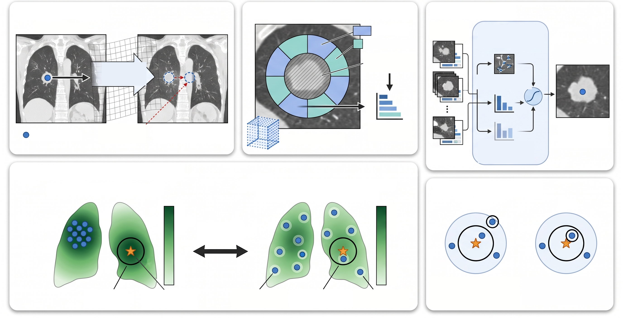
A. Initial Alignment
B. Candidate Generation & Ranking
D. Lesion Scoring
Current Scan
Earlier Scan
Fit Octants
Retained
Candidates
Frozen
Logistic-Regression
Lesion Scorer
Witness Octants
Highest-Scoring
Candidate
Lesion-Excluded
Central Region
Affine
Alignment
Lesion Appearance
Features
Fit Cost
Residual
Displacement
Offset (reference point
hidden from algorithm)
Witness Cost
Contribution
Predicted
Earlier Lesion
Location
Current Lesion
Translation Lattice
Soft Anatomical-Fit
Penalty
(witness costs)
C. Candidate Selection Comparison
Conventional Top-K Selection
Proposed Fit-Ordered Diverse Selection
E. Outcome Distinction
(Minimum Distance r = 2.1 mm)
Reach
Hit
Better Fit
Better Fit
Fit Ranking
Unchanged
3 mm
3 mm
Worse Fit
Worse Fit
Is any candidate
within 3 mm?
Is the final selected
candidate within 3 mm?
Misses
3 mm Circle
Ground-Truth
(Evaluation Only)
Spatially Diverse
Candidates
One Candidate
inside 3 mm Circle
Same Candidate
Budget (K = 12)
YES
YES (Hit)
Reach does not guarantee Hit

