Slide 1
A Simple Spline-based Multilvel Modeling Approach(P-Spline)
Choi TaeYoung

Slide 2
논문에 관한 설명

Slide 3
Slide with Bullets
  Bullet 1
  Bullet 2
  Bullet 3

Slide 4
Slide with R Output
summary(cars)
## speed dist
## Min. : 4.0 Min. : 2.00
## 1st Qu.:12.0 1st Qu.: 26.00
## Median :15.0 Median : 36.00
## Mean :15.4 Mean : 42.98
## 3rd Qu.:19.0 3rd Qu.: 56.00
## Max. :25.0 Max. :120.00

Slide 5
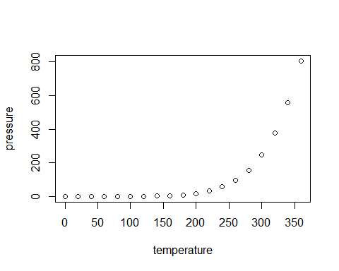
Slide with Plot

