Slide 1
DATA & ANALYTICS • PYTHON + POWER BI
Car Sales Analytics Project
Turning 150 transactions into an executive-ready growth story
Prepared by Ismail Olamide Abdulrazaq
January – June 2024

Slide 2


Business Problem & Objectives
Why this project exists and what it set out to solve
THE PROBLEM
THE SOLUTION
Raw data, no direction
Clean data, clear signal
150 raw car sales transactions sat unused — no clear view of what was actually driving revenue, demand, or delivery performance.
A structured pipeline of data cleaning, statistical analysis, and an interactive Power BI dashboard — turning raw rows into decisions leadership can act on.
CAR SALES ANALYTICS
2

Slide 3




Dataset & Methodology
Scope of the data behind every insight in this deck
150
5
5
4
TRANSACTIONS
BRANDS
REGIONS
FUEL TYPES
TOOLS & TECHNIQUES
Python
Power BI
Statistical Analysis
Data cleaning & EDA
Interactive dashboarding
Trend & driver detection
CAR SALES ANALYTICS
3

Slide 4



Executive KPI Summary
The headline numbers leadership cares about most
$61.09M
1,488
$39.6K
7.3 days
TOTAL REVENUE
UNITS SOLD
AVERAGE PRICE
AVG. DELIVERY TIME
CAR SALES ANALYTICS
4

Slide 5
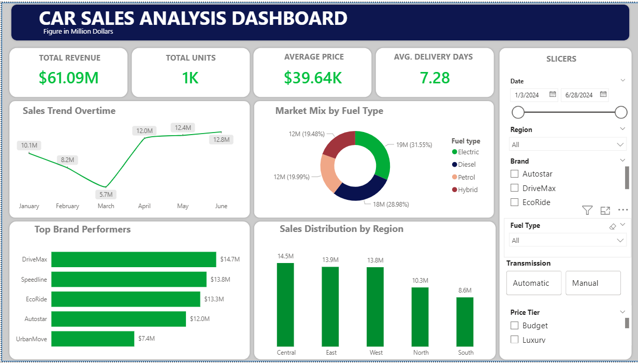
Dashboard Overview
Live Power BI view — revenue, volume, and delivery in one screen
CAR SALES ANALYTICS
5

Slide 6




Key Insights
What the data reveals about brands, fuel types, and regions
DriveMax leads revenue
Electric leads the market
DriveMax outsells every other brand in total revenue generated across the period.
Electric vehicles are the top-performing fuel type by sales volume.
Central region is strongest
Volume drives revenue
The Central region outperforms all other regions in total sales.
Units sold, more than price per unit, is the strongest driver of total revenue.
CAR SALES ANALYTICS
6

Slide 7
Recommendations
Four moves to turn insight into action
01
Increase EV inventory
02
Focus on Central region
Scale electric vehicle stock to meet proven demand leadership.
Double down on marketing and stock allocation where sales are strongest.
03
Improve South performance
04
Cut delivery below 5 days
Investigate underperformance and pilot targeted regional promotions.
Streamline logistics to close the gap from today's 7.3-day average.
CAR SALES ANALYTICS
7

Slide 8



Business Impact
What this project changes for the business, day to day
Clean Dataset
Interactive Reporting
Faster Decisions
A reliable, analysis-ready dataset free of errors and inconsistencies.
A live Power BI dashboard leadership can explore on demand.
Insights surface in minutes instead of days, speeding up strategy.
CAR SALES ANALYTICS
8

Slide 9

Conclusion & Next Steps
This project demonstrates a full end-to-end analytics workflow — from raw transactions to a clean dataset, statistical insight, and an executive-ready Power BI dashboard that turns data into decisions.
Prepared by Ismail Olamide Abdulrazaq

