Slide 1
Neural Networks Update

Slide 2
Summary
Objective: train automatic pipe weld image classifiers
Results so far: if automate 100% of the work, 73% accuracy on it
Prediction: automate >50% of the work and obtain >90% accuracy on it

Slide 3
The Approach
1) Correctly Labelled Data
2) Benchmark Test Run
3) Transfer Learning
4) Hyper Parameters
5) Artificial Data Augmentation
6) Class Imbalance
7) Significance Level
8) Qualitative Embedding

Slide 4
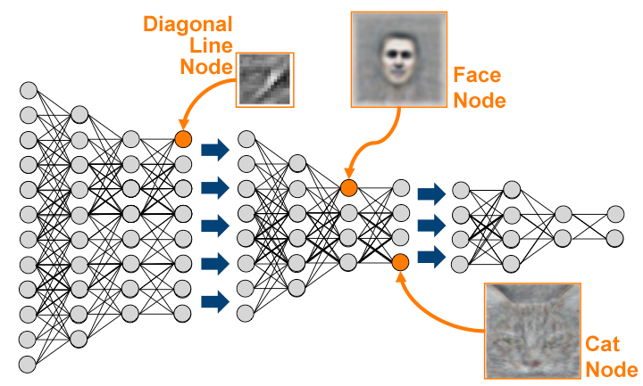
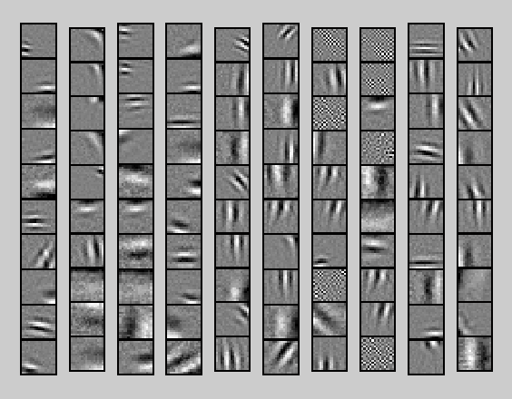
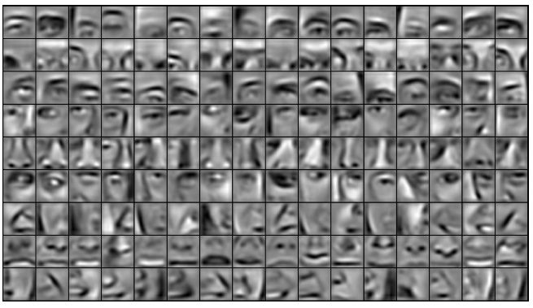
Briefly: How it Works

Slide 5
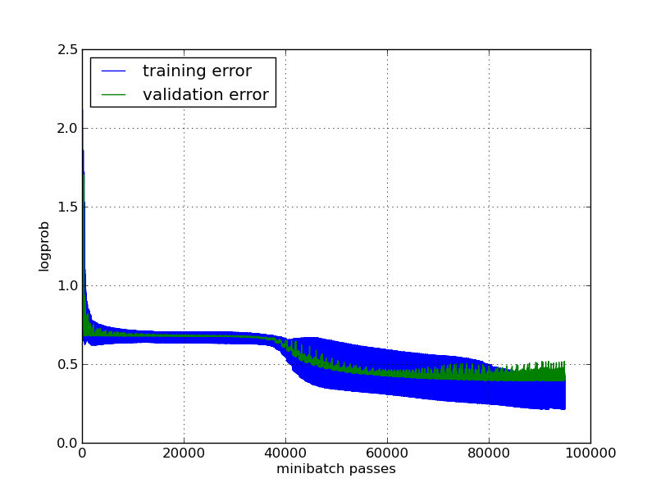
Find the filters that minimise classification error

Slide 6
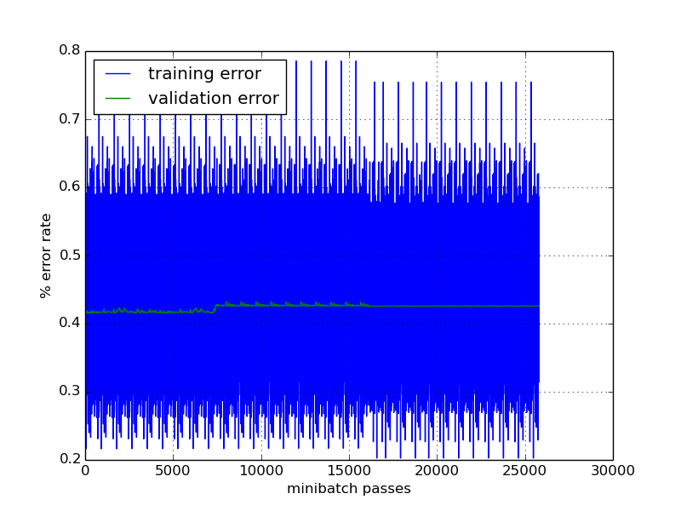
Benchmark Test Run
Redbox Data (110k)

Slide 7
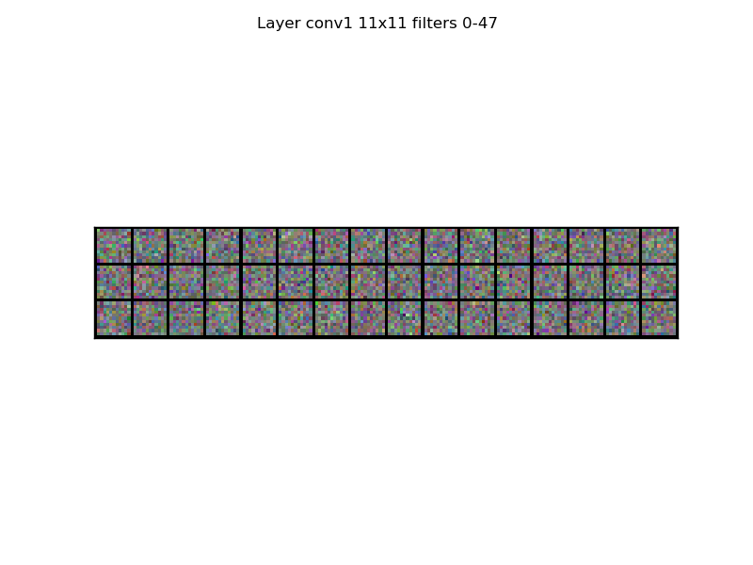
Correctly Labelled Data
Bluebox Data (17k)
clamp_det: 84% accuracy

Slide 8
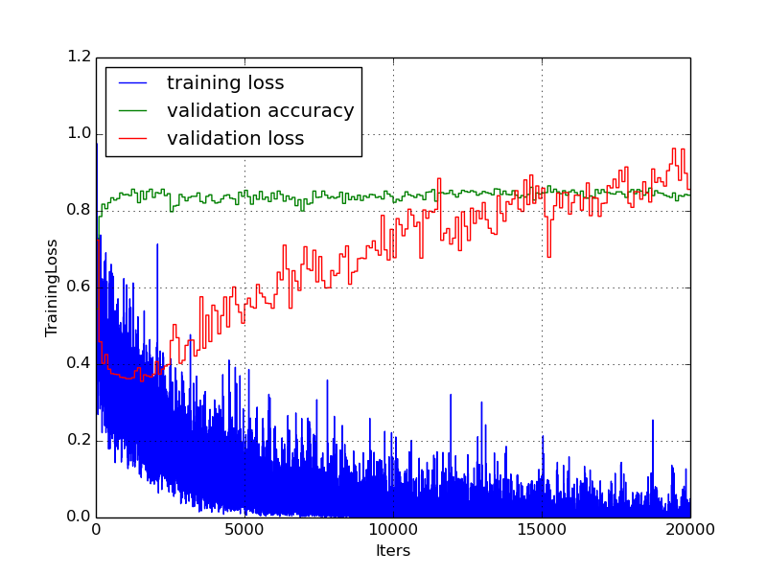
Transfer Learning
BerkeleyNet trained on 1.3 million images
Initialise network parameters to its values
ground_sheet_det: 86% accuracy

Slide 9
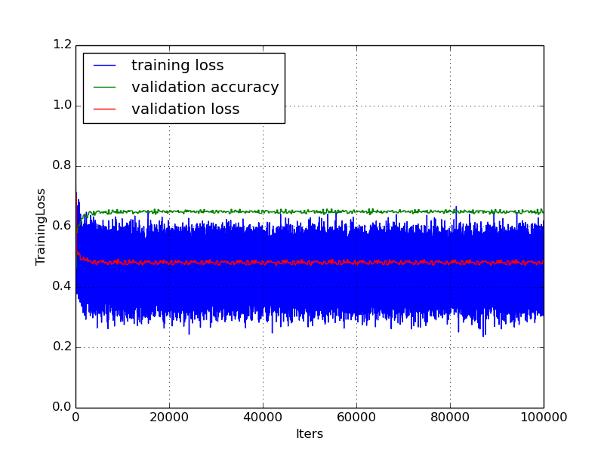
Hyper Parameter Optimisation I
Initially:

Slide 10
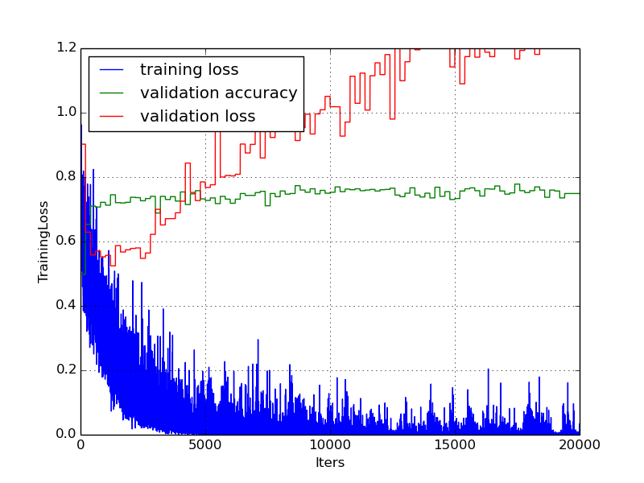
Hyper Parameter Optimisation II
Enable backprop in conv layers to increase expressiveness

Slide 11
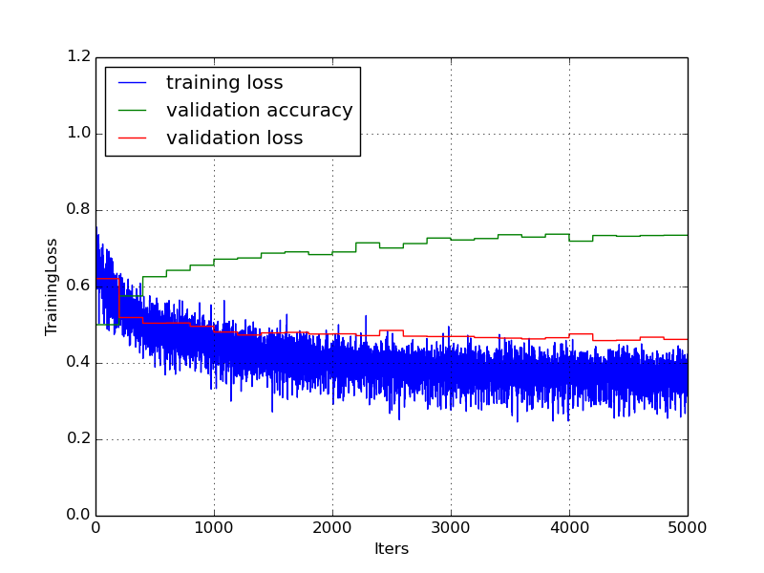
Hyper Parameter Optimisation III
Actually, freeze backprop in low conv layers but re-initialise fc layer weights (and train more)
hatch_markings_det: 73% acc and counting

Slide 12
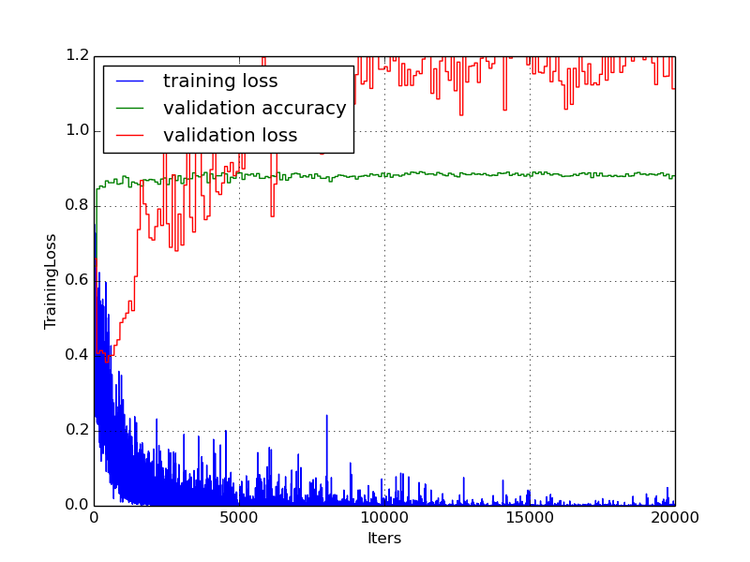
Artificial Data Augmentation
Label-preserving image transformations
Crops, flips, rotations, light & contrast adjustments
insert_depth_markings_det: 89% acc

Slide 13
Further Work

Slide 14
Class Imbalance
Very damaging, especially for rare, fine flags
Potential solutions:
- throw away data
- threshold layer
- bayesian cost function

Slide 15
Significance Level
At the moment, classifier does not raise flag when there is <50% chance that is present
What if we lowered this to 10%? 5%? 1%?
Classifier would instead raise potential flags
Human expert would need to verify only the potential flags
How much workload would be relieved?

Slide 16
Qualitative Embedding
Razvan and I are still unable to recognise most flags ourselves!
We need detailed descriptions of each flag
Use of this knowledge to design better Neural Network
E.g. a special neuron for joint type

Slide 17
Predictions
Automate >50% of the work and obtain >90% accuracy on it
What we can definitely improve:
- later Redbox data
- more data augmentation
- crack class imbalance
- OverFeat instead of Berkeley
- significance level

Slide 18
Thanks!

