Slide 1
Refinery Outage Analytics
Capacity Offline (kbd) - Planned & Unplanned - 2027 Scenario & Sensitivity
Data vintage: 46,456 rows | 2010-2038 | 19,934 distinct outages
Latest full year (2025): 38,674 kbd total offline, 19,258 kbd unplanned (50%)
2026 & 2027 are partial / planned-only - shown for context, not as finals.

Slide 2
Executive Summary
At-a-glance metrics and what matters
Total Offline (FY2025)
Unplanned (FY2025)
Unplanned %
Distinct Outages
Top PADD
38,674
19,258
50%
1,213
PADD 5
kbd
kbd
of total
FY2025
by unplanned
Key Takeaways
PADD 5 dominates unplanned risk at ~20% of US unplanned capacity offline over the baseline window; PADD 2 and PADD 5 are the next largest.
FY2025 total offline of 38,674 kbd was -8% YoY, with the planned/unplanned split near 50/50 (50% unplanned).
Unplanned capacity offline is highly seasonal - peaks in February (winter freeze) and September-October (turnaround), with a summer trough.
2027 is planned-only in the data (15,923 kbd booked). The scenario model adds a baseline-driven unplanned forecast of ~21,790 kbd -> implied total ~37,713 kbd.
Refinery Outage Analytics | Source: Snowflake export (46,456 rows, 2010-2038) | Primary metric: capacity offline (kbd)
2

Slide 3
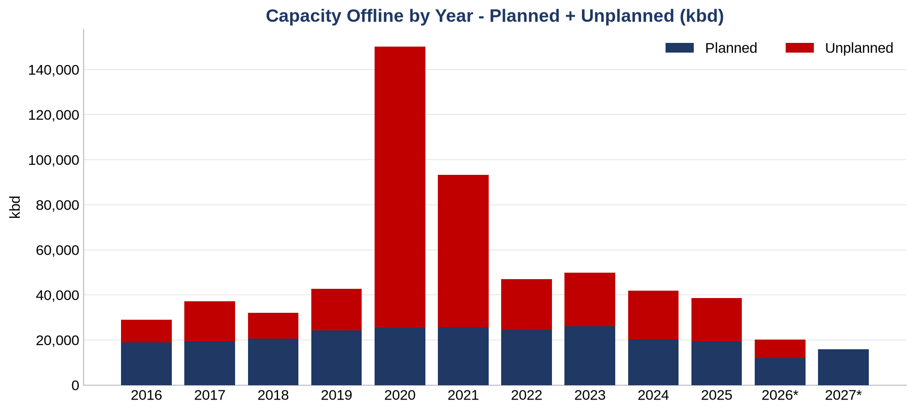
Annual Trend
Capacity offline by year, planned + unplanned
Takeaway
Offline capacity peaked in 2020 (COVID / Winter Storm Uri years 2020-21 are outliers and excluded from forecast baselines). Recent years run a roughly even planned/unplanned split.
Refinery Outage Analytics | Source: Snowflake export (46,456 rows, 2010-2038) | Primary metric: capacity offline (kbd)
3

Slide 4
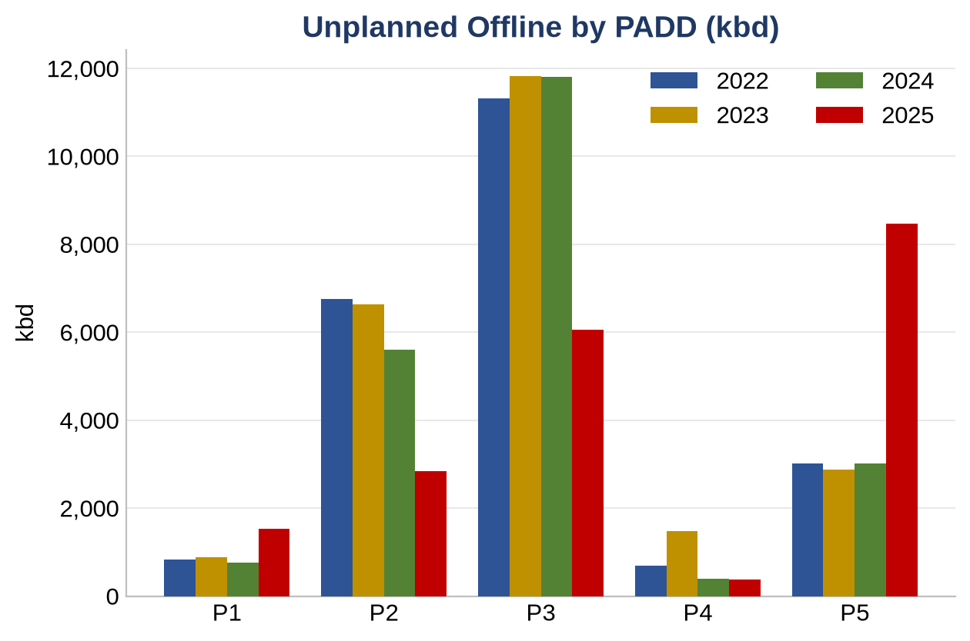
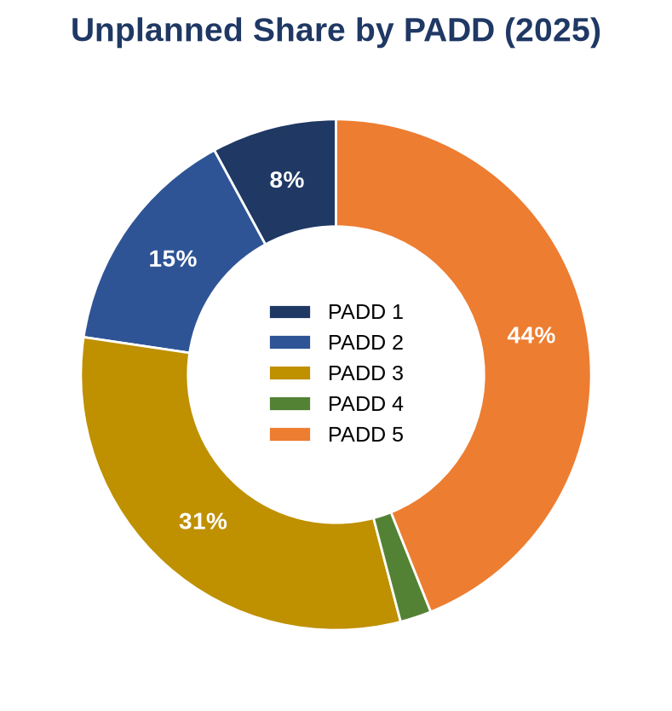
Unplanned by PADD
Where the unplanned risk concentrates
Takeaway
PADD 3 (Gulf Coast) carries ~47% of US unplanned capacity offline; PADD 5 spiked recently on California events.
Refinery Outage Analytics | Source: Snowflake export (46,456 rows, 2010-2038) | Primary metric: capacity offline (kbd)
4

Slide 5
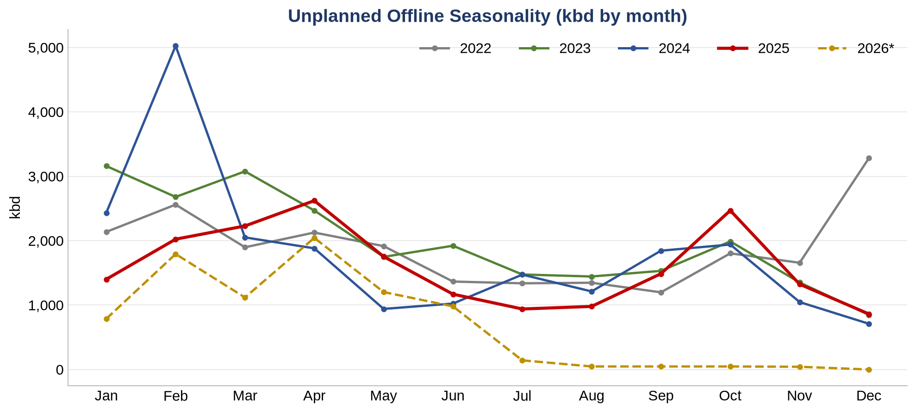
Seasonality
Unplanned offline by calendar month
Takeaway
Unplanned outages cluster in late winter (freeze events) and the autumn turnaround window, with a summer trough - the shape that drives the 2027 scenario.
Refinery Outage Analytics | Source: Snowflake export (46,456 rows, 2010-2038) | Primary metric: capacity offline (kbd)
5

Slide 6
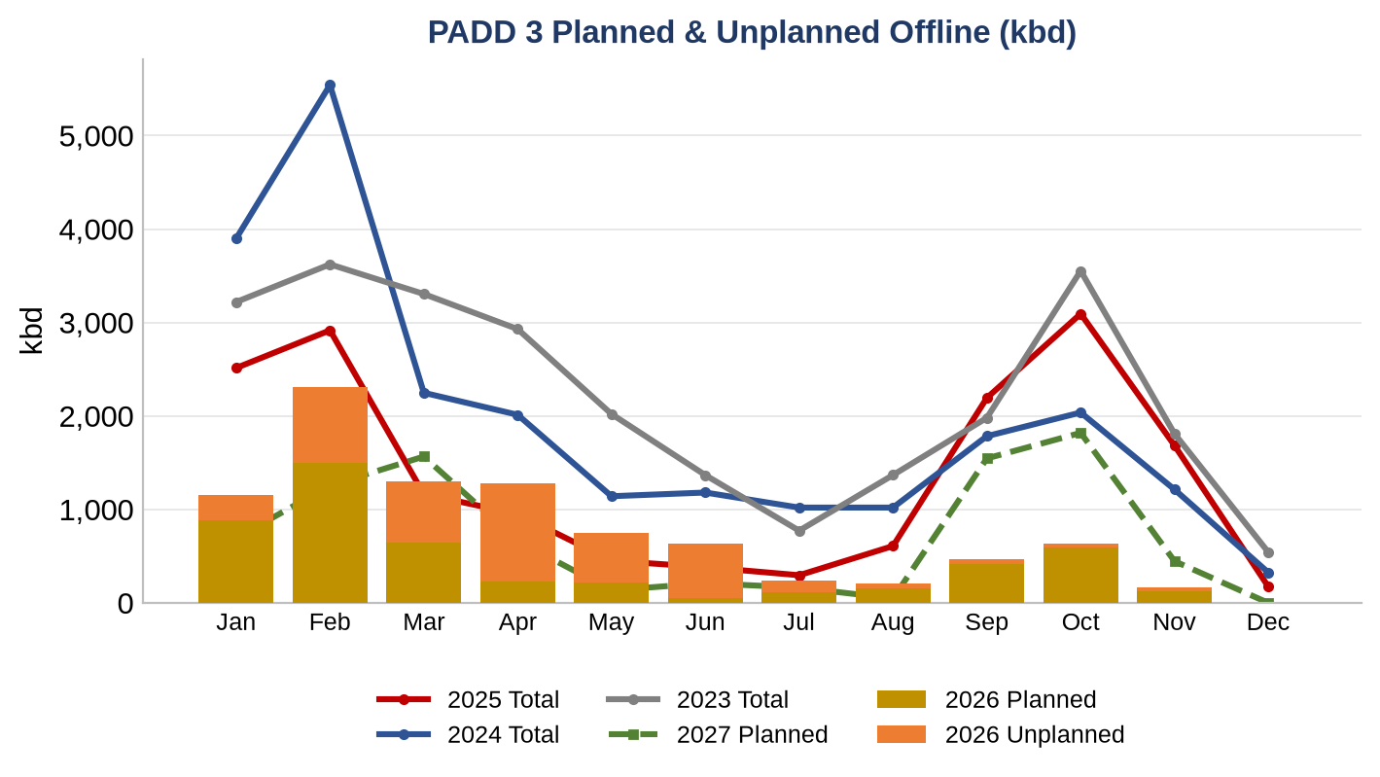
PADD 3 - Reference View
2026 plan + unplanned vs 2023-2025 totals and 2027 plan
Takeaway
Gold/orange columns are 2026 booked plan and unplanned; lines are prior-year total offline; the dashed green line is 2027 booked plan. Magnitudes share one axis (honest scale).
Refinery Outage Analytics | Source: Snowflake export (46,456 rows, 2010-2038) | Primary metric: capacity offline (kbd)
6

Slide 7
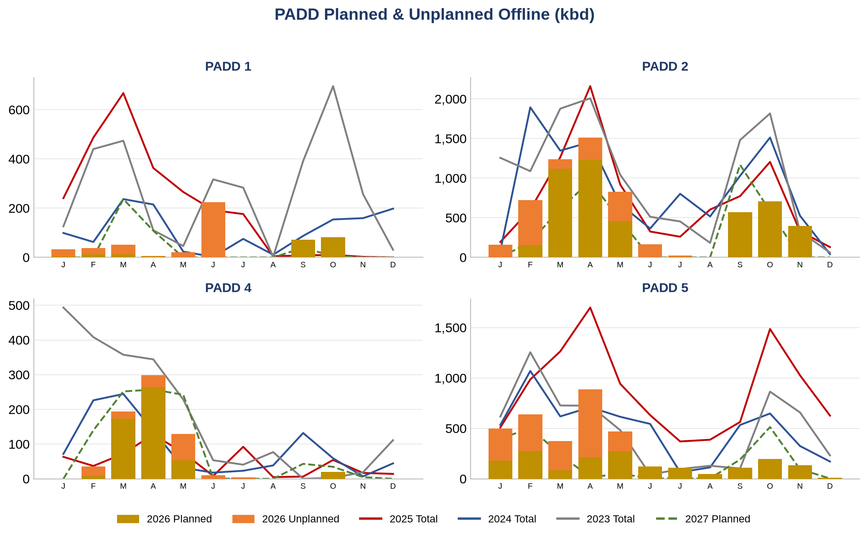
PADD 1, 2, 4 & 5
Same view across the remaining PADDs
Takeaway
PADD 1 is genuinely small; PADD 2 and PADD 5 show the largest swings outside the Gulf Coast. 2027 plan (dashed green) is the only forward-booked series.
Refinery Outage Analytics | Source: Snowflake export (46,456 rows, 2010-2038) | Primary metric: capacity offline (kbd)
7

Slide 8
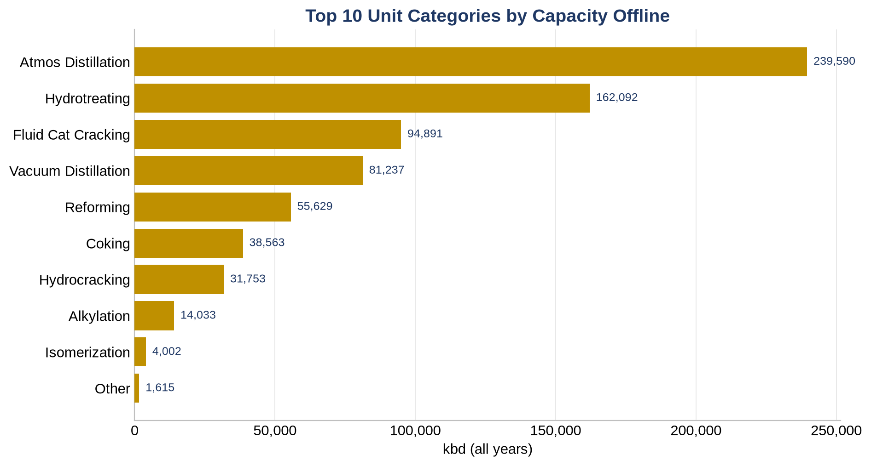
Unit Categories
Capacity offline by unit category (all years)
Takeaway
Crude (atmospheric/vacuum distillation), FCC and reforming units account for the bulk of offline capacity - and the bulk of gasoline-relevant exposure.
Refinery Outage Analytics | Source: Snowflake export (46,456 rows, 2010-2038) | Primary metric: capacity offline (kbd)
8

Slide 9
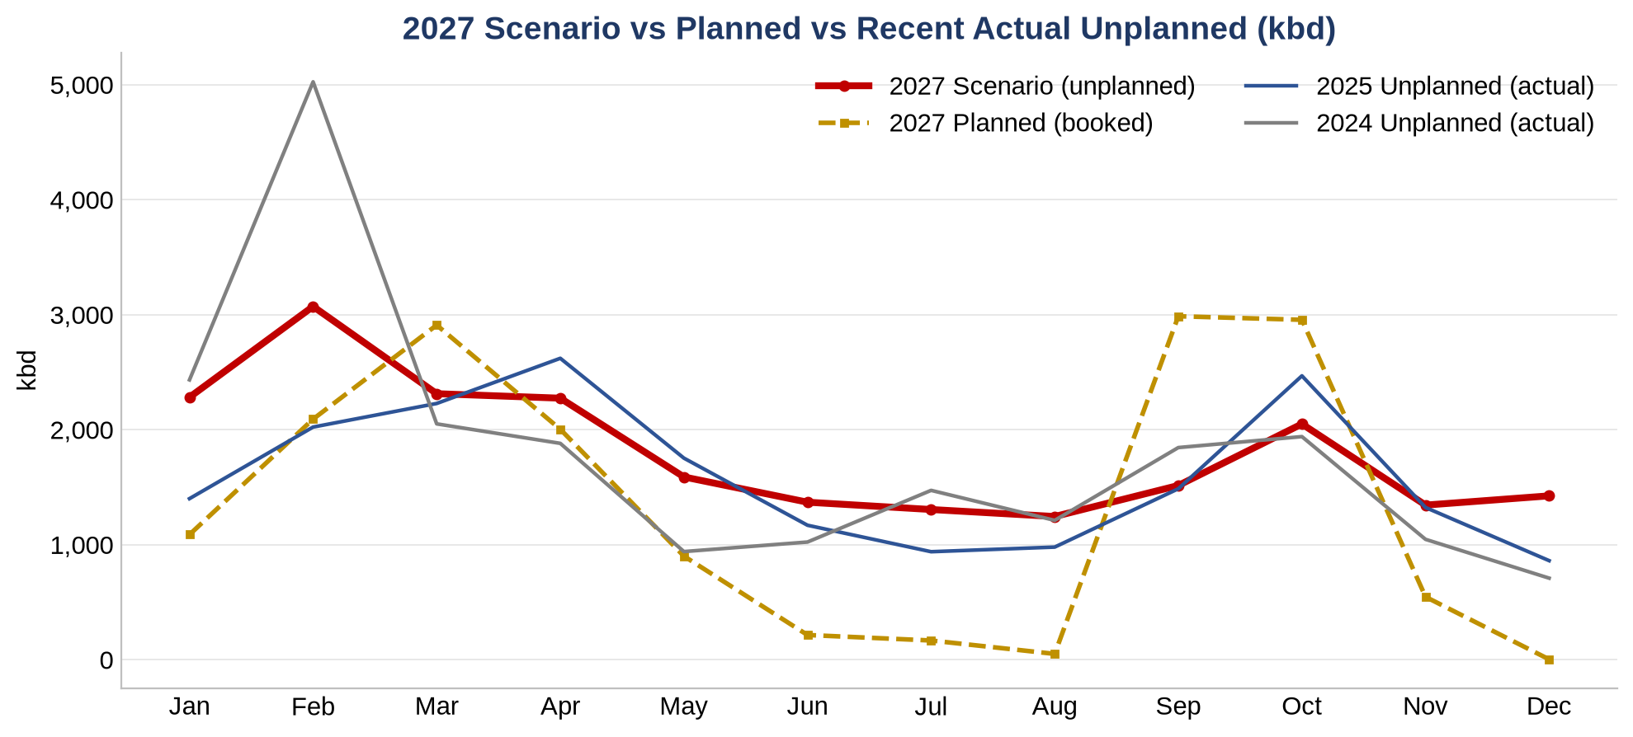
2027 Unplanned Scenario
Driver-based forecast vs planned and recent actuals
Takeaway
Default scenario (window 2022-2025, 0% growth, 1.0x multiplier): ~21,790 kbd unplanned on top of 15,923 kbd booked plan -> ~37,713 kbd implied total. Fully tunable in the workbook.
Refinery Outage Analytics | Source: Snowflake export (46,456 rows, 2010-2038) | Primary metric: capacity offline (kbd)
9

Slide 10
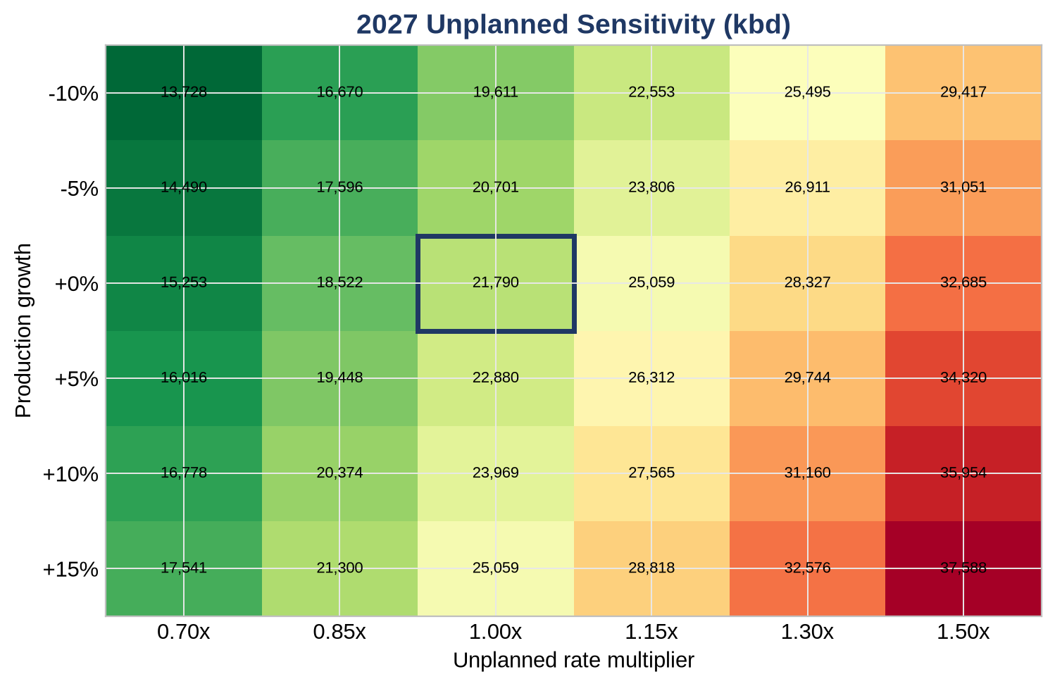
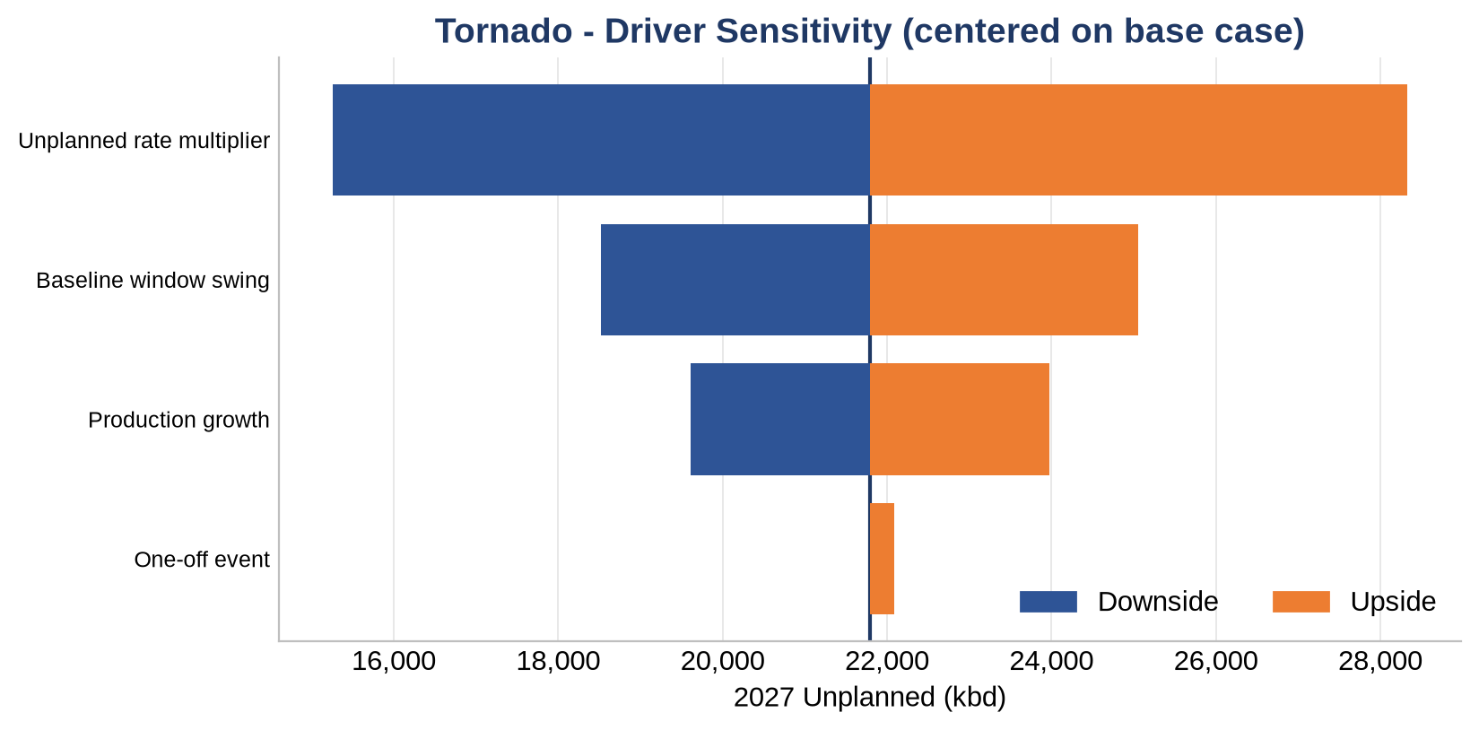
Sensitivity & Risk
How the 2027 unplanned forecast flexes
Takeaway
The unplanned-rate multiplier is the dominant driver (Unplanned rate multiplier); the heatmap base case (21,790 kbd) is outlined.
Refinery Outage Analytics | Source: Snowflake export (46,456 rows, 2010-2038) | Primary metric: capacity offline (kbd)
10

Slide 11
Method & Caveats
Read before use
Primary metric is CAP_OFFLINE_ADJUSTED_KBD (offline capacity, kbd, all units). Mogas is a secondary overlay only.
Outage type is binary {PLANNED, UNPLANNED}; UNKNOWN folds into UNPLANNED per desk rule.
2027 is planned-only - any Plan+Unplanned or Unplanned comparison vs 2027 is shown n/a; only Planned is comparable. Unplanned-2027 is a modeled scenario.
2020-2021 (COVID / Winter Storm Uri) are excluded from forecast baselines by default.
Scenario = baseline(window) x (1+growth) x multiplier + one-off(stress month); the Excel workbook recomputes it live from dropdown inputs.
All numbers refresh from the source export - re-run the build to update workbook, deck and dashboard together.
Refinery Outage Analytics | Source: Snowflake export (46,456 rows, 2010-2038) | Primary metric: capacity offline (kbd)
11

