Slide 1
June 26th, 2026
Products Trading
Products Trading
Refinery Outages
2027 Outlook by Unit
Capacity offline by unit, region & operator -- the gasoline and distillate read
2027: ExxonMobil full-year (verified vs their plan); all other operators H1-confirmed only
PROPRIETARY

Slide 2
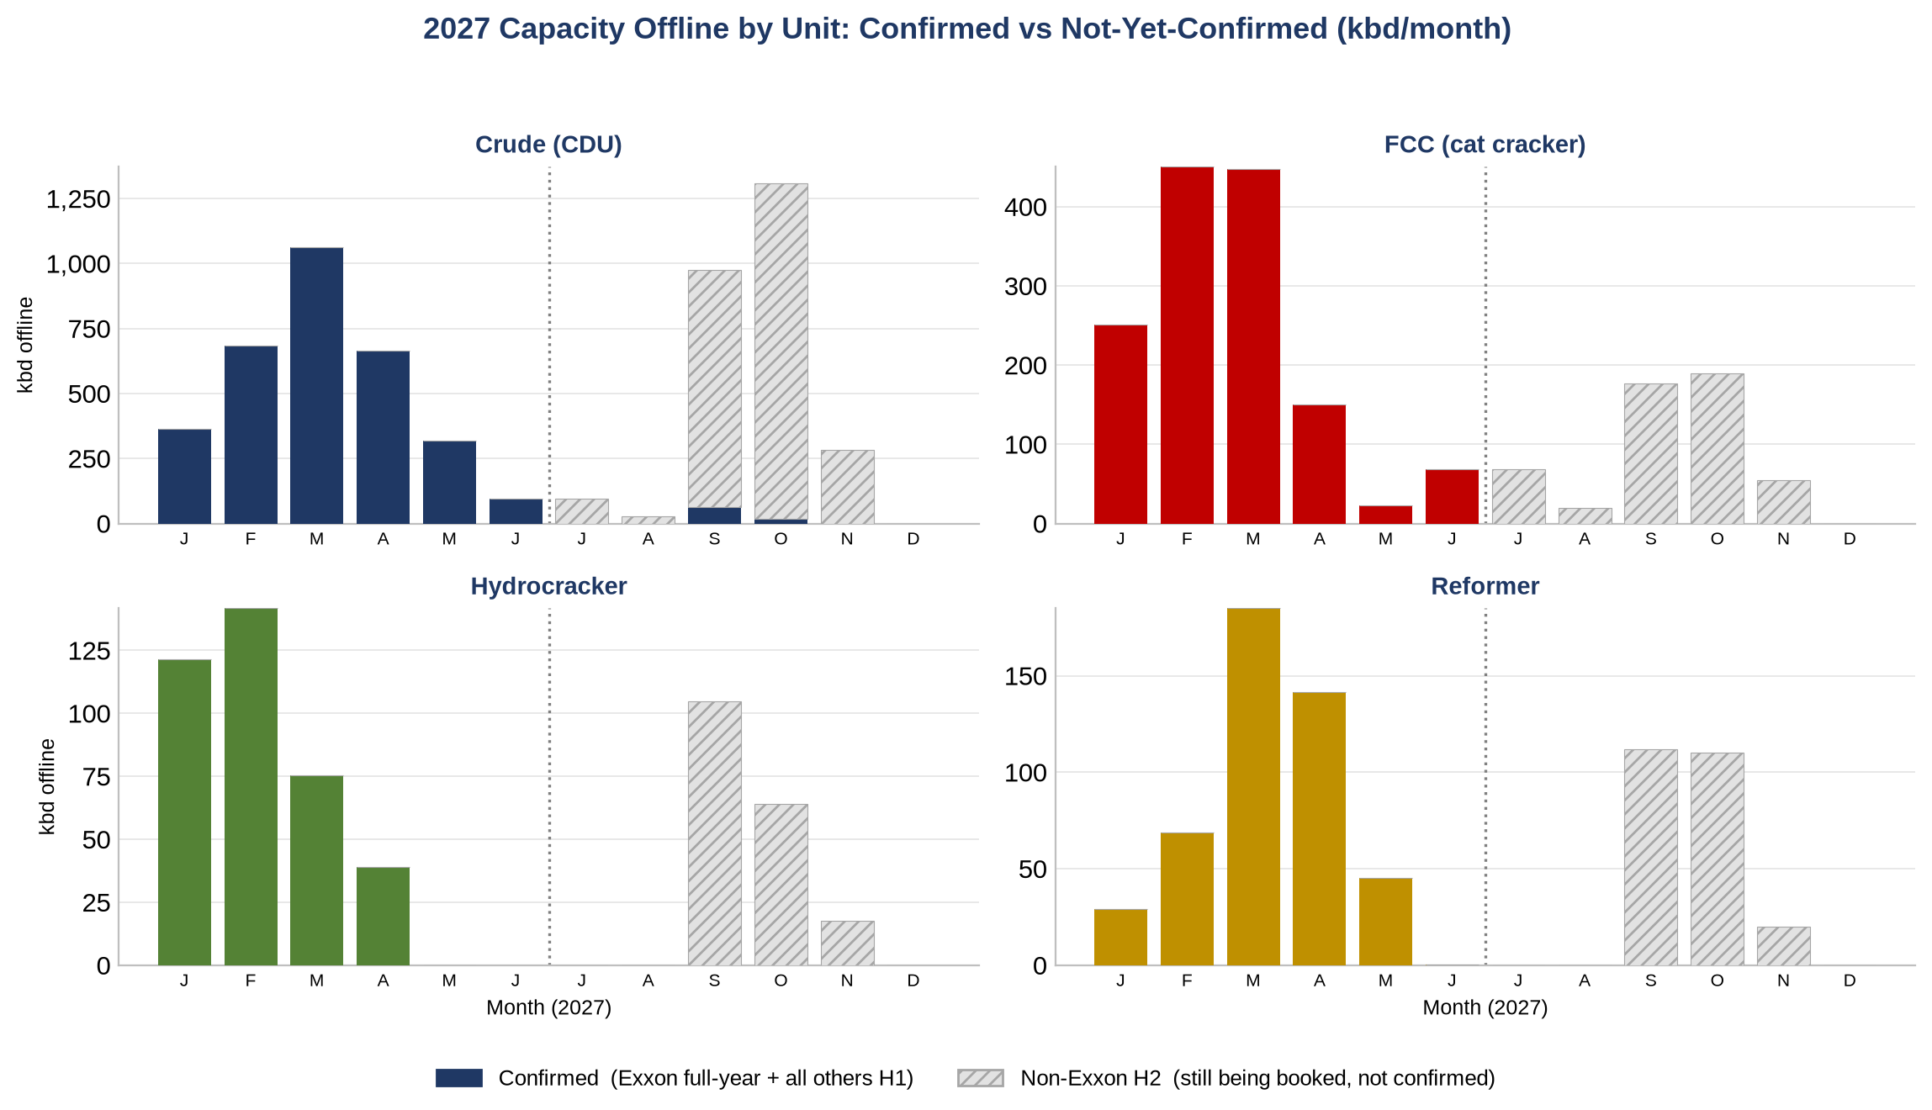
Total 2027 Outages by Unit
Capacity offline by unit & month; solid = confirmed, hatched = non-Exxon H2 (not yet booked)
Day-weighted offline (a unit down part of a month counts only its days down), each unit once per month. Non-Exxon H2 2027 is a floor that fills in.
Products Trading
1

Slide 3
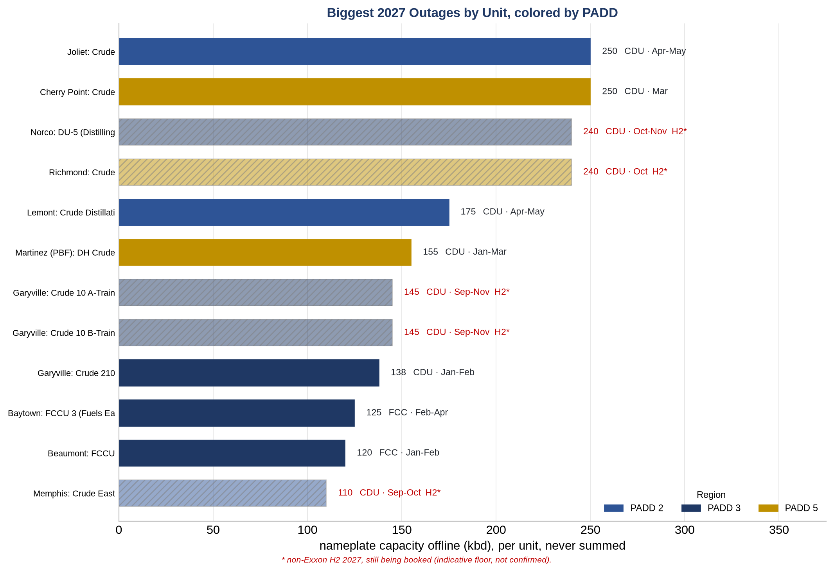
What's Driving the Numbers: the Biggest Outages
Each bar is one unit's nameplate offline (kbd) in 2027, colored by PADD (region)
Per-unit nameplate offline, the 12 biggest focus-unit outages of 2027. Color = PADD region; hatched = non-Exxon H2 (indicative).
Products Trading
2

Slide 4
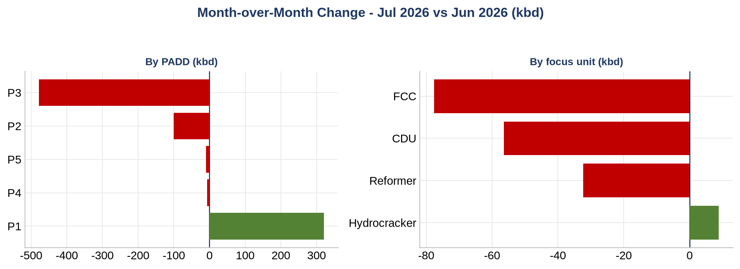
Month-over-Month: What Changed and What's Driving It
Change in capacity offline, Jul 2026 vs Jun 2026, by region (left) and focus unit (right)
Day-weighted offline less month-on-month: ~1,075 kbd in Jul 2026 vs ~1,350 in Jun 2026 (-275 kbd). Biggest swing by region P3, by unit FCC. Green = more offline this month, red = less. Read each unit on its own.
Products Trading
3

Slide 5
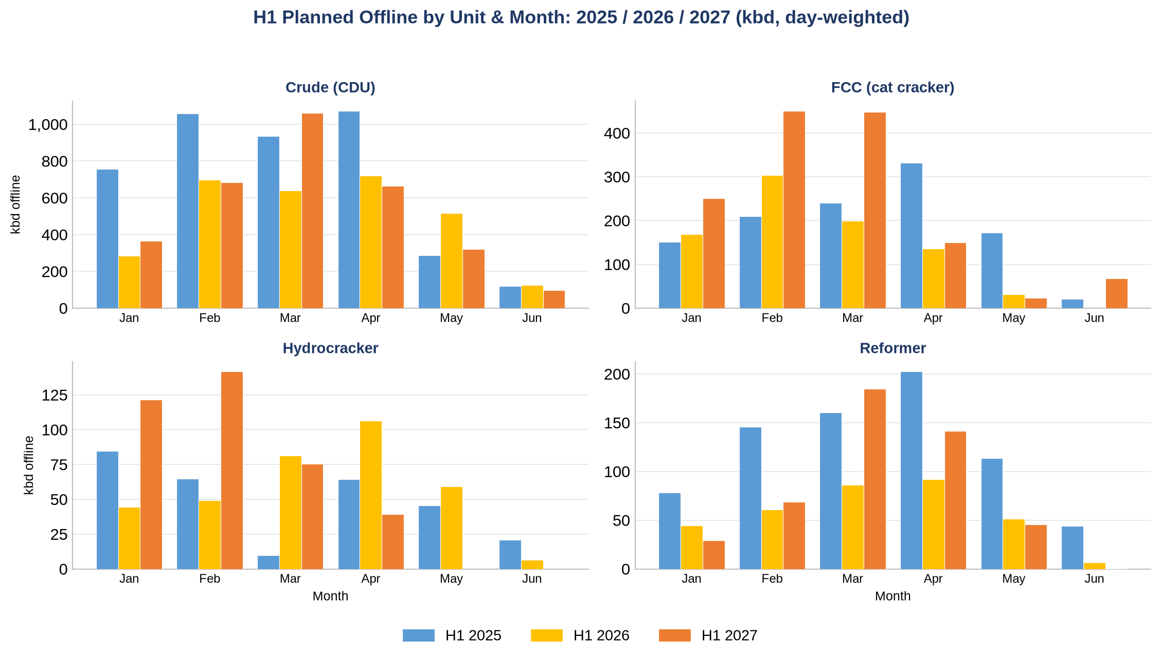
H1 Planned Outages per Unit & Month: 2025 / 2026 / 2027
Like-for-like Jan-Jun planned offline, by unit and month (2027 confirmed through H1)
Day-weighted capacity offline by month, planned only, each unit once per month. Per-panel y-axis. 2025/26 actuals; 2027 the booked plan.
Products Trading
4

Slide 6
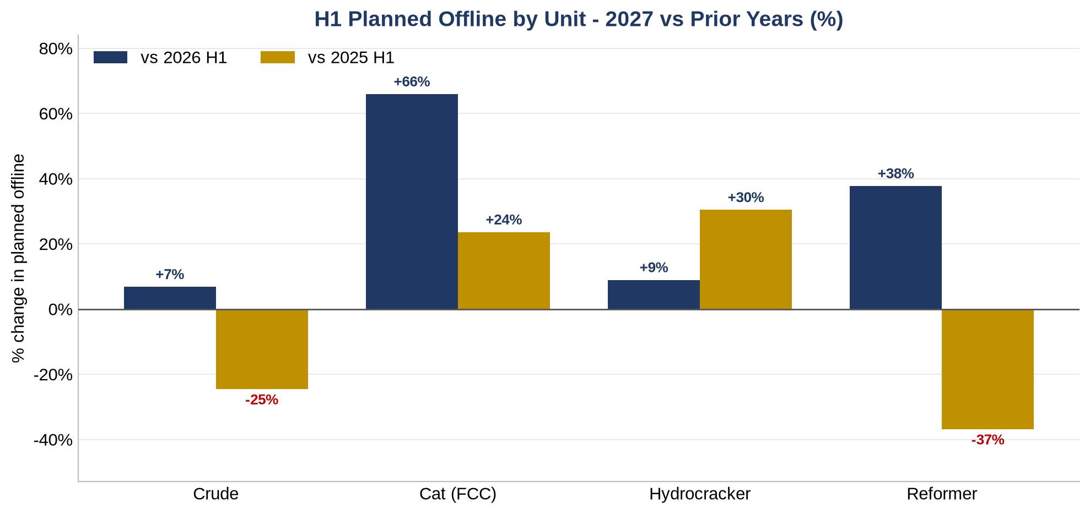
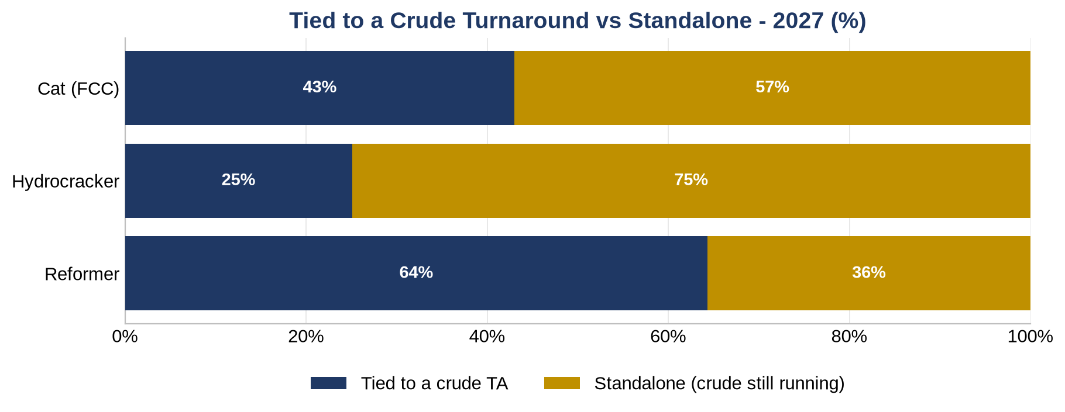
Relatives: 2027 vs Prior Years, and Tied vs Standalone
H1 planned offline % change by unit (left); share of downstream offline tied to a crude turnaround vs standalone (right)
Left: H1 like-for-like, 2027 vs the prior two years -- the cat cracker leads (+66% vs 2026), the reformer beats last year but trails 2025. Right: standalone = the unit is down while crude keeps running (the cleaner product signal); the reformer is mostly tied to crude TAs, the hydrocracker mostly standalone.
Products Trading
5

Slide 7
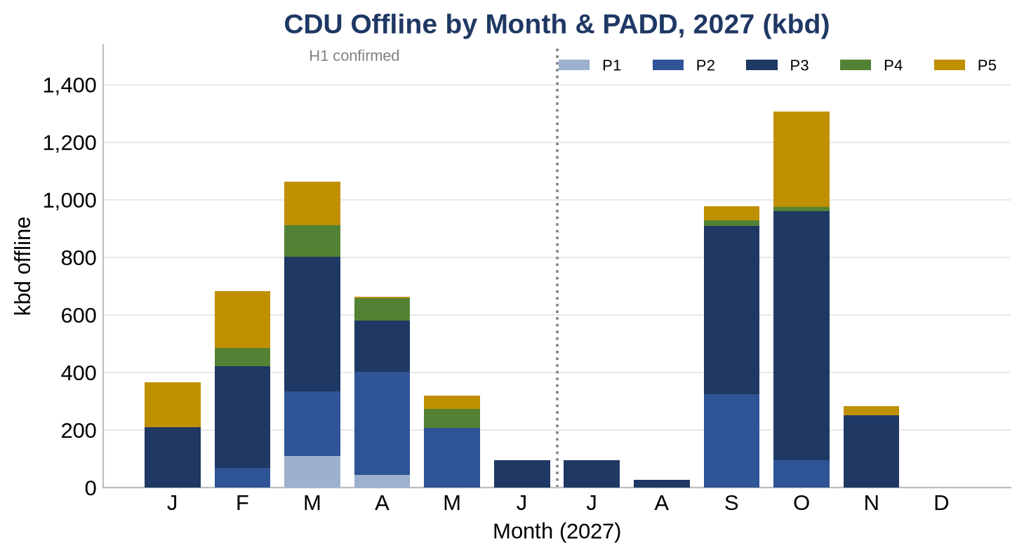
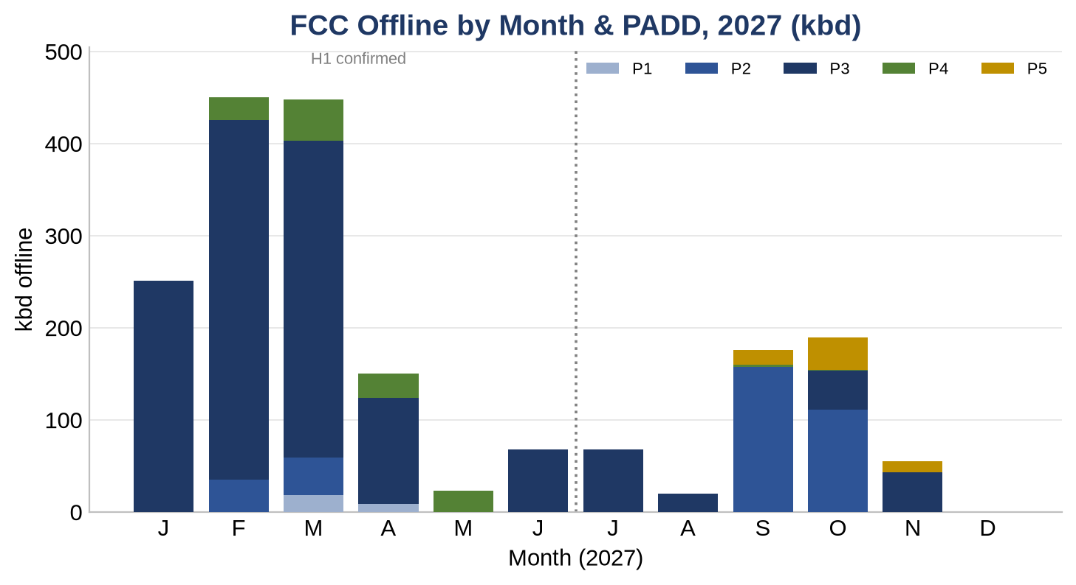
Gasoline Complex: Crude (CDU) + Cat Cracker (FCC) by PADD
2027 crude (CDU, left) and cat-cracker (FCC, right) offline by region & month -- the gasoline read
Day-weighted concurrent offline by month, stacked by PADD. The FCC makes cat gasoline; a CDU outage cuts the whole barrel, gasoline included. P3 (Gulf) is the swing region; P2 (Midwest) carries the spring crude; P5 (West) is islanded. Past the dotted line = non-Exxon H2 (a floor that grows as operators book).
Products Trading
6

Slide 8
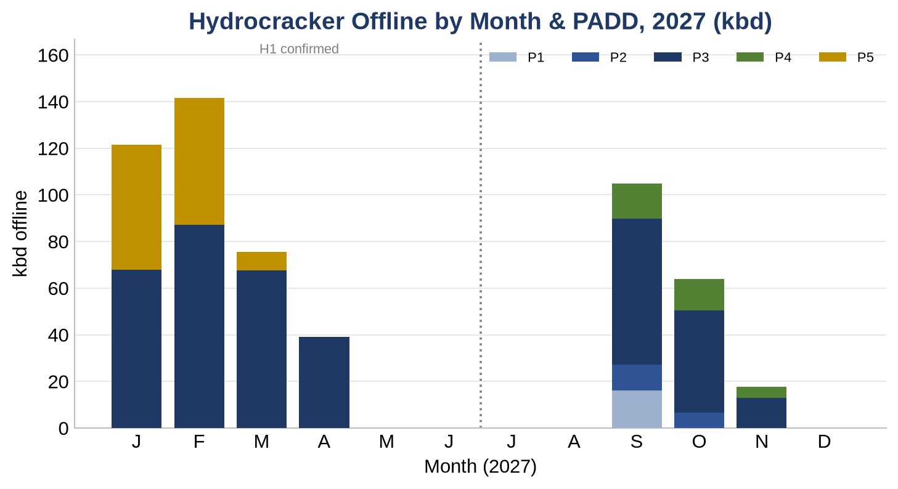
Distillate Complex: Crude (CDU) + Hydrocracker by PADD
2027 crude (CDU, left) and hydrocracker (right) offline by region & month -- the diesel/jet read
Day-weighted concurrent offline by month, stacked by PADD. The hydrocracker makes diesel and jet; the same CDU outage that cuts gasoline cuts distillate too (the whole barrel is down). P3 (Gulf) and P2 (Midwest) carry the hydrocracker work. Past the dotted line = non-Exxon H2 (indicative).
Products Trading
7

Slide 9
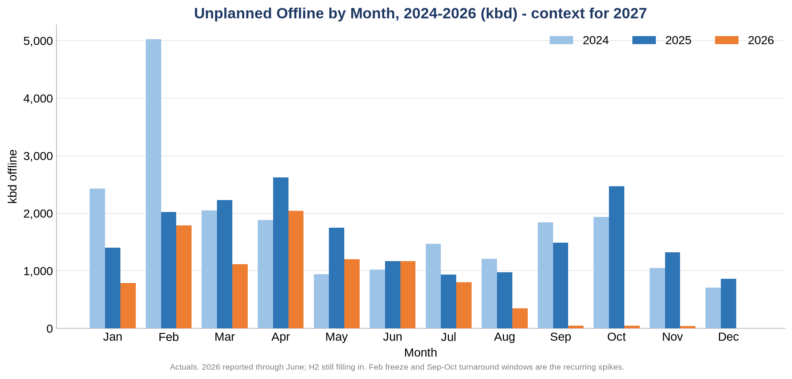
Unplanned Offline: 2024-2026 Context
What unplanned actually looked like in recent years, to ground the 2027 scenario
Actual unplanned capacity offline by month, day-weighted. 2026 reported through June.
Products Trading
8

Slide 10
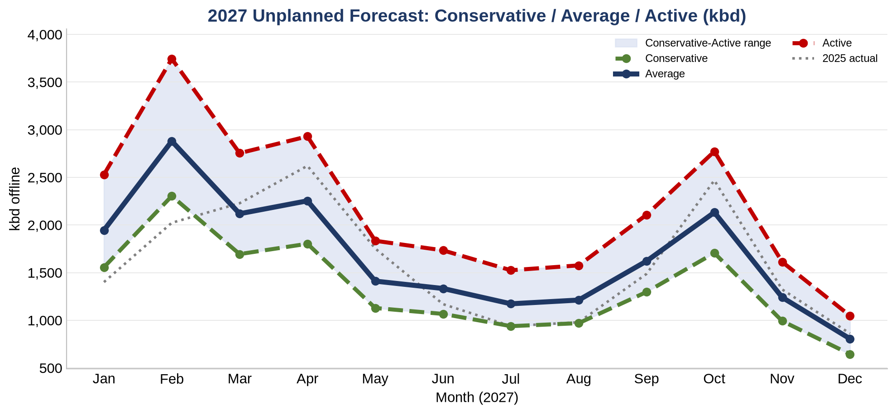
2027 Unplanned Scenario: the Risk on Top of Planned
Potential unplanned offline (kbd per month) modeled on the 2023-26 seasonal pattern
Scenario = mean 2023-26 monthly unplanned shape (completeness-aware) x {0.8 / 1.0 / 1.3}. Monthly concurrent offline, a risk range, not a forecast. Not an annual sum.
Products Trading
9

Slide 11
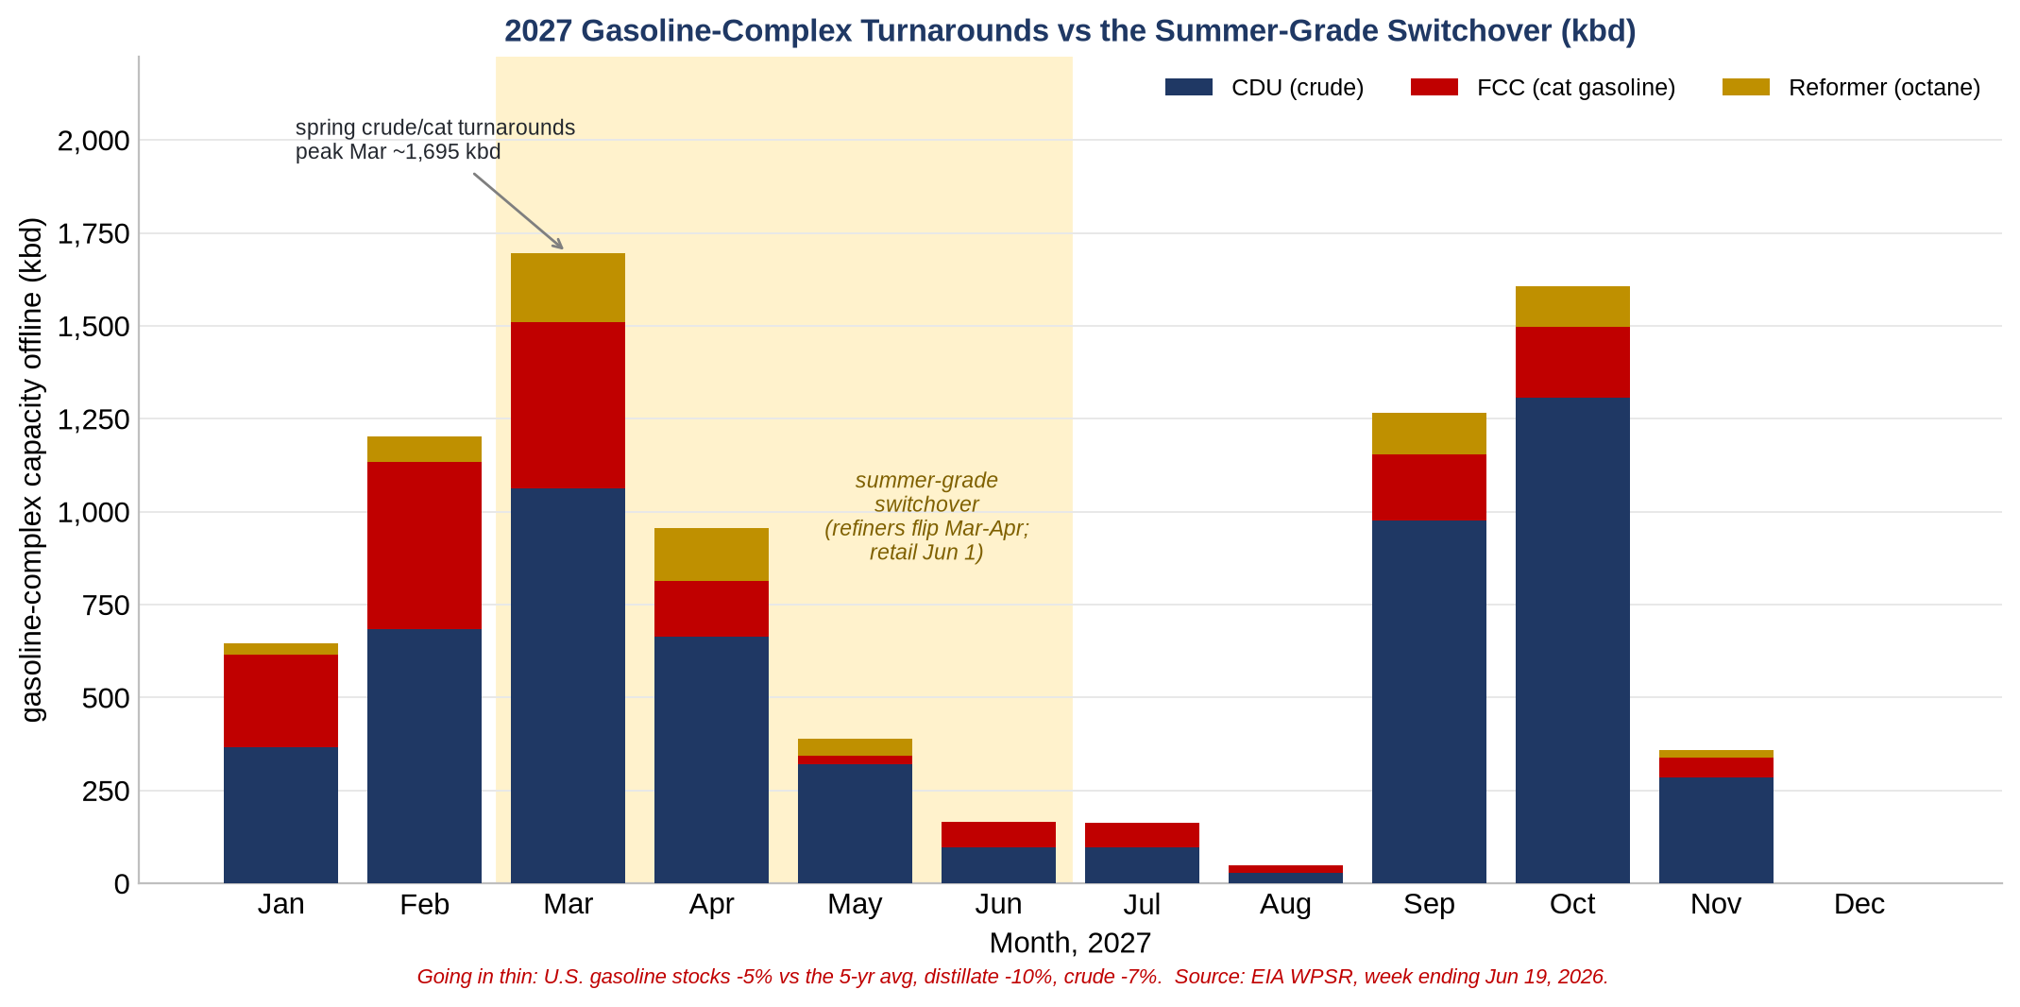
What It Means for the Market: Gasoline & Distillate
Spring crude turnarounds tighten both pools -- summer gasoline and a thin distillate cushion
Gasoline-complex (CDU + FCC + reformer) offline by month vs the summer-grade switchover. U.S. stocks below the 5-yr average on both sides: gasoline -5%, distillate -10%, crude -7% (EIA WPSR, week ending Jun 19, 2026). Spring CDU turnarounds cut crude -- so gasoline and distillate both -- with the FCC tightening summer gasoline and the hydrocracker tightening diesel/jet.
Products Trading
10

