Slide 1
June 26th, 2026
Products Trading
Products Trading
Refinery Outages
Rest of 26 + 27: Naphtha, Reformers & Chem Feed
The octane and petrochemical-feedstock read: reformers and the naphtha complex, not just crude
The forward window: 2026 H1 is actual; the rest of 2026 and all of 2027 are the outlook
PROPRIETARY

Slide 2
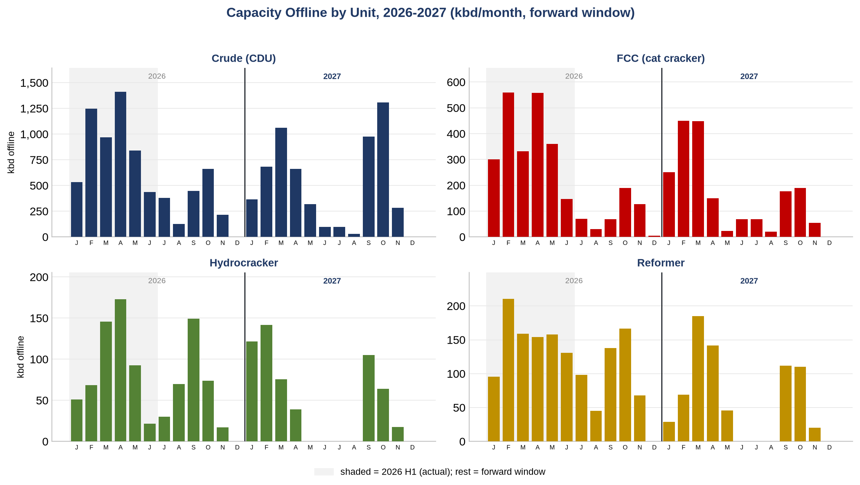
The Forward Book by Unit: Rest of 2026 + 2027
Capacity offline by unit & month across the forward window (2026 H1 shaded = actual)
Day-weighted offline, each unit once per month. Shaded = the current year's H1 (actual, behind us); everything to the right is the forward book (rest of this year + next).
Products Trading
1

Slide 3
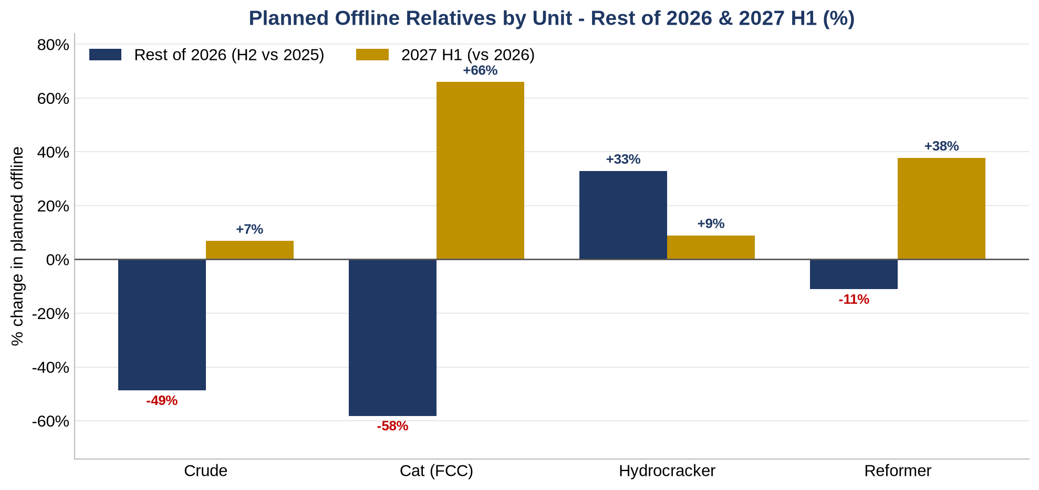
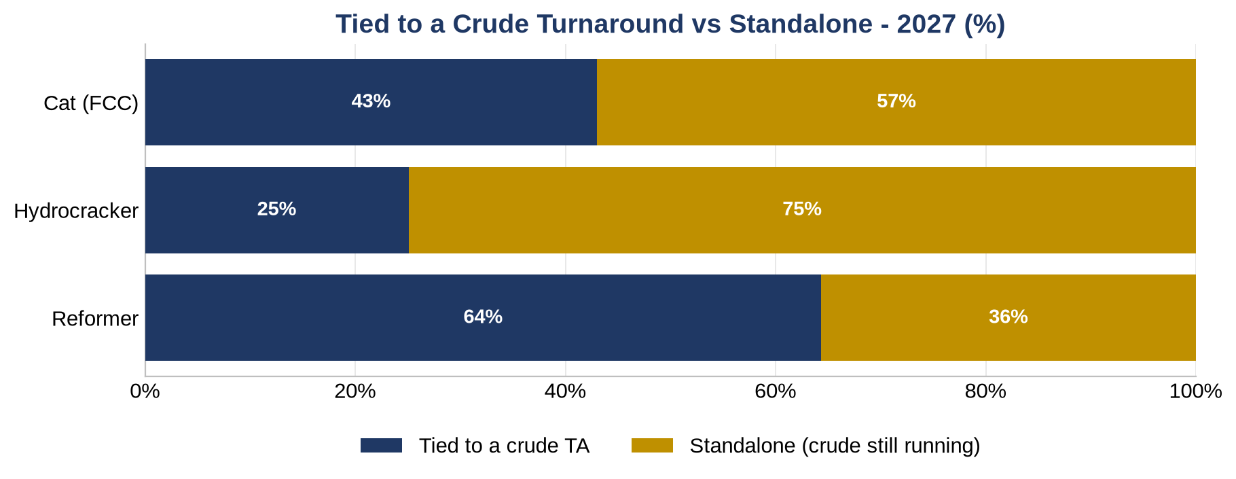
Relatives: Rest of 2026 & 2027 H1, and Tied vs Standalone
Planned offline % change by unit (left); share tied to a crude turnaround vs standalone (right)
Left: rest of 2026 (H2 vs the prior year) and 2027 H1 (vs prior) -- the reformer steps from -11% to +38%. Right: a standalone reformer = HVN demand off while crude keeps running (naphtha lengthens, reformate/octane tightens with no crude offset); the reformer is ~64% tied, so the standalone third is the clean octane signal.
Products Trading
2

Slide 4
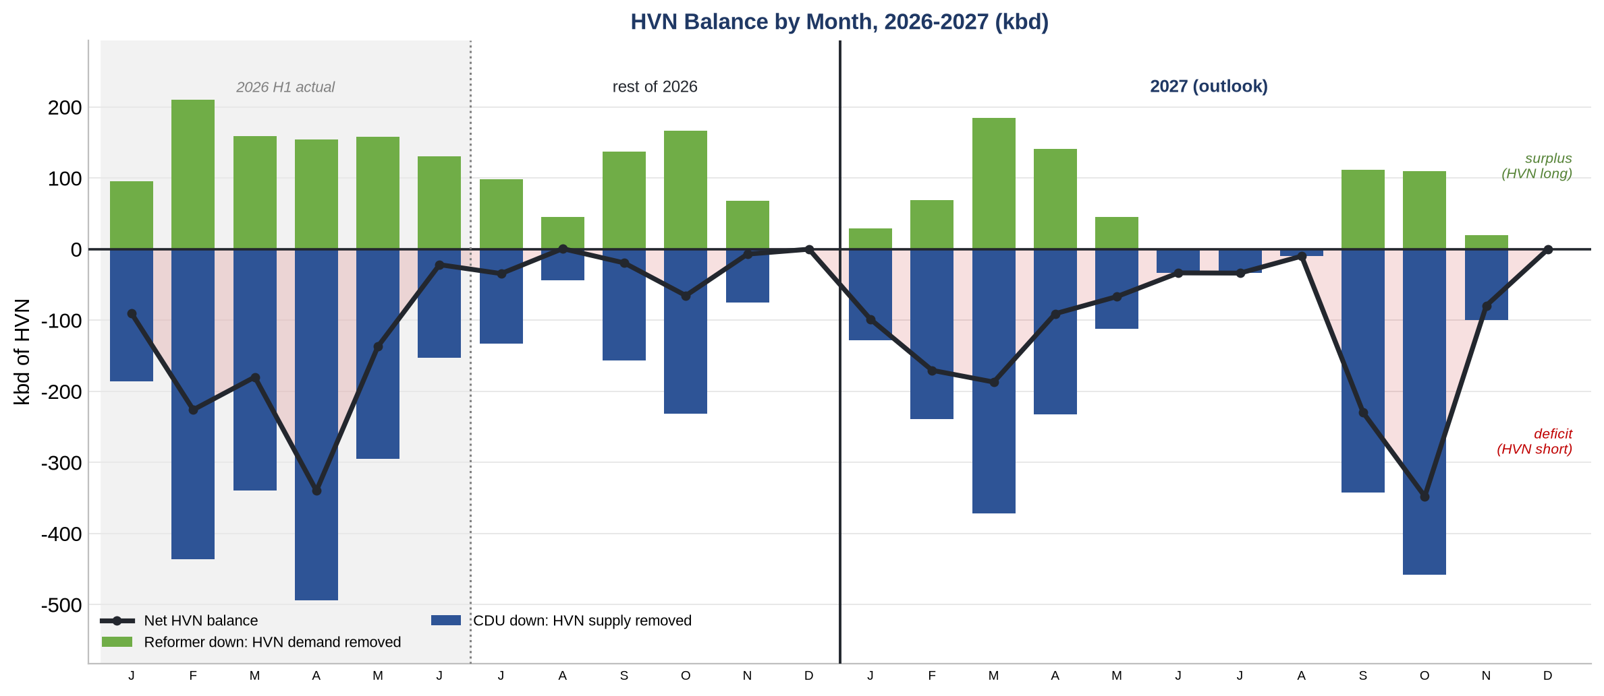
HVN Balance: CDU Supply vs Reformer Demand
Heavy virgin naphtha (the reformer feed) across 2026-2027. CDU makes it; reformers consume it
Net = reformer offline (HVN demand) minus CDU offline x 0.35 (HVN supply, ~35% of crude), day-weighted. The forward window runs short (15 of 18 months in deficit): crude turnarounds pull more HVN off than reformers free.
Products Trading
3

Slide 5
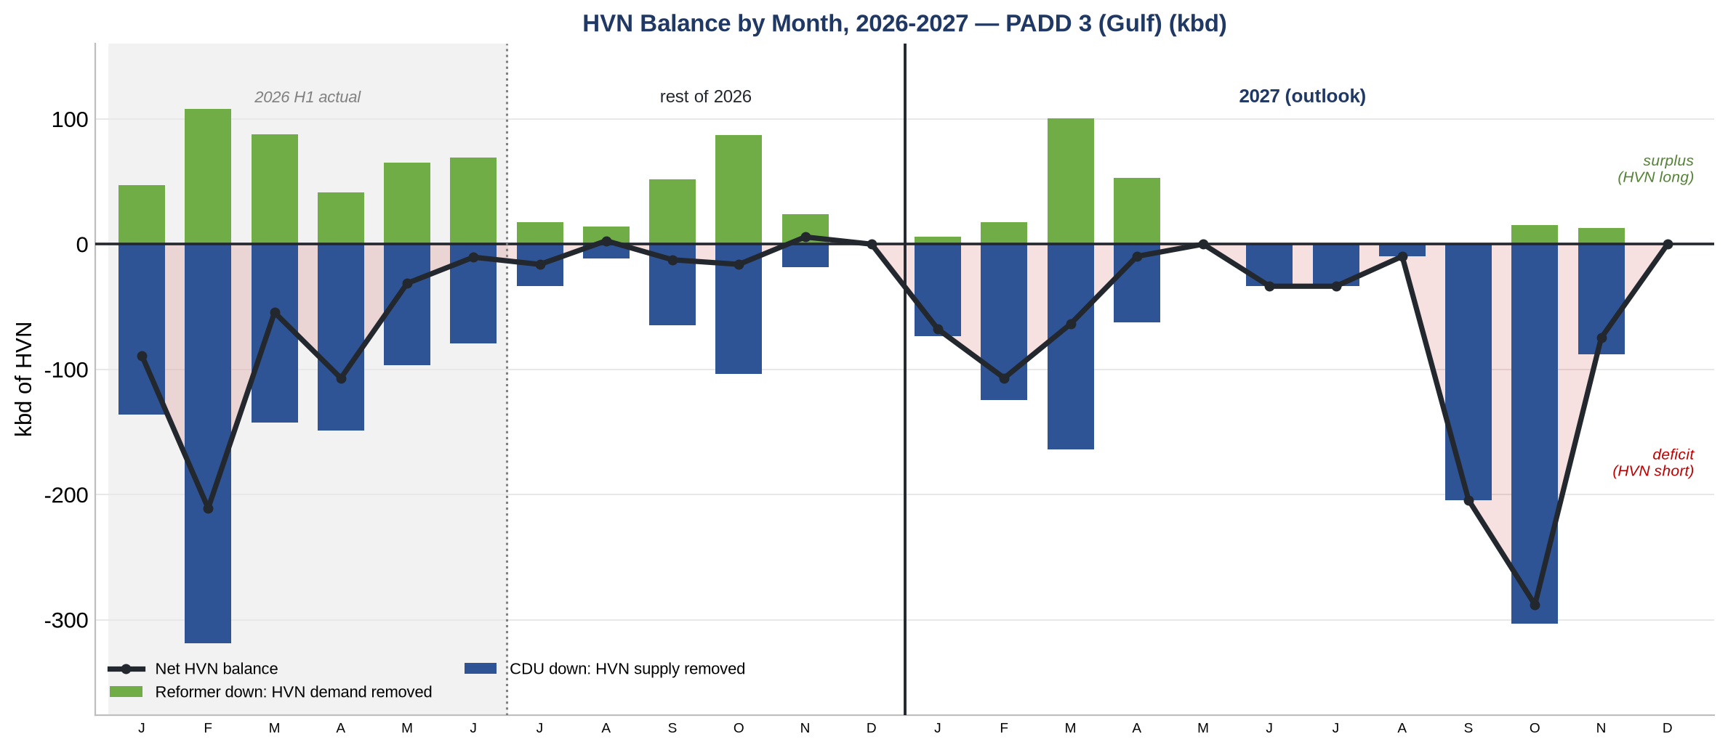
HVN Balance: PADD 3 (Gulf) Only
The same HVN balance, CDU & reformers filtered to PADD 3 (Gulf) -- where the tightness sits
PADD 3 (Gulf) only -- the same supply/demand read as the prior slide, just the Gulf cut. 13 of 18 forward months in deficit; the Gulf carries ~66% of the 2027 HVN deficit.
Products Trading
4

Slide 6
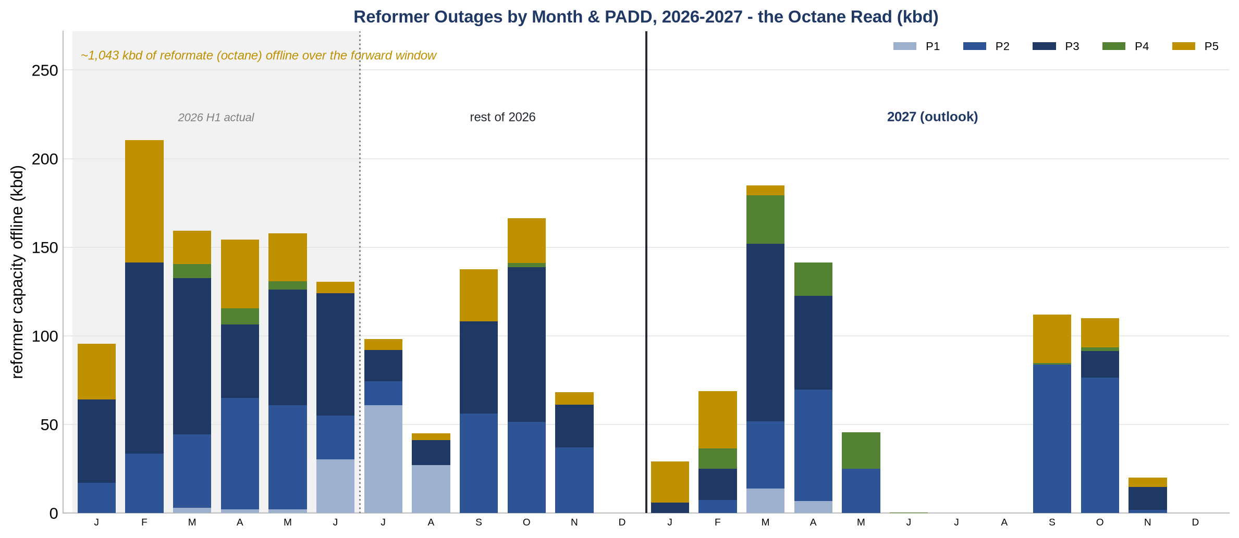
Reformers: the Octane Read
Catalytic-reformer offline by month & PADD across 2026-2027, with reformate (octane) lost
Reformers run naphtha -> reformate (the octane in gasoline). Over the forward window (rest of 2026 + 2027), ~1,227 kbd of reformer offline = ~1,043 kbd of reformate (octane) not made. P3 (Gulf) carries the most.
Products Trading
5

Slide 7
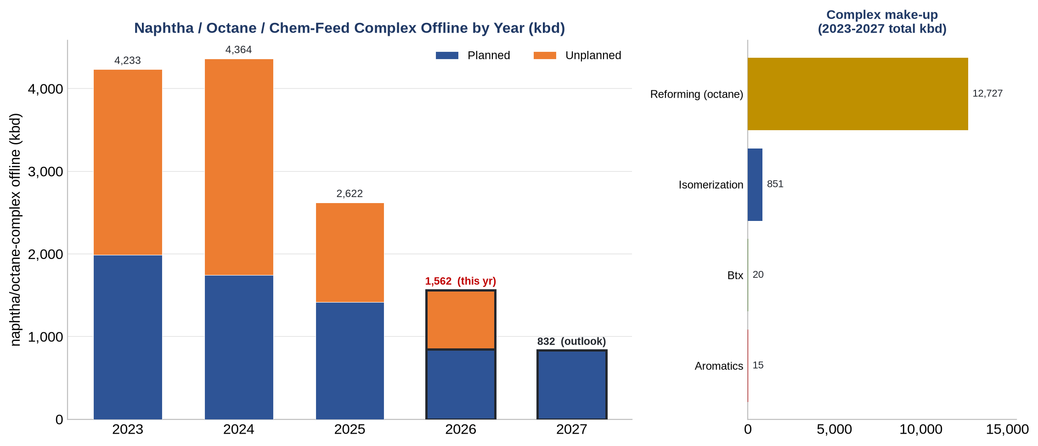
Naphtha / Octane / Chem-Feed Complex
Reforming, isomerization and aromatics/BTX offline by year - the octane & petrochem-feed read
The naphtha/octane complex (reformer charge + steam-cracker / petrochem feed). Offline ~1,562 kbd in 2026 and ~832 kbd booked in 2027. Reforming dominates; this is the octane/chem-feed availability a CDU-only tracker misses.
Products Trading
6

Slide 8
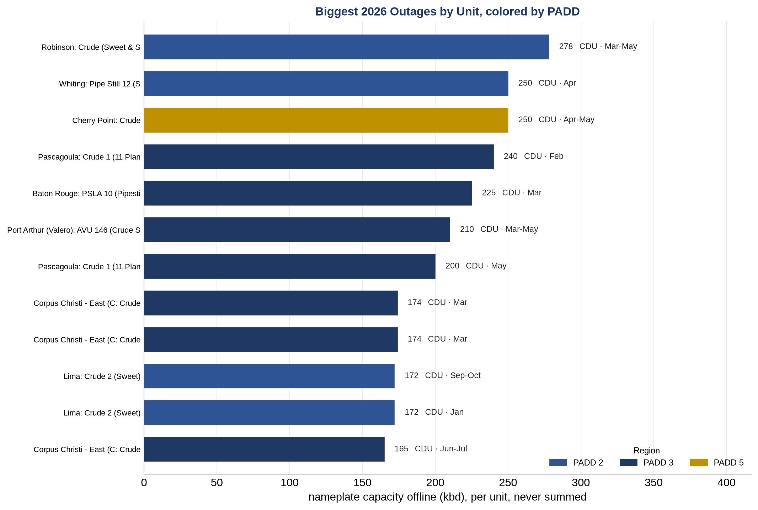
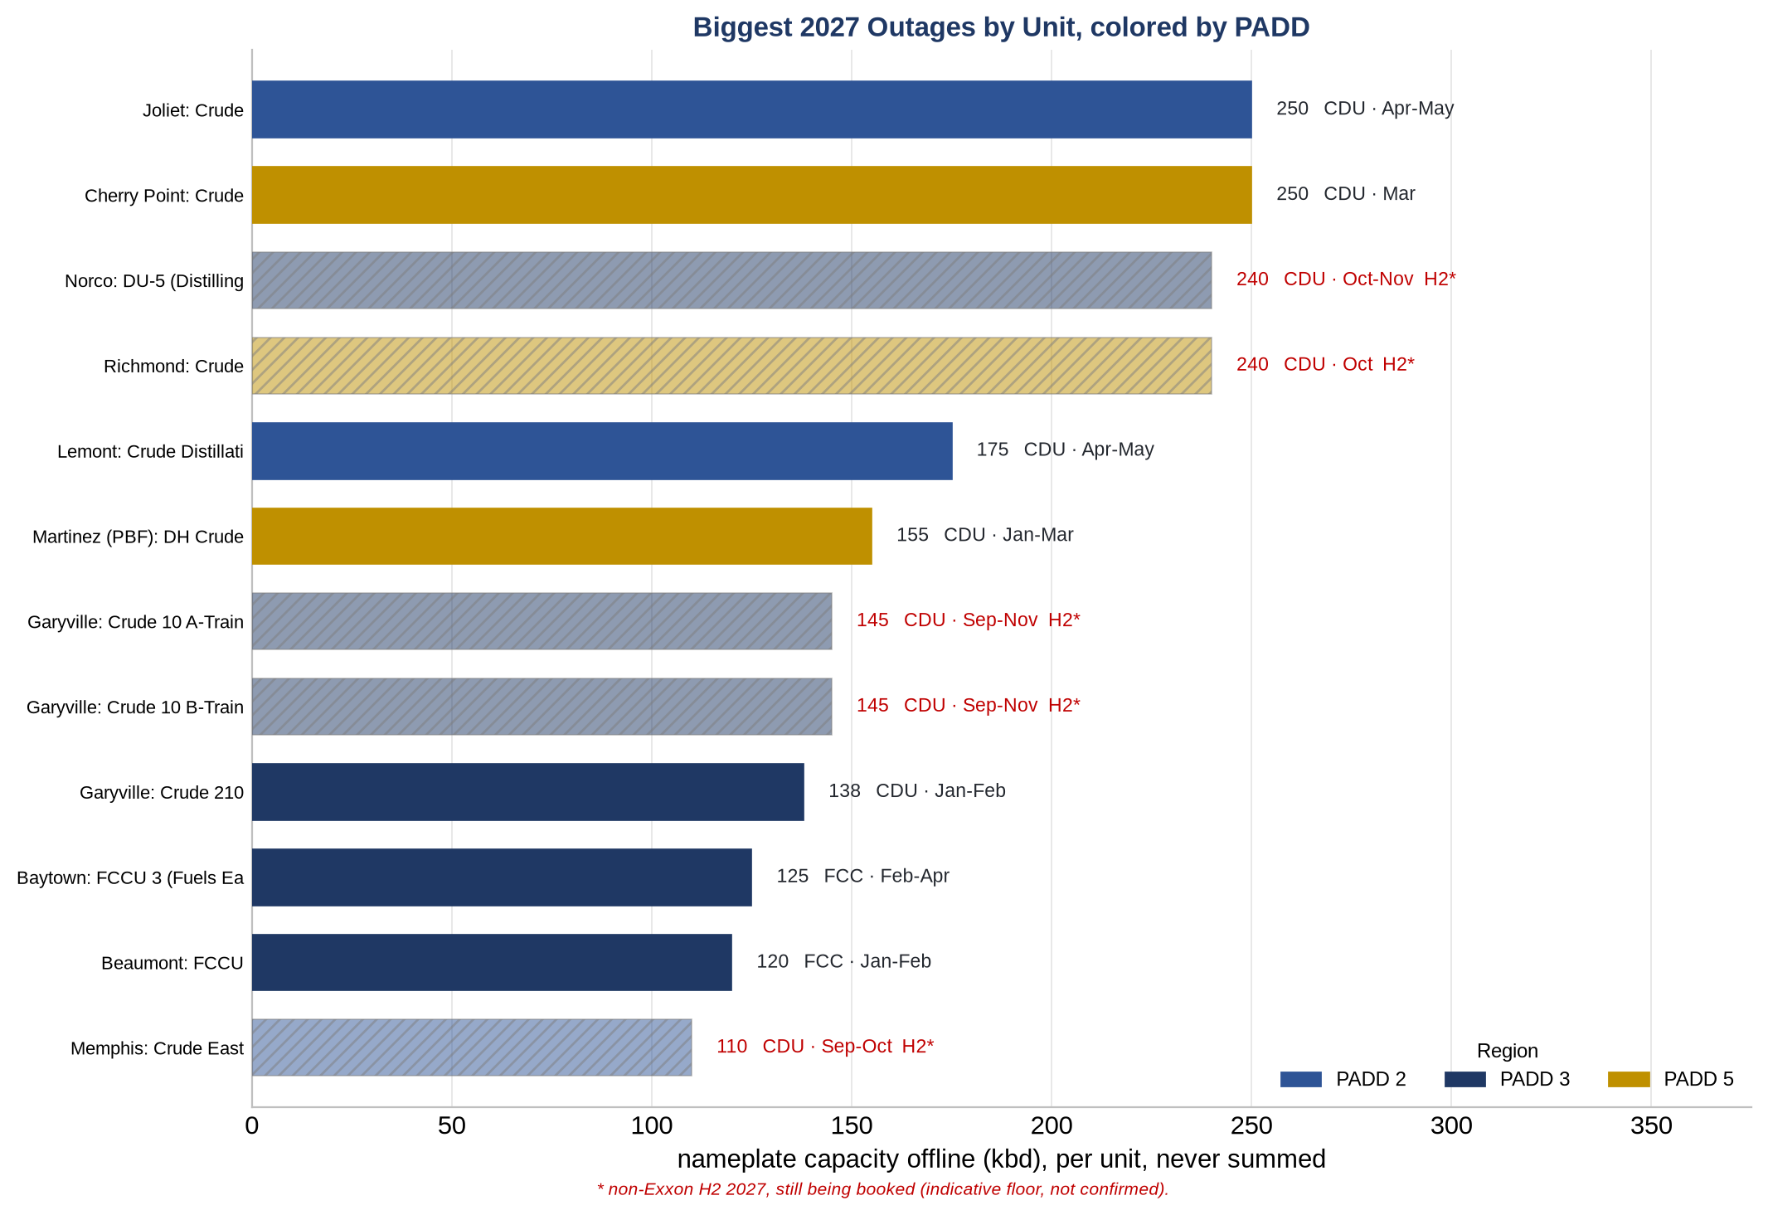
What's Driving It: Biggest 2026 & 2027 Outages
Biggest individual focus-unit outages, 2026 (left) and 2027 (right), by PADD
Per-unit nameplate offline (never summed), the biggest outages each year. Color = PADD region. 2027 non-Exxon H2 is still being booked (an indicative floor).
Products Trading
7

