Slide 1
Notes:
Everyone knows technology is advancing at an incredible pace.
We have refrigerators that can sense when the milk is low and send a notification;
There are cars that can sense where they are positioned and parallel park themselves;
And yet, there are areas where sensor technology advancement is seriously lacking.[ ]
For example a visually impaired person’s primary assistance sensing the world…

Slide 2

Current Sensor Technology for Visually Impaired
Notes:
(For example, a visually impaired person’s primary assistance sensing the world )
…around them is still a tapping cane.
The last major improvement to the cane was about a century ago when it was painted white for visibility.
[ ]
My Name is Gena Holden, and for my capstone project…

Slide 3

Ultrasonic Embedded System for
Visually Impaired Persons
to
Enhance Situational Awareness
Gena Holden
Notes:
(My Name is Gena Holden, and for my capstone project,)
…I wanted to create something that had the potential to make a difference in someone’s life.
I decided to create an ultrasound obstacle detection system for people who are blind.
[ ]
The concept behind my project is…

Slide 4
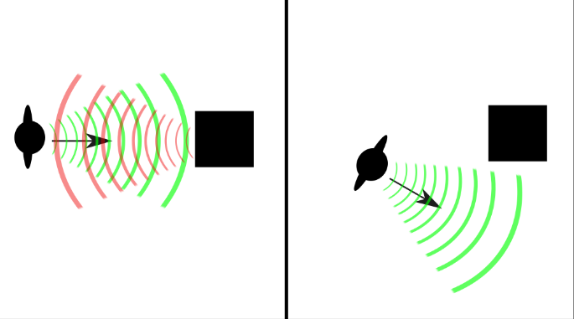
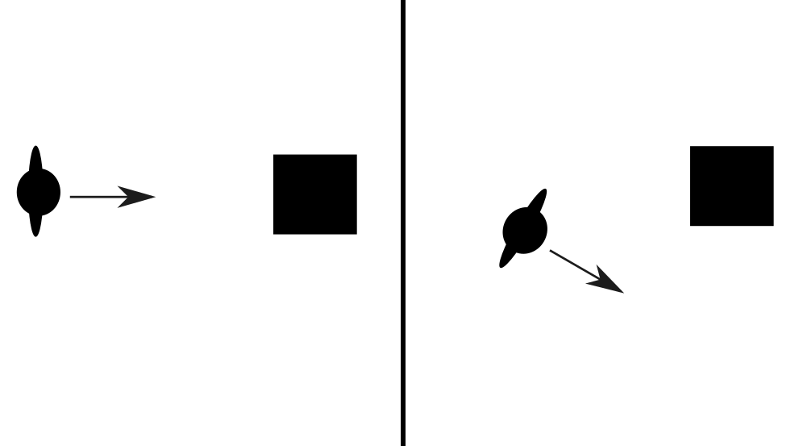
Ultrasonic Embedded system
Project Concept and Goals
• Develop system to alerts users when obstacles are in path.
• Create from inexpensive and widely available components.
• Design for code portability and ease of recreation / enhancement.
Notes:
(The concept behind my project is) …that when a person is walking and sees an obstacle in front of them, they change course to avoid it.
But if a person is using a cane, they have to actually physically contact the object in order to detect it and change course.
- It seems logical that people could be alerted to the presence of obstacles using ultrasonic technology and a haptic vibration motor similar to those used in cell phones.
- [ x ]
- The device would use ultrasonic waves to detect objects and give a signal to the user who would then know they needed to alter their course before they actually reached the obstacle.
I wanted to make this project easy for anyone to recreate or improve upon, so my goals included
using only inexpensive components and designing it with ease of recreation in mind.
My hope was that I could create a system that any middle-schooler could put together for their grandparent.
[ ]
During this presentation, I would like to…

Slide 5
Ultrasonic Embedded system
Presentation Topics
Platform Selection
Hardware
Specific Items Used
Operation
Challenges
Software
Coding motor feedback
Available Ultrasonic Drivers and Limitations
Custom Driver Development
Outcome of project
Vision for the future
Notes:
(…During this presentation, I would like to )
give a quick overview of development platforms,
Describe the hardware I used, how it works, and a couple difficulties I encountered.
I will also, talk about the software available and the software I developed, Explain the current status of the project and
Share my ideas about what else could be done on it.
[ ]
When I started this project, I did not know much about embedded electronics…

Slide 6
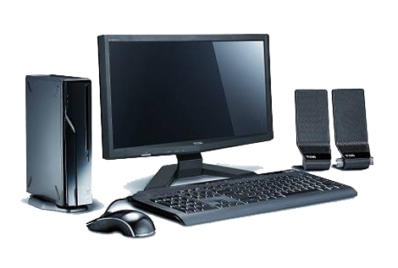
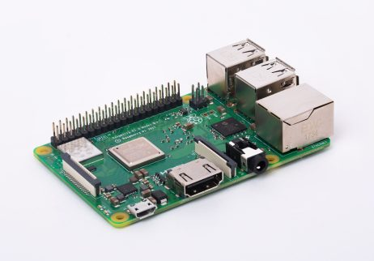
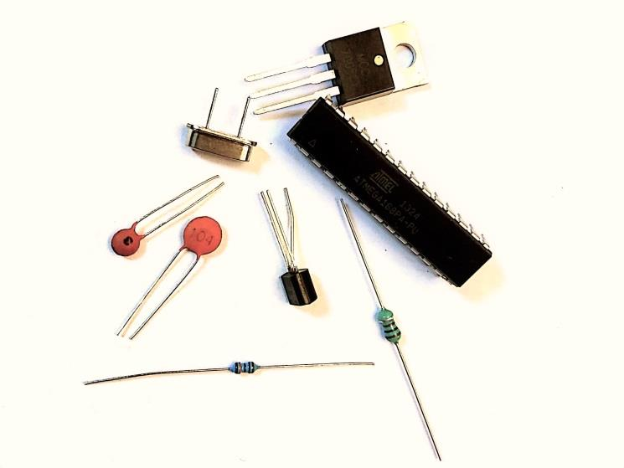
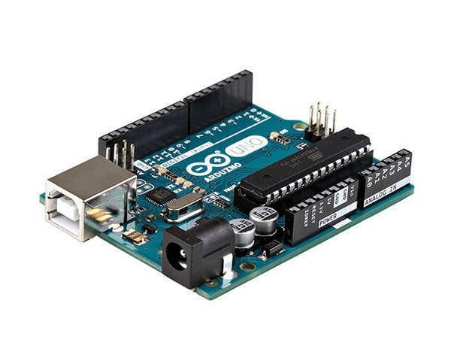
Ultrasonic Embedded system
Platform Selection
Raspberry Pi 3+
Arduino Uno
Notes:
(When I started this project, I did not know much about embedded electronics…)
So my 1st task was to decide what platform to use. The 2 most common platforms, PI and Arduino, both have small footprints and lots of documentation.
At first I thought they were similar devices…but I found out they are nothing alike:
[ x ] (Pi) Entire computer system – it can be directly connected to a KBD, mouse, monitor, network, and speakers. It has an operating system and can run a variety of programs.
[ x ] (ARD) on the other hand, is a microcontroller that has been integrated with a clock crystal, voltage regulator, transistors, capacitors, and resistors to make it much easier to use and program. It has no native input or output other than its I/O pins, but once it is programmed, it runs that program dependably.
The Pi is well suited for applications which need a large amount of user interaction, multiple programs, or heavy computations.
The Arduino is best suited to small dedicated applications which require little or no user knowledge.
[ ]
For this project, I used 4 main hardware components…

Slide 7
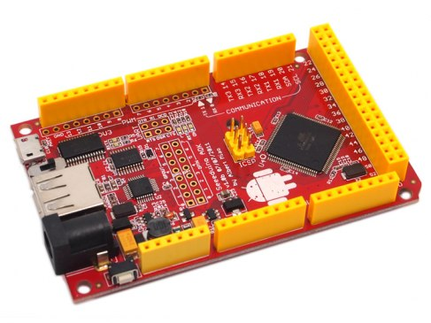
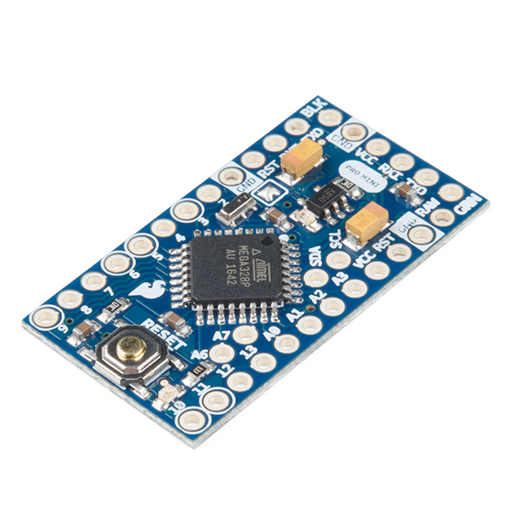
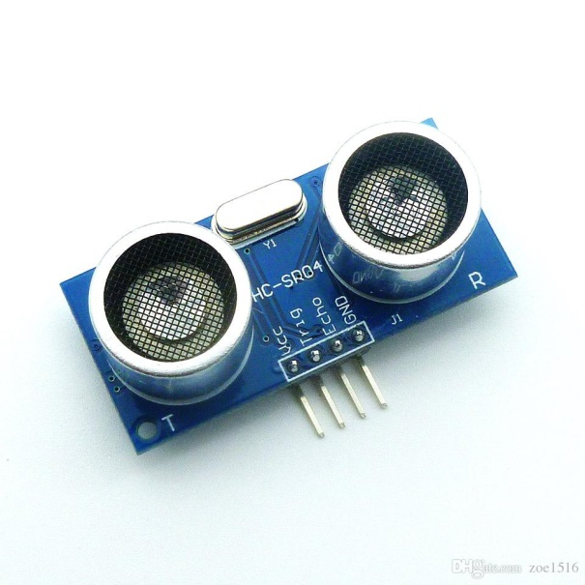
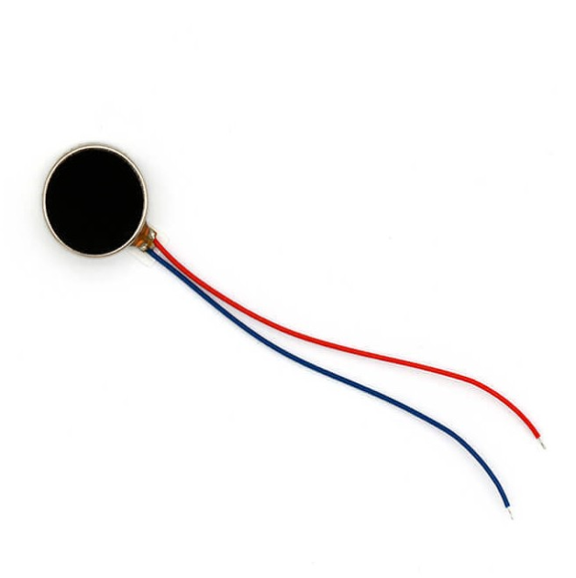
Ultrasonic Embedded system
Hardware Used
Arduino Mega - Prototyping
Arduino Pro-Mini - Embedding
HC-SR04 Ultrasonic Module
10mm Micro Vibration Motor
Notes:
(For this project, I used 4 main hardware components…)
[ x ] An Arduino mega
[ x ] An Arduino pro-mini
[ x ] An Ultrasonic module
[ x ] and a micro vibration motor
[ ]
The Arduino Mega makes prototyping…

Slide 8
Ultrasonic Embedded system
Hardware Used
Arduino Mega - Prototyping
USB port for downloading code
Large number of I/O pins
Breadboard style connections
Switchable 3.3 / 5 volt logic
Power plug or by USB
Notes:
The Mega makes prototyping…
Easy with its built-in usb connections and headers to allow jumper-wire connections to a breadboard.
[ ]
The Pro-Mini is great for embedding…

Slide 9
Ultrasonic Embedded system
Hardware Used
Arduino ProMini - Embedding
Tiny footprint
Inexpensive
Reasonable Number of I/O pins
No USB port to download code
Solder connections
Arduinos can be programmed using the Arduino IDE and C++ based language
Notes:
(The Pro-Mini is great for embedding…)
Because it is very cheap and tiny, but it is a little more difficult to work with because it requires an external adapter to program, and connections have to be soldered to it.
All the styles of Arduinos can be programmed using the Arduino IDE and its C++ based language.
[ ]
The HC-SR04 ultrasonic module is also…

Slide 10
Ultrasonic Embedded system
Hardware Used
HC-SR04 Ultrasonic Module
Inexpensive
Commonly used
Notes:
(The HC-SR04 ultrasonic module is also…)
Inexpensive and is widely use so there is a large amount of documentation available on it
[ ]
(Last, but not least is the micro vibration motor…)

Slide 11
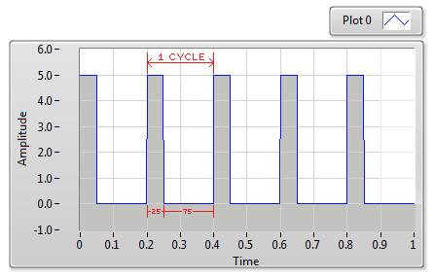
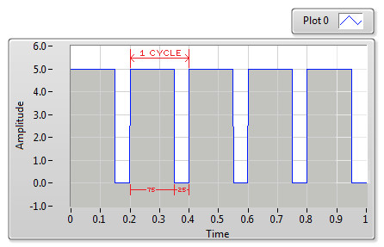
Ultrasonic Embedded system
Hardware Used
10mm Micro Vibration Motor
PWM can be used to set intensity
Inexpensive
Commonly used
1/4 Duty Cycle – spins slowly
3/4 Duty Cycle – spins quickly
Notes:
(Last, but not least is the micro vibration motor…)
Which is also inexpensive and common.
The motor is purely electro-mechanical; the amount of voltage it receives changes the rate it spins, which increases the vibration intensity.
In an electronic circuit it can be controlled without varying voltage by using Pulse Width Modulation.
As the duty cycle increases, the motor spins faster and the intensity of the vibration increases.
[ ]
Big problems can come in small packages, though…

Slide 12
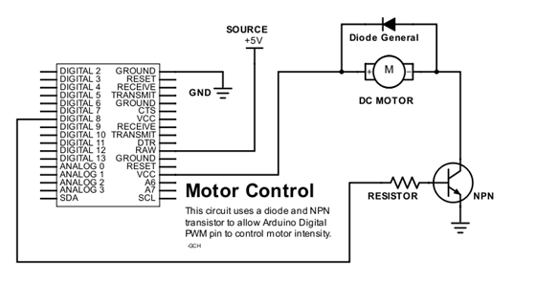
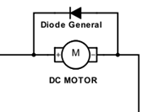
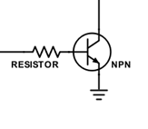
Ultrasonic Embedded system
Challenges - Motors
Current Draw
Motors / Generators
Even small motors draw large amounts of current
PWM pins are only meant to supply logic voltage
Motors become generators when current is lowered
Generated current can destroy electronics
Notes:
(Big problems can come in small packages, though…)
Because even tiny motors draw enough current to damage microcontroller pins, which are only intended to supply logic voltage. The solution to this
[ x ] is use a relay or transistor, like I did here, which acts as a switch and allows current from a power source to flow only when the signal is high.
[ x ] Another issue with motors is that when a motor is spinning and current is stopped, the momentum of the spinning turns it into a generator. When the voltage it creates has nowhere to go, it tends to build up and arc – often destroying sensitive components. This issue can be dealt with by
[ x ] using a diode, which acts as a one-way valve for electricity. If the motor begins generating electricity, the diode allows the electricity to flow back to the motor input which quickly consumes it.
My other major challenges were mostly software related.
[ ]

Slide 13
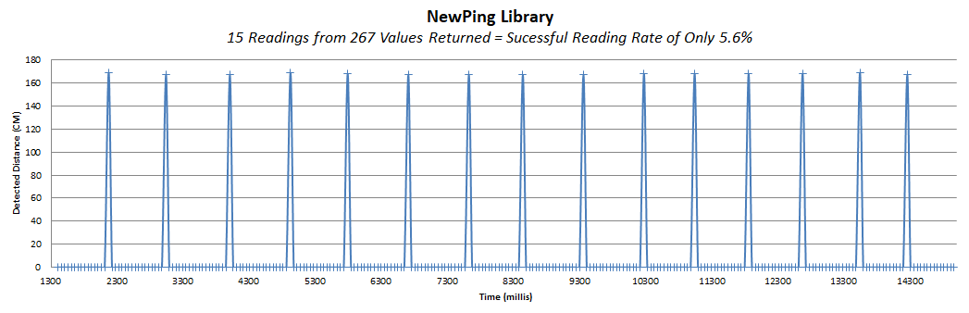
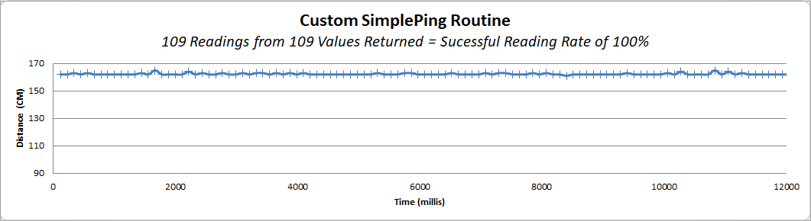
Ultrasonic Embedded system
Sensor Software Issues
NewPing() – High rate of failure reading
PulseIn() – 100% Successful reading
, but only 1 sensor
Notes:
(My other major challenges were mostly software related.)
The most widely used custom library for the ultrasonic sensor was NewPing, which I implemented into my program. When I tested my sensor, though, it performed erratically. I saved the readings to a CSV file and graphed them in a scatter plot
[ x ] which revealed a serious problem. It was successful at reading values less than 6% of the time.
Worried that my cheap sensor might be defective, I learned how to use the Arduino Pulse-In function to manually interface with the module.
[ x ] which gave good readings, but was a blocking function so I could not use it to control two sensors simultaneously.
My plan was to improve the range of the inexpensive sensors by using two of them at the same time – effectively doubling the amount of ultrasonic energy emitted. Having two receivers would also double the chances of the returning energy being sensed.
[ ]
Before this project I had no idea how ultrasonic ranging worked, so I would like to give a quick explanation:

Slide 14

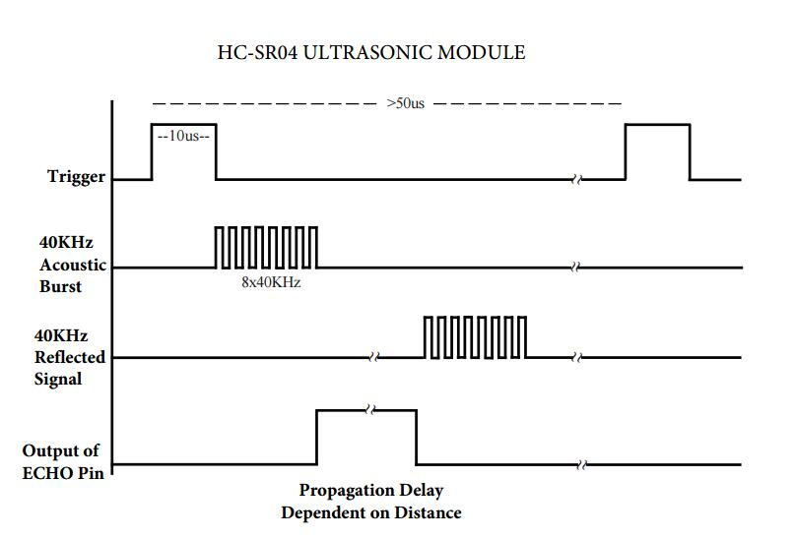
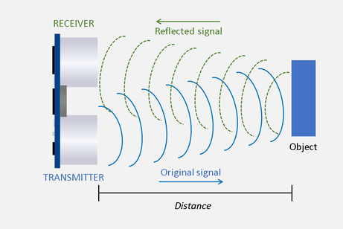
Ultrasonic Embedded system
Ultrasonic Module Communication
Notes:
(Before this project I did not know how ultrasonic ranging worked, so I would like to give a brief explanation- )
The time it takes for a sound wave to travel to an object, bounce off of it, and return to the starting position is called Time of Flight.
Because the speed of sound is effectively constant, by multiplying the Time of Flight by the speed of sound, the roundtrip distance can easily be calculated. That distance divided in half provides the one-way distance to the object.
When the ultrasonic module is signaled, it transmits a 40kHz sound wave out and immediately begins waiting to detect the soundwave coming back. If it DOES detect it, the amount of time between sending the wave and the wave being detected back is the Time of Flight.
If it does NOT detect it, it means no object is bouncing sound back, and the module times out.
[ ]
In order to trigger and read two modules at the same time…

Slide 15
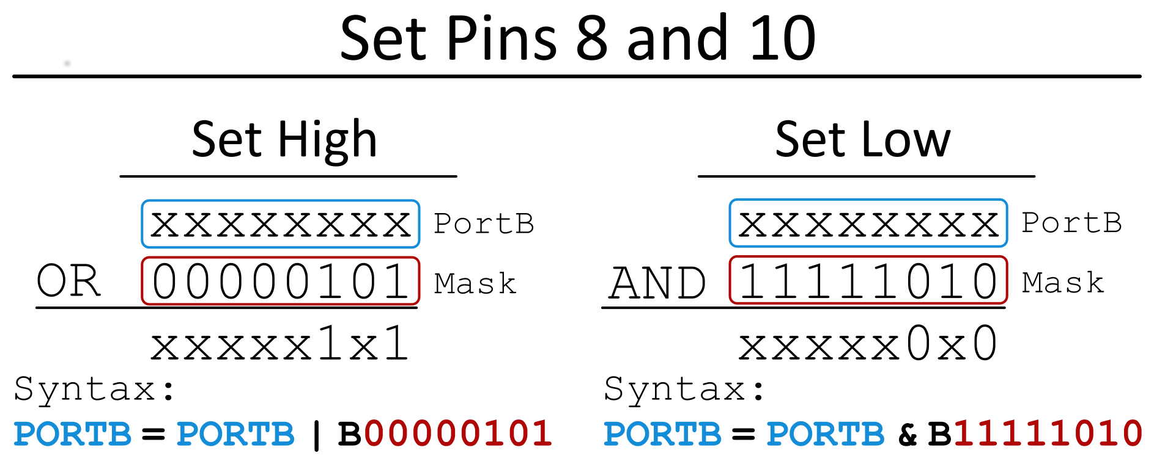
Ultrasonic Embedded system
Simultaneous Writing of Trigger Pin
Notes:
(In order to trigger and read two modules at the same time,) …I had to find pin-mappings of ports and registers used for those pins.
Based on the pins I was using, I was able to trigger the module by writing directly to the PORTB register. I could leave the other pins unaltered by using a bitmask and doing
either a bitwise OR to set them High
or a bitwise AND to set them Low.
[ ]
I used a similar technique to read…

Slide 16
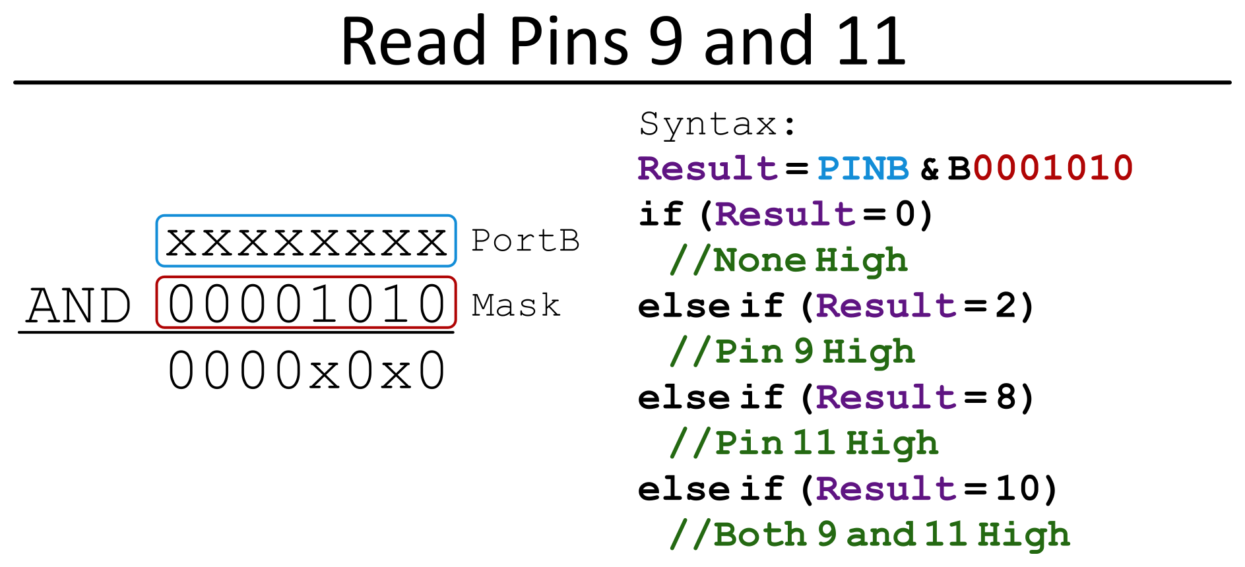
Ultrasonic Embedded system
Simultaneous Reading of Echo Pin
Notes:
(I used a similar technique to read…)
…the state of both echo pins. Depending on what the value of the PINB register is, the status of both pins can be assessed.
After I implemented these strategies, I realized that hard-coding the registers based on the particular type of Arduino I was using destroyed the portability of my code, which was one of my main goals.
I wound up compromising… [ ]

Slide 17
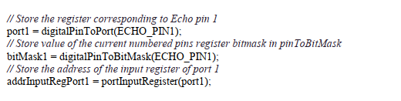
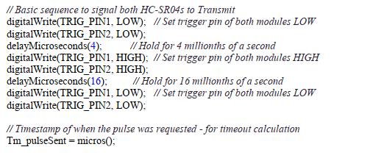
Ultrasonic Embedded system
Code Snippets
Arduino functions to lookup port and bitmask
Trigger pins sequentially written
Notes:
I wound up compromising…
…and used Arduino library functions to lookup the registers
and operate on them sequentially. Although not truly simultaneous, it only introduces an extra four millionths of a second of error per instruction and allows both the modules to operate at the same time.

Slide 18
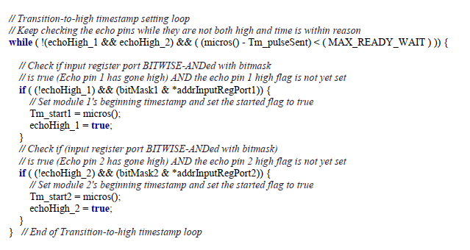
Ultrasonic Embedded system
Code Snippets
Watch for rising edge on Echo pins
Notes:
Because the distance is calculated from the difference between the Echo pin going High and returning Low, I wrote a state machine to watch for the rising edge of the Echo pins and set timestamps appropriately.
I used the same logic to watch for the falling edge and then calculated the distance and set the motor intensity.
[ ] The final outcome of my project …

Slide 19
Ultrasonic Embedded system
Possible Enhancements
Mute Button
Haptic Motor Module
Triple Axis Magnetometer
LIDAR Module
NSU Maker Club
Notes:
(The final outcome of my project …) …works reasonably well. It has trouble detecting a clear path in crowded spaces because the sound waves can bounce back from so many places, but it successfully alerted the presence of a tree in my yard about 5 feet out. I am happy with how it came out and really enjoyed learning everything needed to create it. Of course, there is room for enhancements
[x] A mute button would be good for crowded spaces where there are no wide clear swathes to detect
[x] An integrated haptic motor module would make recreation easier because soldering the extra transistor, resistor, and diode would be unnecessary.
[x] A triple axis magnetometer would be a great addition by allowing users to orient themselves to compass North whenever they wanted.
[x] A LIDAR module, although expensive, would allow for precision detection of thin objects such as chair legs, as well as sound absorptive materials like curtains.

Slide 20
Ultrasonic Embedded system
Contact Information
E-Mail:
HoldenG@NSUOK.Edu
Github:
github.com/HoldenGC/Ultrasonic-Sensory-Augmentation-Project
Notes:
Are there any questions?
Thank you for letting me share my project with you!

