Slide 1
Hotel Booking Demand Case

Slide 2
Agenda
Introduction to the problem(s).
Technical project statement.
Can we change the root cause?
What is the root cause?
Can we predict the cancellations?
How to deliver the insights?
How to ensure the insight are (and stay) correct?
Future improvements / Technical discussion
Disclaimer: Focus on the ideas not the numbers
Time estimates:
Code: 4-5 hours
Presentation: 1 hour

Slide 3




Introduction to the problem.
Goal:
Problem:
How:
OR
Notes:
Goal: Increase profits
Two ways: Capacity vs Pricing.

Slide 4
Technical project statement
Problem: Peple are cancelling, which means the hotels are rarely operating at full capacity
Solution: Predict if a booking will be cancelled, and use this information to overbook the hotel.
Metric (for backtesting):
Simple: Balanced accuracy on prediction if a booking will be canceled when it is booked.
Ideal: Optimize the profits according to below assumptions
Assumptions:
1) Its is three times as costly to relodge a customer at a competitors hotel compared to the profit that booking would generate.
2) When the hotel was operating above 85% of capacity, then the remaining 15% are lost revenue due to cancellations.

Slide 5
Can we change the root cause?
STOP! Are we even solving the correct problem?
Instead of migtigating when bookings are canceled, can we change if bookings are canceled?

Slide 6
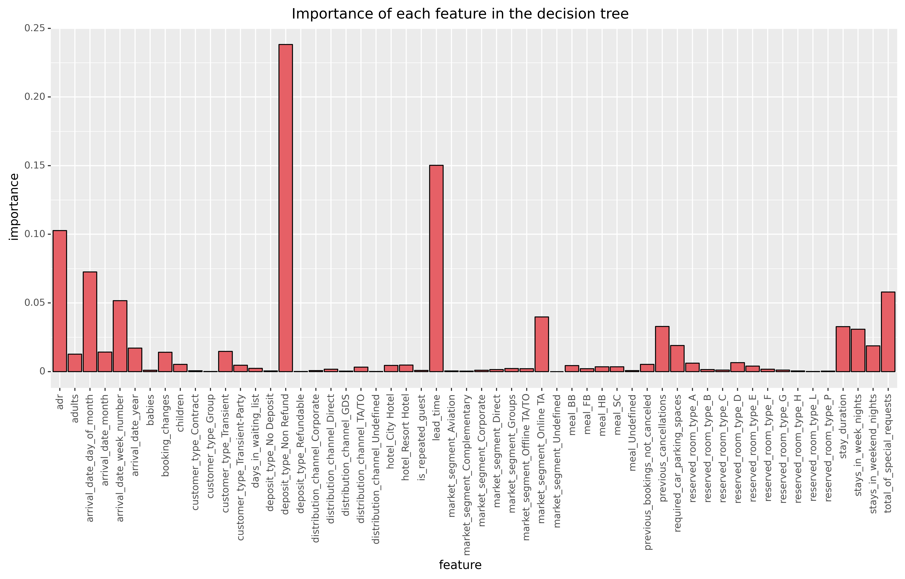
What is the root cause?

Slide 7
Can we predict the cancellations?
> 85%
Sure – but what does that mean?

Slide 8
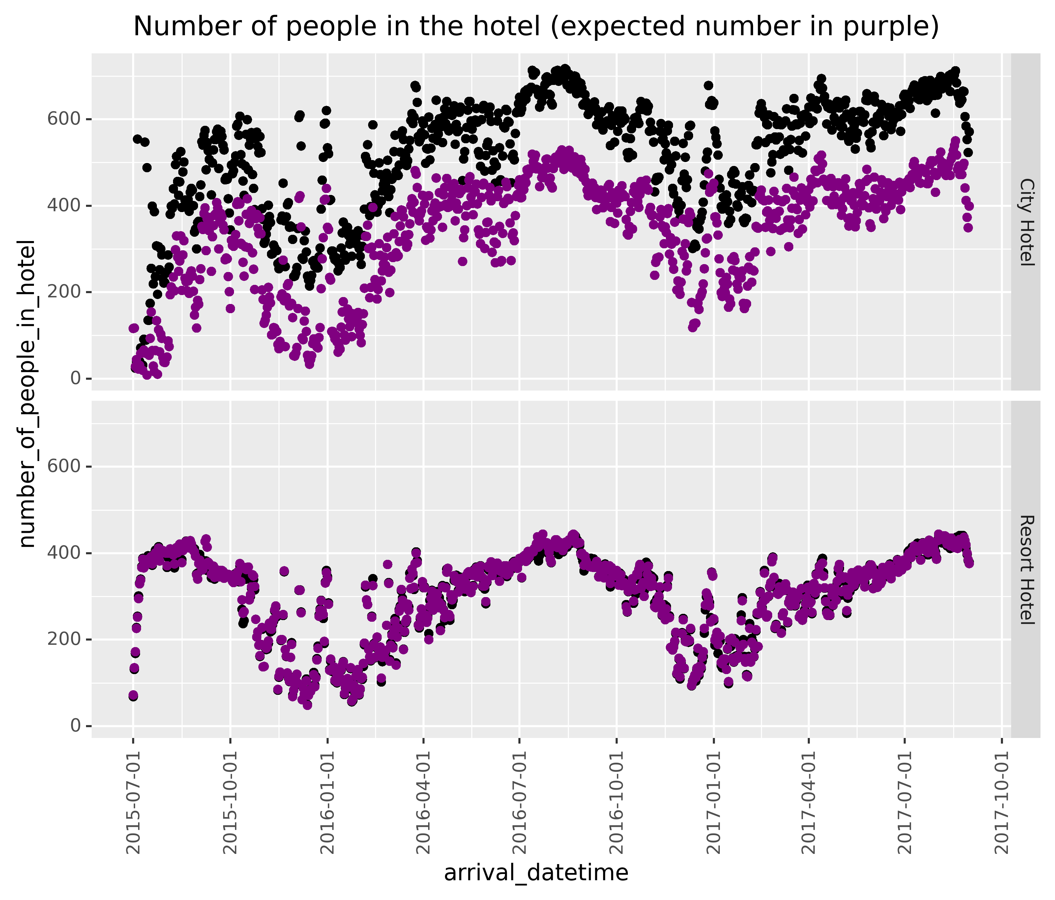
Expected capacity
* Fake numbers

Slide 9
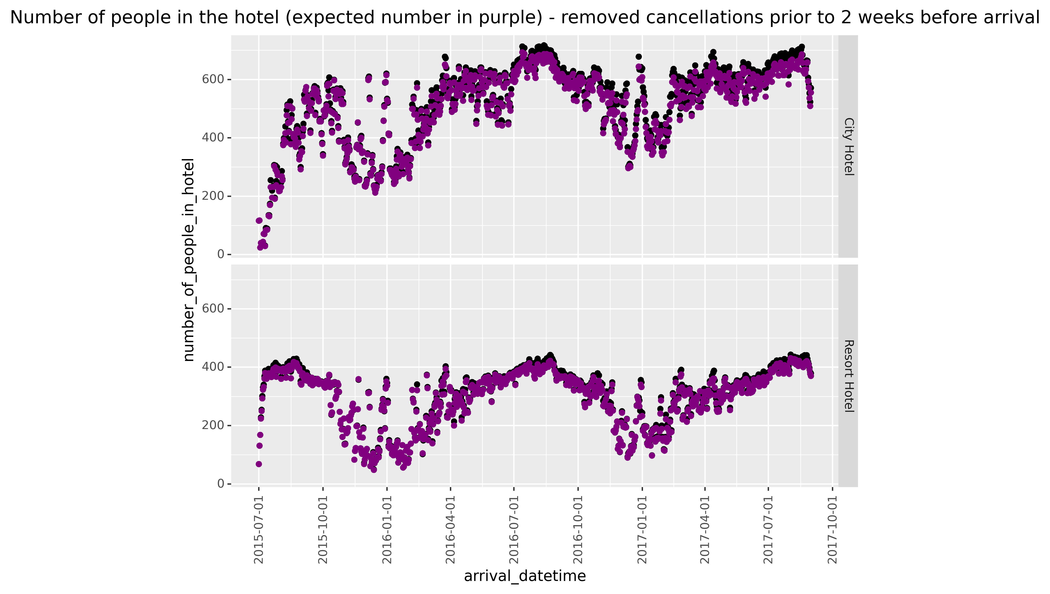
Expected capacity
* Fake numbers

Slide 10


How to deliver the insights?
Website
API
Report
Pros: Easy to access
Cons: User credentials
Pros: Can integrate directly to your system
Cons: More difficult to set up
Pros: Cheapest solution
Cons: Only updates once per day
Notes:
Notes: They are all cheap as the algorithm is simple.

Slide 11
How to ensure the insight are (and stay) correct?
Free labels!
More training data.
Adapt to new behavior with new versions of the model.
The advanced metric easy to test when implemented in the real world.
Drift detection (input & output)

Slide 12
Future improvements / technical discussion
Improve the algorithm
Implement the back-testing
1) Test expected capacity on unseen data (2017 and onwards)
2) Implement the prediction algorithm as part of a forecasting-model and evaluate performance.
Tackle pricing problem
Learn about price / demand ?
Code?

