Slide 2
Investigating Methods for Polymicrogyria Classification
A replication of Guha et al.
“Automated detection of polymicrogyria in pediatric patients using deep learning”

Slide 3
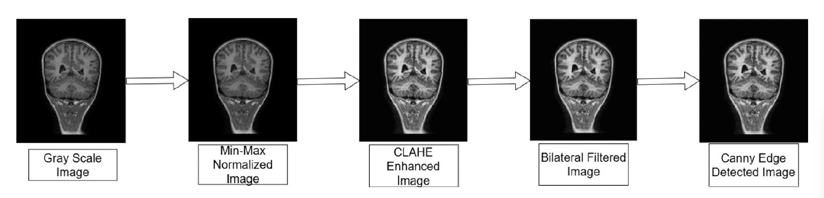
What did Guha et al. do?
Dataset: PPMR — 23 PMG patients, each with 3 matched controls → 15,056 JPEG slices
PMG slices carry radiologist labels: 1 = PMG-positive, 2 = PMG-negative, 3 = uncertain
Preprocessing pipeline
RGB → grayscale → min-max normalisation → CLAHE → bilateral filter → Canny edge detection
Models evaluated: ResNet-50, ResNet-101, VGG-16, DenseNet-201, MobileNetV2
ImageNet-pretrained; final layer replaced with binary PMG vs. HC classifier
5-fold cross-validation, 60 / 20 / 20 train / val / test split
Best result: DenseNet-201, accuracy 0.980 ± 0.037; ResNet-101 F1 = 0.97

Slide 4
Three Methodological Errors in Guha et al.
1 — Label noise
~51 % of PMG-patient slices are label=2 (no pathology) or label=3 (uncertain)
All were treated as positive examples → classifier trained on mislabelled data
2 — Resolution confound
PMG images exported from PACS at median 1508×1727 px; controls at 260–512 px
Class-correlated pixel density provides a trivial, texture-based shortcut signal
Fixed-kernel CLAHE and bilateral filter act differently across resolutions, amplifying the gap
3 — Data leakage via pre-split downsampling
10,539 control slices globally downsampled to 4,517 before the train/val/test split
Discarded slices effectively seen across splits → information leakage into evaluation

Slide 6
Replication — What We Did
Re-implemented the full Guha et al. pipeline
Two experimental conditions compared side by side:
Paper setup: all PMG-patient slices as positives; global pre-split downsampling; slice-level splits
Corrected setup: label=1 only (n = 2,255 slices); patient-level 5-fold CV; weighted cross-entropy
5-fold cross-validation at patient level — 23 PMG + 69 controls, fixed seed
Models: ResNet-101 and DenseNet-201
20 epochs
Fixed backbone
Trained head only

Slide 7
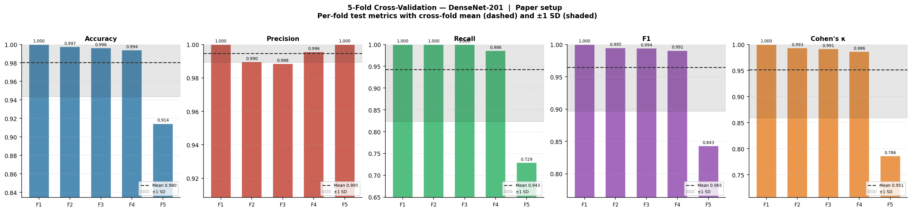
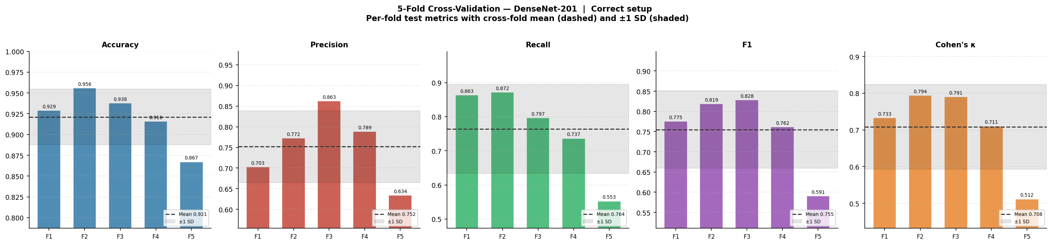
Results: Paper Setup vs. Corrected Setup
Paper setup (DenseNet-201)
Corrected setup (DenseNet-201)

Slide 10
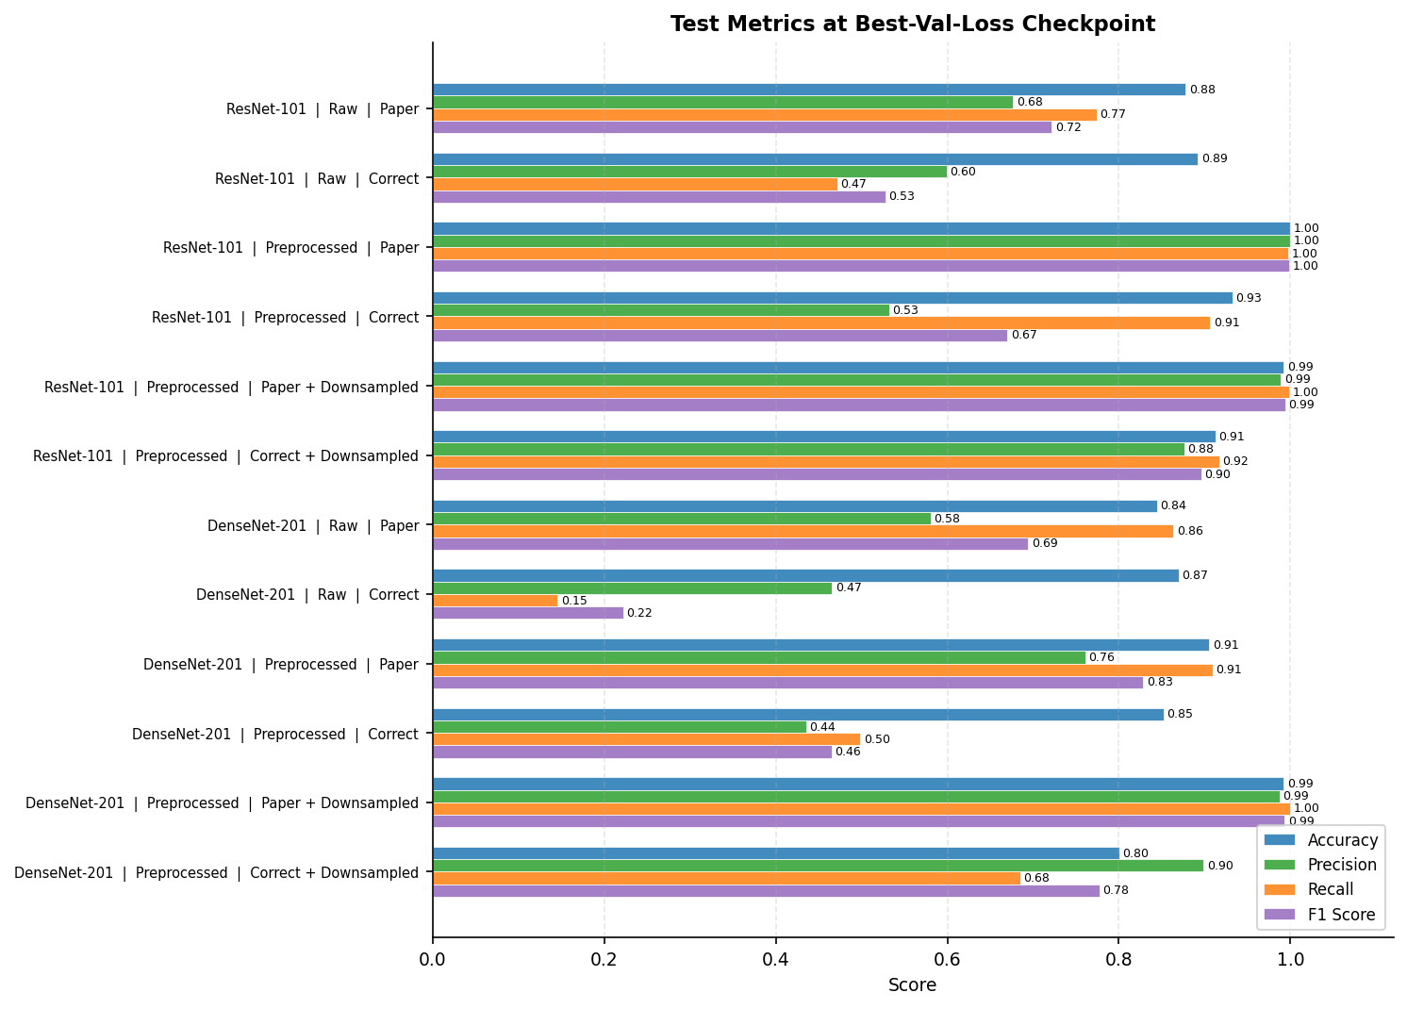
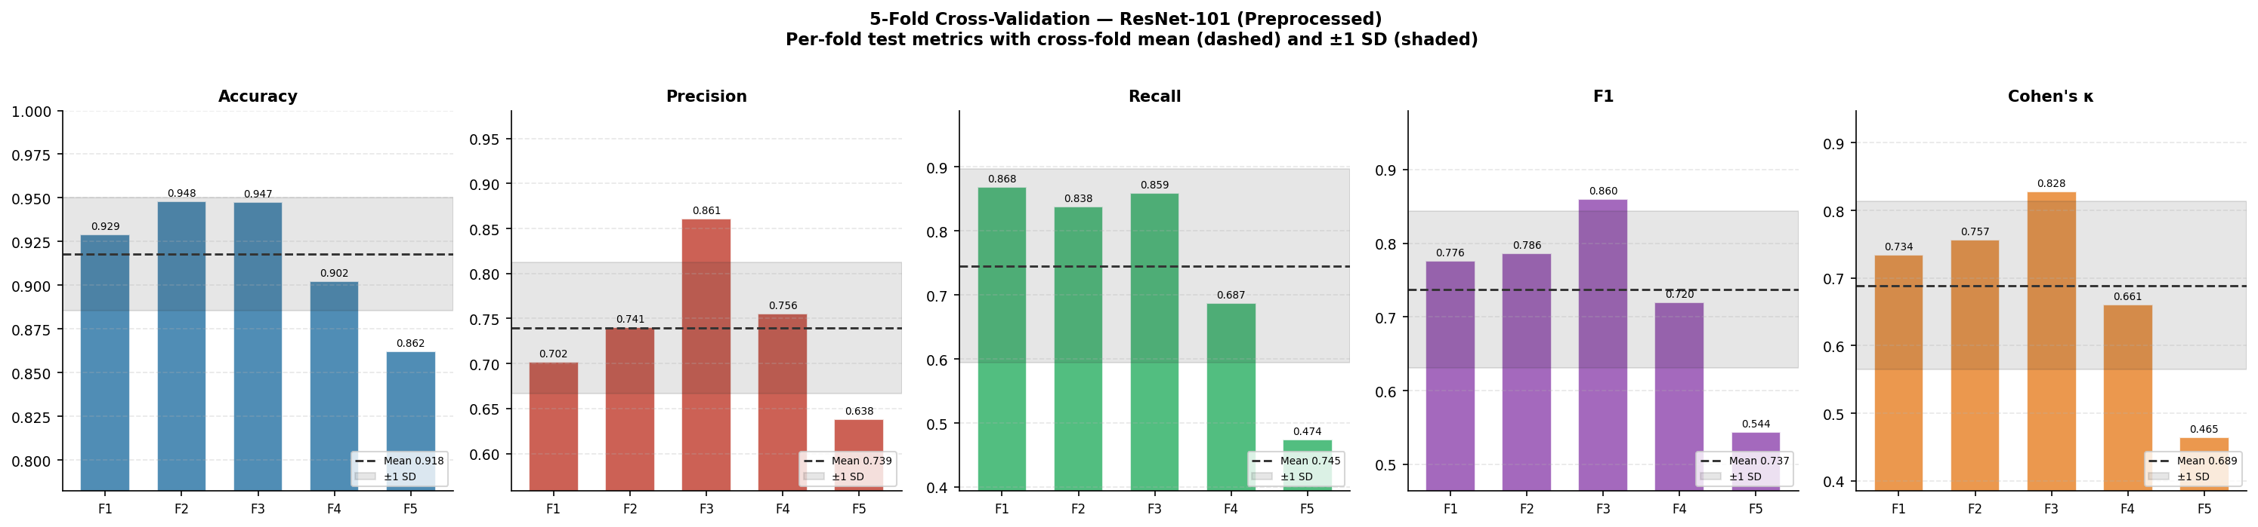

Slide 11
