Slide 1
Investigating Methods for Polymicrogyria Classification
Investigating Methods for Polymicrogyria
Classification
A replication of Guha et al.
“Automated detection of polymicrogyria in pediatric patients using deep learning”

Slide 2
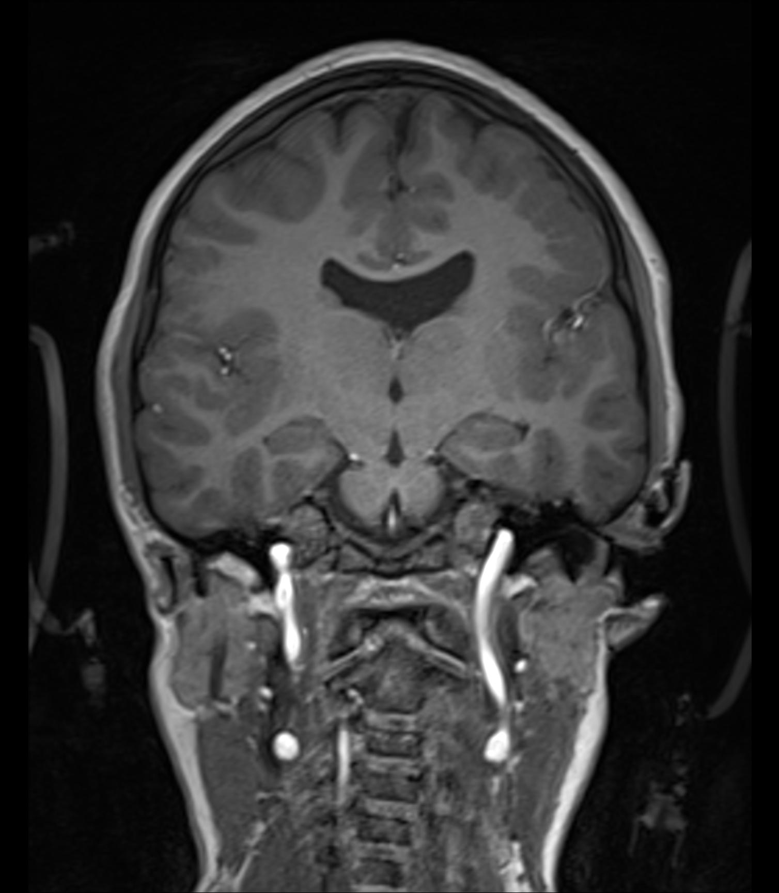
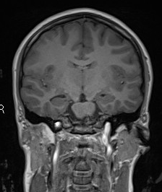
Polymicrogyria (PMG)
Malformation of the developing brain
Appears heterogenuous
High coocurence with epilepsy [1]
Diffucult to diagnose
Deep learning could reduce diagnostic burden and enable earlier identification of the condition
[1] Kolbjer S, Martín Muñoz DA, Örtqvist AK, Pettersson M, Hammarsjö A, Anderlid B-M, Dahlin M. Polymicrogyria: epidemiology, imaging, and clinical aspects in a population-based cohort. Brain Communications.
2023;5(4):fcad213. https://doi.org/10.1093/braincomms/fcad213
Notes:
Charecterised by abnormal lamination and an excessive cortical folding, and small gyri, -> resulting in irregular folding, bumpy cortical surface, stippled gray-white junction, and cortical thickening — some cases appear deceptively smooth. Can small part of the brain or whole brain.
PMG accounts for approximately 20% of all MCDs, making it one of the most common brain malformations.
PMG is frequently encountered in patients with drug-resistant epilepsy and is commonly associated with neurodevelopmental delay, motor impairments, and cognitive deficits. Unilateral PMG affects one hemisphere only; bilateral PMG involves both hemispheres, with severity ranging from mildly focal to extensive bilateral involvement.
MRI appearance
The radiological appearance is heterogeneous, features include an irregular or bumpy cortical surface, a stippled gray-white matter junction, and apparent cortical thickening. . In some cases, adjacent microgyri fuse their overlying molecular layers, producing a deceptively smooth outer surface.
MRI is the only imaging modality that provides sufficient soft-tissue contrast and spatial resolution to identify the fine cortical folds characteristic of PMG; CT is inadequate for this task. MRI appearance also changes with myelination, making diagnosis difficult in infants during the first year of life. T1-weighted sequences offer excellent differentiation between gray and white matter, enabling delineation of cortical thickness, sulcal morphology, and the gray-white matter junction architecture central to identifying MCDs such as PMG.
diagnosis is difficult
variability among specialist neuroradiologist, underscoring both the difficulty of the diagnostic task and the potential value of automated detection methods. The heterogeneous radiological appearance and the limited availability of curated neuroimaging datasets further complicate reliable diagnosis.
Why ML/DL
Automated detection of PMG from MRI could inform clinical decision-making by reducing the diagnostic burden on specialist neuroradiologists and enabling earlier identification of the condition. Deep learning has transformed medical image analysis, achieving performance comparable to clinical experts across tasks including diabetic retinopathy grading and skin lesion classification. In neuroimaging, CNNs have been applied to the automated detection of structural brain abnormalities from MRI, with the promise of supporting radiologists in high-volume screening and reducing diagnostic delays.

Slide 3
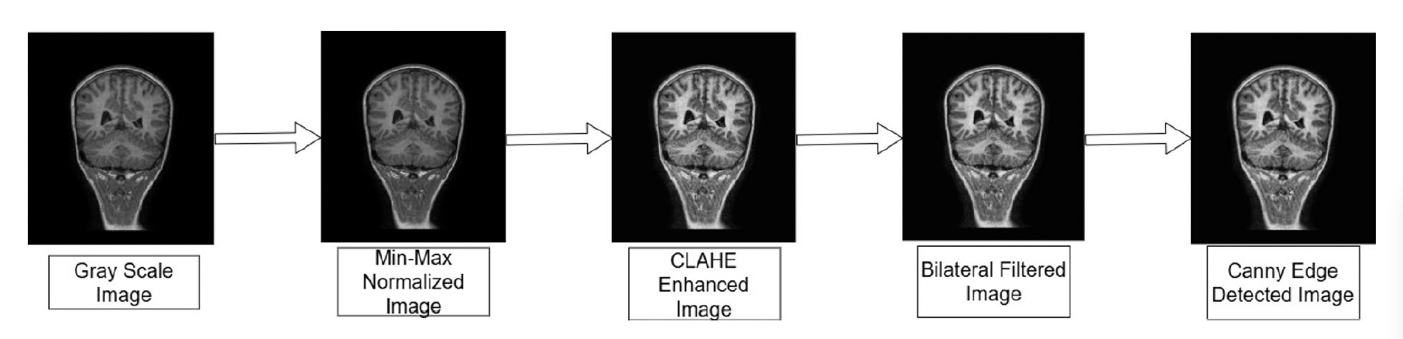
What did Guha et al. do?
[2] PPMR dataset
Zhang, L., Abdeen, N., & Lang, J. (2024). A novel center-based deep contrastive metric learning method for the detection of polymicrogyria in pediatric brain MRI. Computerized Medical Imaging and Graphics, 114, 102373.
[3] Guha et al.
Guha, S., Bhandage, V., & Agarwal, A. (2025).
Automated detection of polymicrogyria in pediatric patients using deep learning. Scientific Reports, 15(1), 41662.
PPMR dataset [2]
23 PMG patients (n = 4517)
69 controls (n = 10539)
PMG cohort slice-level labels
1 = PMG-positive
2 = PMG-negative
3 = Uncertain
Guha et al. Labels [3]
Treat all PMG slices as Label = 1
5 step preprocessing pipeline
Evaluate model
Classification head
Resized to 224x224
ResNet-50
ResNet-101
VGG-16
DenseNet-201
MobileNetV2
Results\Metrics | Accuracy | Precision | Recall
Best result after preprocessing: DenseNet-201 | 0.982 ± 0.034 | 0.995 ± 0.005 | 0.947 ± 0.110
Highest preprocessing impact: ResNet-101 | 0.850 → 0.980 | 0.849 → 0.991 | 0.621 → 0.945
Notes:
Precision:
$$\text{Precision} = \frac{TP}{TP + FP}$$
Recall:
$$\text{Recall} = \frac{TP}{TP + FN}$$
Precision — "of everything I predicted positive, how many were actually positive?" Penalises false positives.
▎ High precision = few false alarms.
Recall — "of everything that was actually positive, how many did I catch?" Penalises false negatives.
▎ High recall = few missed cases.
Guha et al. (2025) experimental setup:
- Preprocessing: min-max normalisation -> CLAHE (clip=2.0, tile 8x8) -> bilateral filter (d=9, sigma=75) -> Canny (low=50, high=200, aperture=3), blended at alpha=0.20
- After preprocessing model input is -> Input: 224x224x3 (RGB), images rescaled to [0,1]
Architectures tested: ResNet-50, ResNet-101, VGG-16, MobileNetV2, DenseNet-201
Models pretrained on ImageNet
5 fold cross validation 60/20/20
All backbones pre-trained on ImageNet; backbone frozen during training
- Classification head: global average pooling -> dense layer (256 units, ReLU, L2=0.001) -> dropout (rate=0.5) -> raw logits
- Optimizer: Adam, learning rate = 0.0005, weight decay = 0.001
- Batch size: 32, up to 10 epochs, early stopping used
Loss: binary cross-entropy
Guha et al. best model results (DenseNet-201 on pre-processed images, test set):
- Accuracy: 0.9967
- Precision: 0.9933
- Recall: 1.000
- F1 score: 0.993
- Cohen's kappa: 0.993
Other architectures on pre-processed images (test set):
- ResNet-50: Acc=0.8489, Prec=0.8689, Recall=0.8173, F1=0.839, kappa=0.673
- VGG-16: Acc=0.9513, Prec=0.9447, Recall=0.9574, F1=0.949, kappa=0.897
- MobileNetV2: Acc=0.9889, Prec=0.9921, Recall=0.9857, F1=0.991, kappa=0.983
On original (non-preprocessed) images, DenseNet-201 achieved Acc=0.9960, Prec=0.993, Recall=0.998 (test set). The preprocessing pipeline yielded modest or negligible improvement for DenseNet-201 but larger gains for ResNet architectures (ResNet-101: +10.3% accuracy).
Context from the original paper
The paper claims near-perfect results demonstrate the value of the preprocessing pipeline. However, the large gap between DenseNet-201 (~99.6%) and ResNet-50 (~75%) on raw images is itself suspicious — consistent with the shortcut learning hypothesis where DenseNet's dense connectivity may better exploit global texture statistics. The near-perfect performance persisting even on raw (non-preprocessed) images for DenseNet-201 supports the view that the classifier is learning the resolution artefact, not cortical morphology.
add clahe name. add increse of dense from raw to preprocessed and the same for resnet.

Slide 4
Three Methodological Errors in Guha et al.
1 — Resolution confound
2 — Mislabeling
3 — Downsampling pre-splits
Notes:
1. Resolution confound - PMG cases are exported from PACS system at median 1508 x 1727 pixel –> when downscaled to 224x224 pixel compressed by 6-7x
-> lead to smooth texture + low-variance globally
Control cases exported at median 512 x 512 pixel – only compressed by 1.1-2.3x -> lead to more coarse/less smooth texture + high-variance globally.
Preprocessing pipeline make this worse because of clahe’s fixed kernel 8x8 and bilateral filter with pixel diamenter of 9. Applied to two widely difference spatial scales. -> lead to task become as smoothness and variance meter.
If smooth + low-variance = PMG
If coarse/less smooth + higher-variance = control
2. ~51 % of PMG-patient slices are label=2 (no pathology) or label=3 (uncertain)
All were treated as positive examples → classifier trained on mislabelled data
Makes resolution confound worse, all pmg samples are high res + some have no pathology -> relying low-level statistical differences = spatial resolution and texture (smoothing and high or low-variance)
3. Downsampling pre-split, as final measure to get accuracy and the metrics higher Guha et al. Downsampled the control cohort to match the PMG cohort.
Leading to a balanced dataset -> now train/val/test split are class balanced -> randomly removed data, could remove patients and sampling of non-essential slices, background, skull and cerebullum -> leading to patient under representation and under representation of essential slices.

Slide 5
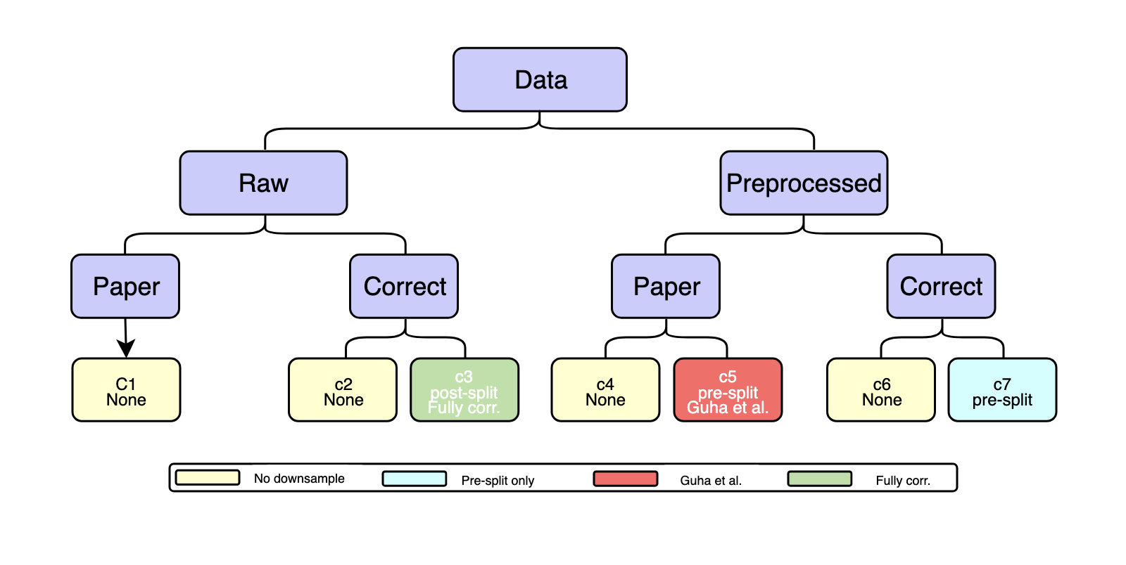
Replication — What We Did
Replicated Guha et al. Preprocessing pipeline
Experimental setup
7 conditions
5-fold cross validation
Model:
Resnet-101
DenseNet-201
Training
20 epochs
Fixed backbone
Notes:
This replication's corrected conditions (patient-level 5-fold CV, label=1 only, no pre-split downsampling) test whether near-perfect performance persists when the three methodological errors are corrected.
Classification head: global average pooling -> dense layer (256 units, ReLU, L2=0.001) -> dropout (rate=0.5) -> single sigmoid output
For label definition: 1. The corrected approach: restrict the positive class to label=1 slices only (n=2,255). Label=2 slices should be reclassified as negatives and pooled with healthy controls (10,539 + 1,386 = 11,925 negatives total). Label=3 (uncertain) slices are excluded entirely.
2. Dont preprocess and move the PMG-negatives to HC, so resolution play a smaller factor.
3. Correct approach: Perform all train/val/test splitting first (at the patient level), then apply class balancing only to the training fold. Validation and test sets retain the natural distribution. This replication uses patient-level 5-fold cross-validation with all slices retained, and applies weighted cross-entropy loss during training rather than undersampling controls.
Re-implemented the full Guha et al. Pipeline, with 7 experimental conditions
Paper setup: all 4,517 PMG-patient slices as PMG positive class; 10,539 controls
Corrected setup: 2,256 label=1 as PMG positive class; 1,386 reclassified as negative -> 11,925 controls
Option to downsampled pre-splits or post-splits, and to run training on raw data
5-fold cross-validation at patient level
Models: ResNet-101 and DenseNet-201
20 epochs
Fixed backbone
Trained head only

Slide 6
Setup\Metrics | Accuracy | Precision | Recall
ResNet-101 | Paper + Raw | 0.850 ± 0.042 | 0.849 ± 0.054 | 0.621 ± 0.131
ResNet-101 | Correct + Raw | 0.839 ± 0.020 | 0.515 ± 0.100 | 0.206 ± 0.097
ResNet-101 | Paper + Preproc | 0.980 ± 0.032 | 0.991 ± 0.006 | 0.945 ± 0.103
ResNet-101 | Correct + Preproc | 0.917 ± 0.034 | 0.755 ± 0.096 | 0.711 ± 0.143
ResNet-101 | Paper + Pre-split + Preproc (Guha et al.) | 0.972 ± 0.050 | 0.994 ± 0.006 | 0.952 ± 0.098
ResNet-101 | Correct + Pre-split + Preproc | 0.881 ± 0.078 | 0.915 ± 0.038 | 0.835 ± 0.149
ResNet-101 | Correct setup + Post-split +Raw | 0.806 ± 0.041 | 0.424 ± 0.049 | 0.520 ± 0.170
Setup\Metrics | Accuracy | Precision | Recall
ResNet-101 | Paper + Raw | 0.850 ± 0.042 | 0.849 ± 0.054 | 0.621 ± 0.131
ResNet-101 | Correct + Raw | 0.839 ± 0.020 | 0.515 ± 0.100 | 0.206 ± 0.097
ResNet-101 | Paper + Preproc | 0.980 ± 0.032 | 0.991 ± 0.006 | 0.945 ± 0.103
ResNet-101 | Correct + Preproc | 0.917 ± 0.034 | 0.755 ± 0.096 | 0.711 ± 0.143
ResNet-101 | Paper + Pre-split + Preproc (Guha et al.) | 0.972 ± 0.050 | 0.994 ± 0.006 | 0.952 ± 0.098
ResNet-101 | Correct + Pre-split + Preproc | 0.881 ± 0.078 | 0.915 ± 0.038 | 0.835 ± 0.149
ResNet-101 | Correct setup + Post-split + Raw | 0.806 ± 0.041 | 0.424 ± 0.049 | 0.520 ± 0.170

Slide 7
Setup\Metrics | Accuracy | Precision | Recall
DenseNet-201 | Paper + Raw | 0.843 ± 0.056 | 0.874 ± 0.044 | 0.567 ± 0.209
DenseNet-201| Correct + Raw | 0.850 ± 0.033 | 0.590 ± 0.204 | 0.260 ± 0.129
DenseNet-201| Paper + Preproc | 0.982 ± 0.034 | 0.995 ± 0.005 | 0.947 ± 0.110
DenseNet-201 | Correct setup + Preproc | 0.919 ± 0.033 | 0.765 ± 0.080 | 0.720 ± 0.118
DenseNet-201 | Paper setup + Pre-split Preproc (Guha et al.) | 0.957 ± 0.058 | 0.974 ± 0.050 | 0.947 ± 0.112
DenseNet-201 | Correct + Pre-split + Preproc | 0.899 ± 0.085 | 0.922 ± 0.020 | 0.867 ± 0.166
DenseNet-201 | Correct setup + Post-split + Raw | 0.832 ± 0.034 | 0.450 ± 0.169 | 0.408 ± 0.191
Setup\Metrics | Accuracy | Precision | Recall
DenseNet-201 | Paper + Raw | 0.843 ± 0.056 | 0.874 ± 0.044 | 0.567 ± 0.209
DenseNet-201| Correct + Raw | 0.850 ± 0.033 | 0.590 ± 0.204 | 0.260 ± 0.129
DenseNet-201| Paper + Preproc | 0.982 ± 0.034 | 0.995 ± 0.005 | 0.947 ± 0.110
DenseNet-201 | Correct setup + Preproc | 0.919 ± 0.033 | 0.765 ± 0.080 | 0.720 ± 0.118
DenseNet-201 | Paper setup + Pre-split Preproc (Guha et al.) | 0.957 ± 0.058 | 0.974 ± 0.050 | 0.947 ± 0.112
DenseNet-201 | Correct + Pre-split + Preproc | 0.899 ± 0.085 | 0.922 ± 0.020 | 0.867 ± 0.166
DenseNet-201 | Correct setup + Post-split + Raw | 0.832 ± 0.034 | 0.450 ± 0.169 | 0.408 ± 0.191

Slide 8
Ablation study
Test model performance on occluded data
Performance drop → model learn pathology features
Negligible performance drop or no drop → shortcut learning
Condition | Accuracy | Precision | Recall
DenseNet-201 | Raw Corrected | Post-split | 0.686 ± 0.269 | 0.755 ± 0.041 | 0.686 ± 0.269
DenseNet-201 | Preprocessed Paper | Pre-split | 0.797 ± 0.093 | 0.833 ± 0.025 | 0.797 ± 0.093
ResNet-101 | Raw Corrected | Post-split | 0.868 ± 0.006 | 0.826 ± 0.017 | 0.868 ± 0.006
ResNet-101 | Preprocessed Paper | Pre-split | 0.878 ± 0.007 | 0.881 ± 0.020 | 0.878 ± 0.007
Notes:
The ablation study probes whether trained models rely on spatially localised image features (i.e., actual cortical morphology visible in a specific cortical region) or on global low-level statistics distributed uniformly across the image (i.e., the resolution/texture artefact). This distinction is critical: a model exploiting the resolution artefact would show high performance on any patch of the image, including patches over skull, ventricles, or background regions with no cortical pathology.
For each test image, a random square patch with a side length equal to 20% of the shorter image dimension is zeroed out prior to inference. The occluded test set is constructed once per split and then passed through every available model checkpoint. Classification metrics (accuracy, precision, recall, F1, Cohen's kappa) are computed on the occluded images and compared to the corresponding unoccluded test performance.
- A substantial drop in performance under occlusion is consistent with the model attending to specific spatial regions, suggesting it has learned spatially localised features (potentially cortical morphology).
- A negligible drop in performance suggests reliance on global texture or low-level statistics distributed across the image, further supporting the shortcut learning hypothesis. If the resolution-driven texture signal is present everywhere in the image, occluding 20% of the area leaves 80% of the shortcut signal intact, so performance should barely change.
The systematic resolution difference (PMG at ~1,508x1,727 px compressed 6x vs HC at ~512x512 px compressed 1.1-2.3x) creates a smooth vs coarse texture signal that is present in every patch of every image. If the occlusion ablation shows negligible performance drop, this would empirically confirm that the classifier is exploiting this global texture rather than localised cortical features — providing direct evidence of shortcut learning rather than genuine PMG detection.

Slide 9
Conclusion
Methodological errors inflate Guha et al.’s model performance on test
→ Resolution confound
→ Preprocessing
→ Mislabelling
→ Pre-split downsampling
→ biased evaluation sets
Correcting methological errors → significant performance drop
Model classifies by global texture, not cortical morphology
Preprocessing enhances artifact — not signal
Mislabeling enhances spatial difference between cohorts
High accuracy does not mean model generalises well
PMG classification using DL from MRI remains an open problem
Notes:
performance, but the mechanism is artifactual
Fixed kernel size applied to systematically different spatial scale amplified the resolution differnence between PMG and control cohorts. Making the texture, rather than cortical morphology, the primary discriminative signal.
When methodological errors are corrected, performance drops substantially, consistant with a model relied on shortcut rather than genuinely learned features of the pathology.
The ablation study supports this.

Slide 11
ResNet-101 | Paper setup
Fold | Accuracy | Precision | Recall | F1 | Cohen's κ
Fold 1 | 0.880 | 0.829 | 0.744 | 0.784 | 0.701
Fold 2 | 0.893 | 0.859 | 0.681 | 0.760 | 0.692
Fold 3 | 0.865 | 0.862 | 0.690 | 0.767 | 0.674
Fold 4 | 0.807 | 0.774 | 0.576 | 0.661 | 0.530
Fold 5 | 0.804 | 0.921 | 0.414 | 0.571 | 0.466
Mean ± Std | 0.850 ± 0.042 | 0.849 ± 0.054 | 0.621 ± 0.131 | 0.708 ± 0.091 | 0.613 ± 0.107

Slide 12
ResNet-101 | Correct setup
Fold | Accuracy | Precision | Recall | F1 | Cohen's κ
Fold 1 | 0.850 | 0.451 | 0.276 | 0.342 | 0.263
Fold 2 | 0.867 | 0.389 | 0.291 | 0.333 | 0.261
Fold 3 | 0.818 | 0.638 | 0.072 | 0.130 | 0.095
Fold 4 | 0.831 | 0.583 | 0.259 | 0.359 | 0.278
Fold 5 | 0.828 | 0.512 | 0.134 | 0.213 | 0.151
Mean ± Std | 0.839 ± 0.020 | 0.515 ± 0.100 | 0.206 ± 0.097 | 0.275 ± 0.100 | 0.210 ± 0.082

Slide 13
ResNet-101 | Paper setup + Preproc
Fold | Accuracy | Precision | Recall | F1 | Cohen's κ
Fold 1 | 0.997 | 1.000 | 0.989 | 0.994 | 0.992
Fold 2 | 0.997 | 0.991 | 0.999 | 0.995 | 0.993
Fold 3 | 0.996 | 0.986 | 1.000 | 0.993 | 0.990
Fold 4 | 0.987 | 0.984 | 0.977 | 0.981 | 0.971
Fold 5 | 0.923 | 0.994 | 0.761 | 0.862 | 0.810
Mean ± Std | 0.980 ± 0.032 | 0.991 ± 0.006 | 0.945 ± 0.103 | 0.965 ± 0.058 | 0.951 ± 0.079

Slide 14
ResNet-101 | Correct setup + Preproc
Fold | Accuracy | Precision | Recall | F1 | Cohen's κ
Fold 1 | 0.921 | 0.725 | 0.713 | 0.719 | 0.673
Fold 2 | 0.946 | 0.716 | 0.872 | 0.786 | 0.756
Fold 3 | 0.946 | 0.886 | 0.818 | 0.851 | 0.818
Fold 4 | 0.907 | 0.812 | 0.642 | 0.717 | 0.663
Fold 5 | 0.865 | 0.636 | 0.512 | 0.568 | 0.488
Mean ± Std | 0.917 ± 0.034 | 0.755 ± 0.096 | 0.711 ± 0.143 | 0.728 ± 0.105 | 0.679 ± 0.124

Slide 15
ResNet-101 | Paper setup + Pre-split Preproc(Guha et al.)
Fold | Accuracy | Precision | Recall | F1 | Cohen's κ
Fold 1 | 0.996 | 1.000 | 0.992 | 0.996 | 0.992
Fold 2 | 0.993 | 0.984 | 0.999 | 0.992 | 0.985
Fold 3 | 0.996 | 0.993 | 1.000 | 0.996 | 0.992
Fold 4 | 0.994 | 0.996 | 0.993 | 0.994 | 0.988
Fold 5 | 0.882 | 0.997 | 0.777 | 0.873 | 0.766
Mean ± Std | 0.972 ± 0.050 | 0.994 ± 0.006 | 0.952 ± 0.098 | 0.970 ± 0.054 | 0.945 ± 0.100

Slide 16
ResNet-101 | Correct setup + Pre-split Preproc
Fold | Accuracy | Precision | Recall | F1 | Cohen's κ
Fold 1 | 0.898 | 0.943 | 0.834 | 0.885 | 0.794
Fold 2 | 0.921 | 0.877 | 0.939 | 0.907 | 0.839
Fold 3 | 0.950 | 0.950 | 0.961 | 0.955 | 0.898
Fold 4 | 0.885 | 0.933 | 0.854 | 0.892 | 0.771
Fold 5 | 0.748 | 0.870 | 0.587 | 0.701 | 0.497
Mean ± Std | 0.881 ± 0.078 | 0.915 ± 0.038 | 0.835 ± 0.149 | 0.868 ± 0.097 | 0.760 ± 0.155

Slide 17
ResNet-101 | Correct setup + Post-split + Preproc
Fold | Accuracy | Precision | Recall | F1 | Cohen's κ
Fold 1 | 0.401 | 0.640 | 0.493 | 0.387 | 0.387
Fold 2 | 0.850 | 0.408 | 0.694 | 0.514 | 0.433
Fold 3 | 0.740 | 0.365 | 0.518 | 0.428 | 0.266
Fold 4 | 0.800 | 0.457 | 0.490 | 0.473 | 0.350
Fold 5 | 0.825 | 0.490 | 0.256 | 0.336 | 0.247
Mean ± Std | 0.806 ± 0.041 | 0.424 ± 0.049 | 0.520 ± 0.170 | 0.449 ± 0.071 | 0.336 ± 0.079

Slide 18
DenseNet-201 | Paper setup
Fold | Accuracy | Precision | Recall | F1 | Cohen's κ
Fold 1 | 0.889 | 0.843 | 0.763 | 0.801 | 0.724
Fold 2 | 0.868 | 0.941 | 0.501 | 0.654 | 0.582
Fold 3 | 0.853 | 0.828 | 0.683 | 0.749 | 0.646
Fold 4 | 0.861 | 0.887 | 0.656 | 0.754 | 0.660
Fold 5 | 0.747 | 0.872 | 0.234 | 0.369 | 0.271
Mean ± Std | 0.843 ± 0.056 | 0.874 ± 0.044 | 0.567 ± 0.209 | 0.665 ± 0.174 | 0.577 ± 0.178

Slide 19
DenseNet-201 | Correct setup
Fold | Accuracy | Precision | Recall | F1 | Cohen's κ
Fold 1 | 0.849 | 0.454 | 0.335 | 0.385 | 0.301
Fold 2 | 0.902 | 0.859 | 0.168 | 0.281 | 0.253
Fold 3 | 0.834 | 0.599 | 0.361 | 0.451 | 0.360
Fold 4 | 0.854 | 0.698 | 0.356 | 0.471 | 0.397
Fold 5 | 0.814 | 0.339 | 0.079 | 0.129 | 0.067
Mean ± Std | 0.850 ± 0.033 | 0.590 ± 0.204 | 0.260 ± 0.129 | 0.343 ± 0.141 | 0.276 ± 0.129

Slide 20
DenseNet-201 | Paper setup + Preproc
Fold | Accuracy | Precision | Recall | F1 | Cohen's κ
Fold 1 | 0.999 | 1.000 | 0.998 | 0.999 | 0.999
Fold 2 | 0.998 | 0.992 | 1.000 | 0.996 | 0.995
Fold 3 | 0.996 | 0.988 | 1.000 | 0.994 | 0.991
Fold 4 | 0.993 | 0.992 | 0.986 | 0.989 | 0.984
Fold 5 | 0.921 | 1.000 | 0.751 | 0.858 | 0.805
Mean ± Std | 0.982 ± 0.034 | 0.995 ± 0.005 | 0.947 ± 0.110 | 0.967 ± 0.061 | 0.955 ± 0.084

Slide 21
DenseNet-201 | Correct setup + Preproc
Fold | Accuracy | Precision | Recall | F1 | Cohen's κ
Fold 1 | 0.925 | 0.726 | 0.754 | 0.740 | 0.696
Fold 2 | 0.959 | 0.807 | 0.844 | 0.825 | 0.802
Fold 3 | 0.933 | 0.833 | 0.809 | 0.821 | 0.780
Fold 4 | 0.905 | 0.816 | 0.619 | 0.704 | 0.649
Fold 5 | 0.871 | 0.642 | 0.573 | 0.606 | 0.529
Mean ± Std | 0.919 ± 0.033 | 0.765 ± 0.080 | 0.720 ± 0.118 | 0.739 ± 0.091 | 0.691 ± 0.110

Slide 22
DenseNet-201 | Paper setup + Pre-split Preproc(Guha et al.)
Fold | Accuracy | Precision | Recall | F1 | Cohen's κ
Fold 1 | 0.997 | 0.997 | 0.998 | 0.997 | 0.995
Fold 2 | 0.999 | 0.997 | 1.000 | 0.999 | 0.998
Fold 3 | 0.931 | 0.884 | 1.000 | 0.939 | 0.861
Fold 4 | 0.991 | 0.993 | 0.990 | 0.992 | 0.983
Fold 5 | 0.867 | 1.000 | 0.746 | 0.855 | 0.736
Mean ± Std | 0.957 ± 0.058 | 0.974 ± 0.050 | 0.947 ± 0.112 | 0.956 ± 0.062 | 0.915 ± 0.115

Slide 23
DenseNet-201 | Correct setup + Pre-split Preproc
Fold | Accuracy | Precision | Recall | F1 | Cohen's κ
Fold 1 | 0.938 | 0.911 | 0.961 | 0.936 | 0.876
Fold 2 | 0.933 | 0.928 | 0.905 | 0.916 | 0.860
Fold 3 | 0.967 | 0.946 | 0.998 | 0.971 | 0.933
Fold 4 | 0.904 | 0.933 | 0.889 | 0.910 | 0.806
Fold 5 | 0.753 | 0.893 | 0.579 | 0.703 | 0.507
Mean ± Std | 0.899 ± 0.085 | 0.922 ± 0.020 | 0.867 ± 0.166 | 0.887 ± 0.106 | 0.797 ± 0.168

