Slide 1
Investigating Methods for Polymicrogyria Classification
Investigating Methods for Polymicrogyria
Classification
A replication of Guha et al.
“Automated detection of polymicrogyria in pediatric patients using deep learning”

Slide 2
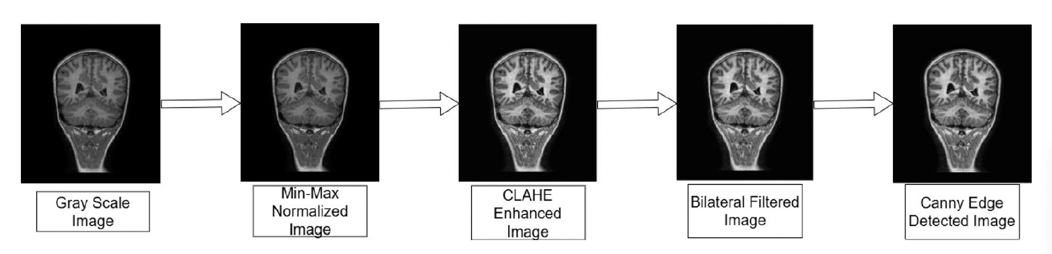
What did Guha et al. do?
Dataset: PPMR — 23 PMG patients, each with 3 matched controls → 15,056 JPEG slices
PMG slices carry radiologist labels: 1 = PMG-positive, 2 = PMG-negative, 3 = uncertain
Preprocessing pipeline
RGB → grayscale → min-max normalisation → CLAHE → bilateral filter → Canny edge detection
Models evaluated: ResNet-50, ResNet-101, VGG-16, DenseNet-201, MobileNetV2
ImageNet-pretrained; final layer replaced with binary PMG vs. HC classifier
5-fold cross-validation, 60 / 20 / 20 train / val / test split
Best result: DenseNet-201, accuracy 0.980 ± 0.037; ResNet-101 F1 = 0.97

Slide 3
1 — Label noise
~51 % of PMG-patient slices are label=2 (no pathology) or label=3 (uncertain)
All were treated as positive examples → classifier trained on mislabelled data

Slide 5
1 — Label noise
~51 % of PMG-patient slices are label=2 (no pathology) or label=3 (uncertain)
All were treated as positive examples → classifier trained on mislabelled data
2 — Resolution confound
PMG images exported from PACS at median 1508×1727 px; controls at 260–512 px
Class-correlated pixel density provides a trivial, texture-based shortcut signal
Fixed-kernel CLAHE and bilateral filter act differently across resolutions, amplifying the gap

Slide 7
Three Methodological Errors in Guha et al.
1 — Label noise
~51 % of PMG-patient slices are label=2 (no pathology) or label=3 (uncertain)
All were treated as positive examples → classifier trained on mislabelled data
2 — Resolution confound
PMG images exported from PACS at median 1508×1727 px; controls at 260–512 px
Class-correlated pixel density provides a trivial, texture-based shortcut signal
Fixed-kernel CLAHE and bilateral filter act differently across resolutions, amplifying the gap
3 — Data leakage via pre-split downsampling
10,539 control slices globally downsampled to 4,517 before the train/val/test split
Discarded slices effectively seen across splits → information leakage into evaluation

Slide 8
Replication — What We Did
Re-implemented the full Guha et al. pipeline
Two experimental conditions compared side by side:
Paper setup: all PMG-patient slices as positives; global pre-split downsampling; slice-level splits
Corrected setup: label=1 only (n = 2,255 slices); patient-level 5-fold CV; weighted cross-entropy
5-fold cross-validation at patient level — 23 PMG + 69 controls, fixed seed
Models: ResNet-101 and DenseNet-201
20 epochs
Fixed backbone
Trained head only

Slide 9
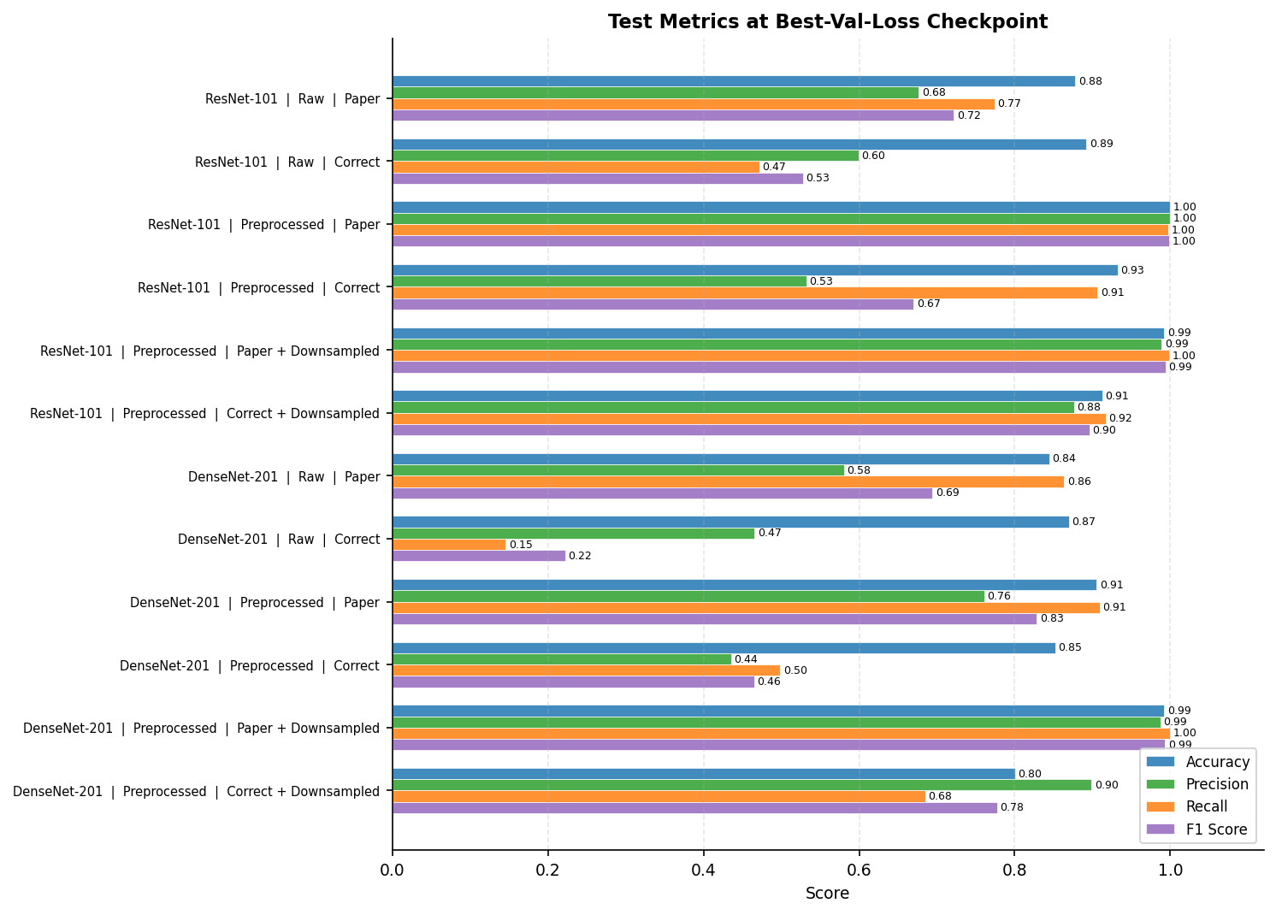

Slide 10
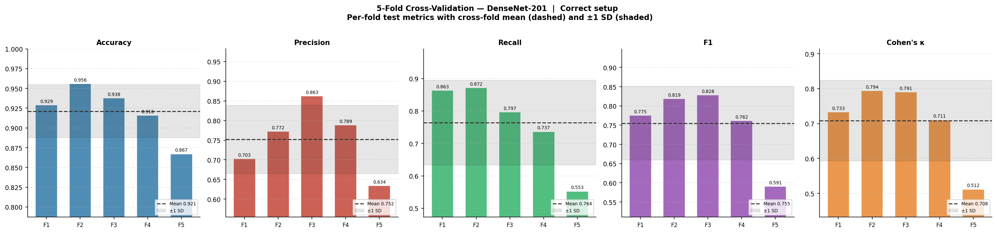
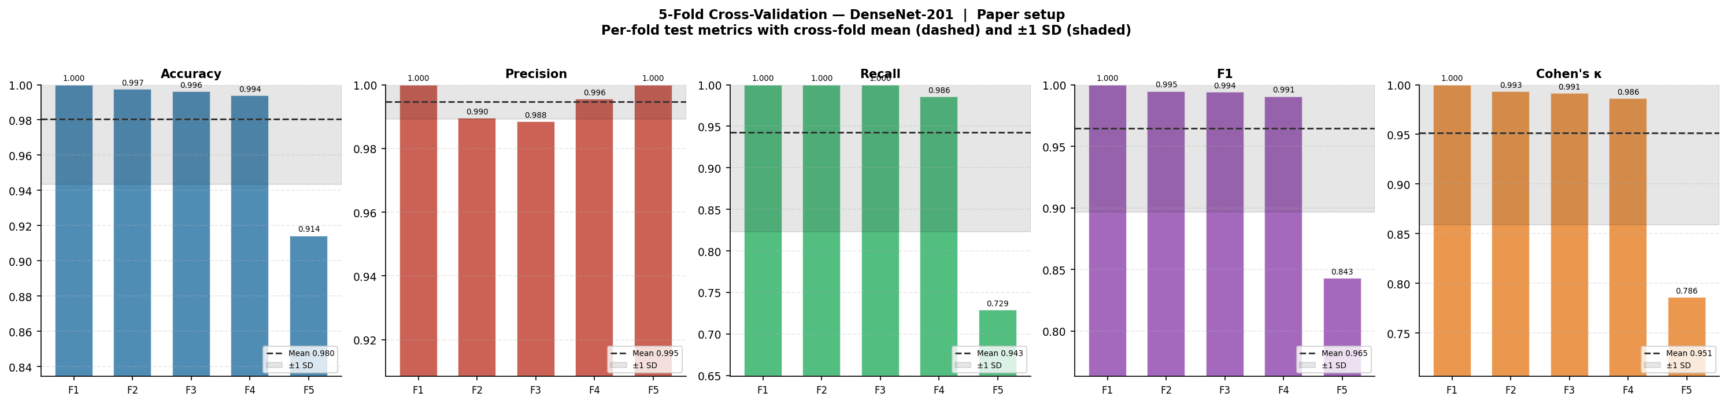

Slide 12
ResNet-101 | Paper setup
Fold | Accuracy | Precision | Recall | F1 | Cohen's κ
Fold 1 | 0.880 | 0.829 | 0.744 | 0.784 | 0.701
Fold 2 | 0.893 | 0.859 | 0.681 | 0.760 | 0.692
Fold 3 | 0.865 | 0.862 | 0.690 | 0.767 | 0.674
Fold 4 | 0.807 | 0.774 | 0.576 | 0.661 | 0.530
Fold 5 | 0.804 | 0.921 | 0.414 | 0.571 | 0.466
Mean ± Std | 0.850 ± 0.042 | 0.849 ± 0.054 | 0.621 ± 0.131 | 0.708 ± 0.091 | 0.613 ± 0.107

Slide 13
ResNet-101 | Correct setup
Fold | Accuracy | Precision | Recall | F1 | Cohen's κ
Fold 1 | 0.850 | 0.451 | 0.276 | 0.342 | 0.263
Fold 2 | 0.867 | 0.389 | 0.291 | 0.333 | 0.261
Fold 3 | 0.818 | 0.638 | 0.072 | 0.130 | 0.095
Fold 4 | 0.831 | 0.583 | 0.259 | 0.359 | 0.278
Fold 5 | 0.828 | 0.512 | 0.134 | 0.213 | 0.151
Mean ± Std | 0.839 ± 0.020 | 0.515 ± 0.100 | 0.206 ± 0.097 | 0.275 ± 0.100 | 0.210 ± 0.082

Slide 14
ResNet-101 | Paper setup + Preproc
Fold | Accuracy | Precision | Recall | F1 | Cohen's κ
Fold 1 | 0.997 | 1.000 | 0.989 | 0.994 | 0.992
Fold 2 | 0.997 | 0.991 | 0.999 | 0.995 | 0.993
Fold 3 | 0.996 | 0.986 | 1.000 | 0.993 | 0.990
Fold 4 | 0.987 | 0.984 | 0.977 | 0.981 | 0.971
Fold 5 | 0.923 | 0.994 | 0.761 | 0.862 | 0.810
Mean ± Std | 0.980 ± 0.032 | 0.991 ± 0.006 | 0.945 ± 0.103 | 0.965 ± 0.058 | 0.951 ± 0.079

Slide 15
ResNet-101 | Correct setup + Preproc
Fold | Accuracy | Precision | Recall | F1 | Cohen's κ
Fold 1 | 0.921 | 0.725 | 0.713 | 0.719 | 0.673
Fold 2 | 0.946 | 0.716 | 0.872 | 0.786 | 0.756
Fold 3 | 0.946 | 0.886 | 0.818 | 0.851 | 0.818
Fold 4 | 0.907 | 0.812 | 0.642 | 0.717 | 0.663
Fold 5 | 0.865 | 0.636 | 0.512 | 0.568 | 0.488
Mean ± Std | 0.917 ± 0.034 | 0.755 ± 0.096 | 0.711 ± 0.143 | 0.728 ± 0.105 | 0.679 ± 0.124

Slide 16
ResNet-101 | Paper setup + Pre-split Preproc(Guha et al.)
Fold | Accuracy | Precision | Recall | F1 | Cohen's κ
Fold 1 | 0.996 | 1.000 | 0.992 | 0.996 | 0.992
Fold 2 | 0.993 | 0.984 | 0.999 | 0.992 | 0.985
Fold 3 | 0.996 | 0.993 | 1.000 | 0.996 | 0.992
Fold 4 | 0.994 | 0.996 | 0.993 | 0.994 | 0.988
Fold 5 | 0.882 | 0.997 | 0.777 | 0.873 | 0.766
Mean ± Std | 0.972 ± 0.050 | 0.994 ± 0.006 | 0.952 ± 0.098 | 0.970 ± 0.054 | 0.945 ± 0.100

Slide 17
ResNet-101 | Correct setup + Pre-split Preproc
Fold | Accuracy | Precision | Recall | F1 | Cohen's κ
Fold 1 | 0.898 | 0.943 | 0.834 | 0.885 | 0.794
Fold 2 | 0.921 | 0.877 | 0.939 | 0.907 | 0.839
Fold 3 | 0.950 | 0.950 | 0.961 | 0.955 | 0.898
Fold 4 | 0.885 | 0.933 | 0.854 | 0.892 | 0.771
Fold 5 | 0.748 | 0.870 | 0.587 | 0.701 | 0.497
Mean ± Std | 0.881 ± 0.078 | 0.915 ± 0.038 | 0.835 ± 0.149 | 0.868 ± 0.097 | 0.760 ± 0.155

Slide 18
DenseNet-201 | Paper setup
Fold | Accuracy | Precision | Recall | F1 | Cohen's κ
Fold 1 | 0.889 | 0.843 | 0.763 | 0.801 | 0.724
Fold 2 | 0.868 | 0.941 | 0.501 | 0.654 | 0.582
Fold 3 | 0.853 | 0.828 | 0.683 | 0.749 | 0.646
Fold 4 | 0.861 | 0.887 | 0.656 | 0.754 | 0.660
Fold 5 | 0.747 | 0.872 | 0.234 | 0.369 | 0.271
Mean ± Std | 0.843 ± 0.056 | 0.874 ± 0.044 | 0.567 ± 0.209 | 0.665 ± 0.174 | 0.577 ± 0.178

Slide 19
DenseNet-201 | Correct setup
Fold | Accuracy | Precision | Recall | F1 | Cohen's κ
Fold 1 | 0.849 | 0.454 | 0.335 | 0.385 | 0.301
Fold 2 | 0.902 | 0.859 | 0.168 | 0.281 | 0.253
Fold 3 | 0.834 | 0.599 | 0.361 | 0.451 | 0.360
Fold 4 | 0.854 | 0.698 | 0.356 | 0.471 | 0.397
Fold 5 | 0.814 | 0.339 | 0.079 | 0.129 | 0.067
Mean ± Std | 0.850 ± 0.033 | 0.590 ± 0.204 | 0.260 ± 0.129 | 0.343 ± 0.141 | 0.276 ± 0.129

Slide 20
DenseNet-201 | Paper setup + Preproc
Fold | Accuracy | Precision | Recall | F1 | Cohen's κ
Fold 1 | 0.999 | 1.000 | 0.998 | 0.999 | 0.999
Fold 2 | 0.998 | 0.992 | 1.000 | 0.996 | 0.995
Fold 3 | 0.996 | 0.988 | 1.000 | 0.994 | 0.991
Fold 4 | 0.993 | 0.992 | 0.986 | 0.989 | 0.984
Fold 5 | 0.921 | 1.000 | 0.751 | 0.858 | 0.805
Mean ± Std | 0.982 ± 0.034 | 0.995 ± 0.005 | 0.947 ± 0.110 | 0.967 ± 0.061 | 0.955 ± 0.084

Slide 21
DenseNet-201 | Correct setup + Preproc
Fold | Accuracy | Precision | Recall | F1 | Cohen's κ
Fold 1 | 0.925 | 0.726 | 0.754 | 0.740 | 0.696
Fold 2 | 0.959 | 0.807 | 0.844 | 0.825 | 0.802
Fold 3 | 0.933 | 0.833 | 0.809 | 0.821 | 0.780
Fold 4 | 0.905 | 0.816 | 0.619 | 0.704 | 0.649
Fold 5 | 0.871 | 0.642 | 0.573 | 0.606 | 0.529
Mean ± Std | 0.919 ± 0.033 | 0.765 ± 0.080 | 0.720 ± 0.118 | 0.739 ± 0.091 | 0.691 ± 0.110

Slide 22
DenseNet-201 | Paper setup + Pre-split Preproc(Guha et al.)
Fold | Accuracy | Precision | Recall | F1 | Cohen's κ
Fold 1 | 0.997 | 0.997 | 0.998 | 0.997 | 0.995
Fold 2 | 0.999 | 0.997 | 1.000 | 0.999 | 0.998
Fold 3 | 0.931 | 0.884 | 1.000 | 0.939 | 0.861
Fold 4 | 0.991 | 0.993 | 0.990 | 0.992 | 0.983
Fold 5 | 0.867 | 1.000 | 0.746 | 0.855 | 0.736
Mean ± Std | 0.957 ± 0.058 | 0.974 ± 0.050 | 0.947 ± 0.112 | 0.956 ± 0.062 | 0.915 ± 0.115

Slide 23
DenseNet-201 | Correct setup + Pre-split Preproc
Fold | Accuracy | Precision | Recall | F1 | Cohen's κ
Fold 1 | 0.938 | 0.911 | 0.961 | 0.936 | 0.876
Fold 2 | 0.933 | 0.928 | 0.905 | 0.916 | 0.860
Fold 3 | 0.967 | 0.946 | 0.998 | 0.971 | 0.933
Fold 4 | 0.904 | 0.933 | 0.889 | 0.910 | 0.806
Fold 5 | 0.753 | 0.893 | 0.579 | 0.703 | 0.507
Mean ± Std | 0.899 ± 0.085 | 0.922 ± 0.020 | 0.867 ± 0.166 | 0.887 ± 0.106 | 0.797 ± 0.168

