Slide 1
第二章关系模型

Slide 2
概念回顾
数据模型
  是一个描述数据、数据联系、数据语义以及一致性约束的概念工具的集合。
数据模型的三要素
  数据结构
数据及其它们之间的联系
  数据操作
检索、更新等操作及其操作规则
  完整性约束条件
规定数据库状态及状态变化所应满足的条件，以保证数据的正确、有效、相容
2-<number>

Slide 3
第二章 关系模型
教学目的
  本章首先学习关系模型的基础，然后介绍关系代数，为稍后学习的关系数据库查询语言SQL打好基础
主要内容
  关系基本概念，关系模型，关系代数，关系系统及其查询优化
2-<number>

Slide 4
Introduction to Database
CHAPTER 2
RELATIONAL MODEL
2.1 Structure of Relational Databases
2.2 Fundamental Relational-Algebra Operations
2.3 Additional Relational-Algebra Operations
2.4 Extended Relational-Algebra Operations
2.5 Null Values
2.6 Modification of the Database
2-<number>

Slide 5

2.1 Structure of Relational Databases
Relational Database: a collection of tables
  Table has a unique name
  A row (tuple) in a table: a relationship of a set of values
  Table: mathematical concept of relation
Relational Model: proposed by Codd, 1970, ref. p.1108: Bibliography
  [Codd 1970] E. F. Codd, "A Relational Model for Large Shared Data banks," CACM Vol. 13, No.6, (1970), pp. 377-387
account
2-<number>

Slide 6
关系模型的组成
数据模型
  数据结构、数据操作、完整性规则
关系模型的组成
  数据结构（表）
  关系操作集
  关系完整性
2-<number>

Slide 7
2.1.1 Basic Structure
Relation:
  Formally, given sets D₁, D₂, …. D_{n}
  D₁ x D₂ x … x D_{n} = {(a₁, a₂, …, a_{n}) | where each a_{i} ∈ D_{i}}
  a Relation r is a subset of D₁ x D₂ x … x D_{n}
  Thus a relation is a set of n-tuples (a₁, a₂, …, a_{n}) where
  each a_{i} ∈ D_{i}
Example: if
customer-name = {Jones, Smith, Curry, Lindsay}
customer-street = {Main, North, Park}
customer-city = {Harrison, Rye, Pittsfield}
Then r = {(Jones, Main, Harrison), (Smith, North, Rye),
(Curry, North, Rye), (Lindsay, Park, Pittsfield)}
is a relation over customer-name x customer-street x customer-city
2-<number>
Notes:
???
域（Domain）
■ 具有相同类型的值的集合
■ 如整数的集合、字符串的集合、全体学生的集合
笛卡尔积（Cartesian Product）
■ 一组域D1 , D2 ,…, Dn的笛卡尔积为:
D1×D2×…×Dn = {(d1 , d2 , … , dn) | di∈Di , i=1,…,n}
■ 笛卡尔积的每个元素(d1 , d2 , … , dn)称作一个n-
元组（n-tuple）
■ 元组的每一个值di叫做一个分量（component）
■ 若Di的基数为mi，则笛卡尔积的基数为inim

Slide 8
Example: The account Relation, Fig. 2.1
account
        D₁ = { }
        D₂ = { }
        D₃ = { }
        D₁ x D₂ x D₃ =
        account =
2-<number>

Slide 9
Attribute Types
account
Each attribute of a relation has a name
The set of allowed values for each attribute is
called the domain of the attribute
Attribute values are (normally) required to be atomic, that is, indivisible
  E.g. multivalued attribute values are not atomic, (A-201, A-217)
  E.g. composite attribute values are not atomic, BirthDate: (5, 17, 1950)
The special value null is a member of every domain
The null value causes complications in the definition of many operations
  we shall ignore the effect of null values in our main presentation and consider their effect later
2-<number>
Notes:
重要的是我们怎么在数据库中使用域中元素

Slide 10
2.1.2 Database Schema
Attributes: Suppose A₁, A₂, …, A_{n} are attributes
Relation schema: R = (A₁, A₂, …, A_{n}) is a relation schema
e.g. Customer-schema =
(customer-name, customer-street, customer-city)
Relation: r(R) is a relation on the relation schema R
e.g. customer(Customer-schema)
attributes
(or columns)
customer
customer-name
customer-street
customer-city
Jones
Smith
Curry
Lindsay
Main
North
North
Park
Harrison
Rye
Rye
Pittsfield
tuples
(or rows)
customer
2-<number>

Slide 11
Relation Instance
Relation Instance: The current values (relation instance) of a relation are specified by a table
Tuple: An element t of r is a tuple, represented by a row in a table
attributes
(or columns)
customer
customer-name
customer-street
customer-city
Jones
Smith
Curry
Lindsay
Main
North
North
Park
Harrison
Rye
Rye
Pittsfield
tuples
(or rows)
2-<number>

Slide 12
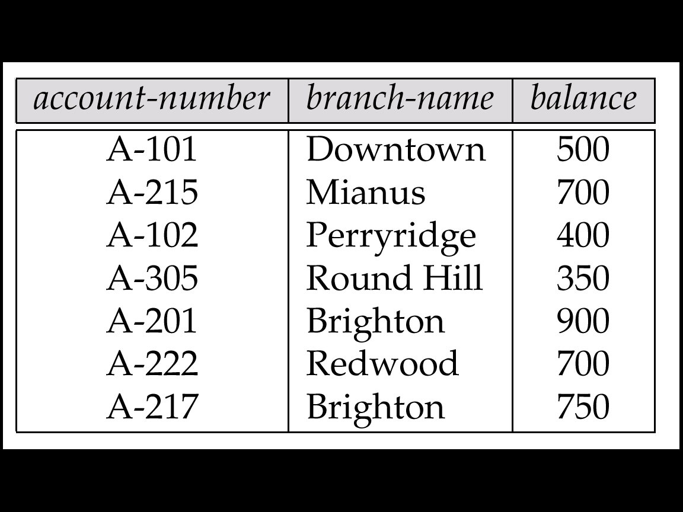
Relations are Unordered
Order of tuples is irrelevant (tuples may be stored in an arbitrary order)
e.g. The account relation with unordered tuples
(unordered tuples)
account
(ordered by account-number)
2-<number>

Slide 13
Database
Database: A database consists of multiple relations (ref. p. 1-??)
Information about an enterprise is broken up into parts, with each relation storing one part of the information
E.g.: account: stores information about accounts
depositor: stores information about which customer
owns which account
customer: stores information about customers
Storing all information as a single relation such as
bank(account-number, balance, customer-name, ..)
results in
  repetition of information (e.g. an customers own two account)
  the need for null values (e.g. represent a customer without an account)
Normalization theory (Chapter 7) deals with how to design relational schemas
bank
…
2-<number>

Slide 14
Example: Banking Database
Banking Database: consists 6 relations:
  branch (branch-name, branch-city, assets)
  customer (customer-name, customer-street, customer-only)
  account (account-number, branch-name, balance)
  loan (loan-number, branch-name, amount)
  depositor (customer-name, account-number)
  borrower (customer-name, loan-number)
2-<number>

Slide 15





Example: Banking Database
1. branch
2. customer
3. depositor
分公司
客戶(存款戶,貸款戶)
存款戶
4. borrower
貸款戶
5. account
存款帳
6. loan
貸款帳
2-<number>

Slide 16
2.1.3 Keys 码、键、主键等
Let K ⊆ R = (A₁, A₂, …, A_{n}), set of attributes of relation r(R)
Superkey超码: K is a superkey of R if values for K are sufficient to identify a unique tuple of each possible relation r(R)
  Example: {customer-name, customer-street} and {customer-name}
  are both superkeys of Customer, if no two customers can possibly have the same name.
Candidate key候选码: K is a candidate key if K is minimal
e.g: {customer-name} is a candidate key for Customer,
  since it is a superkey and
  no subset of it is a superkey.
Primary Key主码
Foreign key外码
customer
2-<number>

Slide 17
2.1.3 Keys 码、键、主键等
Primary key（主码）: a candidate key chosen as the principal means of identifying tuples within a relation
  Should choose an attribute whose value never, or very rarely, changes.
Foreign key外码：
A relation schema may have an attribute that corresponds to the primary key of another relation. The attribute is called a foreign key(外键).
  referenced relation & referencing relation.
2-<number>

Slide 18

Schema Diagram, Fig. 2.8
Primary Key and foreign key can be depicted by schema diagram模式图
Schema Diagram for the Banking Enterprise, Fig. 2.8
2-<number>

Slide 19
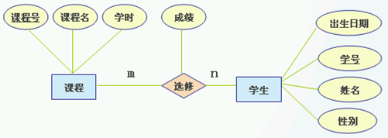
主键外键实例
转换为关系模式后：
学生(学号,姓名,性别，出生日期)
课程(课程号,课程名,学时)
选修（学号，课程号，成绩）

Slide 20
2.1.4 Query Languages
Query Language: user requests information from the database.
Categories of languages
  Procedural 过程化
  non-procedural 非过程化
    SQL (ch. 3, ch. 4)
    QBE (Section 5.3)
“Pure” languages 抽象的查询语言:
  Relational Algebra关系代数 (Section 2.2, 2.3, 2.4)
  Tuple Relational Calculus 元组关系演算(Section 5.1)
  Domain Relational Calculus 域关系演算(Section 5.2)
Pure languages form underlying basis of query languages that people use (e.g. SQL).
2-<number>
Notes:
？

Slide 21
Introduction to Database
CHAPTER 2
RELATIONAL MODEL
2.1 Structure of Relational Databases
2.2 Fundamental Relational-Algebra Operations
2.3 Additional Relational-Algebra Operations
2.4 Extended Relational-Algebra Operations
2.5 Null Values
2.6 Modification of the Database
2-<number>

Slide 22
Relational-Algebra Operations
The operators take one or more relations as inputs and give a new relation as a result.
Fundamental Relational-Algebra Operations
  Select 选择
  Project 投影
  Union 并
  Set difference 差
  Cartesian product 笛卡尔积
  Rename 更名
Additional Relational-Algebra Operations
  Intersection 交
  Natural Join 自然连接
  Division 除
  Assignment 赋值
2-<number>
Notes:
关系代书的基本运算足以表达任何关系代数查询

Slide 23
2.2 Fundamental Relational-Algebra Operations
  Select
  Project
  Union
  Set difference
  Cartesian product
  Rename
Select (σ)
Project (Π)
Union (∪)
Difference (−)
Product (x)
a
b
c
x
y
a
a
b
b
c
c
x
y
x
y
x
y
2-<number>

Slide 24
2.2.1 Select Operation: Example
Relation r
A
B
C
D
α
α
β
β
α
β
β
β
1
5
12
23
7
7
3
10
σ_{A=B ^ D > 5} (r)
A
B
C
D
α
β
α
β
1
23
7
10
2-<number>

Slide 25
Select Operation
谓词
Notation: σ _{p}(r)
p is called the selection predicate
Defined as:
σ_{p}(r) = {t | t ∈ r and p(t)}
Where p is a formula in propositional calculus consisting of terms connected by : ∧ (and), ∨ (or), ¬ (not)
Each term is one of:
<attribute> op <attribute> or <constant>
where op is one of: =, ≠, >, ≥. <. ≤
Example of selection:
σ _{branch-name=“Perryridge”}(account)
2-<number>
Notes:
结束
propositional calculus_百度词典
[网络释义] 1.命题演算

Slide 26
Example Queries 1: Select
Find all loans of over $1200
σ_{amount > 1200} (loan)
5. loan
2-<number>

Slide 27
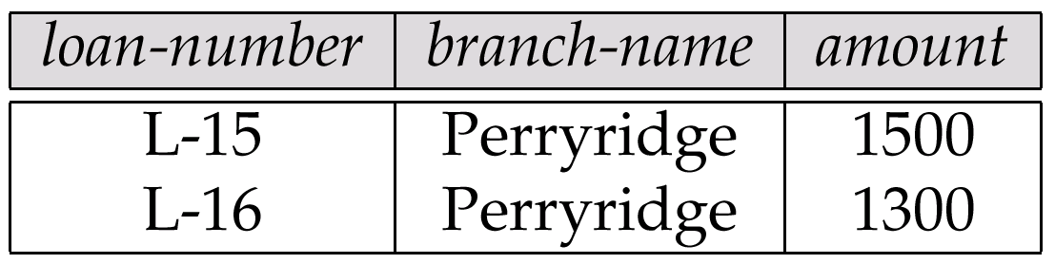
Example Queries 3: Select
Can use =, =, < > <=, >=, and, or, not …
Find all loans of over $1200 made by the Perryridge branch
梨崗山
σamount > 1200 ^ branch-name=“Perryridge” (loan)
loan
Fig. 2.9
2-<number>

Slide 28
2.2.2 Project Operation: Example
A
B
C
Relation r:
α
α
β
β
10
20
30
40
1
1
1
2
A
C
A
C
∏_{A,C} (r)
α
α
β
β
1
1
1
2
α
β
β
1
1
2
=
2-<number>

Slide 29
Project Operation
Notation:
∏_{A1, A2, …, Ak} (r)
where A₁, A₂ are attribute names and r is a relation name.
The result is defined as the relation of k columns obtained by erasing the columns that are not listed
Duplicate rows removed from result, since relations are sets
e.g. To eliminate the branch-name attribute of account
∏_{account-number, balance} (account)
2-<number>

Slide 30
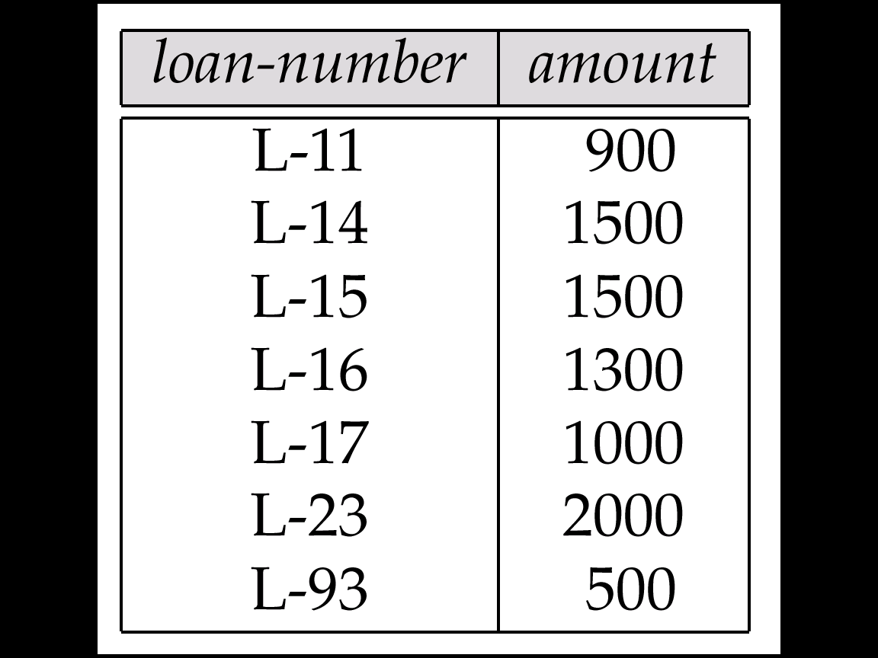
Example Queries 2: Project
List all all loan numbers and the amount of the loans
∏_{loan-number, amount} (loan)
Fig. 2.10
2-<number>

Slide 31
2.2.3 Composition of Operations
关系运算的组合
Find the loan number for each loan of an amount greater than $1200
∏_{loan-number} (σ_{amount} _{> 1200} (loan))
5. loan
2-<number>

Slide 32
Example Queries 5: Composition
Find those customers who live in Harrison
∏_{customer-name} (σ_{customer-city=“Harrison”} (customer))
2. customer
2-<number>

Slide 33
2.2.4 Union Operation: Example
A
B
A
B
Relations r, s:
α
α
β
1
2
1
α
β
2
3
s
r
r ∪ s:
A
B
α
α
β
β
1
2
1
3
2-<number>

Slide 34
Union Operation
Notation: r ∪ s
Defined as:
r ∪ s = {t | t ∈ r or t ∈ s}
For r ∪ s to be valid,它们必须相容.
1. r, s must have the same arity 同元(same number of attributes, same heading)
2. The attribute domains must be compatible域相同 (e.g., 2nd column
of r deals with the same type of values as does the 2nd
column of s)
E.g. to find all customers with either an account or a loan
∏_{customer-name} (depositor) ∪ ∏_{customer-name} (borrower)
2-<number>
Notes:
第二周授课结束2013

Slide 35
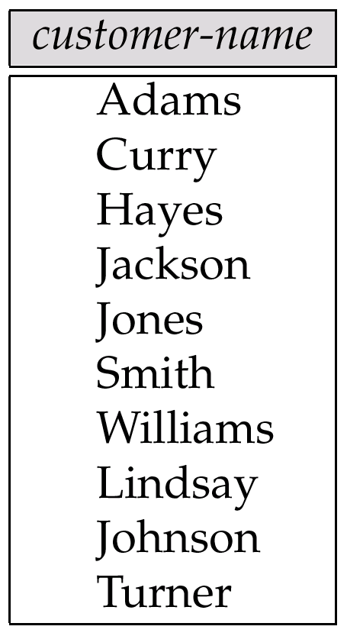
Example Queries 6: Union/Intersection
Find the names of all customers who have a loan, an account, or both, from the bank
  ∏_{customer-name} (borrower) ∪ ∏_{customer-name} (depositor)
Find the names of all customers who have a loan and an account at bank.
Fig. 2.11
  ∏_{customer-name} (borrower) ∩ ∏_{customer-name} (depositor)
2-<number>

Slide 36
2.2.5 Set-Difference Operation: Example
A
B
A
B
Relations r, s:
α
α
β
1
2
1
α
β
2
3
s
r
r – s:
A
B
α
β
1
1
2-<number>

Slide 37
Set Difference Operation
Notation r – s
Defined as:
r – s = {t | t ∈ r and t ∉ s}
Set differences must be taken between compatible 相容 relations.
  r and s must have the same arity 同元
  attribute domains of r and s must be compatible 域相容
2-<number>

Slide 38
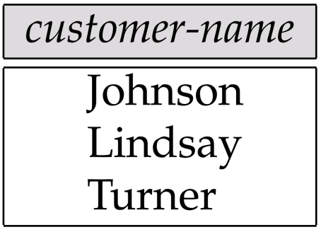
Example Queries 7: Set Difference
Find the names of all customers who have an account, but not a loan
  ∏_{customer-name} (depositor) - ∏_{customer-name} (borrower)
4. depositor
6. borrower
Fig. 2.12
2-<number>

Slide 39
2.2.6 Cartesian-Product Operation: Example
r
A
B
s
C
D
E
Relations r, s:
α
β
1
2
α
β
β
γ
10
10
20
10
a
a
b
b
Product (x)
A
B
C
D
E
r x s:
a
b
c
x
y
a
a
b
b
c
c
x
y
x
y
x
y
α
α
α
α
β
β
β
β
1
1
1
1
2
2
2
2
α
β
β
γ
α
β
β
γ
10
10
20
10
10
10
20
10
a
a
b
b
a
a
b
b
2-<number>

Slide 40
Cartesian-Product Operation
Notation r x s
Defined as:
r x s = {t q | t ∈ r and q ∈ s}
Assume that attributes of r(R) and s(S) are disjoint. (That is,
R ∩ S = ∅).
If attributes of r(R) and s(S) are not disjoint, then renaming must be used.
Product (x)
a
b
c
x
y
a
a
b
b
c
c
x
y
x
y
x
y
2-<number>

Slide 41
Example Queries 8: Cartesian-Product
borrower x loan
6. borrower
5. loan
2-<number>

Slide 42
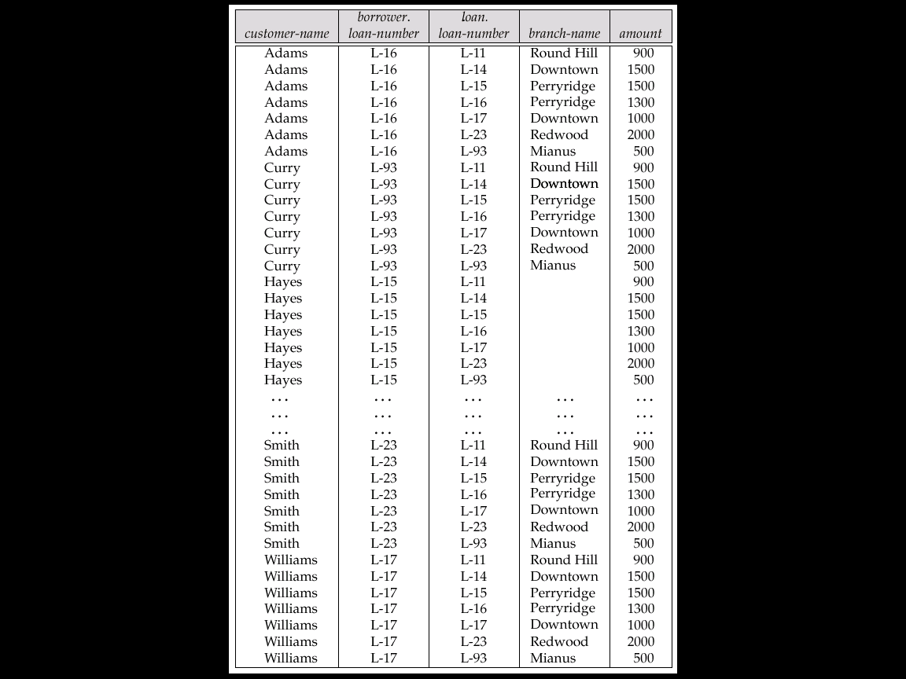
Queries 8: borrower × loan (Fig. 2.13)
8 x 7 = 56 tuples
2-<number>

Slide 43
Queries 8.1:
Find the names of all customers who have a loan at the Perryridge branch. σ _{branch-name = “Perryridge”} (borrower × loan)
8 x 2 = 16 tuples
(Fig. 2.14)
2-<number>

Slide 44
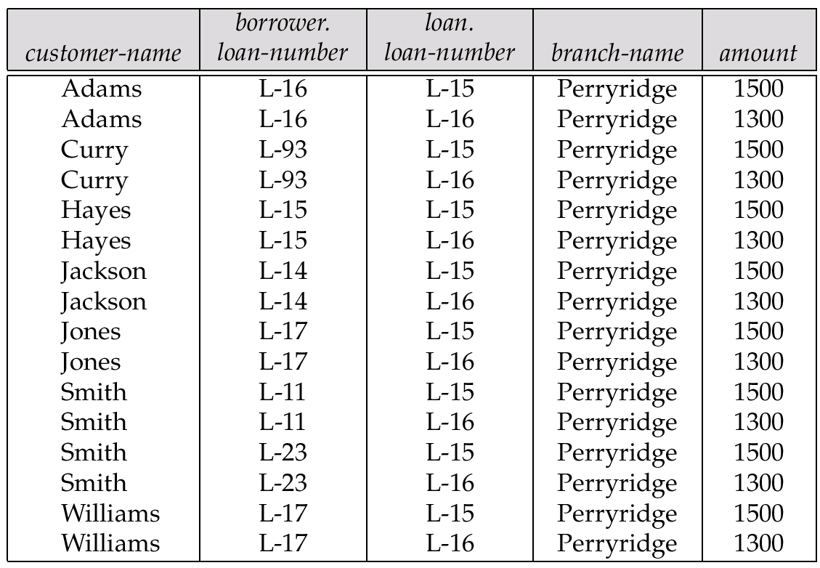
σ _{branch-name = “Perryridge”} (borrower × loan), (Fig. 2.14)
8 x 2 = 16 tuples
2-<number>

Slide 45
Queries 8.2: (σborrower.loan-number = loan.loan-number (borrower x loan))
8 x 1 = 8 tuples
2-<number>

Slide 46
Queries 8.3:
(σ_{branch-name=“Perryridge”}
(σborrower.loan-number = loan.loan-number (borrower x loan)))
2 tuples
2-<number>

Slide 47
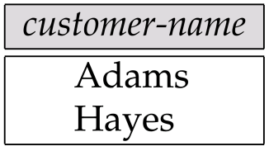
Example Queries 8.4: Cartesian-Product
Query: Find the names of all customers who have a loan at the Perryridge branch.
∏_{customer-name} (σ_{branch-name=“Perryridge”}
(σborrower.loan-number = loan.loan-number (borrower x loan)))
(Fig. 2.15)
6. borrower
5. loan
2-<number>

Slide 48
Example Queries 9
Query: Find the names of all customers who have a loan at the Perryridge branch but do not have an account at any branch of the bank.
∏_{customer-name} (σ_{branch-name = “Perryridge”}
(σborrower.loan-number = loan.loan-number(borrower x loan))) –
∏_{customer-name} (depositor)
2-<number>

Slide 49
2.2.7 Rename Operation
Rename Operation: Allows us to name, and therefore to refer to, the results of relational-algebra expressions.
  E.g.1:
ρ _{x} (E)
returns the expression E under the name X
  E.g. 2. If a relational-algebra expression E has arity n, then
ρ_{x} (A1, A2, …, An) (E)
returns the result of expression E under the name X, and with the attributes renamed to A1, A2, …., An.
  E.g. 3. ρ _{x} (r) ?
    SQL: Rename r As x
2-<number>

Slide 50
Example Queries 11: Rename, p.53
Query: Find the largest account balance
Rename account relation as d
The query is:
∏_{balance}(account) - ∏_{account.balance}
(σ_{account.balance < d.balance} (account x ρ _{d} (account)))
3. account
3. Account = d
2-<number>

Slide 51
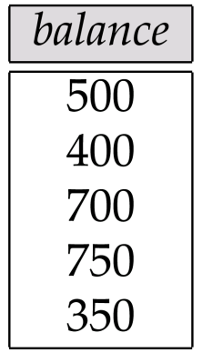
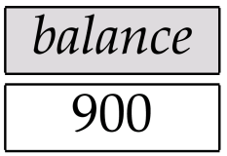
Example Queries 11: Rename (cont.)
∏_{account.balance} (σ_{account.balance < d.balance} (account x r_{d} (account)))
3. account
3. Account = d
(Fig. 2.16)
(Fig. 2.17)
2-<number>

Slide 52
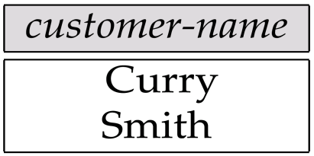
Query: “Find the names of all customers who live on the same street and in the same city as Smith”
Example Queries 12: Rename
Algebra: p. 54
2. customer
Fig. 2.18
2-<number>
Notes:
？
\rou_smith_addr(street,city)(\pi_customer_street,customer_city(\sigma_customer_name = “smith”(customer)))

Slide 53
2.2.8 Formal Definition
A basic expression in the relational algebra consists of either one of the following:
  A relation in the database
  A constant relation
Let E₁ and E₂ be relational-algebra expressions; the following are all relational-algebra expressions:
  E₁ ∪ E₂
  E₁ - E₂
  E₁ x E₂
  σ_{p} (E₁), P is a predicate on attributes in E₁
  ∏_{s}(E₁), S is a list consisting of some of the attributes in E₁
  ρ _{x} (E₁), x is the new name for the result of E₁
2-<number>
Notes:
？

Slide 54
Introduction to Database
CHAPTER 2
RELATIONAL MODEL
2.1 Structure of Relational Databases
2.2 Fundamental Relational-Algebra Operations
2.3 Additional 附加的Relational-Algebra Operations
2.4 Extended Relational-Algebra Operations
2.5 Null Values
2.6 Modification of the Database
2-<number>

Slide 55
2.3 Additional Relational-Algebra Operations
Four Additional Operations:
  Set intersection 交
  Natural join 自然连接
  Division 除
  Assignment 赋值
Additional Operations:
  do not add any power to the relational algebra,
  but that simplify common queries.
Why?
2-<number>

Slide 56
2.3.1 Set-Intersection Operation
Notation: r ∩ s
Defined as:
r ∩ s ={ t | t ∈ r and t ∈ s }
Assume:
  r, s have the same arity
  attributes of r and s are compatible
Note: r ∩ s = r - (r - s)
Intersection (∩)
2-<number>

Slide 57
Set-Intersection Operation: Example
Relation r, s:
r ∩ s
A B
A B
α
α
β
1
2
1
α
β
2
3
r
s
A B
α 2
2-<number>

Slide 58
2.3.2 Natural-Join Operation: r s
Let r and s be relations on schemas R and S respectively.
Then, r s is a relation on schema R ∪ S obtained as follows:
  Consider each pair of tuples t_{r} from r and t_{s} from s.
  If t_{r} and t_{s} have the same value on each of the attributes in R ∩ S, add a tuple t to the result, where
    t has the same value as t_{r} on r
    t has the same value as t_{s} on s
Example:
  R = (A, B, C, D)
  S = (E, B, D)
  Result schema = (A, B, C, D, E)
  r s is defined as:
  ∏_{r.A, r.B, r.C, r.D, s.E} (σ_{r.B = s.B ∧ r.D = s.D} (r x s))
2-<number>

Slide 59
Natural Join Operation: Example
Relations r, s:
A
B
C
D
B
D
E
α
β
γ
α
δ
1
2
4
1
2
α
γ
β
γ
β
a
a
b
a
b
1
3
1
2
3
a
a
a
b
b
α
β
γ
δ
∈
r
s
A
B
C
D
E
r s
_{r.B = s.B ∧ r.D = s.D}
α
α
α
α
δ
1
1
1
1
2
α
α
γ
γ
β
a
a
a
a
b
α
γ
α
γ
δ
2-<number>

Slide 60
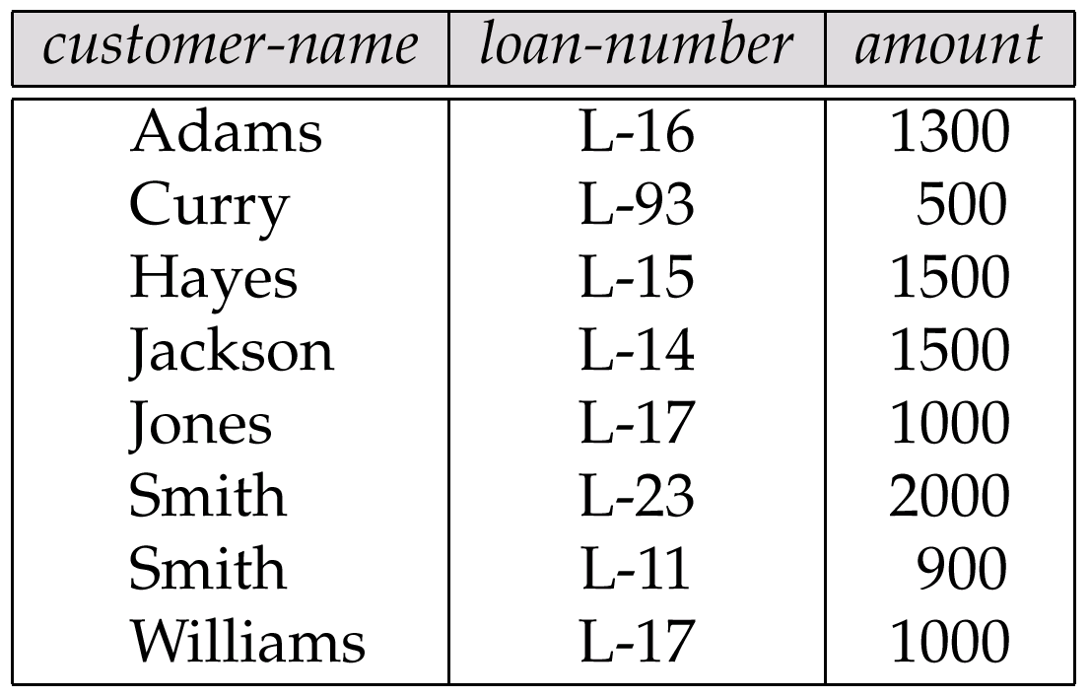
Πcustomer-name, loan-number, amount (borrower loan)
6. borrower
5. loan
Fig. 2.20
2-<number>

Slide 61
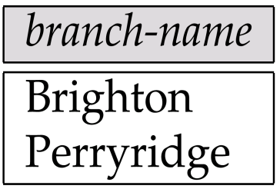
Π_{branch-name}(σ_{customer-city = “Harrison”}(customer account depositor))
Query: Find the names of all branches with customers who have an
account and live in Harrison
2. customer
3. account
4. depositor
Fig. 2.21
2-<number>

Slide 62
2.3.3 Division Operation: r ÷ s
Suited to queries that include the phrase “for all”.
Let r and s be relations on schemas R and S respectively where
  R = (A₁, …, A_{m}, B₁, …, B_{n})
  S = (B₁, …, B_{n})
  The result of r ÷ s is a relation on schema
  R – S = (A₁, …, A_{m})
  r ÷ s = { t | t ∈ ∏ _{R-S}(r) ∧ ∀ u ∈ s ( tu ∈ r ) }
Divide (÷)
a
a
a
b
c
x
y
z
x
y
x
z
a
2-<number>

Slide 63
Division Operation: Example 1
Relations r, s:
r
s
r ÷ s:
A
B
B
A
α
α
α
β
γ
δ
δ
δ
∈
∈
β
1
2
3
1
1
1
3
4
6
1
2
1
2
α
β
2-<number>
Notes:
伽马 德尔塔 爱普希龙

Slide 64
Division Operation: Example 2
Relations r, s:
A
B
C
D
E
D
E
α
α
α
β
β
γ
γ
γ
a
a
a
a
a
a
a
a
α
γ
γ
γ
γ
γ
γ
β
a
a
b
a
b
a
b
b
1
1
1
1
3
1
1
1
a
b
1
1
s
r
r ÷ s:
A
B
C
α
γ
a
a
γ
γ
2-<number>

Slide 65
Division Operation (Cont.)
Property
  Let q = r ÷ s
  Then q is the largest relation satisfying q x s ⊆ r
Definition in terms of the basic algebra operation
Let r(R) and s(S) be relations, and let S ⊆ R
r ÷ s = ∏_{R-S} (r) –∏_{R-S} ( (∏_{R-S} (r) x s) – ∏_{R-S,S}(r))
To see why
  ∏_{R-S,S}(r) simply reorders attributes of r
  ∏_{R-S}(∏_{R-S} (r) x s) – ∏_{R-S,S}(r)) gives those tuples t in
  ∏_{R-S} (r) such that for some tuple u ∈ s, tu ∉ r.
2-<number>
Notes:
结束

Slide 66
Division Operation: Example 3
Find all customers who have an account at all the branches located in Brooklyn
Π_{customer-name, branch-name}(depositor account)
÷
Π_{branch-name}(σ_{branch-city = “Brooklyn”}(branch))
2-<number>

Slide 67
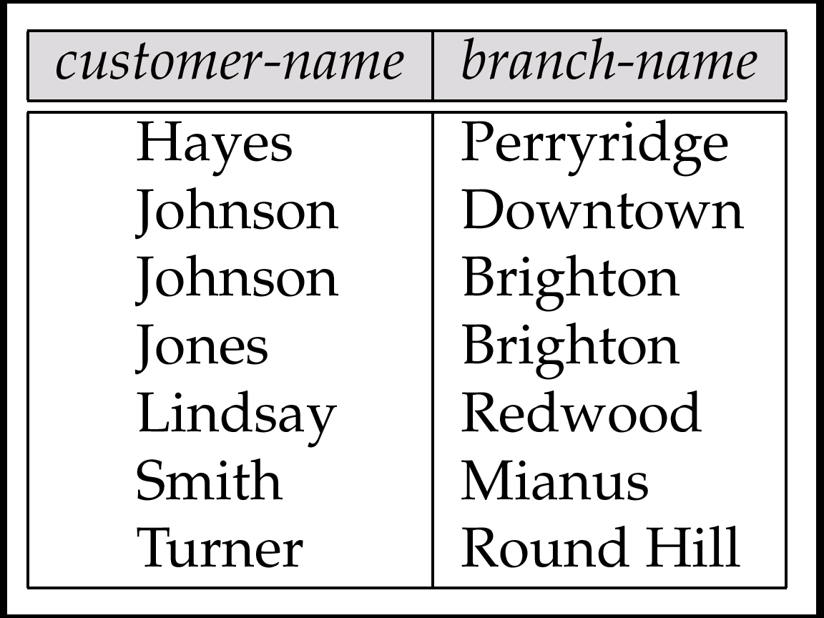
Π_{customer-name, branch-name}(depositor account), Fig. 2.23
4. depositor
3. account
2-<number>

Slide 68
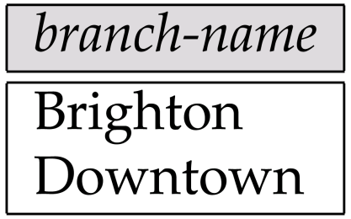
Π_{branch-name}(σ_{branch-city = “Brooklyn”}(branch)), Fig. 2.22
1. branch
2-<number>

Slide 69
2.3.4 Assignment Operation
The assignment operation (←) provides a convenient way to express complex queries.
  Write query as a sequential program consisting of
    a series of assignments
    followed by an expression whose value is displayed as a result of the query.
  Assignment must always be made to a temporary relation variable.
Example: Write r ÷ s as
temp1 ← ∏_{R-S} (r)
temp2 ← ∏_{R-S} ((temp1 x s) – ∏_{R-S,S} (r))
result = temp1 – temp2
  The result to the right of the ← is assigned to the relation variable on the left of the ←.
  May use variable in subsequent expressions.
2-<number>

Slide 70
Introduction to Database
CHAPTER 2
RELATIONAL MODEL
2.1 Structure of Relational Databases
2.2 Fundamental Relational-Algebra Operations
2.3 Additional Relational-Algebra Operations
2.4 Extended Relational-Algebra Operations
2.5 Null Values
2.6 Modification of the Database
2-<number>

Slide 71
2.4 Extended Relational-Algebra Operations
Generalized Projection 广义投影
Aggregate Functions 聚集函数
Outer Join 外连接
2-<number>

Slide 72
2.4.1 Generalized Projection广义投影
Extends the projection operation by allowing arithmetic functions to be used in the projection list. 投影列表中使用算数函数
∏ _{F1, F2, …, Fn}(E)
E is any relational-algebra expression
Each of F₁, F₂, …, F_{n} are are arithmetic expressions involving constants and attributes in the schema of E.
Given relation credit-info(customer-name, limit, credit-balance), find how much more each person can spend:
∏customer-name, limit – credit-balance (credit-info)
2-<number>

Slide 73
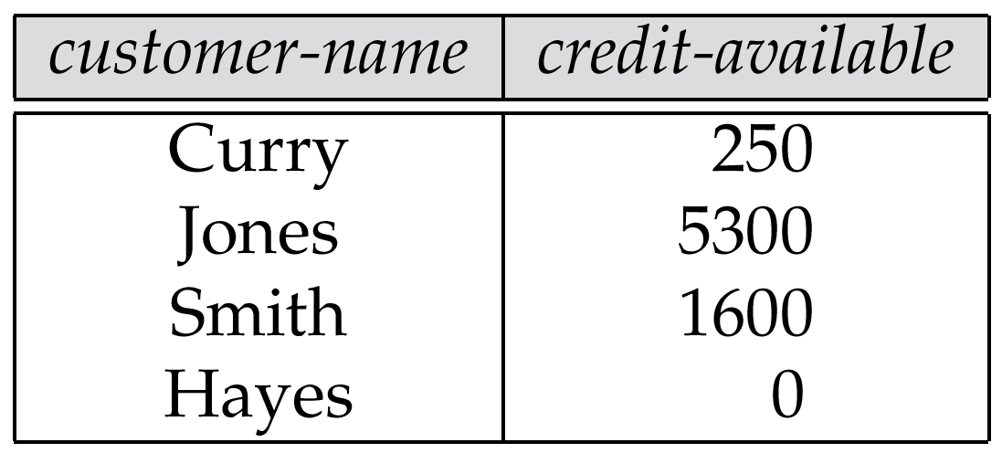
Πcustomer-name, (limit – credit-balance) as credit-available(credit-info).
Generalized Projection: Example
Query: Find how much more each person can spend
credit-info
P. 61
Fig. 2.24
Fig. 2.25
2-<number>

Slide 74
2.4.2 Aggregate Functions
Aggregation function takes a collection of values and returns a single value as a result.
1. avg: average value
2. min: minimum value
3. max: maximum value
4. sum: sum of values
4. count: number of values
Aggregate operation in relational algebra
G₁, G₂, …, G_{n} g F1( A1), F2( A2),…, Fn( An) (E)
  E is any relational-algebra expression
  G₁, G₂, …, G_{n} is a list of attributes on which to group (can be empty)
  Each F_{i} is an aggregate function
  Each Ai is an attribute name
2-<number>

Slide 75
Aggregate Functions: Example 1
Relation r:
A
B
C
α
α
β
β
α
β
β
β
7
7
3
10
sum-C
g _{sum(c)} (r)
27
2-<number>

Slide 76
Aggregate Functions: Example 2
Relation account grouped by branch-name:
branch-name
account-number
balance
Perryridge
Perryridge
Brighton
Brighton
Redwood
A-102
A-201
A-217
A-215
A-222
400
900
750
750
700
_{branch-name} g _{sum(balance)} (account)
branch-name
balance
Perryridge
Brighton
Redwood
1300
1500
700
2-<number>

Slide 77
Aggregate Functions: Rename
Result of aggregation does not have a name
  Can use rename operation to give it a name
  For convenience, we permit renaming as part of aggregate operation
_{branch-name} g _{sum(balance) as sum-balance} (account)
branch-name
sum-balance
Perryridge
Brighton
Redwood
1300
1500
700
2-<number>

Slide 78
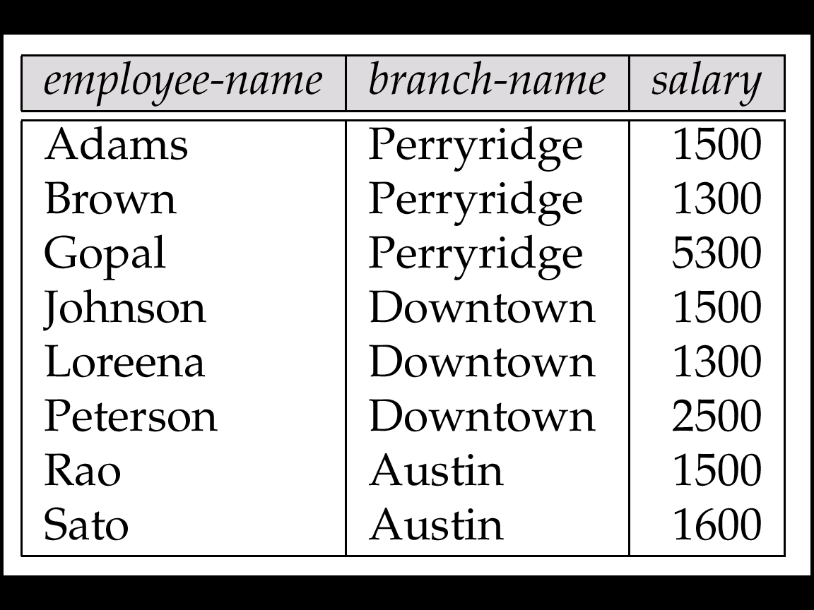
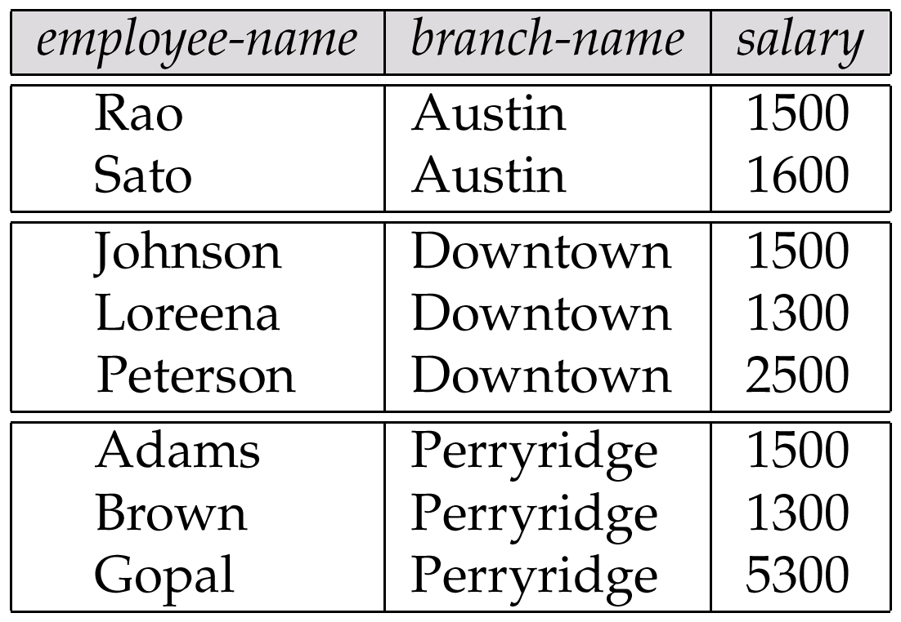
Aggregate Functions: Example 3
pt-works Fig. 2.26
pt-works
Fig. 2.27
The pt-works relation after Grouping
2-<number>

Slide 79
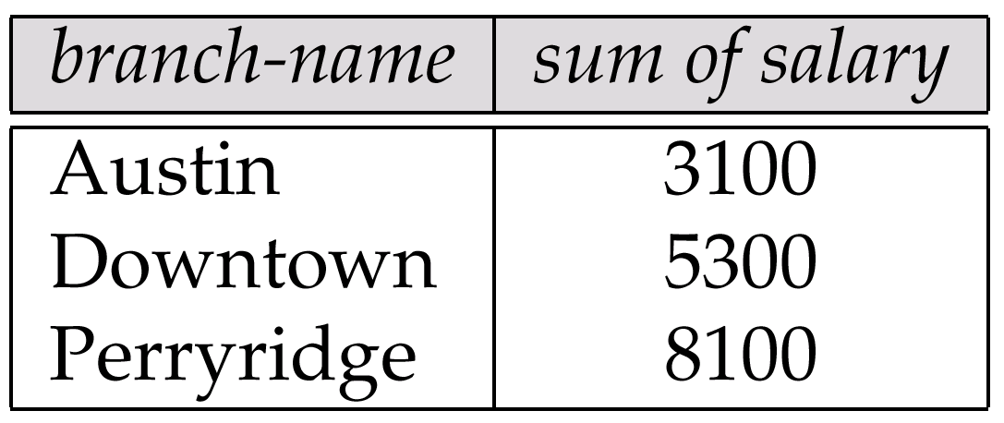
Aggregate Functions: Example 3 (cont.)
pt-works
branch-name ς _{sum(salary)} (pt-works)
Fig. 2.28
2-<number>

Slide 80
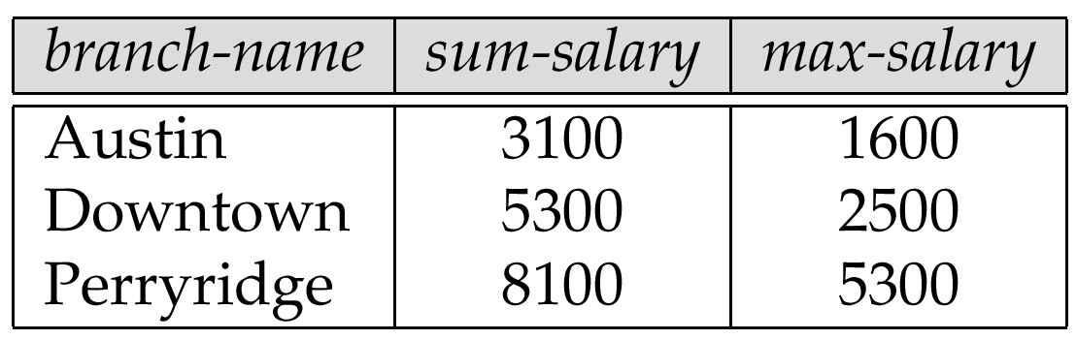
branch-name ς sum salary, max(salary) as max-salary (pt-works), Fig. 2.29
Aggregate Functions: Example 3 (cont.)
pt-works
2-<number>

Slide 81
2.4.3 Outer Join 外连接
An extension of the join operation that avoids loss of information.
连接运算的扩展避免丢失信息
Computes the join and then adds tuples form one relation that do not match tuples in the other relation to the result of the join.
Uses null values:
  null signifies that the value is unknown or does not exist
  All comparisons involving null are (roughly speaking) false by definition.
    Will study precise meaning of comparisons with nulls later
2-<number>

Slide 82
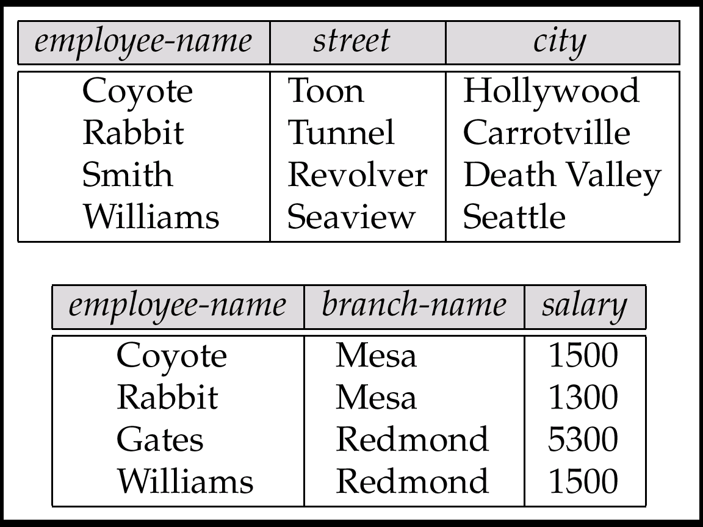
The employee and ft-works Relations, Fig. 2.30
Example 1: Outer Join
employee
ft-works
2-<number>

Slide 83
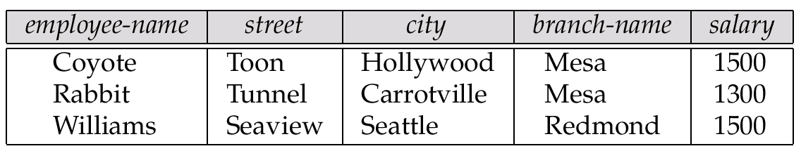
Fig. 2.31: The Result of employee ft-works
Example 1: Natural Join
employee
ft-works
2-<number>

Slide 84
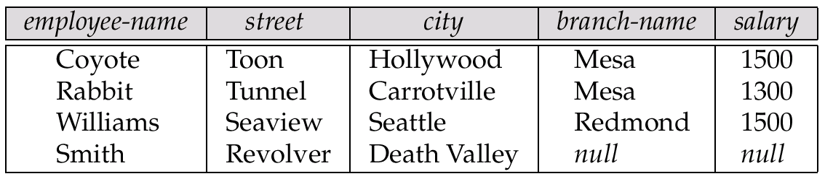
Fig. 2.32: The Result of employee ft-works
Example 1: Left Outer Join
employee
ft-works
2-<number>

Slide 85
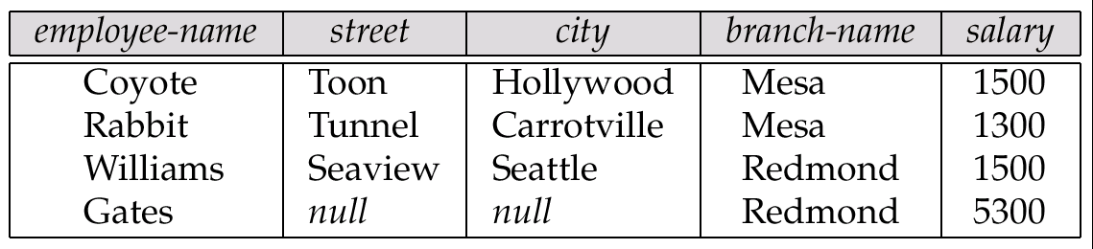
Fig. 2.33: Result of employee ft-works
Example 1: Right Outer Join
employee
ft-works
2-<number>

Slide 86
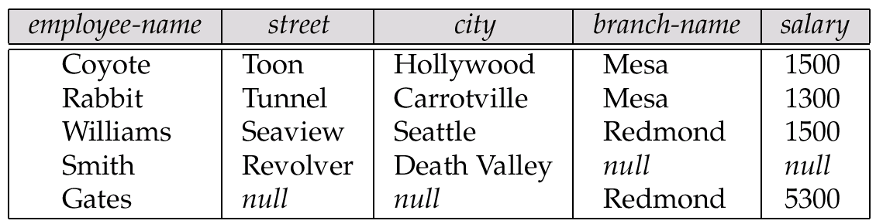
Fig. 2.34: Result of employee ft-works
Example 1: Full Outer Join
employee
ft-works
2-<number>

Slide 87
Outer Join: Example 2
Relation loan
loan-number
branch-name
amount
L-170
L-230
L-260
Downtown
Redwood
Perryridge
3000
4000
1700
Relation borrower
customer-name
loan-number
Jones
Smith
Hayes
L-170
L-230
L-155
2-<number>

Slide 88
Outer Join: Example 2 (cont.)
Inner Join
loan Borrower
loan-number
branch-name
amount
customer-name
L-170
L-230
Downtown
Redwood
3000
4000
Jones
Smith
Left Outer Join
loan Borrower
loan-number
branch-name
amount
customer-name
L-170
L-230
L-260
Downtown
Redwood
Perryridge
3000
4000
1700
Jones
Smith
null
2-<number>

Slide 89
Outer Join: Example 2 (cont.)
Right Outer Join
loan borrower
loan-number
branch-name
amount
customer-name
L-170
L-230
L-155
Downtown
Redwood
null
3000
4000
null
Jones
Smith
Hayes
Full Outer Join
loan borrower
loan-number
branch-name
amount
customer-name
L-170
L-230
L-260
L-155
Downtown
Redwood
Perryridge
null
3000
4000
1700
null
Jones
Smith
null
Hayes
2-<number>

Slide 90
Introduction to Database
CHAPTER 2
RELATIONAL MODEL
2.1 Structure of Relational Databases
2.2 Fundamental Relational-Algebra Operations
2.3 Additional Relational-Algebra Operations
2.4 Extended Relational-Algebra Operations
2.5 Null Values
2.6 Modification of the Database
2-<number>

Slide 91
2.5 Null Values
It is possible for tuples to have a null value, denoted by null, for some of their attributes
null signifies an unknown value or that a value does not exist.
The result of any arithmetic expression involving null is null.
Aggregate functions simply ignore null values
  Is an arbitrary decision. Could have returned null as result instead.
  We follow the semantics of SQL in its handling of null values
For duplicate elimination and grouping, null is treated like any other value, and two nulls are assumed to be the same
  Alternative: assume each null is different from each other
  Both are arbitrary decisions, so we simply follow SQL
2-<number>

Slide 92
Null Values
Comparisons with null values return the special truth value unknown
  If false was used instead of unknown, then not (A < 5)
  would not be equivalent to A >= 5
Three-valued logic using the truth value unknown:
  OR: (unknown or true) = true,
  (unknown or false) = unknown
  (unknown or unknown) = unknown
  AND: (true and unknown) = unknown,
  (false and unknown) = false,
  (unknown and unknown) = unknown
  NOT: (not unknown) = unknown
  In SQL “P is unknown” evaluates to true if predicate P evaluates to unknown
Result of select predicate is treated as false if it evaluates to unknown
2-<number>

Slide 93
2.6 Modification of the Database
The content of the database may be modified using the following operations:
  Deletion
  Insertion
  Updating
All these operations are expressed using the assignment operator.
2-<number>

Slide 94
2.6.1 Deletion
A delete request is expressed similarly to a query, except instead of displaying tuples to the user, the selected tuples are removed from the database.
Can delete only whole tuples; cannot delete values on only particular attributes
A deletion is expressed in relational algebra by:
r ← r – E
where r is a relation and E is a relational algebra query.
2-<number>

Slide 95
Deletion: Examples
Delete all account records in the Perryridge branch.
account ← account – σ _{branch-name = “Perryridge”} (account)
Delete all loan records with amount in the range of 0 to 50
loan ← loan – σ amount ≥ 0 and amount ≤ 50 (loan)
Delete all accounts at branches located in Needham. P44Fig.2.8
r₁ ← σ _{branch-city = “Needham”} (account branch)
r₂ ← ∏branch-name, account-number, balance (r₁)
r₃ ← ∏ _{customer-name, account-number} (r₂ depositor)
account ← account – r₂
depositor ← depositor – r₃
2-<number>

Slide 96
2.6.2 Insertion
To insert data into a relation, we either:
  specify a tuple to be inserted
  write a query whose result is a set of tuples to be inserted
in relational algebra, an insertion is expressed by:
r ← r ∪ E
where r is a relation and E is a relational algebra expression.
The insertion of a single tuple is expressed by letting E be a constant relation containing one tuple.
2-<number>

Slide 97
Insertion: Examples
Insert information in the database specifying that Smith has $1200 in account A-973 at the Perryridge branch.
account ← account ∪ {(“Perryridge”, A-973, 1200)}
depositor ← depositor ∪ {(“Smith”, A-973)}
Provide as a gift for all loan customers in the Perryridge branch, a $200 savings account. Let the loan number serve as the account number for the new savings account.
r₁ ← (σ_{branch-name = “Perryridge”} (borrower loan))
account ← account ∪ ∏branch-name, account-number,200 (r₁)
depositor ← depositor ∪ ∏_{customer-name, loan-number}(r₁)
2-<number>

Slide 98
2.6.3 Updating
A mechanism to change a value in a tuple without charging all values in the tuple
Use the generalized projection operator to do this task
r ← ∏ _{F1, F2, …, FI,} (r)
Each F_{i} is either
  the ith attribute of r, if the ith attribute is not updated, or,
  if the attribute is to be updated F_{i} is an expression, involving only constants and the attributes of r, which gives the new value for the attribute
2-<number>
Notes:
\sigma_P(r) union (r-\sigma_p(r))

Slide 99
Update: Examples
Make interest payments by increasing all balances by 5 percent.
account ← ∏ _{AN, BN, BAL * 1.05} (account)
where AN, BN and BAL stand for account-number, branch-name and balance, respectively.
Pay all accounts with balances over $10,000 6 percent interest and pay all others 5 percent
account ← ∏ _{AN, BN, BAL * 1.06} (σ _{BAL > 10000} (account))
∪ ∏_{AN, BN, BAL * 1.05} (σ_{BAL ≤ 10000} (account))
2-<number>

