Slide 1
Introduction to Database
1-50
CHAPTER 4
Advanced SQL
SQL Data Types and Schemas
Integrity Constraints
Authorization
Embedded SQL
Dynamic SQL
Functions and Procedural Constructs**
Recursive Queries**
Advanced SQL Features**
4-<number>

Slide 2
4.1 SQL Data Types and Schemas
Basic Data Types:
  Integer
  Char
  …
Build-in Data Types in SQL
User-Defined Types
Large-Object Types
4-<number>

Slide 3
4.1.1 Build-in Data Types in SQL
Build-in Data Types in SQL:
  date: Dates, containing a (4 digit) year, month and date, ‘2005-7-27’
  time: Time of day, in hours, minutes and seconds, ‘09:00:30’
  timestamp: date plus time of day, ‘2005-7-27 09:00:30.75’
Operations for Build-in Data Types in SQL :
  Convert string types to date/time/timestamp, cast string as date
  Find interval: period of time, dtae1 – date2
    Interval values can be added to date/time/timestamp values
  Extract values of individual fields from date/time/timestamp
    Example: extract (year from r.starttime)
  Comparison: if date1 < date2 then …
4-<number>

Slide 4
4.1.2 User-Defined Types
create type: construct in SQL creates user-defined type
  E.g. create type Dollars as numeric (12,2) final
  E.g. create type Pounds as numeric (12,2) final
create domain: construct in SQL-92
  E.g. create domain person_name char(20) not null
Types and domains are similar.
  Domains can have constraints, such as not null, specified on them.
  E.g. create domain person_name char(20) not null
  v.s.
  create type person_name char(20);
整
4-<number>

Slide 5
4.1.3 Large-Object Types
Large objects (photos, videos, CAD files, etc.) are stored as a large object:
  blob: binary large object –
    object is a large collection of uninterpreted binary data
    whose interpretation is left to an application outside of the database system
  clob: character large object –
    object is a large collection of character data
When a query returns a large object,
  a pointer is returned rather than the large object itself.
4-<number>

Slide 6
4.2 Integrity Constraints
Integrity Constraints
  guard against accidental damage to the database,
  by ensuring that authorized changes to the database do not result in a loss of data consistency.
  Example:
    E.g. 1: A checking account must have a balance
    greater than $10,000.00
    E.g. 2: A salary of a bank employee must be at least
    $4.00 an hour
    E.g. 3: A customer must have a (non-null) phone
    number
4-<number>

Slide 7
4.2.1 Constraints on a Single Relation
not null
primary key
unique
check (P ), where P is a predicate
create table branch
(branch-name char(15) not null,
branch-city char(30),
assets integer,
primary key (branch-name),
check (assets >= 0))
4-<number>

Slide 8
4.2.2 Not Null Constraint
E.g. Declare branch_name for branch is not null
branch_name char(15) not null
E.g. Declare the domain Dollars to be not null
create domain Dollars numeric(12,2) not null
create table branch
(branch-name char(15) not null,
branch-city char(30),
assets integer,
primary key (branch-name),
check (assets >= 0))
4-<number>

Slide 9
4.2.3 Unique Constraint
A statement:
unique ( A1, A2, …, Am)
  The unique specification states that the attributes
A1, A2, … Am
form a candidate key.
4-<number>

Slide 10
4.2.4 The check clause
check (P ), where P is a predicate
Example 1: Declare branch_name as the primary key for branch and ensure that the values of assets are non-negative.
attribute
create table branch
(branch-name char(15) not null,
branch-city char(30),
assets integer,
primary key (branch-name),
check (assets >= 0))
  Example 2: Use check clause to ensure that an hourly_wage domain allows only values greater than a specified value.
  create domain hourly_wage numeric(5,2)
  constraint value_test check(value > = 4.00)
    The clause constraint value_test is optional
Domain
4-<number>
Notes:
结束

Slide 11
4.2.5 Referential Integrity
Referential Integrity: ensures that a value that appears in one relation for a given set of attributes also appears for a certain set of attributes in another relation.
  Example: If “Perryridge” is a branch-name appearing in one of the tuples in the account relation, then there exists a tuple in the branch relation for branch “Perryridge”.
In SQL create table statement:
  The primary key clause: lists attributes that comprise the primary key.
  The unique key clause: lists attributes that comprise a candidate key.
  The foreign key clause: lists the attributes that comprise the foreign key and the name of the relation referenced by the foreign key.
4-<number>

Slide 12


Referential Integrity: Example
create table account
(account-number char(10),
branch-name char(15),
balance integer,
primary key (account-number),
foreign key (branch-name) references branch)
3. account
1. branch
4-<number>

Slide 13
Referential Integrity in SQL
Foreign keys can be specified as part of the SQL create table statement:
  By using the foreign key clause
By default, a foreign key references the primary key attributes of the referenced table
create table account
(account-number char(10),
branch-name char(15),
balance integer,
primary key (account-number),
foreign key (branch-name) references branch)
4-<number>

Slide 14
Example: Banking Database
Banking Database: consists 6 relations:
  branch (branch-name, branch-city, assets)
  customer (customer-name, customer-street, customer-only)
  account (account-number, branch-name, balance)
  loan (loan-number, branch-name, amount)
  depositor (customer-name, account-number)
  borrower (customer-name, loan-number)
4-<number>

Slide 15




Example: Banking Database
1. branch
2. customer
3. depositor
分公司
客戶(存款戶,貸款戶)
存款戶
4. borrower
貸款戶
5. account
存款帳
6. loan
貸款帳
4-<number>

Slide 16
Referential Integrity in SQL: Example
2. customer
create table customer
(customer-name char(20),
customer-street char(30),
customer-city char(30),
primary key (customer-name))
create table branch
(branch-name char(15),
branch-city char(30),
assets integer,
primary key (branch-name))
1. branch
4-<number>

Slide 17
Referential Integrity in SQL: Example (cont.)
5. account
存款帳
create table account
(account-number char(10),
branch-name char(15),
balance integer,
primary key (account-number),
foreign key (branch-name) references branch)
create table depositor
(customer-name char(20),
account-number char(10),
primary key (customer-name, account-number),
foreign key (account-number) references account,
foreign key (customer-name) references customer)
3. depositor
references
存款戶
4-<number>

Slide 18
Referential Integrity: Cascade
5. account
create table account
(account-number char(10),
branch-name char(15),
balance integer,
primary key (account-number),
foreign key (branch-name) references branch)
on delete cascade
on update cascade
)
references
1. branch
Due to the on delete cascade clauses,
  if a delete of a tuple in branch
    Eg. Brighton Broklyn 7100000
  the delete “cascades” to the account relation, A-201, A-217
Cascading updates are similar.
See p.130
4-<number>

Slide 19
Referential Integrity: Set Null
5. account
create table account
(account-number char(10),
branch-name char(15),
balance integer,
primary key (account-number),
foreign key (branch-name) references branch)
on delete set null
)
null
null
references
1. branch
Due to the on delete set null clauses,
  if a delete of a tuple in branch
    Eg. Brighton Broklyn 7100000
  the delete “set null” to the account relation, A-201, A-217
4-<number>

Slide 20
4.2.6 Assertions/Integrity Rules
断言
An assertion is a predicate expressing a condition that we wish the database always to satisfy.
An assertion in SQL takes the form
create assertion <assertion-name> check <predicate>
  E.g. create assertion balance-constraint check account.balance >= 1000
When an assertion is made, the system tests it for validity, and tests it again on every update that may violate the assertion
  The testing may introduce a significant amount of overhead;
  Hence, assertions should be used with great care.
  The rule of an assertion is stored in “dictionary” (system catalog)
4-<number>

Slide 21
Assertion: Example 1
The sum of all loan amounts for each branch must be less than the sum of all account balances at the branch.
create assertion sum-constraint check
(not exists (select * from branch
where (select sum(amount) from loan
where loan.branch-name =
branch.branch-name)
>= (select sum(amount) from account
where loan.branch-name =
branch.branch-name)))
4-<number>
Notes:
结束

Slide 22
Assertion: Example 2
Every loan has at least one borrower who maintains an account with a minimum balance of $1000.00
create assertion balance-constraint check
(not exists (
select * from loan
where not exists (
select *
from borrower, depositor, account
where loan.loan-number = borrower.loan-number
and borrower.customer-name = depositor.customer-name
and depositor.account-number = account.account-number
and account.balance >= 1000)))
4-<number>

Slide 23
4.3 Authorization
Forms of authorization on parts of the database:
  Read authorization
  Insert authorization
  Update authorization
  Delete authorization
Forms of authorization to modify the database schema:
  Index authorization - allows creation and deletion of indices.
  Resources authorization - allows creation of new relations.
  Alteration authorization - allows addition or deletion of attributes in a relation.
  Drop authorization - allows deletion of relations.
4-<number>

Slide 24
Authorization Specification in SQL
授與
The grant statement is used to confer authorization
  < privilege list> is: select, insert, update, delete, all privileges, … (ch. 8)
  <user list> is:
    a user-id
    public, which allows all valid users the privilege granted
    A role (ch. 8)
  E.g.
The grantor of the privilege must already hold the privilege on the specified item (or be the database administrator).
grant <privilege list> on <relation name/view name> to <user list>
grant select on branch to U1, U2, U3
4-<number>
Notes:
?实例

Slide 25
Revoking Authorization in SQL
The revoke statement is used to revoke authorization.
Example:
  revoke select on branch from U₁, U₂, U₃
  revoke <privilege list> on <relation name or view name> from <user list>
4-<number>

Slide 26
4.4 Embedded SQL
Embedded SQL: The SQL standard defines embeddings of SQL in a variety of programming languages such as Pascal, PL/I, Fortran, Cobol, C, C++, C#, and Visual Basic.
Host language: A language to which SQL queries are embedded is referred to as a host language.
The basic form of these languages follows that of the System R embedding of SQL into PL/I.
EXEC SQL statement is used to identify embedded SQL request to the preprocessor
Note: This varies by language. e.g. the Java embedding uses
EXEC SQL <embedded SQL statement > END-EXEC
# SQL { …. } ;
4-<number>

Slide 27
嵌入式SQL执行过程
主语言 + 嵌入SQL
DBMS处理宿主型数据库语言SQL 的方法
  预编译
  修改和扩充主语言使之能处理SQL语句
预处理
主语言 + 函数调用
主语言编译器
主语言执行程序

Slide 28
嵌入式SQL
预编译
  1. 由DBMS的预处理程序对源程序进行扫描，识别出SQL语句
  2. 把它们转换成主语言调用语句，以使主语言编译程序能识别它
  3. 最后由主语言的编译程序将整个源程序编译成目标码

Slide 29
Embedded SQL: Example
Example: From within a host language, find the names and cities of customers with more than the variable amount dollars in some account.
Specify the query in SQL and declare a cursor for it
EXEC SQL
declare c cursor for
select customer-name, customer-city
from depositor, customer, account
where depositor.customer-name = customer.customer-name
and depositor account-number = account.account-number
and account.balance > :amount
END-EXEC
4-<number>

Slide 30
4.5.1 ODBC
Open DataBase Connectivity (ODBC) standard
  Defines a way for application a program to communicate with a database server.
  ODBC defines an API (Application Program Interface) that applications can use to
    open a connection with a database,
    send queries and updates,
    get back results.
Applications such as
  GUI (graphical user interfaces), spreadsheets, etc.
  can use of the same ODBC API to connect to any database server that supports ODBC
ODBC Code Example
  Fig. 4.4, p.139
4-<number>

Slide 31
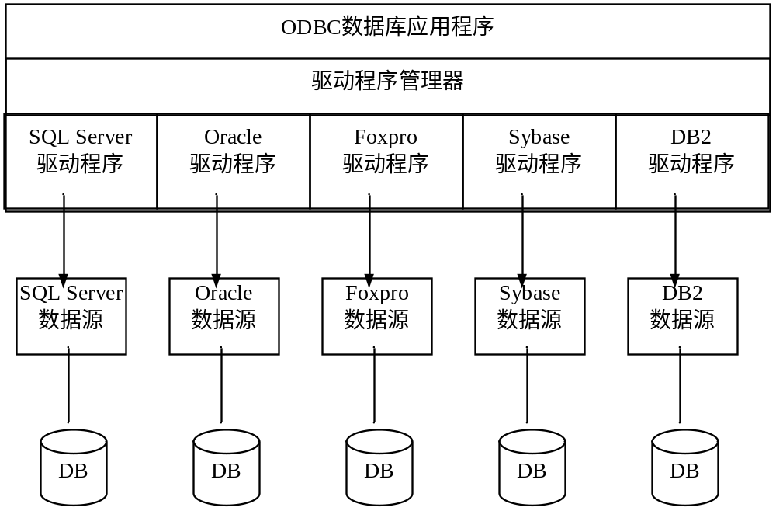
ODBC的体系结构

Slide 32
ODBC (cont.)
Each database system supporting ODBC provides a "driver" library that must be linked with the client program.
When client program makes an ODBC API call, the code in the library communicates with the server to carry out the requested action, and fetch results.
ODBC program first allocates
  an SQL environment: HENV env; 分配环境句柄
  a database connection handle: HDBC conn;分配连接句柄
Opens database connection using SQLConnect( ). Parameters are:
  connection handle: conn
  the server to which to connect: “db.yale.edu”
  the user identifier: “avi”
  Password: “avipasswd”
Must also specify types of arguments:
  SQL_NTS denotes previous argument is a null-terminated string.
4-<number>

Slide 33
ODBC Code
int ODBCexample()
{
  RETCODE error;
  HENV env; /* environment */
  HDBC conn; /* database connection */
  SQLAllocEnv(&env);
  SQLAllocConnect(env, &conn);
  SQLConnect(conn, "aura.bell-labs.com", SQL_NTS, "avi", SQL_NTS, "avipasswd", SQL_NTS);
  SQLDisconnect(conn);
  SQLFreeConnect(conn);
  SQLFreeEnv(env);
}
  { …. Do actual work … } // Main body of program
4-<number>

Slide 34
ODBC Code (cont.)
Main body of program
  char branchname[80];
  float balance;
  int lenOut1, lenOut2;
  HSTMT stmt;
  char * sqlquery = "select branch_name, sum (balance)
  from account
  group by branch_name";
  SQLAllocStmt(conn, &stmt);
  error = SQLExecDirect(stmt, sqlquery, SQL_NTS); //sends SQL to the database
  if (error == SQL_SUCCESS) {
  SQLBindCol(stmt, 1, SQL_C_CHAR, branchname, 80, &lenOut1);
  SQLBindCol(stmt, 2, SQL_C_FLOAT, &balance, 0, &lenOut2);
  while (SQLFetch(stmt) == SQL_SUCCESS) {
  printf (" %s %g\n", branchname, balance);
  }
  }
  SQLFreeStmt(stmt, SQL_DROP);
4-<number>

Slide 35
ODBC Code (cont.)
SQLExecDirect: Program sends SQL commands to the database
SQLFetch(): Result tuples are fetched using SQLFetch()
SQLBindCol(): binds C language variables to attributes of the query result
    When a tuple is fetched, its attribute values are automatically stored in corresponding C variables.
    Arguments to SQLBindCol()
      ODBC stmt variable, attribute position in query result
      The type conversion from SQL to C.
      The address of the variable.
      variable-length types
Feedback:
  Good programming requires checking results of every function call for errors;
  we have omitted most checks for brevity.
4-<number>

Slide 36
More ODBC Features
Prepared Statement
  SQL statement prepared: compiled at the database
  Can have placeholders: E.g. insert into account values(?,?,?)
  Repeatedly executed with actual values for the placeholders
Metadata features
  finding all the relations in the database and
  finding the names and types of columns of a query result or a relation in the database.
By default, each SQL statement is treated as a separate transaction, that is committed automatically.
  Can turn off automatic commit on a connection
    SQLSetConnectOption(conn, SQL_AUTOCOMMIT, 0)}
  transactions must then be committed or rolled back explicitly by
    SQLTransact(conn, SQL_COMMIT) or
    SQLTransact(conn, SQL_ROLLBACK)
4-<number>

Slide 37
4.5.2 JDBC
JDBC is a Java API for communicating with database systems supporting SQL
JDBC supports a variety of features for querying and updating data, and for retrieving query results
JDBC also supports metadata retrieval, such as querying about relations present in the database and the names and types of relation attributes
Model for communicating with the database:
  Open a connection
  Create a “statement” object
  Execute queries using the Statement object to send queries and fetch results
  Exception mechanism to handle errors
JDBC Code Example
  Fig. 4.5, p.141
4-<number>
Notes:
Odbc难
有些函数参数选项很多、复杂
Java简单直观风格不服，依赖很多指针不符合Java语言特性

Slide 38
JDBC Code
  public static void JDBCexample(String dbid, String userid, String passwd)
{
  try {
    Class.forName ("oracle.jdbc.driver.OracleDriver"); //load drivers
    Connection conn =DriverManager.getConnection(
    "jdbc:oracle:thin:@db.yale.edu:2000:bankdb",
    userid, passwd);
  Statement stmt = conn.createStatement(); //create a statement handle
  .
  stmt.close();
  conn.close(); //disconnect
  }
  catch (SQLException sqle) {
  System.out.println("SQLException : " + sqle); //print out error message
  }
}
//get connection
  { …. Do actual work … } // Main body of program
4-<number>

Slide 39
JDBC Code (Cont.)
Update to database
  try {
  stmt.executeUpdate( "insert into account values
  ('A-9732', 'Perryridge', 1200)");
  } catch (SQLException sqle) {
  System.out.println("Could not insert tuple. " + sqle);
  }
Execute query and fetch and print results
  ResultSet rset = stmt.executeQuery(
  "select branch_name, avg(balance)
  from account
  group by branch_name");
  while (rset.next()) {
    System.out.println(
    rset.getString("branch_name") + " " + rset.getFloat(2));
  }
//update
//get error message
//print out error message
//retrieve a result set
//retrieve next tuple on the result set one by one
//print out error message
4-<number>

Slide 40
JDBC Code Details
Getting result fields:
  rs.getString(“branchname”) and rs.getString(1)
  equivalent if branchname is the first argument of select result.
Dealing with Null values
  int a = rs.getInt(“a”);
  if (rs.wasNull()) Systems.out.println(“Got null value”);
4-<number>
Notes:
Reports whether the last column read had a value of SQL NULL. Note that you must first call one of the getter methods on a column to try to read its value and then call the method wasNull to see if the value read was SQL NULL.

Slide 41
Prepared Statement
Prepared statement allows queries to be compiled and executed multiple times with different arguments:
  PreparedStatement pStmt = conn.prepareStatement(
  “insert into account values(?,?,?)”); pStmt.setString(1, "A-9732");
  pStmt.setString(2, "Perryridge");
  pStmt.setInt(3, 1200);
  pStmt.executeUpdate();
  pStmt.setString(1, "A-9733");
  pStmt.executeUpdate();
4-<number>

Slide 42
pyodbc
1 import pyodbc as odbc
2
3 def connect(**kwargs):
4 cnx = odbc.connect(**kwargs)
5 cur = cnx.cursor()
6 sql='SELECT * FROM information_schema.TABLES’
7 cur.execute(sql)
8 re = cur.fetchall()
9 print(re)
10 cur.close()
11 cnx.close()
12
13 connect(host='host', user='user', password='password', database='db', charset='UTF-8', driver='SQL Server')
4-<number>

