Slide 1
Introduction to Database
CHAPTER 11
Storage and File Structure
Overview of Physical Storage Media
Magnetic Disks
RAID
Tertiary Storage
Storage Access
File Organization
Organization of Records in Files
Data-Dictionary Storage
11-<number>

Slide 2
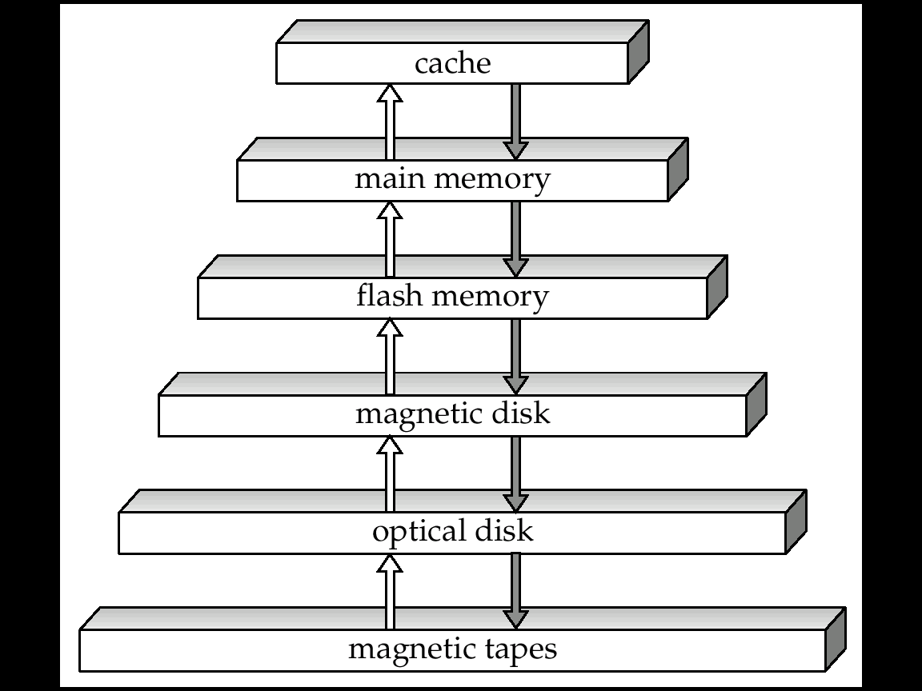
11.1 Physical Storage Media: Overview
Primary storage:
  Fastest media but volatile
  E.g. Cache, Main memory
Secondary storage:
  next level in hierarchy, on-line storage
  non-volatile, moderately fast access time
  E.g. Flash memory, Magnetic disks
Tertiary storage:
  lowest level in hierarchy,
  non-volatile, slow access time
  also called off-line storage
  E.g. Optical storage, Magnetic tape
Storage Hierarchy
11-<number>

Slide 3
Storage Media: Classification
Speed with which data can be accessed
Cost per unit of data
Reliability
  data loss on power failure or system crash
  physical failure of the storage device
Volatile vs. Non-Volatile
  Volatile storage: loses contents when power is switched off
  Non-Volatile storage:
    Contents persist even when power is switched off.
    Includes secondary and tertiary storage, and batter-backed up main-memory.
11-<number>

Slide 4
Storage Media: Cache , Main Memory
Cache:
  fastest and most costly
  Volatile
  managed by the computer system hardware.
Main Memory:
  fast access (10s to 100s of nanoseconds; 1 nanosecond = 10^{–9} seconds)
  generally too small (or too expensive) to store the entire database
  Volatile
11-<number>

Slide 5
Storage Media: Flash Memory
Flash Memory
  Data survives power failure
  Data can be written at a location only once, but location can be erased and written to again
    Can support only a limited number of write/erase cycles.
  Reads are roughly as fast as main memory
  But writes are slow (few microseconds), erase is slower
  Cost per unit of storage roughly similar to main memory
  Widely used in embedded devices such as digital cameras
11-<number>
Notes:
Ssd区别？

Slide 6
Storage Media: Magnetic Disk
Magnetic Disk:
  Data is stored on spinning disk, and read/written magnetically
  Primary medium for the long-term storage of data
  typically stores entire database.
  Data must be moved from disk to main memory for access, and written back for storage
    Much slower access than main memory
  Can direct-access – possible to read data on disk in any order
  Capacities range up to roughly 4 TB currently
    Growing constantly and rapidly with technology improvements (factor of 2 to 3 every 2 years)
  Survives power failures and system crashes
    disk failure can destroy data, but is very rare
11-<number>
Notes:
结束

Slide 7
Storage Media: Optical Storage
Optical Storage:
  non-volatile, data is read optically from a spinning disk using a laser
  CD-ROM (640 MB) and DVD (4.7 to 17 GB) most popular forms
  Write-one, read-many (WORM) optical disks used for archival storage (CD-R and DVD-R)
  Multiple write versions also available (CD-RW, DVD-RW, and DVD-RAM)
  Reads and writes are slower than with magnetic disk
  Juke-box systems自动光盘机, with large numbers of removable disks, a few drives, and a mechanism for automatic loading/unloading of disks available for storing large volumes of data
11-<number>

Slide 8
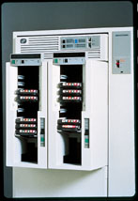
Storage Media: Tape
Tape Storage:
  non-volatile, used primarily for backup (to recover from disk failure), and for archival data
  sequential-access – much slower than disk
  very high capacity (40 to 300 GB tapes available)
  tape can be removed from drive ⇒ storage costs much cheaper than disk, but drives are expensive
  Tape jukeboxes
    available for storing massive amounts of data
    hundreds of terabytes (1 terabyte = 10⁹ bytes)
    to even a petabyte (1 petabyte = 10¹² bytes)
11-<number>

Slide 9
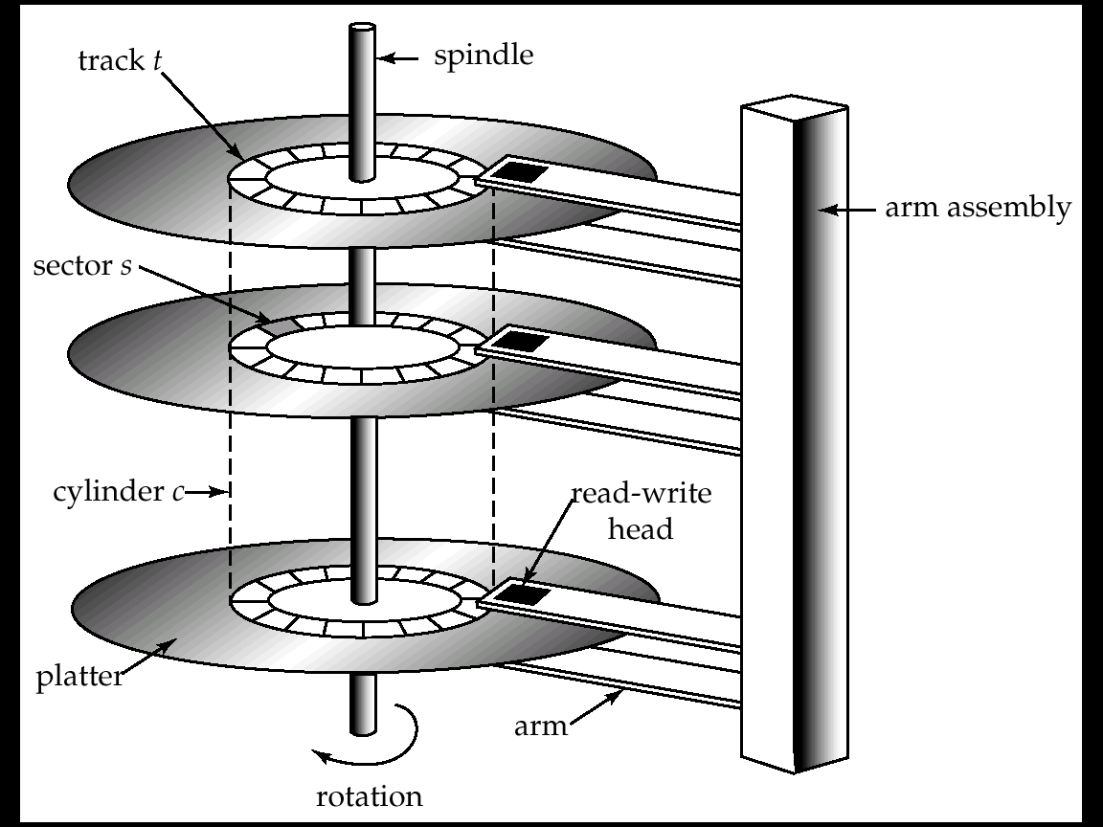
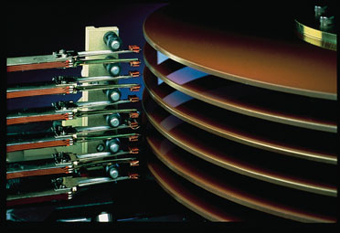
Magnetic Hard Disk Mechanism
11.2 Magnetic Disks
NOTE: Diagram is schematic, and simplifies the structure of actual disk drives
11-<number>

Slide 10
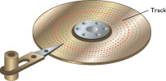
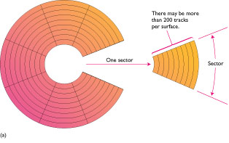
11.2.1 Characteristics of Disks
Read-write head
  Positioned very close to the platter surface (almost touching it)
  Reads or writes magnetically encoded information.
Tracks: Surface of platter divided into circular tracks
  Over 50,000 tracks per platter on typical hard disks
Sectors: Each track is divided into sectors
  A sector is the smallest unit of data that can be read or written.
  Sector size typically 512 bytes
  Typical sectors per track: 500 (on inner tracks) to 1000 (on outer tracks)
To read/write a sector
  disk arm swings to position head on right track
  platter spins continually; data is read/written
  as sector passes under head
11-<number>

Slide 11
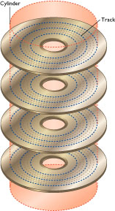
Characteristics of Disks (cont.)
Head-disk assemblies
  multiple disk platters on a single spindle
  one head per platter, mounted on a common arm.
Cylinder柱面: Cylinder i consists of i^{th} track of all the platters
Disk controller
  interfaces between the computer system and the disk
  drive hardware.
  accepts high-level commands to read or write a sector
  initiates actions such as moving the disk arm to the
  right track and actually reading or writing the data
  Computes and attaches checksums to each sector to
  verify that data is read back correctly
  Performs remapping of bad sectors
11-<number>

Slide 12
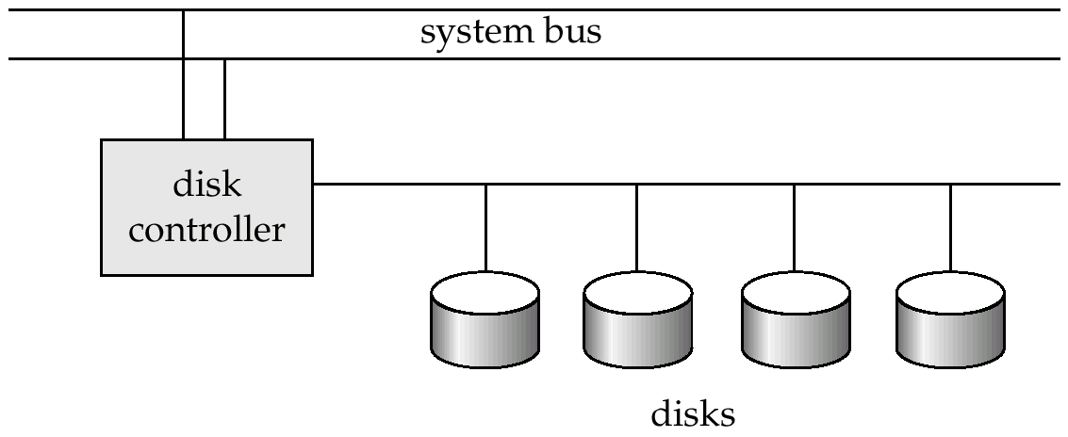
Disk Subsystem
Multiple disks connected to a computer system through a controller
  Controllers functionality (checksum, bad sector remapping) often carried out by individual disks; reduces load on controller
Disk interface standards families
  IDE,SATA, SCSI ,光纤
  Several variants of each standard (different speeds and capabilities)
11-<number>

Slide 13
11.2.2 Performance Measures of Disks
Performance Measures of Disks
  Access time访问时间, Data-transfer rate数据传输率
  Mean time to failure (MTTF) 平均故障时间
Access time
  the time it takes from when a read or write request is issued to when data transfer begins.
  Consists of:
    Seek time 寻道– time it takes to reposition the arm over the correct track.
      Average seek time is 1/2 the maximum seek time. if all tracks had the same number of sectors
      ignore the time to start and stop arm movement
      4 to 10 milliseconds on typical disks
    Rotational latency 旋转等待– time it takes for the sector to be accessed to appear under the head.
      Average latency is 1/2 of the worst case latency.
      4 to 11 milliseconds on typical disks (5400 to 15000 r.p.m.)
11-<number>

Slide 14
Performance Measures (cont.)
Data-transfer Rate
  the rate at which data can be retrieved from or stored to the disk.
  I.e. data be transferred between disk and main memory
  20 to 100 MB per second is typical
  Multiple disks may share a controller, so rate that controller can handle is also important
    E.g. ATA-5: 66 MB/sec, SATA: 150 MB/sec, Ultra 320 SCSI: 320 MB/s
Mean Time to Failure (MTTF)
  the average time the disk is expected to run continuously without any failure.
  Typically 3 to 5 years
11-<number>

Slide 15
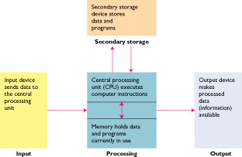
11.2.3 Optimization of Disk-Block Access
Access to data in disk is several orders of magnitude slower than access to data in main memory
Block
  a contiguous sequence of sectors from a single track
  data is transferred between disk and main memory in blocks
  sizes range from 512 bytes to several kilobytes
    Smaller blocks: more transfers from disk
    Larger blocks: more space wasted due to partially filled blocks
    Typical block sizes today range from 4 to 16 kilobytes
Study on techniques for improving the speed of access to blocks on disk
11-<number>
Notes:
块德概念
磁盘的最小存储单位是扇区，数据存储的最小单位是块！
其实就是sector是对磁盘的概念，block是对文件系统的概念。
块是文件系统层的，mkfs时可以设置块的大小

Slide 16
Disk-Block Access: Method 1, 2
Method 1: Buffering of Blocks
  Using buffer to store blocks to satisfy future requests
  Section 11.5 will discuss more
Method 2: Disk-Arm-Scheduling
  algorithms order pending accesses to tracks so that disk arm movement is minimized
  Elevator Algorithm : move disk arm in one direction (from outer to inner tracks or vice versa), processing next request in that direction, till no more requests in that direction, then reverse direction and repeat
升降式
11-<number>

Slide 17
Disk-Block Access: Method 3
Method 3: File organization
  Store related information on the same or nearby cylinders
    Optimize block access time by organizing the blocks to correspond to how data will be accessed
  Defragment:
    Files may get fragmented碎片化over time
      E.g. if data is inserted to/deleted from the file
      Or free blocks on disk are scattered, and newly created file has its blocks scattered over the disk
      Sequential access to a fragmented file results in increased disk arm movement
    Some systems have utilities to defragment the file system, in order to speed up file access
    Re- organization
四散
11-<number>

Slide 18
Disk-Block Access: Method 4
Method 4: Using Nonvolatile write buffers
  Speed up disk writes by writing blocks to a non-volatile RAM buffer immediately
  Non-volatile RAM: battery backed up RAM or flash memory
    Even if power fails, the data is safe and will be written to disk when power returns
  Controller then writes to disk whenever the disk has no other requests or when the NVRAM buffer becomes full
  Database operations that require data to be safely stored before continuing can continuing without waiting for data to be written to disk
  Writes can be reordered to minimize disk arm movement
11-<number>

Slide 19
Disk-Block Access: Method 5
Method 5: Using a Special Log Disk
  A disk devoted to writing a sequential log of block updates
  Used exactly like nonvolatile RAM
    Write to log disk is very fast since no seeks are required
    No need for special hardware (NV-RAM)
Write
Time
log
database
11-<number>

Slide 20
11.3 RAID
RAID (Redundant Arrays of Independent Disks，冗余独立磁盘阵列)
  disk organization techniques that manage a large numbers of disks, providing a view of a single disk of
    high capacity and high speed by using multiple disks in parallel, and
    high reliability by storing data redundantly, so that data can be recovered even if a disk fails
Originally a cost-effective alternative to large, expensive disks
  I in RAID originally stood for ``inexpensive’’
  Today RAIDs are used for their higher reliability and bandwidth.
    The “I” is interpreted as independent
11-<number>

Slide 21

RAID: Levels
11-<number>
Notes:
http://wiki.dzsc.com/info/4972.html
RAID2 称为纠错海明码磁盘阵列，其设计思想是利用海明码实现数据校验冗余。海明码是一种在原始数据中加入若干校验码来进行错误检测和纠正的编码技术

Slide 22
11.4 Tertiary Storage
Optical Disks
  Compact disk-read only memory (CD-ROM)
  Digital Video Disk (DVD)
  Record once versions (CD-R and DVD-R)
Magnetic Tapes
11-<number>

Slide 23
11.4.1 Optical Disks
Compact disk-read only memory (CD-ROM)
  Disks can be loaded into or removed from a drive
  High storage capacity (640 MB per disk)
  High seek times or about 100 msec (optical read head is heavier and slower)
  Higher latency (3000 RPM) and lower data-transfer rates (3-6 MB/s) compared to magnetic disks
Digital Video Disk (DVD)
  DVD-5 holds 4.7 GB , and DVD-9 holds 8.5 GB
  DVD-10 and DVD-18 are double sided formats with capacities of 9.4 GB and 17 GB
Record once versions (CD-R and DVD-R) are becoming popular
  data can only be written once, and cannot be erased.
  high capacity and long lifetime; used for archival storage
  Multi-write versions (CD-RW, DVD-RW and DVD-RAM) also available
11-<number>

Slide 24
11.4.2 Magnetic Tapes
Hold large volumes of data and provide high transfer rates
  Few GB for DAT (Digital Audio Tape) format, 10-40 GB with DLT (Digital Linear Tape) format, 100 GB+ with Ultrium format, and 330 GB with Ampex helical scan format
  Transfer rates from few to 10s of MB/s
Currently the cheapest storage medium
  Tapes are cheap, but cost of drives is very high
Very slow access time in comparison to magnetic disks and optical disks
  limited to sequential access.
  Some formats (Accelis) provide faster seek (10s of seconds)
Used mainly for backup,
Tape jukeboxes used for very large capacity storage
  (terabyte (10¹² bytes) to petabye (10¹⁵ bytes)
11-<number>

Slide 25
Introduction to Database
CHAPTER 11
Storage and File Structure
Overview of Physical Storage Media
Magnetic Disks
RAID
Tertiary Storage
Storage Access
File Organization
Organization of Records in Files
Data-Dictionary Storage
11-<number>

Slide 26
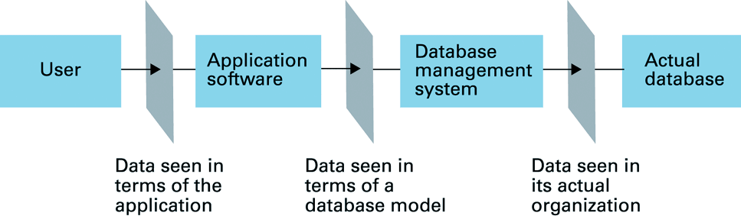
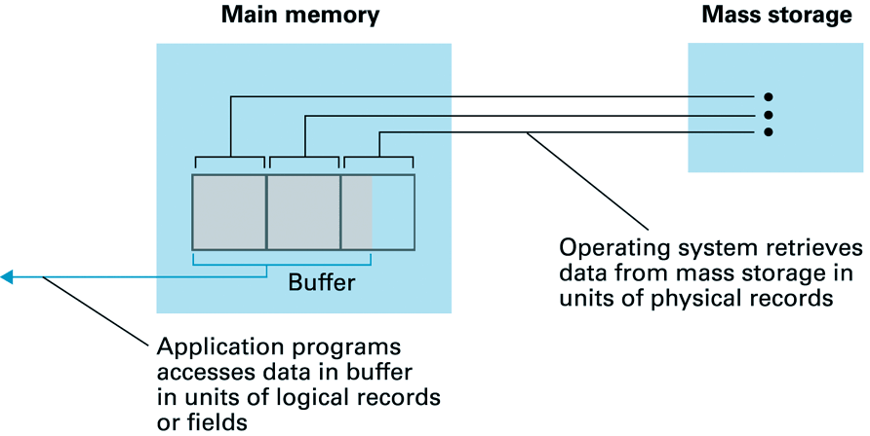
11.5 Storage Access
Database: is mapped into a number of files
A database file
  is partitioned into fixed-length
  storage units called blocks.
  Blocks are units of both storage
  allocation and data transfer.
Program
DISK
blocks
CPU
11-<number>

Slide 27
Storage Access (cont.)
Reduce the number of block transfers
  Database system seeks to minimize the number of block transfers between the disk and memory.
  We can reduce the number of disk accesses by keeping as many blocks as possible in main memory.
Buffer
  portion of main memory available to store copies of disk blocks.
Buffer manager
  subsystem responsible for allocating buffer space in main memory.
11-<number>

Slide 28
11.5.1 Buffer Manager
Programs call on the Buffer Manager when they need a block from disk.
  If the block is already in the buffer, the requesting program is given the address of the block in main memory
  If the block is not in the buffer,
    the buffer manager allocates space in the buffer for the block, replacing (throwing out) some other block, if required, to make space for the new block.
    The block that is thrown out is written back to disk only if it was modified since the most recent time that it was written to/fetched from the disk.
    Once space is allocated in the buffer, the buffer manager reads the block from the disk to the buffer, and passes the address of the block in main memory to requester.
Buffer-Replacement Policies
11-<number>

Slide 29
11.5.2 Buffer-Replacement Policies
Policy 1: First in first out (FIFO)
Policy 2: Least Recently Used (LRU)
  Most operating systems replace the block by LRU strategy
Queries have well-defined access patterns (such as sequential scans), and a database system can use the information in a user’s query to predict future references
  LRU can be a bad strategy for certain access patterns involving repeated scans of data
    e.g. when computing the join of 2 relations r and s by a nested
    loops
    for each tuple tr of r do
    for each tuple ts of s do
    if the tuples tr and ts match …
先進先出
最近最少使用者先出
11-<number>
Notes:
?

Slide 30
Buffer-Replacement Policies (cont.)
Policy 3: Toss-immediate strategy – frees the space occupied by a block as soon as the final tuple of that block has been processed
Policy 4: Most recently used (MRU) strategy –
  Pinned block – memory block that is not allowed to be written back to disk
  system must pin the block currently being processed.
  After the final tuple of that block has been processed, the block is unpinned, and it becomes the most recently used block.
Other Policy : Buffer manager can use statistical information regarding the probability that a request will reference a particular relation
  E.g., the data dictionary is frequently accessed.
  Heuristic: keep data-dictionary blocks in main memory buffer
剛用者先出
探索法的,歸納的
11-<number>
Notes:
结束

Slide 31
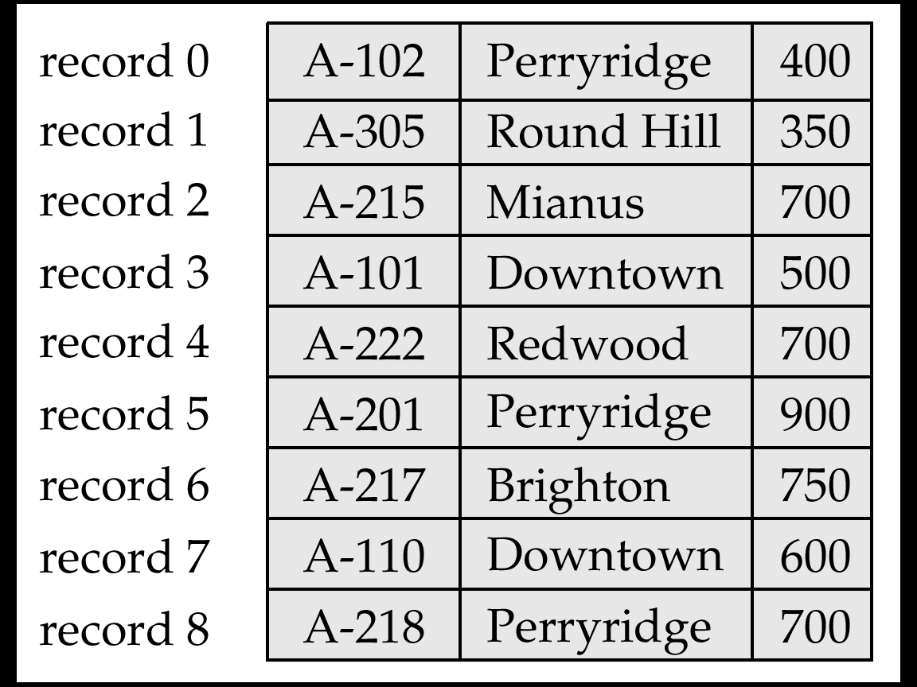

11.6 File Organization
The database is stored as a collection of files.
  Each file is a sequence of records.
  A record is a sequence of fields.
File Organization
  How to organize the relations (records) and store in a disk?
  The ways of representing logical data model (tables) by using files (in disk)
Disk File
table
11-<number>

Slide 32
11.6.1 Fixed-Length Records
The Approach:
  Assume record size is fixed
  Each file has records of one particular type only
  Different files are used for different relations
  This case is easiest to implement
11-<number>

Slide 33
Fixed-Length Records (cont.)
Simple approach:
  Store record i starting from byte n ∗ (i – 1), where n is the size of each record.
  Record access is simple but records may cross blocks
    Modification: do not allow records to cross block boundaries
Deletion of record i
- Alternatives Methods: (see next pages)
  Move All: move records i + 1, . . ., n
  to i, . . . , n – 1
  Move Last One: move record n to i
  Using Free List: do not move records,
  but link all free records on a free list
11-<number>

Slide 34
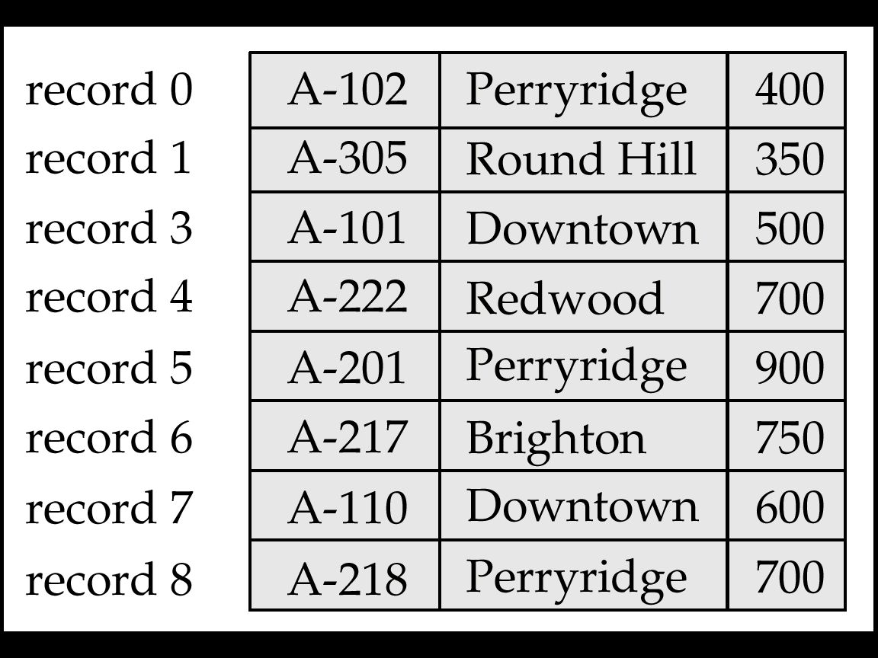
1) Move All: Record 2 deleted and all records moved
Fixed-Length Records Delete: Move All
11-<number>

Slide 35
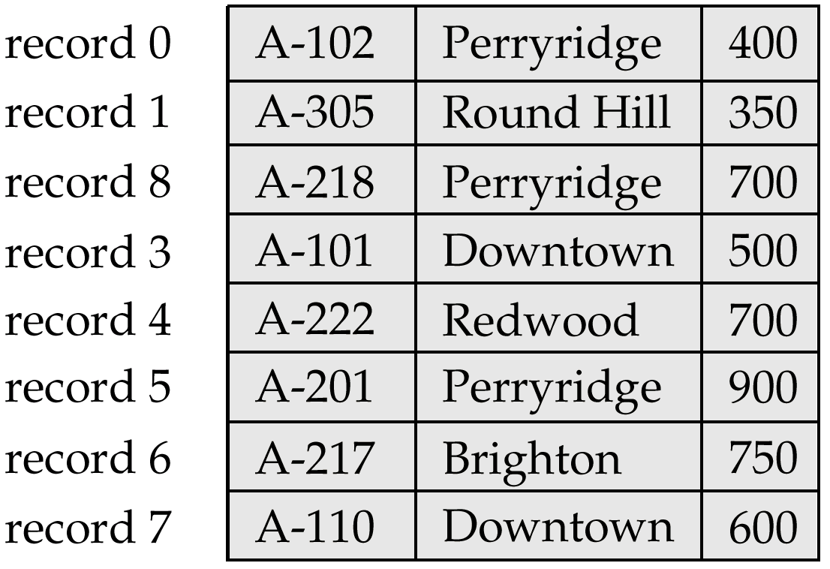
2) Move Last One: Record 2 deleted and final record moved
Fixed-Length Records Delete: Move Last One
11-<number>

Slide 36
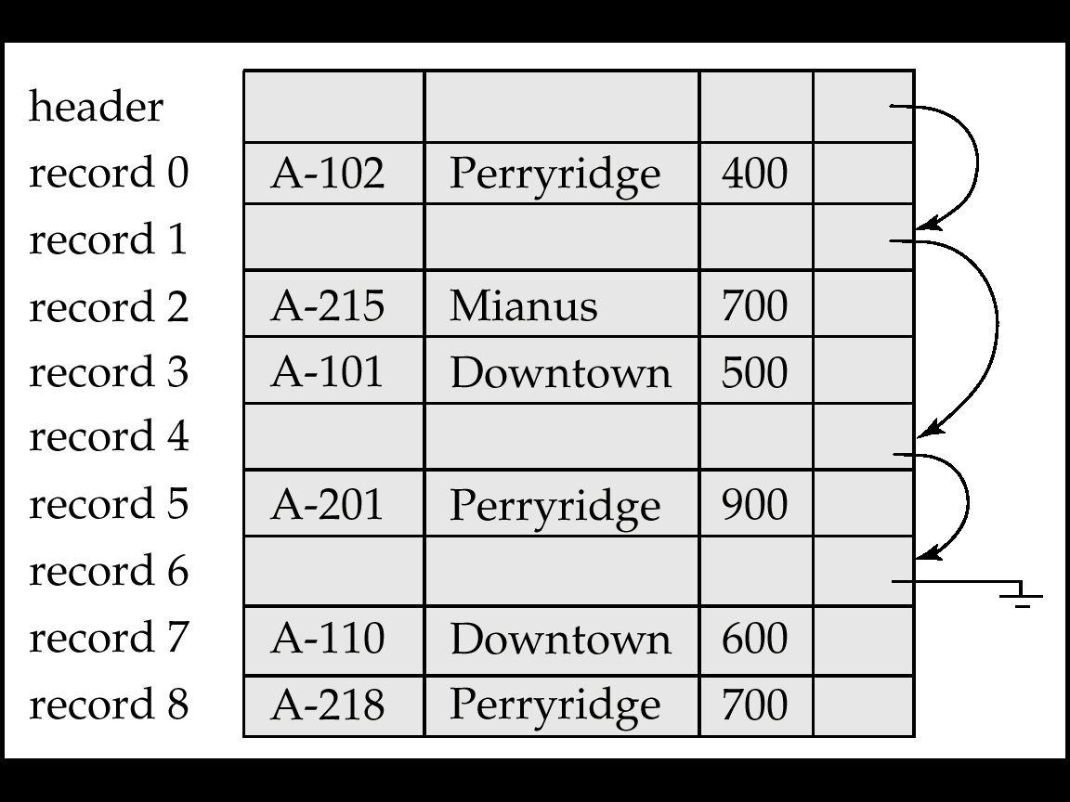
Fixed-Length Records Delete: Free List
Store the address of the first deleted record in the file header.
Use this first record to store the address of the second deleted record, and so on
Can think of these stored addresses as pointers since they “point” to the location of a record.
More space efficient representation: reuse space for normal attributes of free records to store pointers. (No pointers stored in in-use records.)
3) Using Free Lists
11-<number>

Slide 37
11.6.2 Variable-Length Records
Variable-length records arise in database systems in several ways:
  Storage of multiple record types in a file. e.g. S, P, SP in a file
  Record types that allow variable lengths for one or more fields.
Representation Methods:
  1) Byte String Representation
    1. Basic Method
    2. Slotted Page Method 分槽的页结构
  2) Fixed-Length Representation
    1. Reserved Space Method
    2. List Representation Method
11-<number>

Slide 38
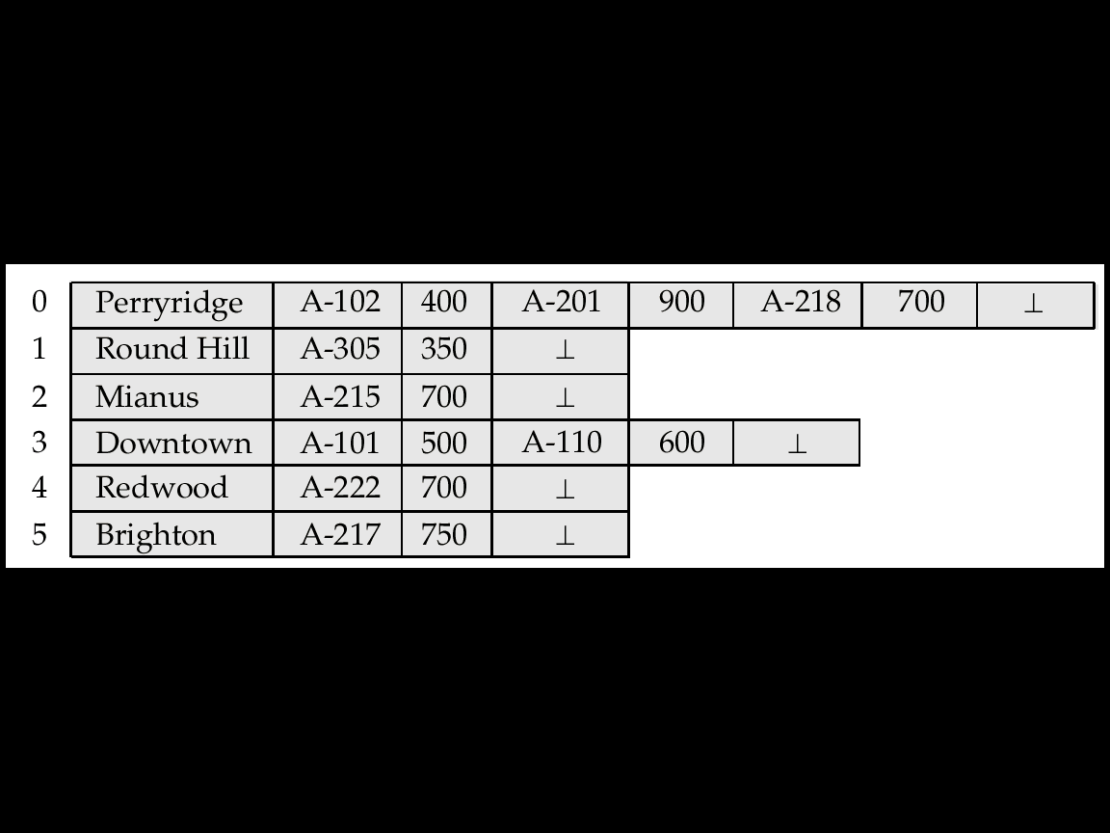
Byte-String Representation:
Basic Method
Byte string representation: Basic Method
  Attach an end-of-record (⊥) control character to the end of each record
  Advantage:
  Disadvantages:
    Not easy to reuse space after a deletion
    Difficulty with growth
Disk File
account
11-<number>

Slide 39
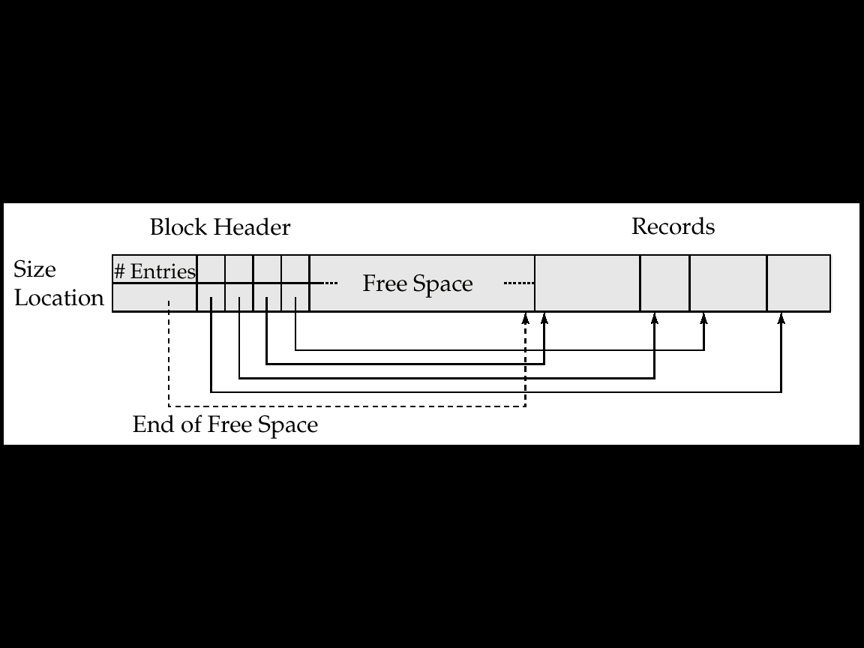
Byte-String Representation:
Slotted Page 分槽页结构Method
槽
Slotted page header contains:
  number of record entries
  end of free space in the block
  location and size of each record
Records can be moved around within a page to keep them contiguous with no empty space between them; entry in the header must be updated.
Pointers should not point directly to record — instead they should point to the entry for the record in header.
4
11-<number>

Slide 40
Byte-String Representation:
Slotted Page Method (cont.)
Insertion
Deletion
How to insert?
How to delete?
11-<number>

Slide 41
Comparison: Fixed vs. Variable-Length
Disk File
account
Disk File
11-<number>

Slide 42
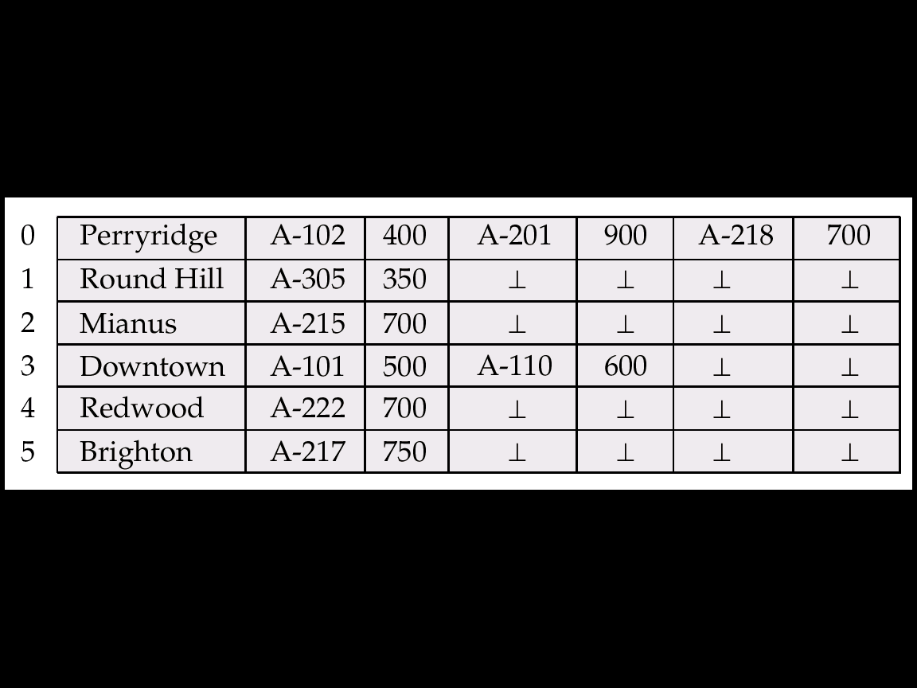
2) Fixed-length Representation
Fixed-length representation:
  Reserved space
  Pointers
1. Fixed-length Representation with Reserved Space
  use fixed-length records of a known maximum length
  unused space in shorter records filled with a null or end-of-record symbol.
11-<number>

Slide 43
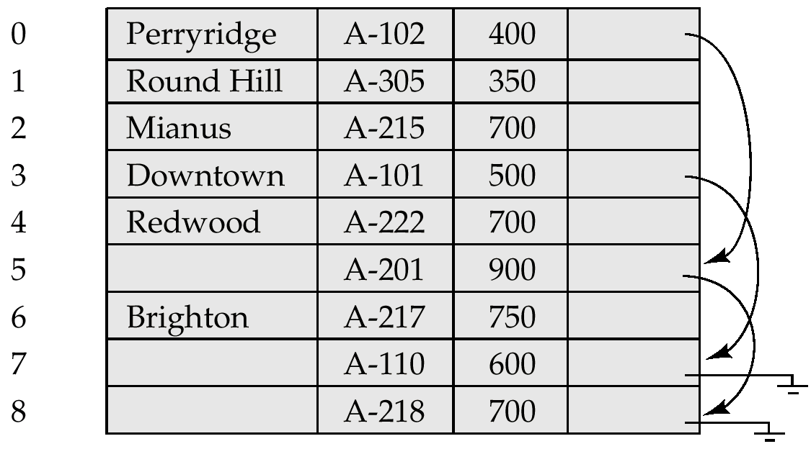
Fixed-length Representation with Pointer
2. Fixed-length Representation with Pointer
  A variable-length record is represented by a list of fixed-length records, chained together via pointers.
  Can be used even if the maximum record length is not known
11-<number>
Notes:
?

Slide 44
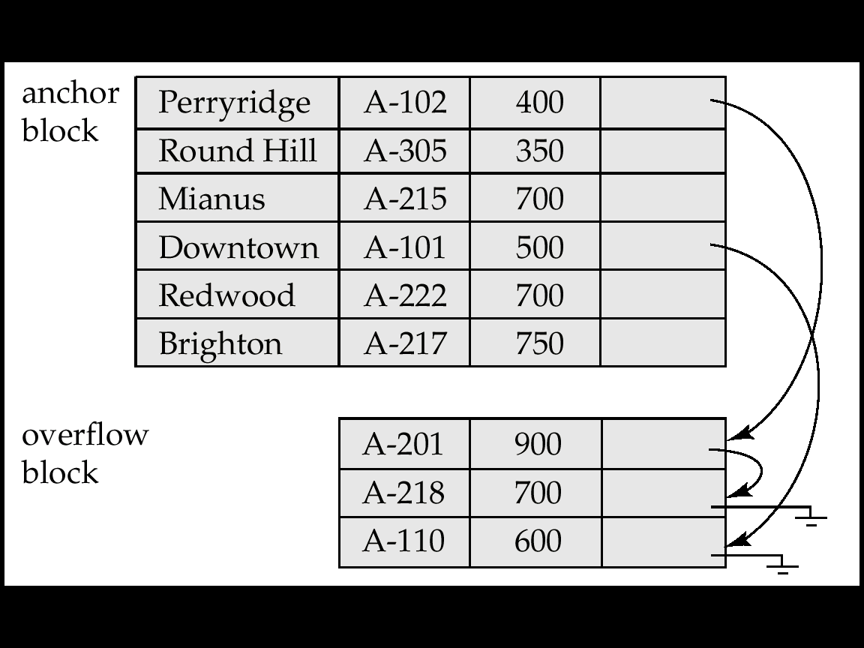
Fixed-length Represent. with Pointer (改良式)
Disadvantage to pointer structure; space is wasted in all records except the first in a a chain.
Solution is to allow two kinds of block in file:
  Anchor block – contains the first records of chain
  Overflow block – contains records other than those that are the first records of chairs.
錨
11-<number>

Slide 45
11.7 Organization of Records in Files
Heap File堆文件 Organization
  a record can be placed anywhere in the file where there is space
Sequential File顺序文件 Organization (ch. 11.7.1)
  store records in sequential order, based on the value of the search key of each record
Hashing File散列文件 Organization (ch. 12)
  a hash function computed on some attribute of each record;
  the result specifies in which block of the file the record should be placed
Note: How to Store records of each relation
  Generally, separate file is used to store the records of each relation
  In a clustering file聚集文件 organization records of several different relations can be stored in the same file
    Motivation: store related records on the same block to minimize I/O
11-<number>

Slide 46
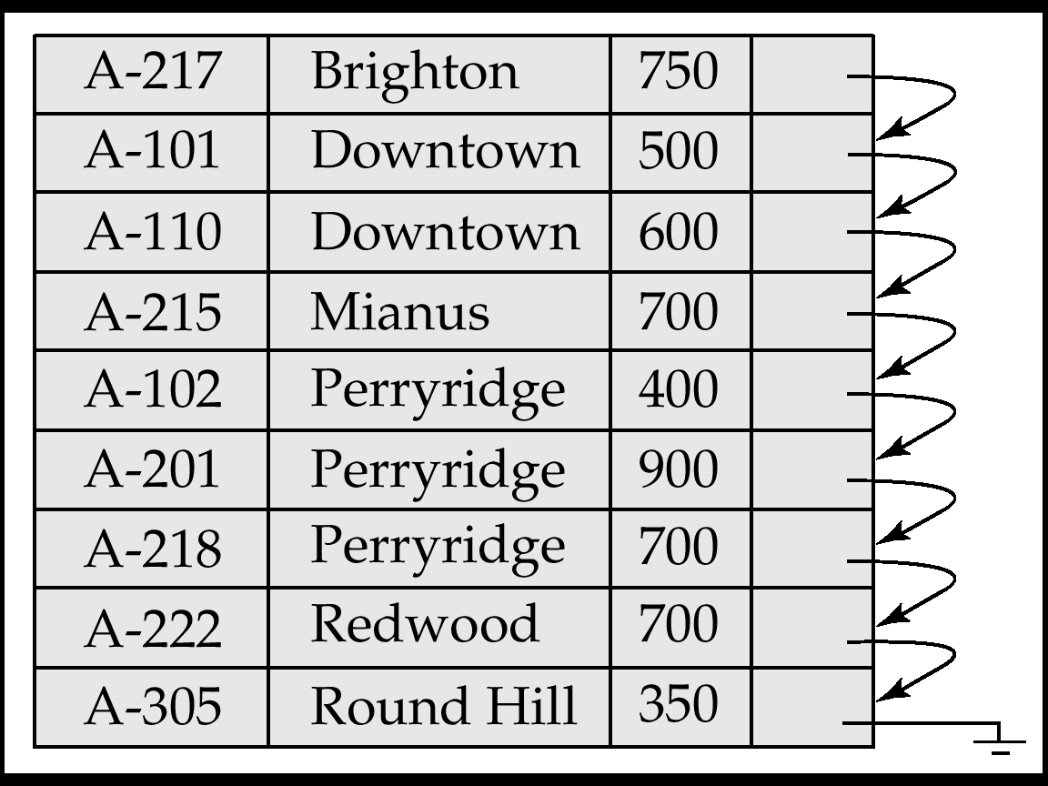
11.7.1 Sequential File Organization
Suitable for applications that require sequential processing of the entire file
The records in the file are ordered by a search-key
search-key
11-<number>

Slide 47
Sequential File Organization (cont.)
Deletion – use pointer chains
Note: Need to reorganize the file from time to time to restore
sequential order
How to delete?
11-<number>

Slide 48
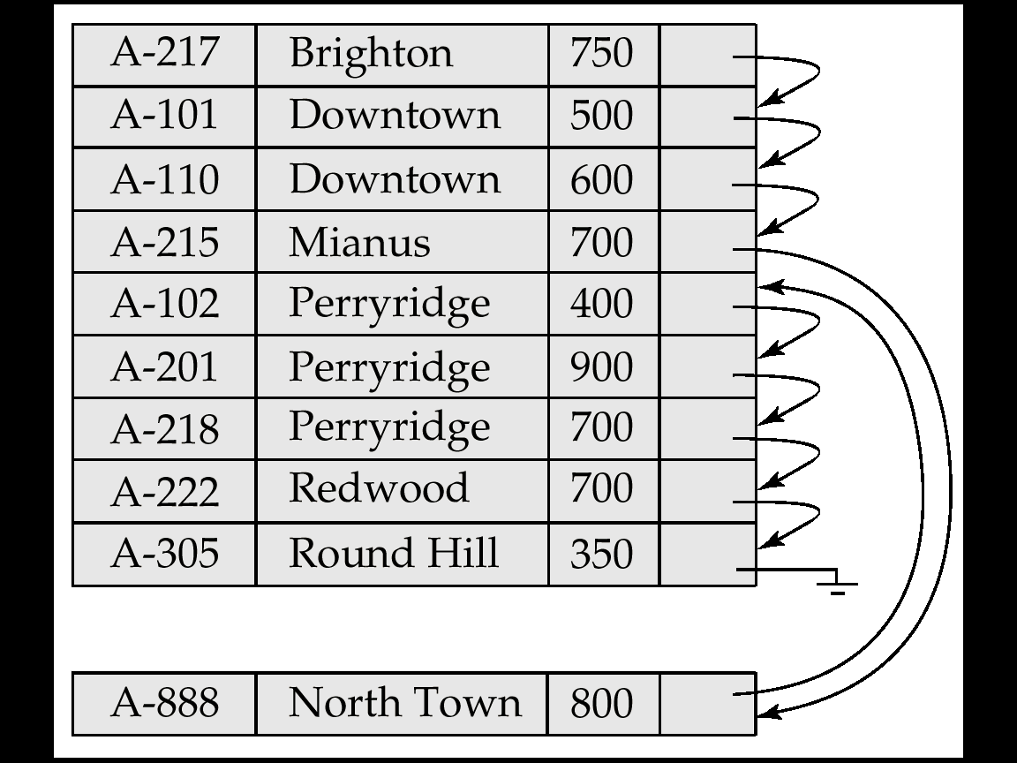
Sequential File Organization (cont.)
Insertion –locate the position where the record is to be inserted
  if there is free space insert there
  if no free space, insert the record in an overflow block
  In either case, pointer chain must be updated
Note: Need to reorganize the file from time to time to restore
sequential order
How to insert?
overflow block
11-<number>

Slide 49
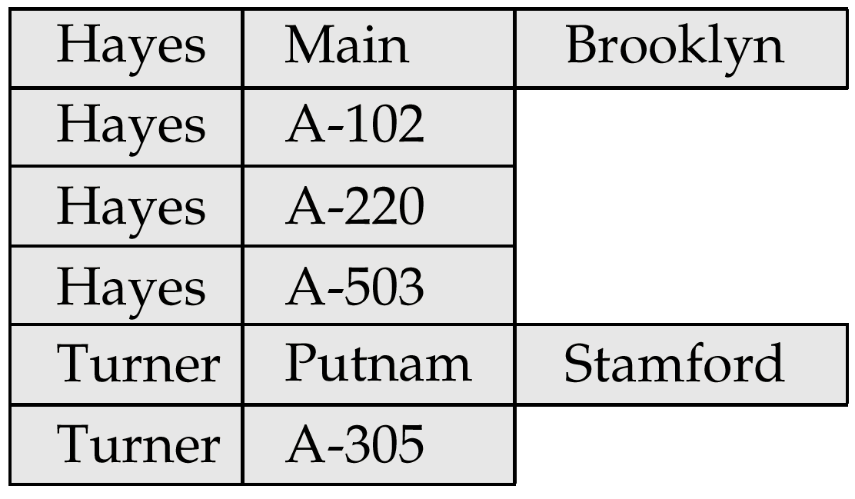
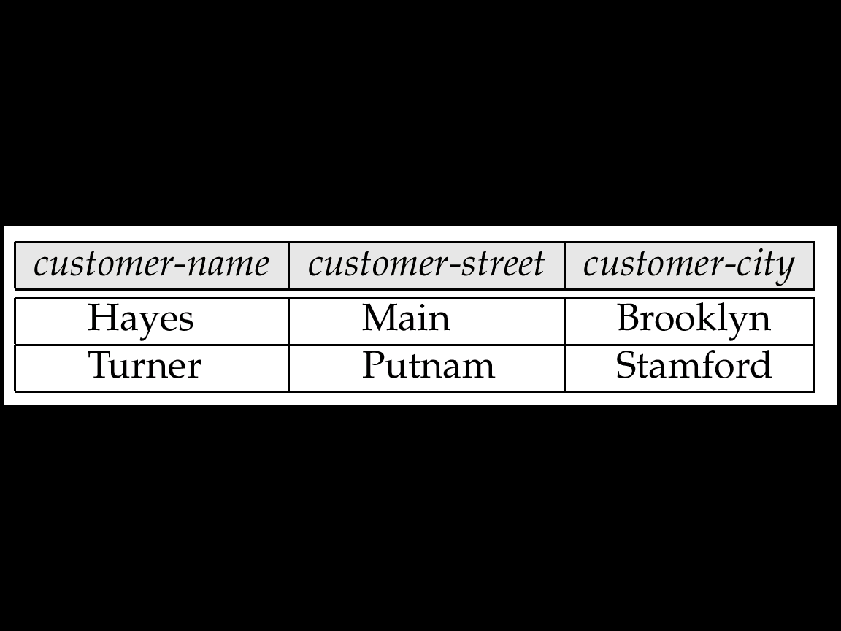
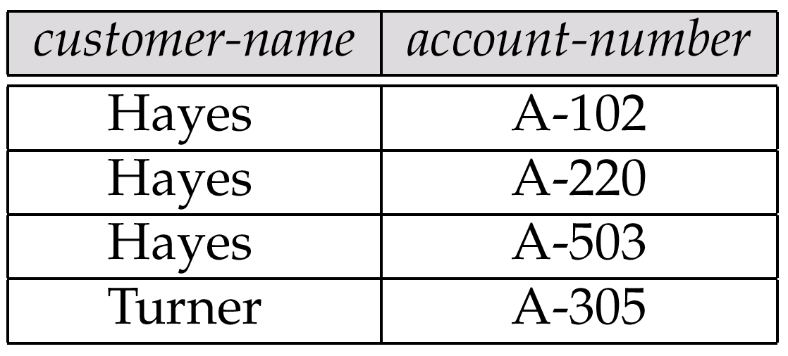
11.7.2 Clustering File Organization
Simple file structure stores each relation in a separate file
Can instead store several relations in one file using a clustering file organization
E.g., clustering organization of customer and depositor:
群集
customer
depositor
Fig. 11.19
  good for queries involving depositor, customer, and for queries involving one single customer and his accounts
  bad for queries involving only customer
  results in variable size records
11-<number>

Slide 50
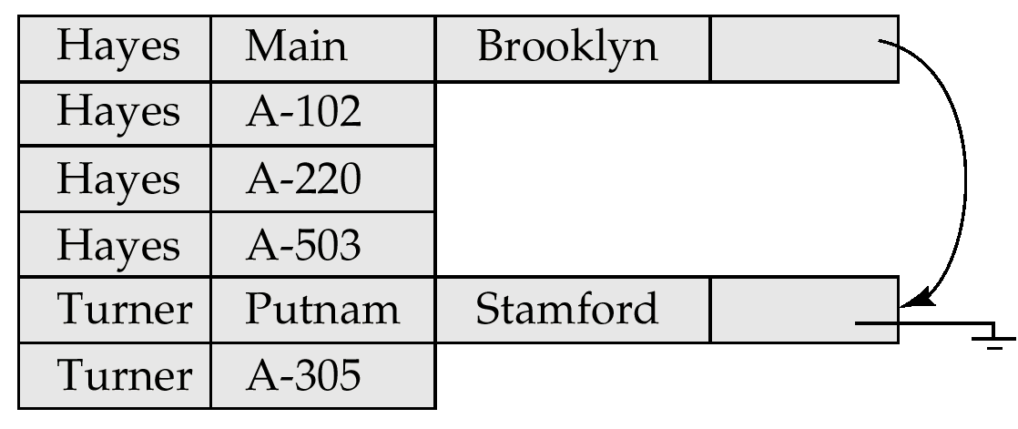
Clustering File Structure With Pointer Chains
Fig. 11.19
Without Pointer Chains
Fig. 11.20
With Pointer Chains
11-<number>

Slide 51
11.8 Data Dictionary Storage
Data Dictionary数据字典 (also called System Catalog)
  stores metadata: that is, data about data
Contents of Data dictionary
  Information about relations
    names of relation
    names and types of attributes of each relation
    names and definitions of views
    integrity constraint
  User and accounting information, including passwords
  Statistical and descriptive data
    number of tuples in each relation
  Physical file organization information
    How relation is stored (sequential/hash/…)
    Physical location of relation
      operating system file name or
      disk addresses of blocks containing records of the relation
  Information about indices (Chapter 12)
11-<number>
Notes:
数据字典

Slide 52
Data Dictionary Storage (cont.)
Catalog structure: can use either
  specialized data structures designed for efficient access
  a set of relations, with existing system features used to ensure efficient access
    usually preferred
A possible catalog representation:
Relation-metadata = (relation-name, number-of-attributes,
storage-organization, location)
Attribute-metadata = (attribute-name, relation-name, domain-type,
position, length)
User-metadata = (user-name, encrypted-password, group)
Index-metadata = (index-name, relation-name, index-type, index-attributes)
View-metadata = (view-name, definition)
11-<number>

