Slide 1
Chapter 15: Transactions

Slide 2
Chapter 15: Transactions
Transaction Concept(事务概念)
Transaction State（事务状态）
Concurrent Executions（并发执行）
Serializability（可串行化）
Recoverability（可恢复性）
Implementation of Isolation（隔离性的实现）
Transaction Definition in SQL（SQL中的事务定义）
Testing for Serializability.（可串行性测试）

Slide 3
Transaction Concept
A transaction is a unit of program execution that accesses and possibly updates various data items.
A transaction must see a consistent database.
During transaction execution the database may be temporarily inconsistent.
When the transaction completes successfully (is committed), the database must be consistent.

Slide 4
Transaction Concept
After a transaction commits, the changes it has made to the database persist, even if there are system failures.
Multiple transactions can execute in parallel.
Two main issues to deal with:
  Failures of various kinds, such as hardware failures and system crashes
  Concurrent execution of multiple transactions

Slide 5
ACID Properties
Atomicity原子性. all in one.
Consistency一致性. Database is in consistent before and after a transaction is finished
Isolation隔离性. Although multiple transactions may execute concurrently, each transaction must be unaware of other concurrently executing transactions.
Durability持久性. After a transaction completes successfully, the changes it has made to the database persist, even if there are system failures.

Slide 6
Example of Fund Transfer
Transaction to transfer $50 from account A to account B:
  1. read(A)
  2. A := A – 50
  3. write(A)
  4. read(B)
  5. B := B + 50
  6. write(B)
Notes:
▪ 丢失修改（Lost Update）
▪ 不可重复读（Non-repeatable Read）
▪ 读“脏”数据（Dirty Read）

Slide 7
Example of Fund Transfer (Cont.)
Atomicity requirement —
Consistency requirement —
Isolation requirement —
Durability requirement —

Slide 8
Transaction State
Active – the initial state; the transaction stays in this state while it is executing
Partially committed – after the final statement has been executed.
Failed -- after the discovery that normal execution can no longer proceed.
Aborted – after the transaction has been rolled back and the database restored to its state prior to the start of the transaction. Two options after it has been aborted:
Committed – after successful completion.
Notes:
Restart
kill

Slide 9

Transaction State (Cont.)

Slide 10
Concurrent Executions
Multiple transactions are allowed to run concurrently in the system. Advantages are:
  increased processor and disk utilization
  reduced average response time
Concurrency control schemes – mechanisms to achieve isolation; that is, to control the interaction among the concurrent transactions in order to prevent them from destroying the consistency of the database

Slide 11





Concurrent Database Access
Even more software
Select…
Update…
Create Table…
Drop Index…
Help…
Delete…
More software
DBMS
Data

Slide 12
Concurrent Access: Attribute-level Inconsistency
Update College Set enrollment = enrollment + 1000
Where cName = ‘Stanford’
concurrent with …
Update College Set enrollment = enrollment + 1500
Where cName = ‘Stanford’

Slide 13
Concurrent Access: Tuple-level Inconsistency
Update Apply Set major = ‘CS’ Where sID = 123
concurrent with …
Update Apply Set decision = ‘Y’ Where sID = 123

Slide 14
Concurrent Access: Table-level Inconsistency
Update Apply Set decision = ‘Y’
Where sID In (Select sID From Student Where GPA > 3.9)
concurrent with …
Update Student Set GPA = (1.1) ∗ GPA Where sizeHS > 2500

Slide 15
Concurrent Access: Multi-statement inconsistency
Insert Into Archive
Select * From Apply Where decision = ‘N’;
Delete From Apply Where decision = ‘N’;
concurrent with …
Select Count(*) From Apply;
Select Count(*) From Archive;

Slide 16
Schedules
Schedule – a sequences of instructions that specify the chronological order in which instructions of concurrent transactions are executed
  a schedule for a set of transactions must consist of all instructions of those transactions
  must preserve the order in which the instructions appear in each individual transaction.

Slide 17

Schedule 1
Let T₁ transfer $50 from A to B, and T₂ transfer 10% of the balance from A to B.
A serial schedule in which T₁ is followed by T₂:

Slide 18

Schedule 2
A serial schedule where T₂ is followed by T₁

Slide 19

Schedule 3
Let T₁ and T₂ be the transactions defined previously. The following schedule is not a serial schedule, but it is equivalent to Schedule 1.
In Schedules 1, 2 and 3, the sum A + B is preserved.

Slide 20

Schedule 4
The following concurrent schedule does not preserve the value of (A + B).

Slide 21
Serializability 可串行性化
Basic Assumption –
  Each transaction preserves database consistency.
  Thus serial execution of a set of transactions preserves database consistency.

Slide 22
Serializability
A (possibly concurrent) schedule is serializable可串行化 if it is equivalent to a serial schedule
  1. conflict serializability冲突可串行化调度
We ignore operations other than read and write instructions, and our simplified schedules consist of only read and write instructions.

Slide 23
Conflicting Instructions
Instructions l_{i} and l_{j} of transactions T_{i} and T_{j} respectively, conflict if and only if there exists some item Q accessed by both l_{i} and l_{j}, and at least one of these instructions wrote Q.
1. l_{i} = read(Q), l_{j} = read(Q). l_{i} and l_{j} don’t conflict.
2. l_{i} = read(Q), l_{j} = write(Q). They conflict.
3. l_{i} = write(Q), l_{j} = read(Q). They conflict
4. l_{i} = write(Q), l_{j} = write(Q). They conflict

Slide 24
Conflict Serializability
If a schedule S can be transformed into a schedule S´ by a series of swaps of non-conflicting instructions, we say that S and S´ are conflict equivalent 冲突等价的.
a schedule S is conflict serializable if it is conflict equivalent to a serial schedule

Slide 25


Conflict Serializability (Cont.)
Schedule 3 can be transformed into Schedule 6, a serial schedule by series of swaps of non-conflicting instructions.
Schedule 3
Schedule 6

Slide 26

Conflict Serializability (Cont.)
Example of a schedule that is not conflict serializable:
We are unable to swap instructions in the above schedule to obtain either the serial schedule < T₃, T₄ >, or the serial schedule < T₄, T₃ >.

Slide 27

Testing for Serializability 判定
Consider some schedule of a set of transactions T₁, T₂, ..., T_{n}
Precedence优先 graph — a direct graph
  the vertices are the transactions (names).
  arc from T_{i} to T_{j} if the two transaction conflict, and T_{i} accessed the data item on which the conflict arose earlier.
Example 1
x
y
Notes:
读写
写读
写写

Slide 28
Example Schedule (Schedule A) + Precedence Graph
T₁ T₂ T₃ T₄ T₅
read(X)
read(Y)
read(Z)
read(V)
read(W)
read(W)
read(Y)
write(Y)
write(Z)
read(U)
read(Y)
write(Y)
read(Z)
write(Z)
read(U)
write(U)
T₁
T₂
T₄
T₃

Slide 29

Test for Conflict Serializability
A schedule is conflict serializable if and only if its precedence graph is acyclic无环.
Cycle-detection algorithms exist which take order n² time, where n is the number of vertices in the graph.
  (Better algorithms take order n + e where e is the number of edges.)

Slide 30
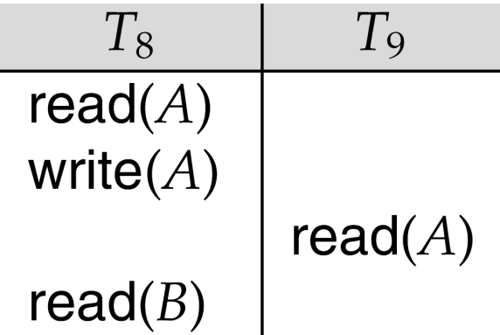
Recoverable 可恢复调度 Schedules
Recoverable schedule — if a transaction T_{j} reads a data item previously written by a transaction T_{i} , then the commit operation of T_{i} appears before the commit operation of T_{j}.
The following schedule (Schedule 11) is not recoverable if T₉ commits immediately after the read
If T₈ should abort, T₉ would have read (and possibly shown to the user) an inconsistent database state. Hence, database must ensure that schedules are recoverable.

Slide 31

Cascading Rollbacks 级联回滚
Cascading rollback – a single transaction failure leads to a series of transaction rollbacks. Consider the following schedule where none of the transactions has yet committed (so the schedule is recoverable)
If T₁₀ fails, T₁₁ and T₁₂ must also be rolled back.
Can lead to the undoing of a significant amount of work

Slide 32
Cascadeless Schedules
Cascadeless schedules — cascading rollbacks cannot occur; for each pair of transactions T_{i} and T_{j} such that T_{j} reads a data item previously written by T_{i}, the commit operation of T_{i} appears before the read operation of T_{j}.
Every cascadeless schedule is also recoverable
It is desirable to restrict the schedules to those that are cascadeless

Slide 33
Concurrency Control
A database must provide a mechanism that will ensure that all possible schedules are
  conflict serializable, and
  are recoverable and preferably cascadeless
A policy in which only one transaction can execute at a time generates serial schedules, but provides a poor degree of concurrency
  Are serial schedules recoverable/cascadeless?
Goal – to develop concurrency control protocols that will assure serializability.
Notes:
?

Slide 34
Concurrency Control vs. Serializability Tests
Concurrency control protocols generally do not examine the precedence graph as it is being created
  Instead a protocol imposes a discipline that avoids nonseralizable schedules.
  We study such protocols in Chapter 16.
Different concurrency control protocols provide different tradeoffs between the amount of concurrency they allow and the amount of overhead that they incur.
Tests for serializability help us understand why a concurrency control protocol is correct.

Slide 35
End of Chapter

Slide 36
Levels of Consistency in SQL-92
Serializable — default
Repeatable read — only committed records to be read, repeated reads of same record must return same value. However, a transaction may not be serializable – it may find some records inserted by a transaction but not find others.
Read committed — only committed records can be read, but successive reads of record may return different (but committed) values.
Read uncommitted — even uncommitted records may be read.
Lower degrees of consistency useful for gathering approximate information about the database

Slide 37
Transaction Definition in SQL
Data manipulation language must include a construct for specifying the set of actions that comprise a transaction.
In SQL, a transaction begins implicitly.
A transaction in SQL ends by:
  Commit work commits current transaction and begins a new one.
  Rollback work causes current transaction to abort.
Levels of consistency specified by SQL-92:
  Serializable — default
  Repeatable read
  Read committed
  Read uncommitted

Slide 39
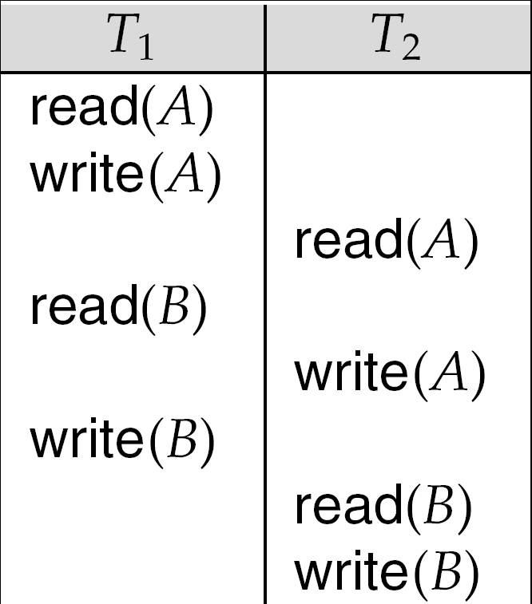

Slide 40

Schedule 7

Slide 41
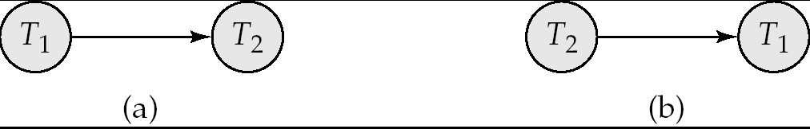
Precedence Graph for
(a) Schedule 1 and (b) Schedule 2

Slide 42
Illustration of Topological Sorting

Slide 43
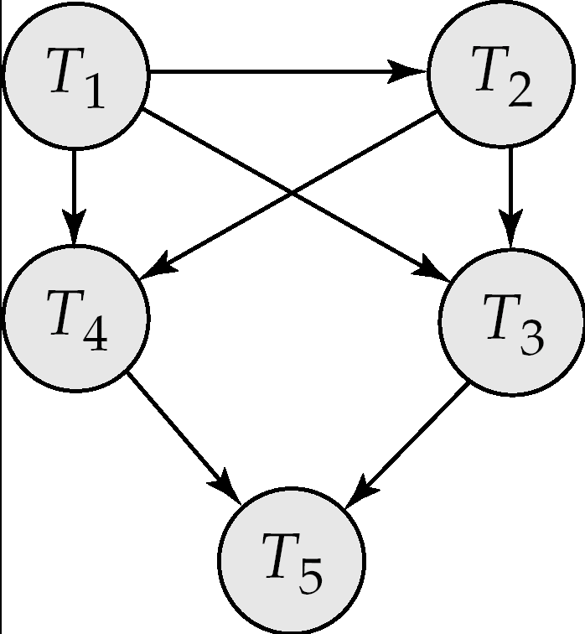
Precedence Graph

Slide 44
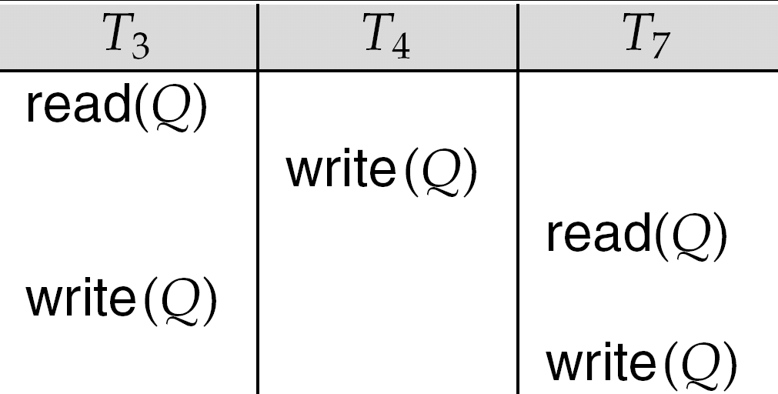
fig. 15.21

Slide 45
Implementation of Isolation
Schedules must be conflict or view serializable, and recoverable, for the sake of database consistency, and preferably cascadeless.
A policy in which only one transaction can execute at a time generates serial schedules, but provides a poor degree of concurrency.
Concurrency-control schemes tradeoff between the amount of concurrency they allow and the amount of overhead that they incur.
Some schemes allow only conflict-serializable schedules to be generated, while others allow view-serializable schedules that are not conflict-serializable.

Slide 46
Figure 15.6

Slide 47

Figure 15.12

