Slide 1
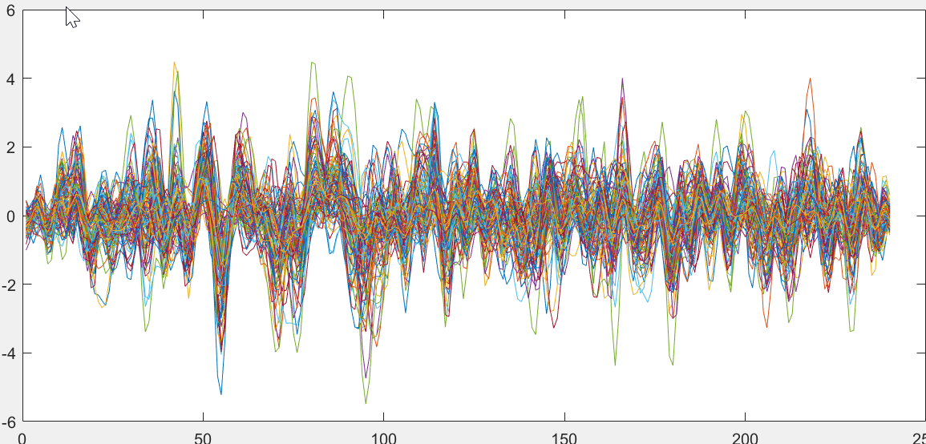
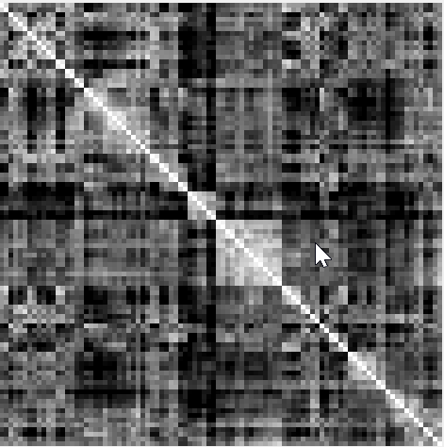
The goal is to tell if a person is healthy or not based on his fMRI data
(1) perform sequence classification, as shown in the left
(2) Graph neural networks
Most GNN’s are confined to static cases
Meaning that only a single correlation matrix is computed for each subject
fMRI
Time index
Each person is represented as a sequence of correlation matrices (brain functional networks)

