Slide 1

Welcome to Our Experiment!

Slide 2

Overview
In this study, you will see images and numbers appearing on the screen.
Each image tells you where to pay attention next.
Your job is to judge whether the numbers at the attended location are odd or even.

Slide 3
The Asterisk
Each trial will start with a flashing asterisk * in either the left or right stream.
The asterisk will tell you which side to attend to
Always keep your eyes on the central +.
*
+
+
*
Notes:
Do we need fixation point for the training?

Slide 4
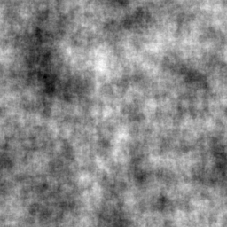
Noise Images
After the asterisk appears, both locations will show rapidly changing noise images.
Keep your attention on the side where the asterisk just appeared.
*
+
Notes:
Do we need fixation point for the training?

Slide 5
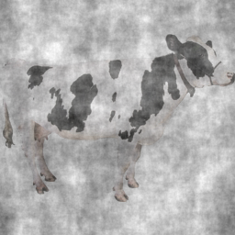
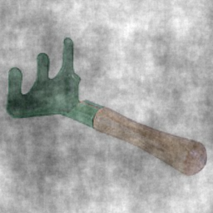
Target Images
Then, a target image flashes at the cued location where the asterisk appeared
This image is either an ANIMAL or a NON-ANIMAL object
If you see an Animal
SHIFT your attention to the OTHER side
If you see a Non-Animal
KEEP your attention on the SAME side
*
+
+
*
Notes:
Do we need fixation point for the training?

Slide 6
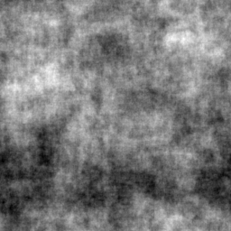
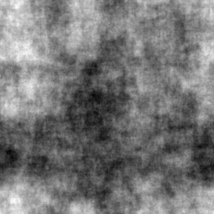
Your Response
After the target image, two numbers then appears at each side
Report the number at the location indicated by the image.
Press Z if the number is ODD.
Press M if the number is EVEN.
Respond as quickly as you can while still being accurate.
4
+
5
Notes:
Do we need fixation point for the training?

Slide 7
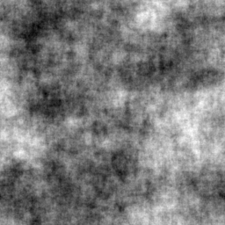
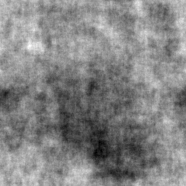
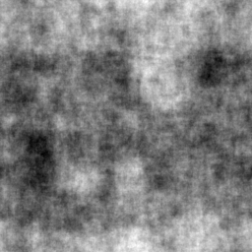
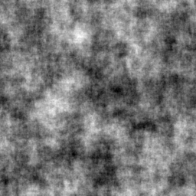
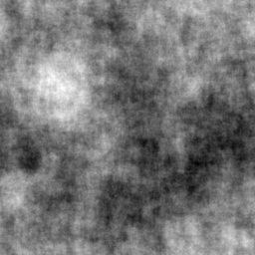
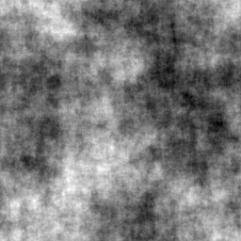
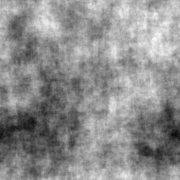
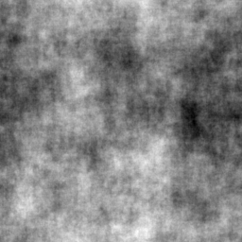
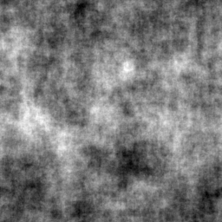
Example 1
Hold attention at left stream
*
+
1
+
6
4
7
Hold attention
+
Press M to report Even number
ANI.
2
+
4
7
9
+
5
Time
4
7
2
+
1

Slide 8
Example 2
Hold attention at left stream
*
+
1
+
6
4
7
Shift attention
+
Press Z to report Odd number
ANI.
2
+
9
5
4
+
7
Time
4
7
2
+
1

