Slide 1
Data Analysis Process Project
Exploring Kaggles Airbnb dataset by Hollie Whitehead Anthony

Slide 2
I will guide you through my analysis process of Airbnb activity in New York City.
I will explore specific features of this vast dataset including:
  Room type (whole house, private room, and shared room)
  Price per night.
  Number of reviews
  Availability
  Neighborhood where the listing is located

Slide 3
Let us begin with our question:
How does the number of reviews relate to the price, availability, or other features of the listing?
Let the analysis begin!
I loaded all my python libraries and did a brief inspection of the entire dataset. For efficiency I collected only the features I was interested in and created a smaller dataset to work from.

Slide 4

Data Inspection:
I looked at statistical information.
Structure of the data and its types
Checked for null values
Ensured value consistency and no negative values
Distribution with skew
Ended with checking for duplicates.

Slide 5
Data Cleaning
All that inspecting and I only uncovered duplicates! I removed approximately 25% of my data. It is now squeaky clean and ready to analyze.
Made note that the distribution was highly right tailed for my price column.

Slide 6
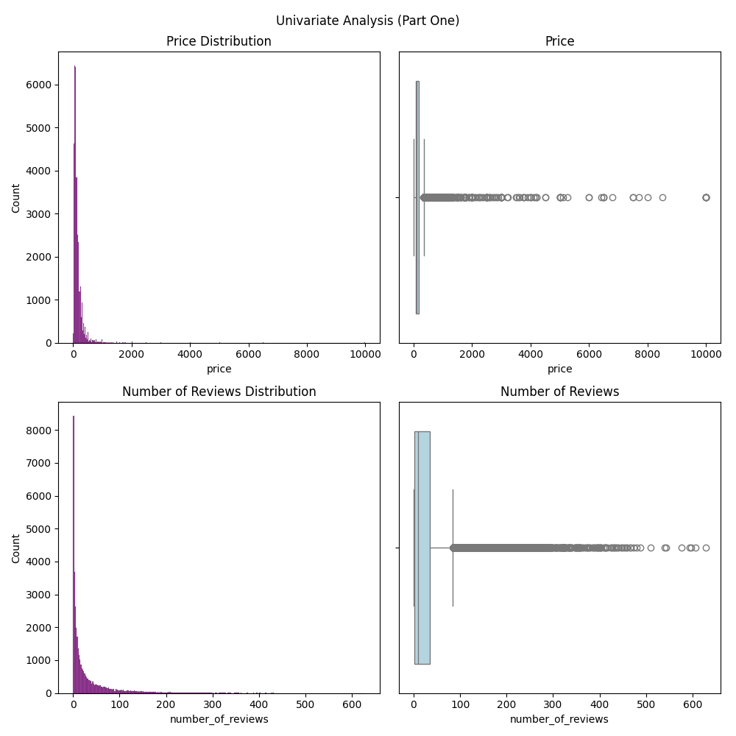
Univariate analysis:
I created histograms and box plots to SEE what my data looks like.
Both distributions for price and number of reviews are heavily right tailed with large amounts of outliers, which I wanted to keep due to the nature of the data
The other features were fairly distributed and raised no concerns.

Slide 7
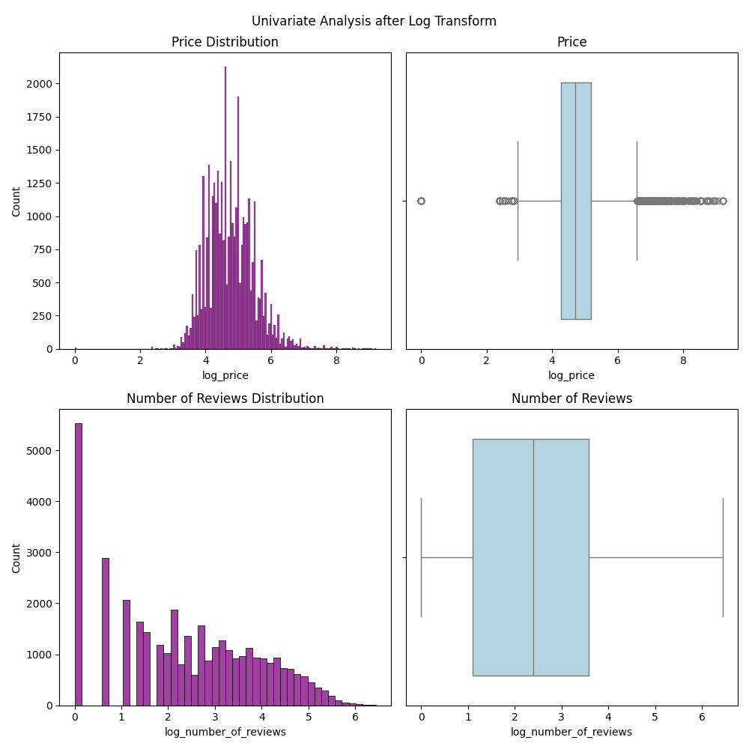
Lets deal with that heavy right tail and outliers:
I decided to transform my data with log transform, my intention was to create a more normal distribution, minimize the influence of the outliers and stabilize the data for more accurate analysis.
I created another visualization to ensure I got the results I wanted.
From the charts we have much more stabilized data to work with now.
Fun Fact - skewness comparison values (0 is best) for the price data went from 17.9 to 0.55! And Number of Reviews went from 3.2 to 0.06.

Slide 8
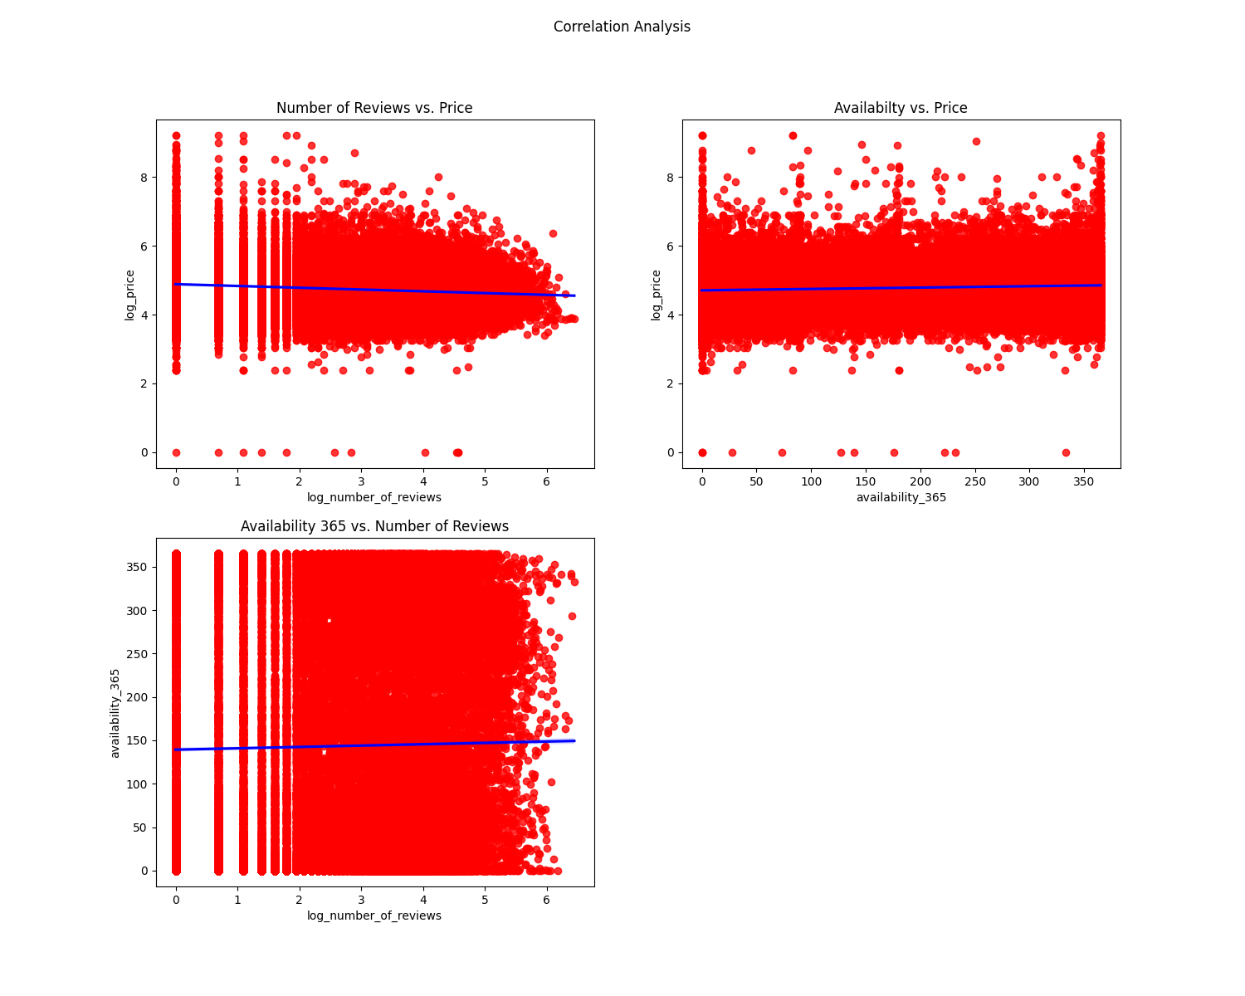
Lets dig into exploratory data analysis
Here I began by plotting my scatter plots with trendlines.
For all of these comparisons (reference graphs), there is no evidence to support any strong correlations.
We can see this from our fairly horizontal blue trendline and our box like points.

Slide 9
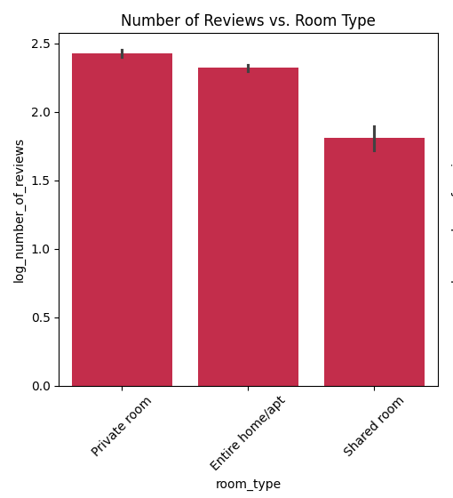
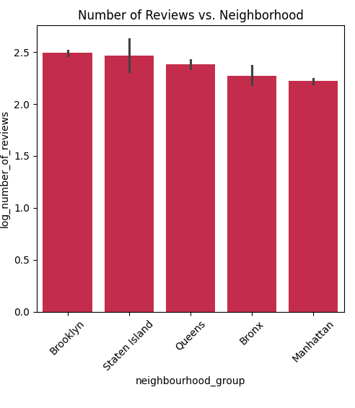
Analyzing Number of Reviews:
This visualization shows us the number of reviews in reference to room type. From this we see that private rooms receive the highest amount of reviews, followed by entire homes and shared rooms receive the least amount.
Further analysis point: we could dig deeper and find out why private rooms receive the highest number of reviews. i.e. – are these more frequently rented.
From our number of reviews across the neighborhood groups, Brooklyn takes the lead, followed by Staten Island, Queens, Bronx and Manhattan having the least amount of reviews.
Further analysis point: we could also dig in deeper to analyze the why of these results. I found it intriguing that Manhattan came in at the lowest but it is the more in demand and centralized location.

Slide 10
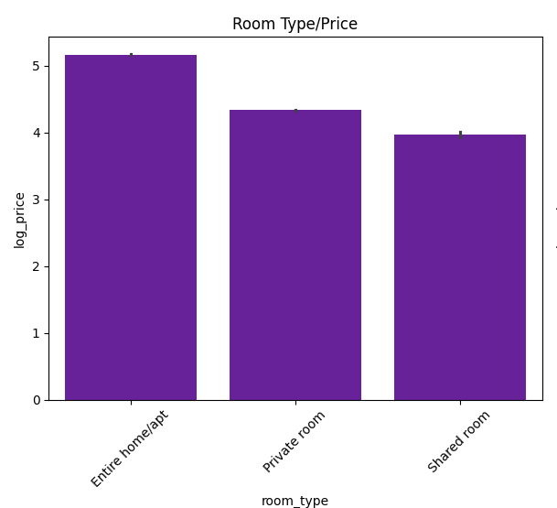
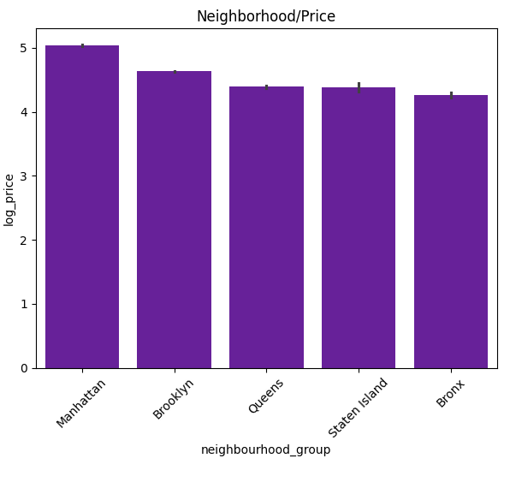
Now lets check out our categorical data with bar charts:
I created this chart by grouping my values into the different room parts. From the chart we can see that the average price is highest for an entire house/apt, followed by private rooms and the lowest prices being from shared rooms. This analysis supports the assumption that entire homes would cost more than its smaller accommodations.
I also created the Neighborhood/Price chart by grouping the data into the 5 different neighborhood sections. We can see that Manhattan takes the lead with the highest average price, followed by Brooklyn, Queens, Staten Island and lastly the Bronx. This analysis supports assumptions that prices tend to be higher in more central and in demand areas compared to its surrounding areas.

Slide 11

Lets conclude the EDA with the fun part! Seeing if we can predict Room Type from Price and Neighborhood and evaluating how well our machine models worked.
I compared the Decision Tree Classifier, Logistic Regression model and Random Forest Classifier. I loaded from sklearn, defined my variables, encoded the categorical variables, split the data into train and test. Then trained the models, tested them and evaluated them.
Overall accuracy of these models was similar at about 80%. The models predicted entire home section very well, followed by private room predictions but honestly failed terribly predicting shared room portion.
I believe this to be because of an imbalance of data. Shared rooms had a much lower value count compared to entire home and private room value counts.
Because of the similar performances, I conclude that there needs to be more data or features to predict room type accurately. Price and neighborhood are not the only things to consider.

Slide 12
What does this all mean?
Back to our original question now that you have had the tour. How does the number of reviews relate to the price, availability, or other features of the listing?
From our scatter plots that show us patterns and relationships, I conclude that availability and number of reviews has a very weak relation to the price. There is also enough evidence to conclude that availability has a very weak relation to the number of reviews.
I can also conclude from our bar charts that there is evidence to support that location and room type may reflect the price of the listing. Although from our prediction models, I would suggest further analysis to check other factors that would reflect the price of the listing as well.
Next Steps:
I would dive into the popularity of these listings, I would want to know if the cheaper shared rooms are more popular than entire homes. Do more people stay in the centralized locations compared to the surrounding areas. What are the types of groups staying in these places, are they families, couples, work related, leisure. Sometimes with an extensive opportunity like this the curiosity just never seems to end!

Slide 13
Project Reflection
I really enjoyed this project, it was a great mix of numerical and categorical data. Some relationships surprised me and the data intrigued me. I learned a lot and there is still a lot more to learn! That seems to be the beauty of analysis. I found this project helped me in creating my individuality for the analysis process. Some methods I chose I’m sure seem repetitive to advanced analysis, but I assure you the repetitiveness was intended for memory purposes.
In the process I found myself doing one thing only to realize I forgot another and go back and redo, great way to remember is when you have to redo something because you forgot!
I enjoy projects like these as it is my best way to learn. I was given a new tool belt with lots of new tools these past few months and it was very satisfying to finally get to use them. I felt like I understood the concepts but now I understand how to use them.
I’m sure the skills I need are still vast, but my goal right now is code memory and just familiarizing myself with what to type and memorizing the language so I can recall it better. As well as interpretations, sometimes things are hard to interpret, especially if you’ve never seen them before so they really make you think.
This was a great experience and I find with every assignment and project I complete, I learn more, especially from my mistakes and error codes! Every time I start the process though, I find there is a new section that comes straight from memory and not referencing my notes and demos helping to build my confidence.

Slide 14
Thank you for taking the tour of my analysis process!
THE END!

