Slide 1
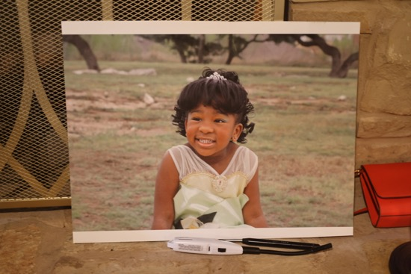
Lauryn's
HBCU Celebration
Add your featured photo here
Prairie View A&M University
A Night to Remember • Full Event Keepsake
June 20, 2026
PVAMU • Class of 2030

Slide 2
Getting Ready
Family prepares for the big celebration

Slide 3
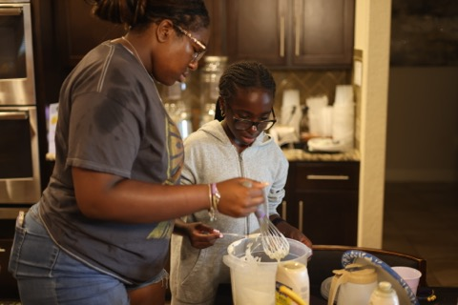
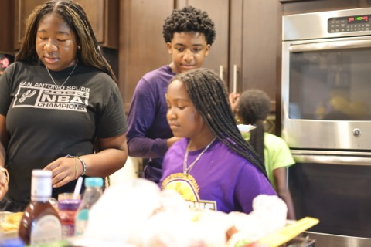
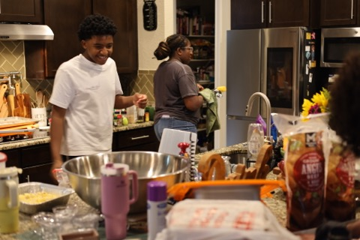
S1 • 1/3
The setup begins 💛
Family pulling together
Working Together

Slide 4
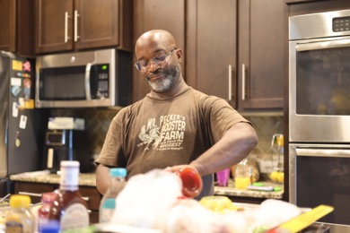
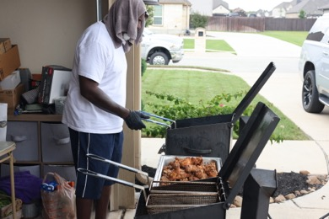
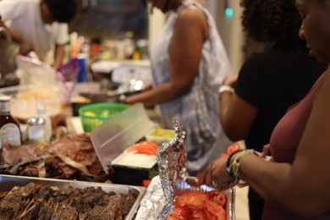
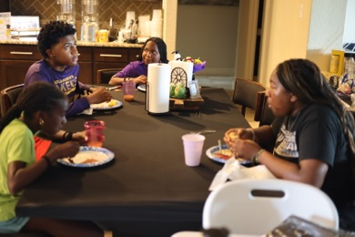
S1 • 2/3

Slide 5
The Final Prep
Every detail tells a story

Slide 6
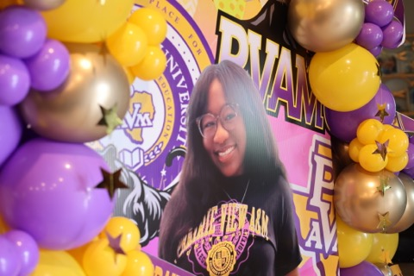
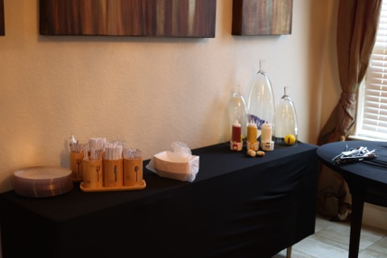
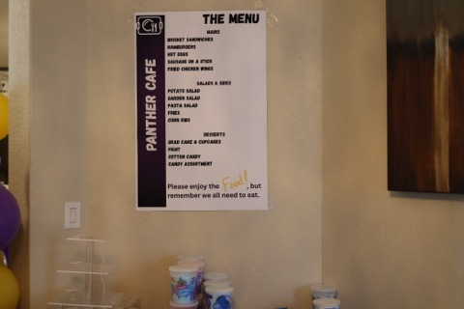
S2 • 1/2
PVAMU purple everywhere 💜

Slide 7
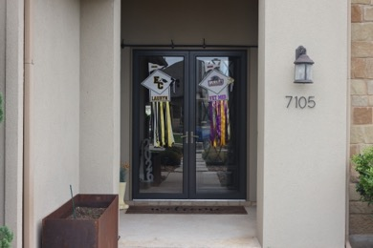
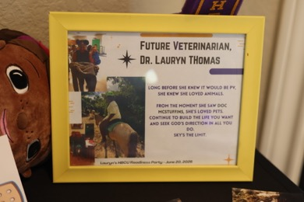
S2 • 2/2
Table settings fit for a queen
The decorations shine

Slide 8
Guests & the Grad
An evening filled with love and celebration

Slide 9
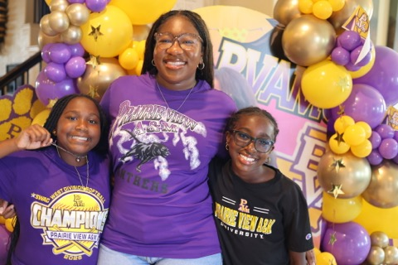
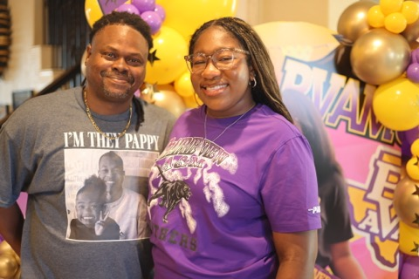
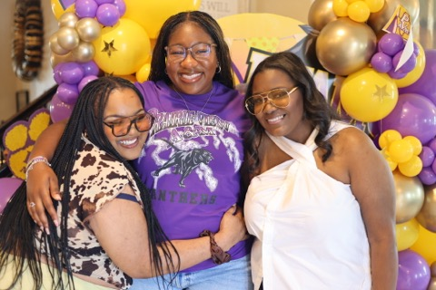
S3 • 1/9
Welcome, everyone!
So happy you're here
Cherished family moments

Slide 10

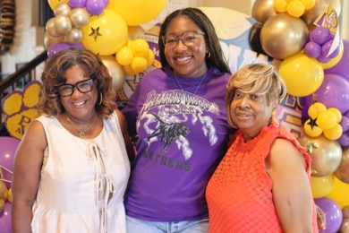
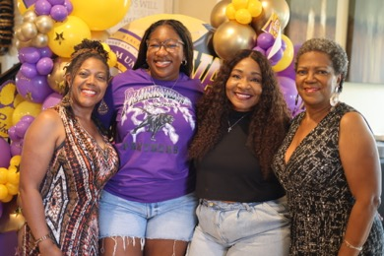
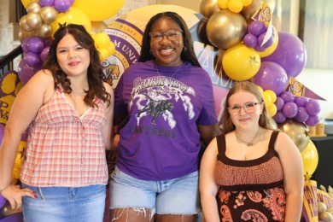
S3 • 2/9
Friends who feel like family
Lauryn glowing all night
Catching up and celebrating
The grad and her people

Slide 11
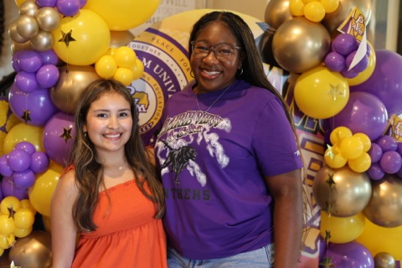
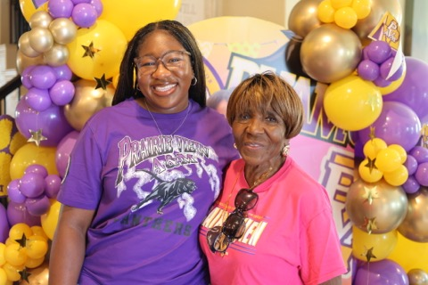
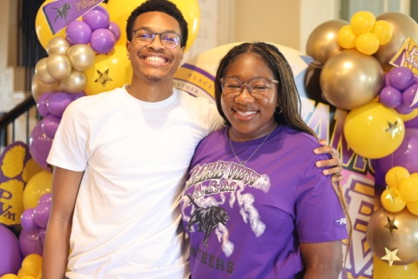
S3 • 3/9
Smiles all around 😊
Photo memories for life
Pure joy in this moment

Slide 12
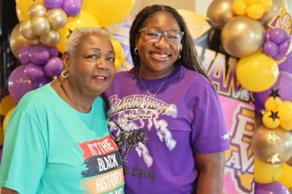
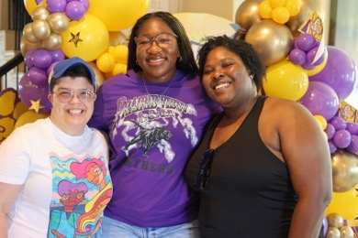
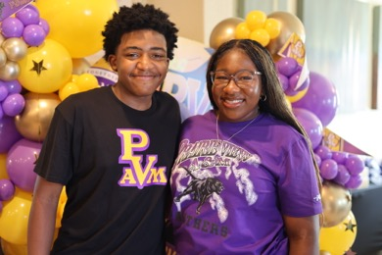
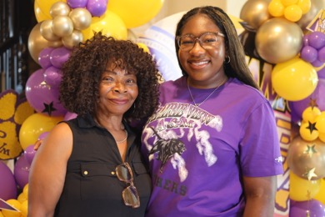
S3 • 4/9
Sharing the Love!
The love in this room 💜
Golden moments
Together we celebrate

Slide 13
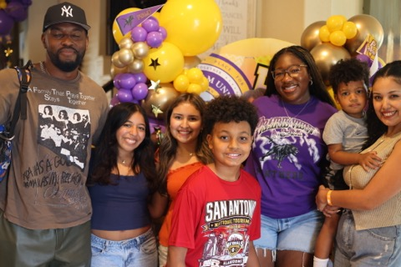
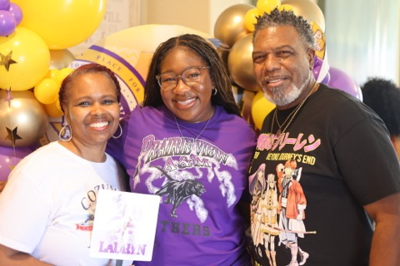
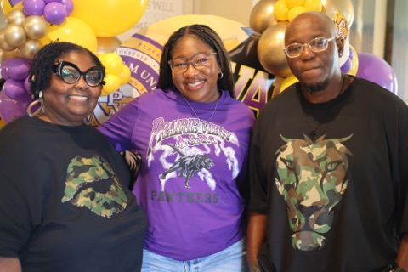
S3 • 5/9
Group shot perfection
Lauryn x her guests
Pose, snap, repeat!

Slide 14
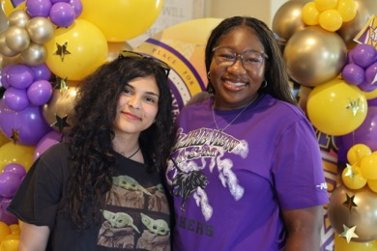
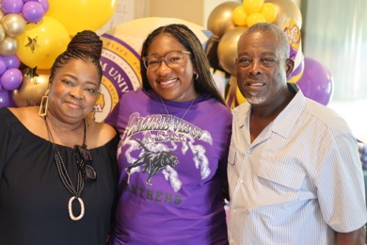
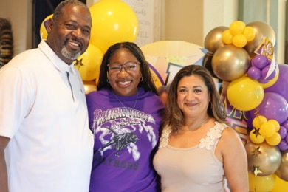
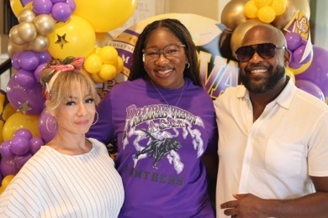
S3 • 6/9
The night is young 🌙
Family first, always
Beautiful inside and out
This is what love looks like

Slide 15
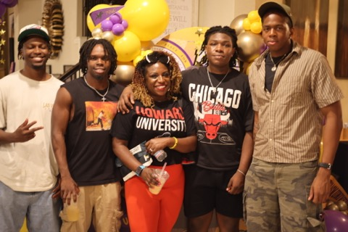
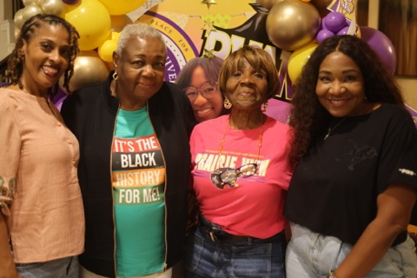
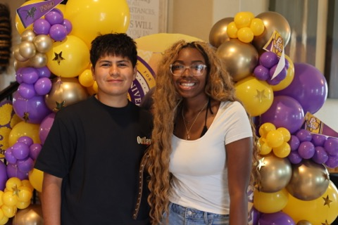
S3 • 7/9
PVAMU proud 💜💛
Surrounded by your village
Every guest a blessing

Slide 16
Memories
The Vibe was all Love

Slide 17
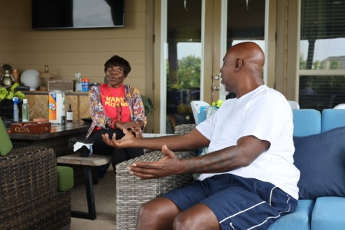
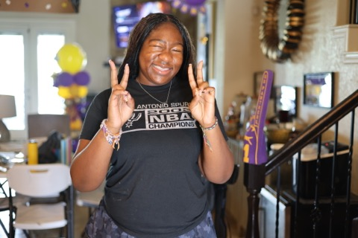
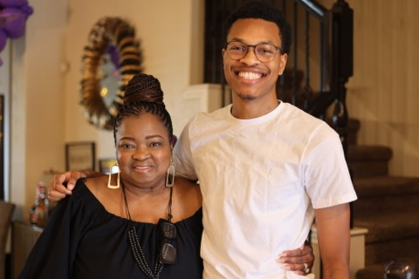
S4 • 1/5
Conversations
What’s Up1
Family

Slide 18
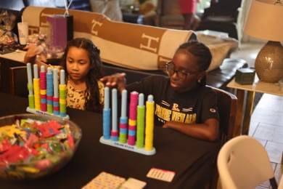
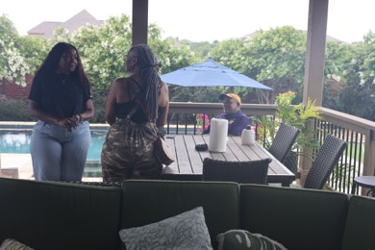
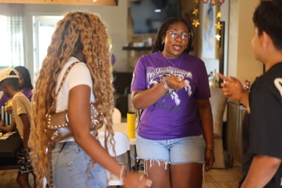
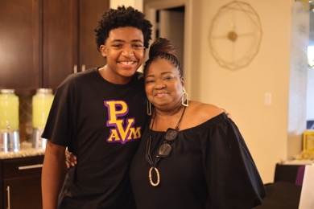
S4 • 2/5
Games
Outdoors
Holding Court
Family📸

Slide 19
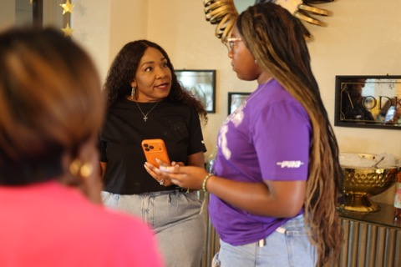
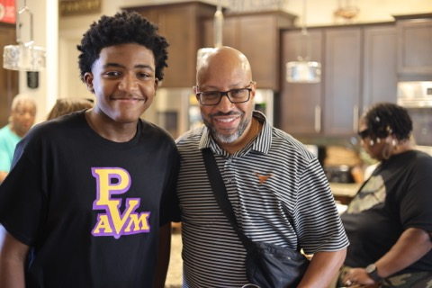
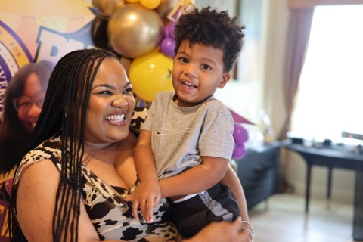
S4 • 1/5
Always Looking Out for You
Sharing Love and Wisdom
Big Smiles 🦉

Slide 20
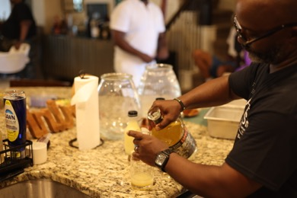
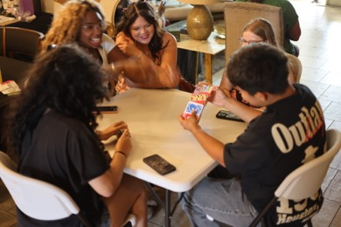
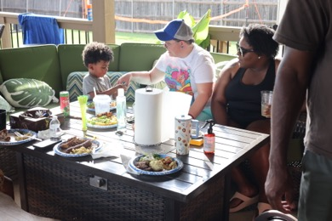
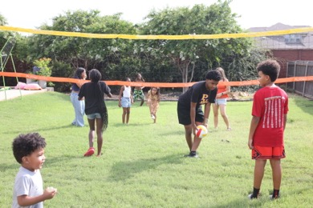
S4 • 2/5
Hook It Up
Playing Games
More Joy
We Outside📸

Slide 21



S4 • 3/5
Memories
Good Times
Welcoming Vibe

Slide 22




S4 • 4/5
Enjoying the Family 💛
Hey There
Holding it Down
Leave Us Alone

Slide 23



S4 • 3/5
The Gril Master
Watch out for the Water
“My turn one day!”

Slide 24




S4 • 4/5
Competition 💛
Brotherly Love
Learning from the Best
Oh No!

Slide 25



S4 • 5/5
Reflections✨
Hey There!
Poolside 🎓

Slide 26




S4 • 4/5
“What happened Was…” 💛
Strategy!
Joy of Laughter
Watchful Eye

Slide 27



S4 • 5/5
Happiness Everywhere ✨
Sharing with Family
What a Great Night🎓

Slide 28




S4 • 4/5
What’s She Saying? 💛
Let Me Explain
Taking a Dip
Welcome to the Party!

Slide 29



S4 • 5/5
Catching Up ✨
Peaceful Vibes
Hey There 🎓

Slide 30




S4 • 4/5
Everyone Enjoy💛
Good Times
Cooling Off
Sharing our Joy

Slide 31



S4 • 5/5
Joyful ✨
Best night ever!
Celebrating Family🎓

Slide 32




S4 • 4/5
Represent PVMU
More Smiles
Outdoor Fun!
Sharing with Friends

Slide 33



S4 • 4/5
Until next time 💛
Last memories of the night
Signing off in style
Forever in our hearts

Slide 34
Congratulations, Lauryn!
Prairie View A&M University
Thank you to everyone who celebrated with us tonight.
PVAMU • Class of 2030 • June 20, 2026

