Slide 1

Bézier Triangles
and G1 continuity
3D computational geometry and shape reconstruction
By Holló-Szabó Ákos
2020.5.15

Slide 2
Task
Load and save Bézier Triangle
Show Bézier Triangle
Modify and Elevate degree
Two Bézier surfaces
G1 continuity across common border

Slide 3
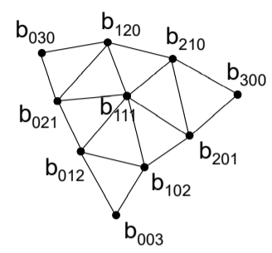
Basics I.
Domain:
Indexek:
i = (i, j, k)
i, j, k in N
|i| = i + j + k = n

Slide 4
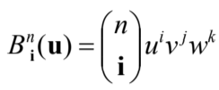
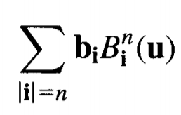

Bernstein Polinomials
Bézier Triangle:
Futó változók:
u = (u, v, w)
u, v, w in R
0 < u, v, w < 1
u + v + w = 1

Slide 5
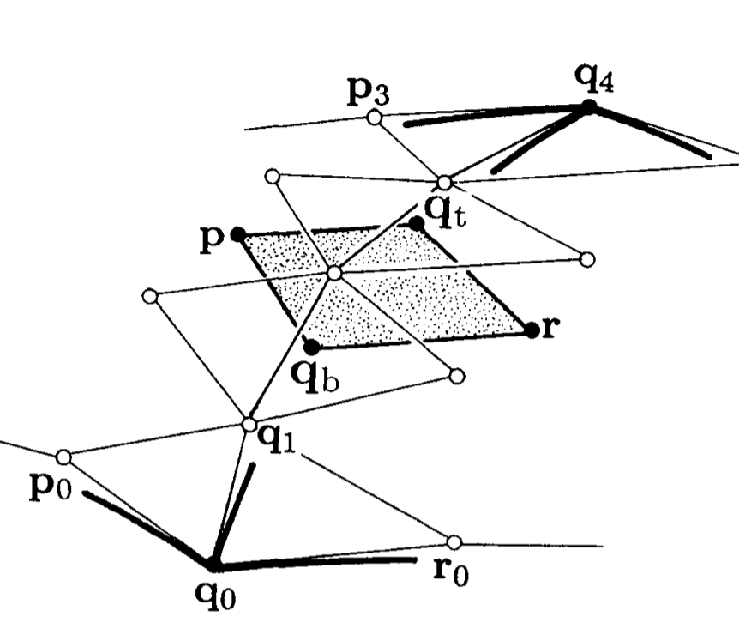
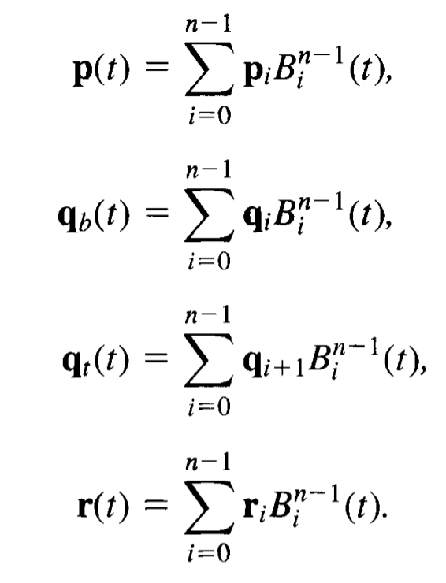
G1 continuity I.
Master-Slave
Row = n is the common border
Common and parallel rows
Intersection of:
qb->qt
P->r

Slide 6
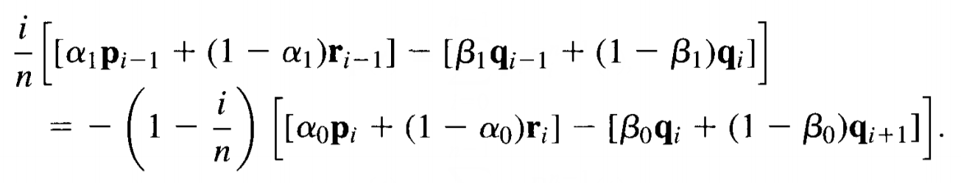

G1 continuity II.

Slide 7
Store control points
[ (0, 0, n) ]
[ (1, 0, n-1), (0, 1, n- ]
[ … … ]
[ (n-1, 0, 1) … (0, n-1, 1) ]
[ (n, 0, 0), (n-1, 1, 0) … (1, n-1, 0), (0, n, 0) ]
row column <-> k, l, m
line = k + l, column = l
k = line – column, l = column, m = n - line

Slide 8
Recursion
Points, first derivatives, second derivatives in one recursion!!!
Set size of storage
Set n = 0 value
Actual n = max_n – Depth
Recursion with Depth + 1
Depth == 1 -> second derivatives
Depth == 0 -> first derivatives
Values for actual n
Double for cicles without if branches!!!

Slide 9
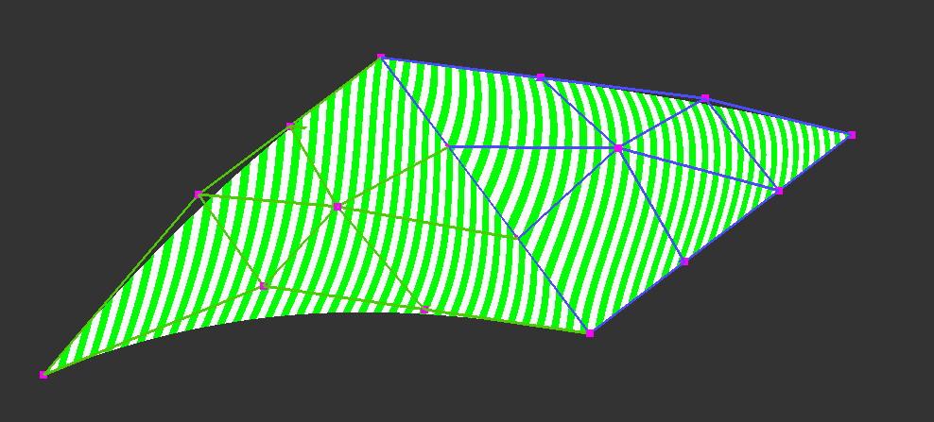
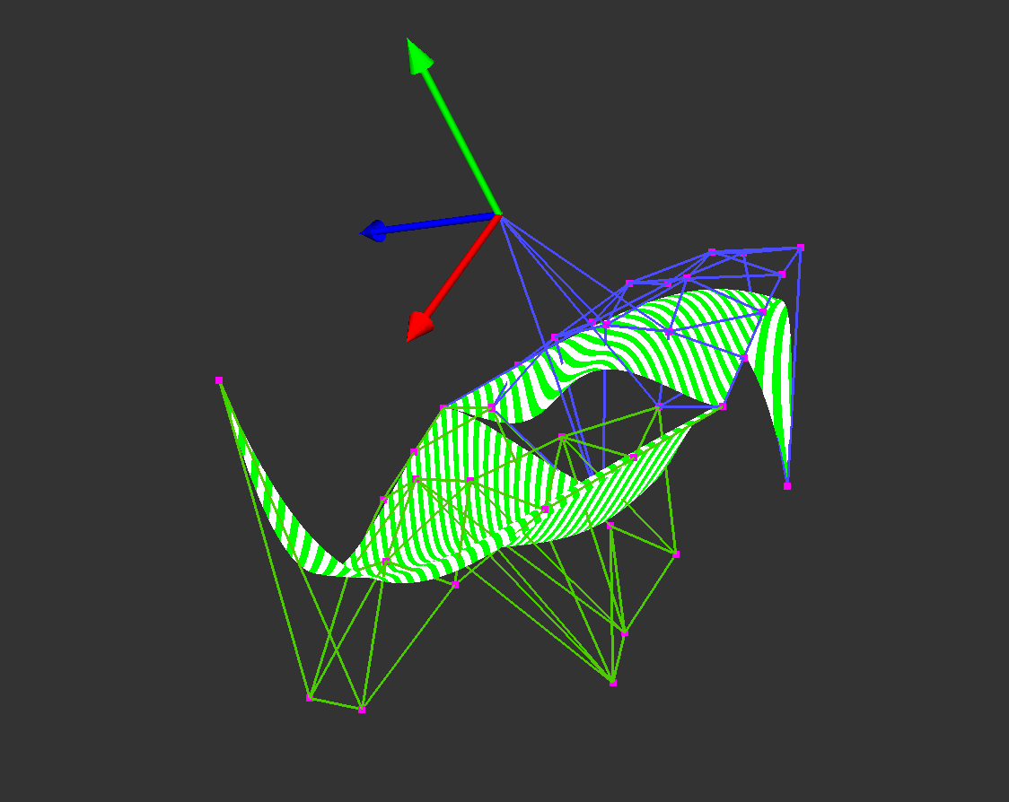
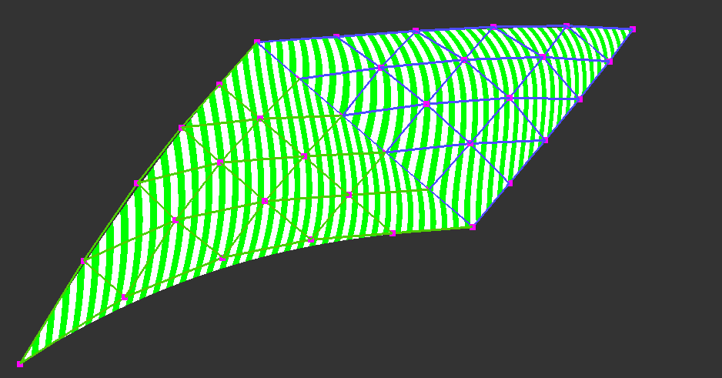
Implementation I.

Slide 10
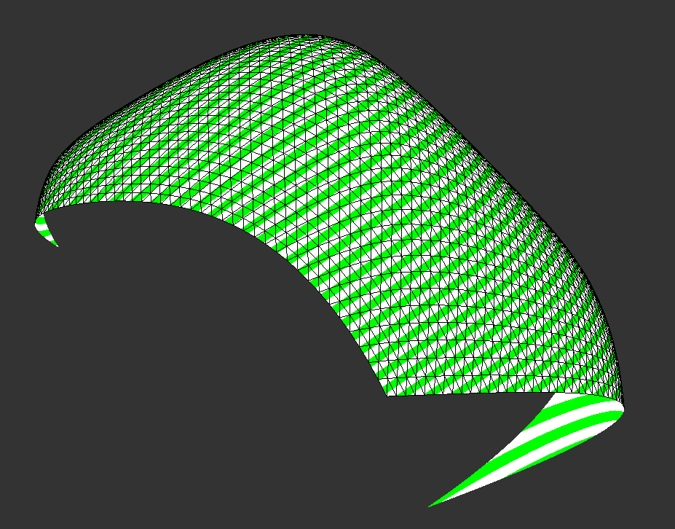
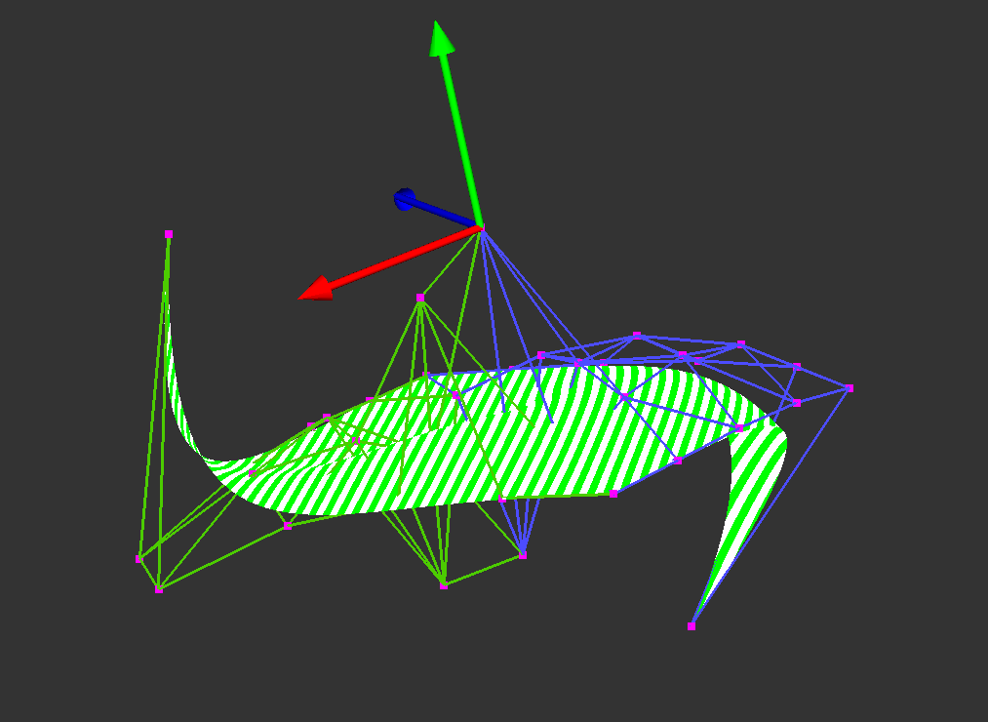
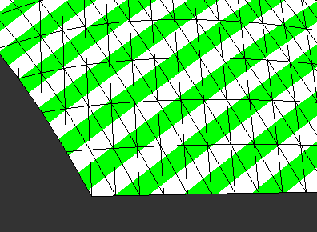
Implementation II.

Slide 11
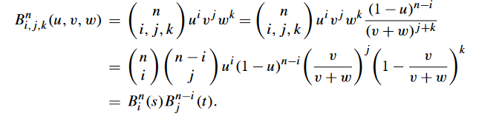
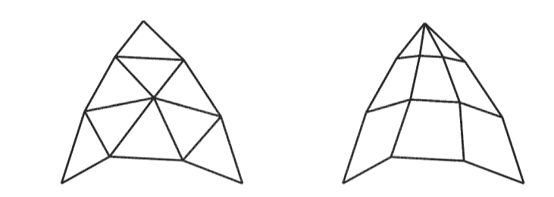

Conversion to Bézier Rectangle

Slide 12
Thanks for the attention!

Slide 13
Any questions? ☺

