Slide 1
Network Security Project 1 DEMO
Group 10

Slide 2
OVERVIEW
Back-end / Cloud
Ticket Data Structure
Issuing New Ticket
Using Ticket
Highlight

Slide 3
Backend / Cloud
Using Deno and PostgreSQL
Server authenticates through HTTPS TLS certificates
Client authenticates with API key and login token
Card readers fetch secrets / blocked cards, submit logs
Admin view / clear logs, block / unblock cards

Slide 4
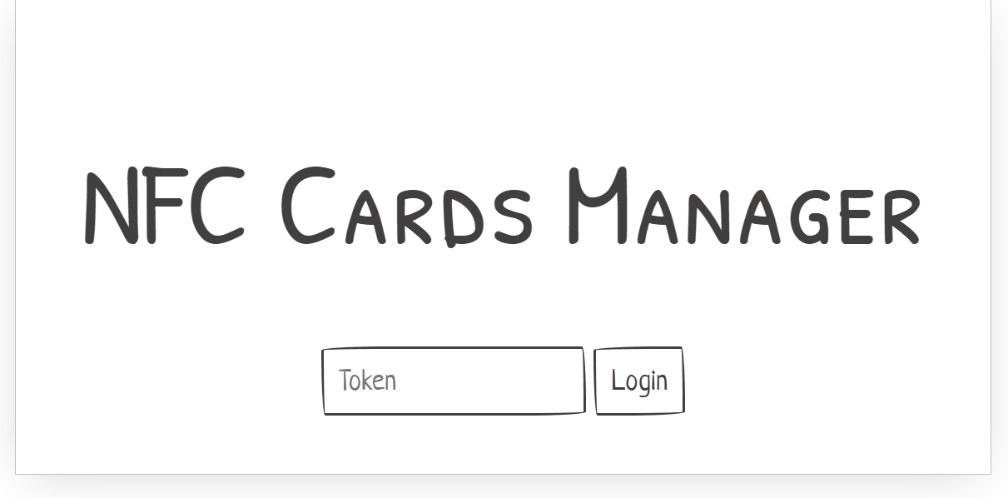
Backend / Cloud

Slide 5
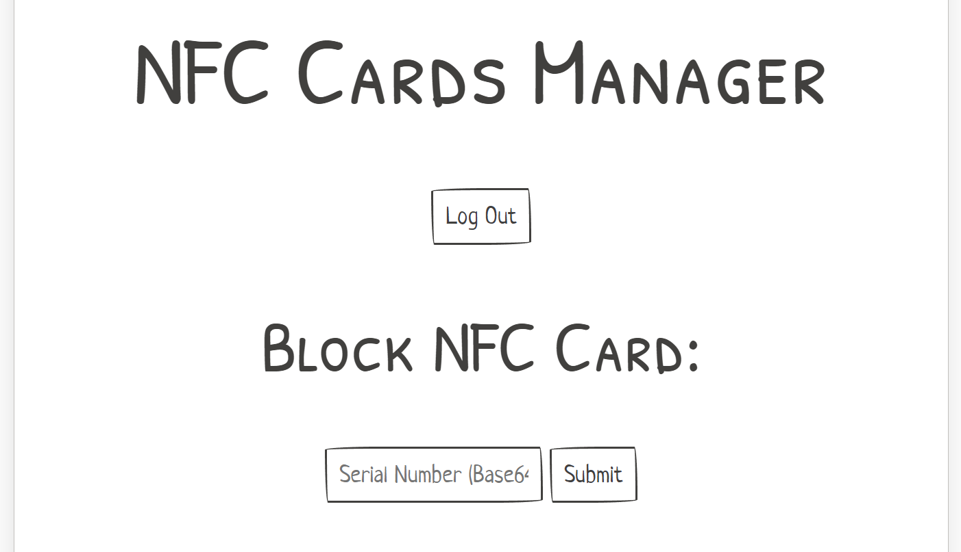
Backend / Cloud

Slide 6
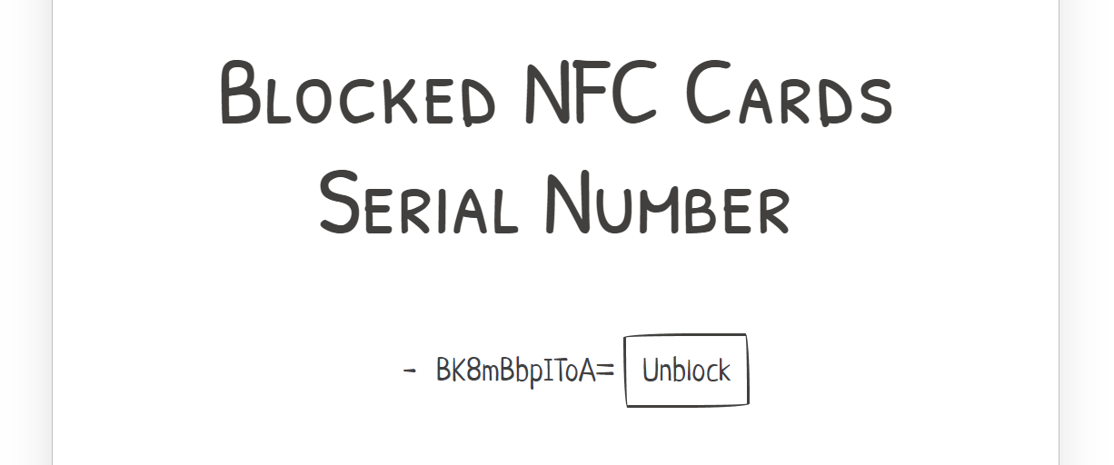
Backend / Cloud

Slide 7
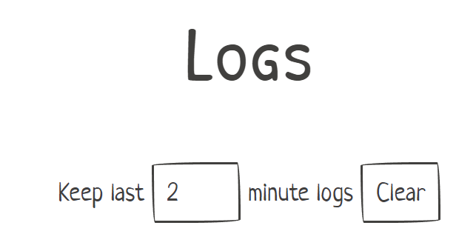
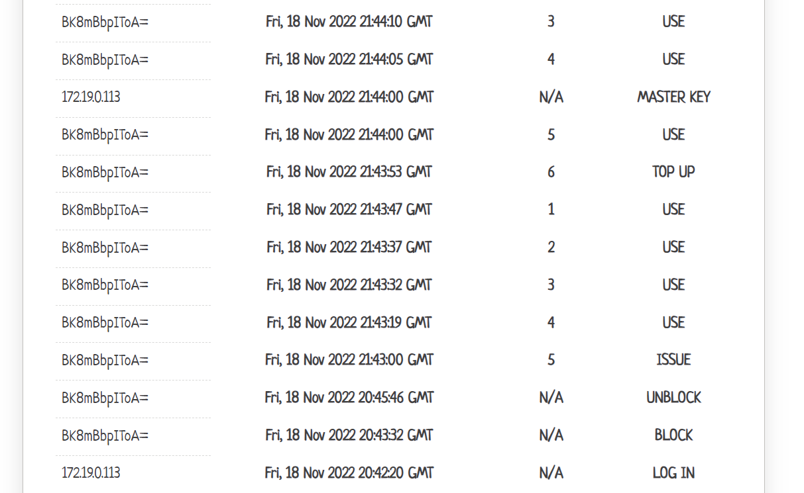
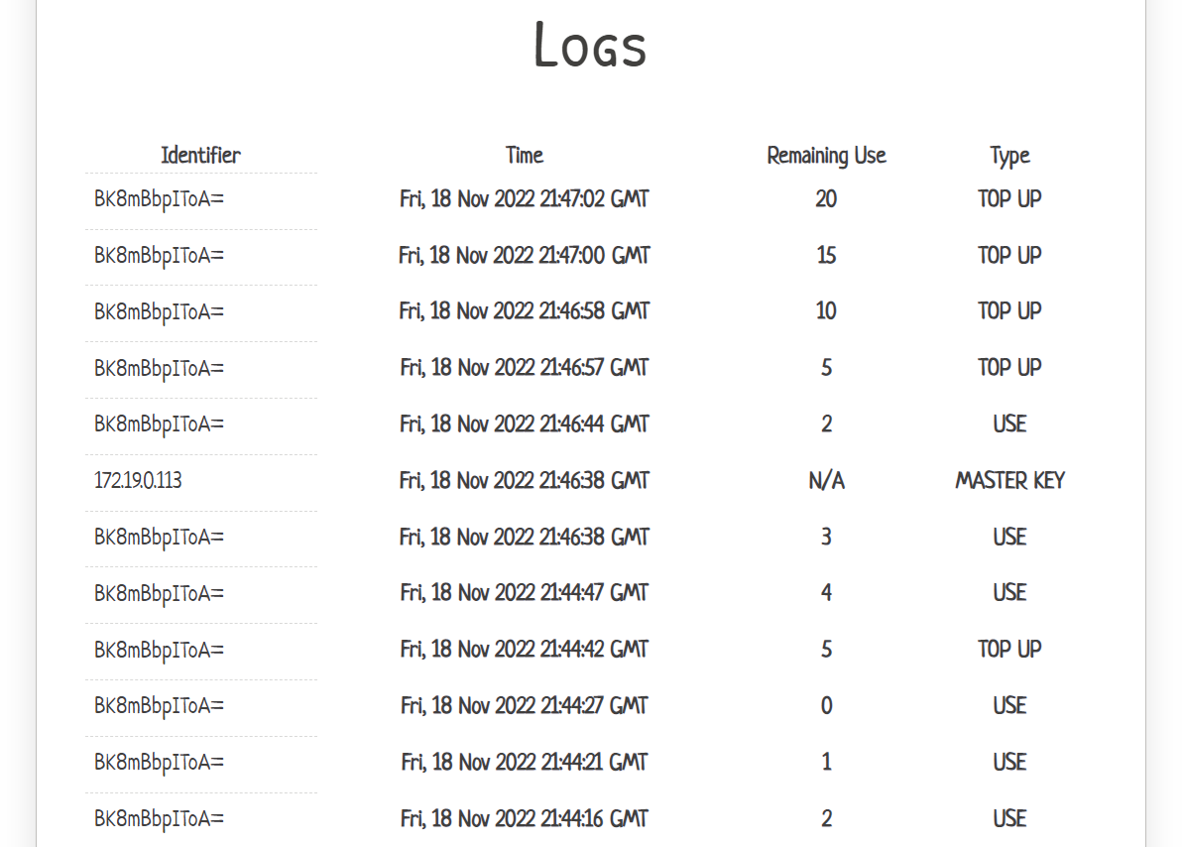
Backend / Cloud

Slide 8
Ticket Data Structure
2 ticket blocks
6 -> max ride number (counter limit)
7 -> initial counter, expected counter
8 -> last check-in time
9 -> expiration time
10 -> hmac
11 -> max ride number (counter limit)
12 -> initial counter, expected counter
13 -> last check-in time
14 -> expiration time
15 -> hmac
Tag block
4 -> application tag (CSE4)
5 -> version (v0.1)
Logs block
30,31 -> timestamp, remaining ride, type
32,33 -> timestamp, remaining ride, type
34,35 -> timestamp, remaining ride, type
36,37 -> timestamp, remaining ride, type
38,39 -> timestamp, remaining ride, type

Slide 9
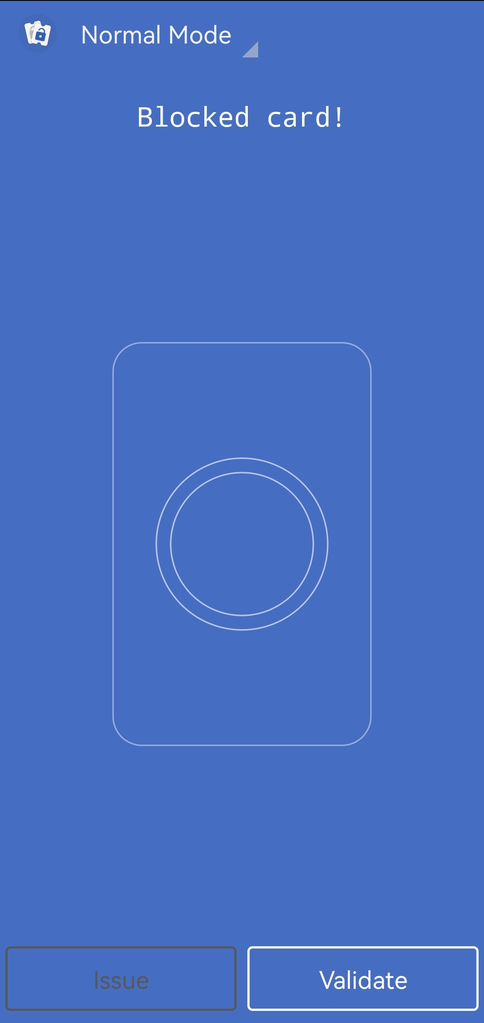
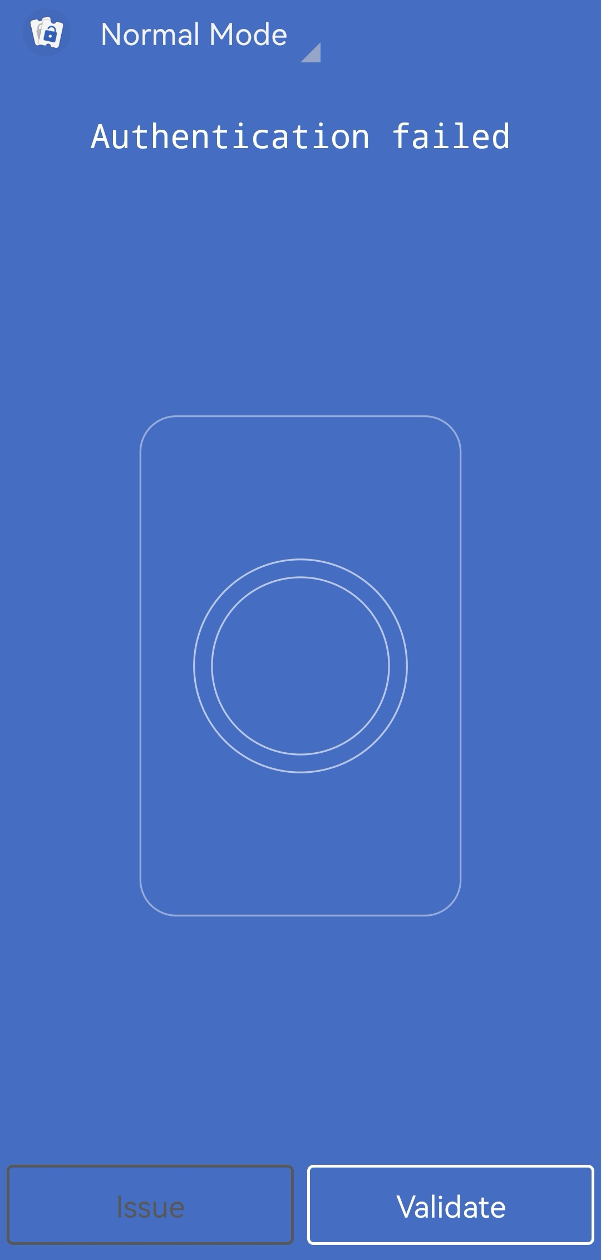
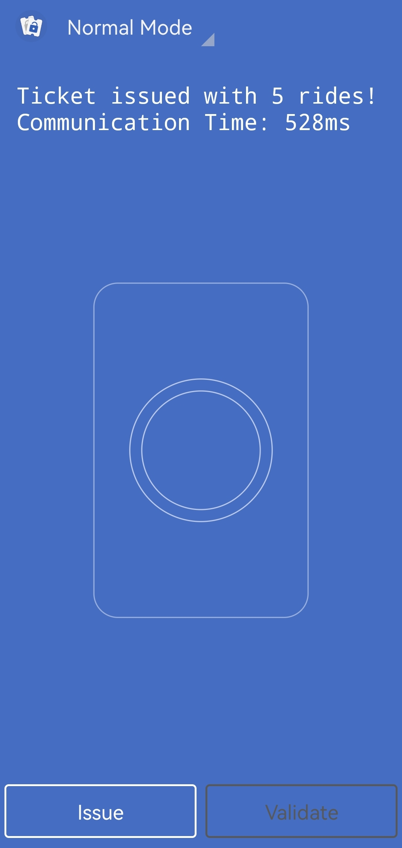
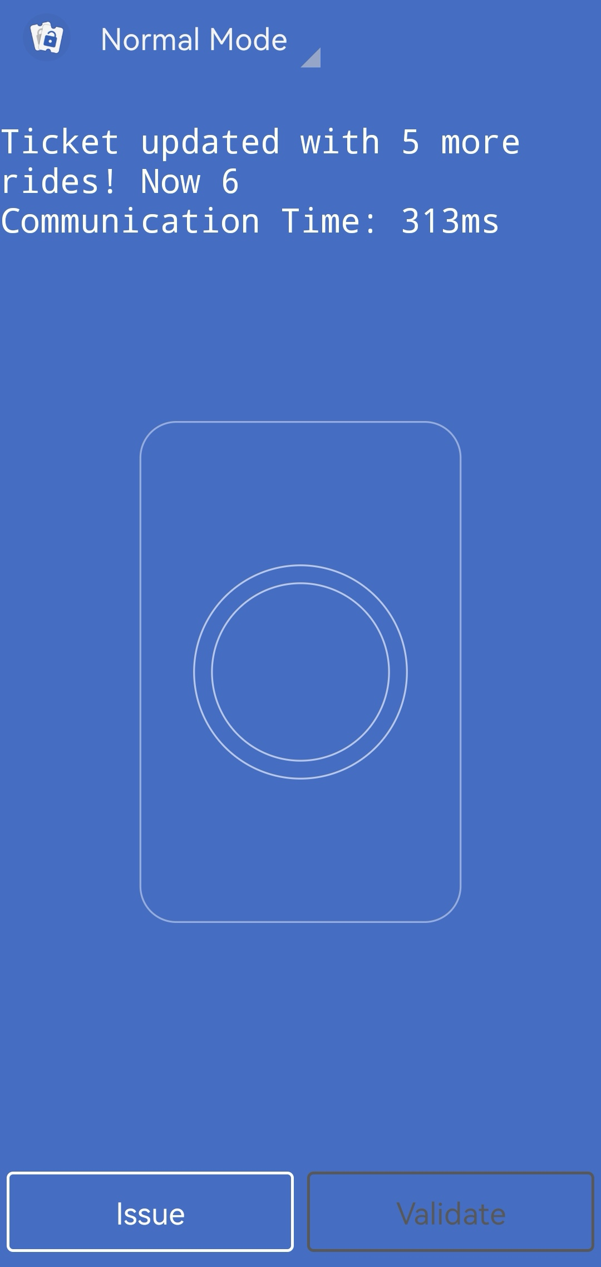
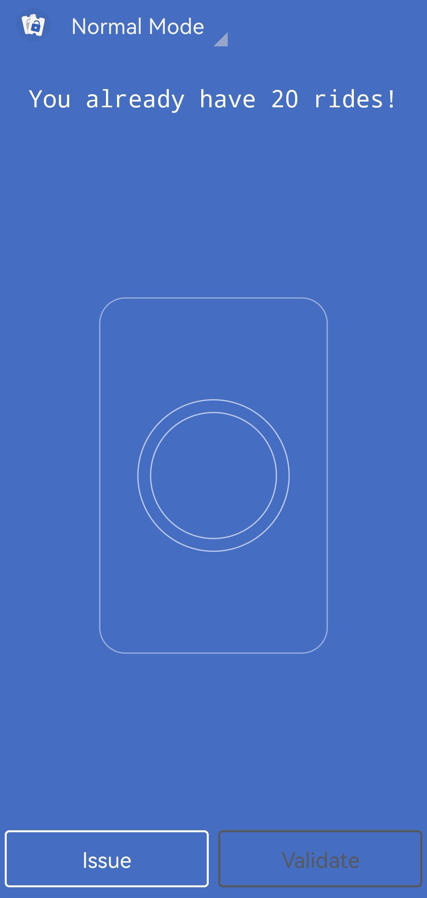
Issuing New Ticket

Slide 10
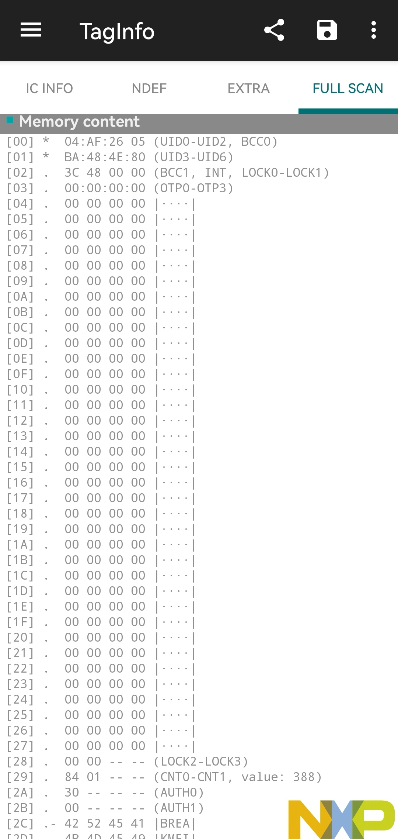
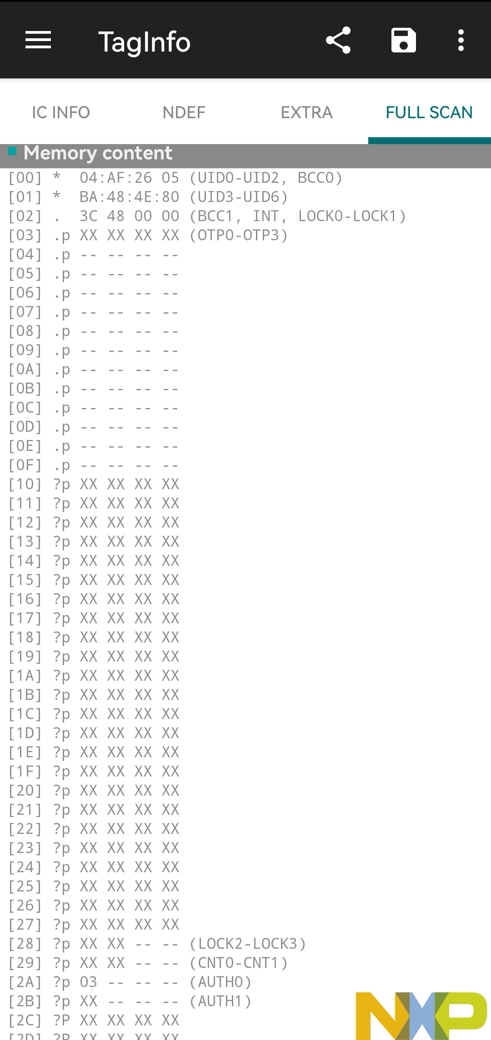
Issuing New Ticket

Slide 11
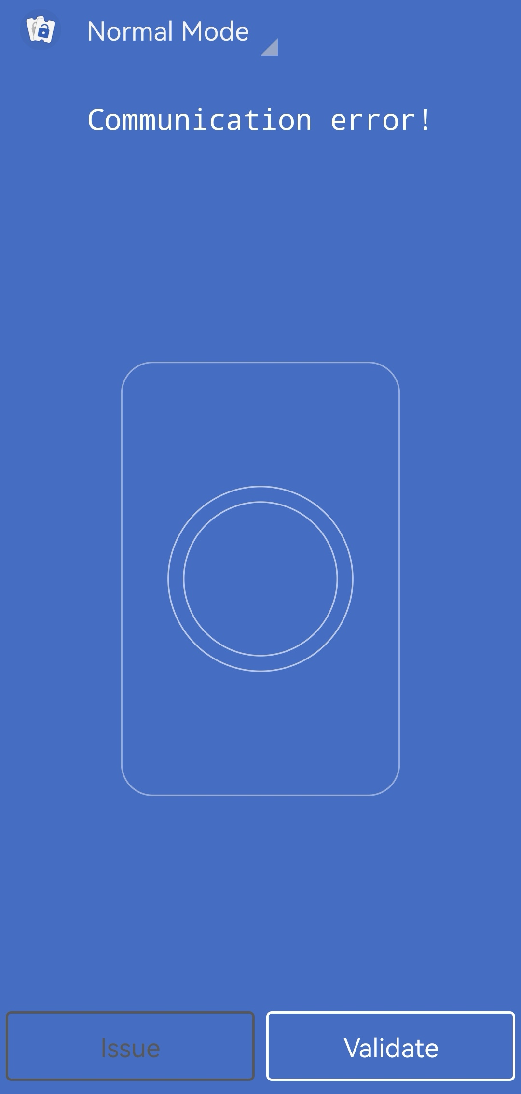

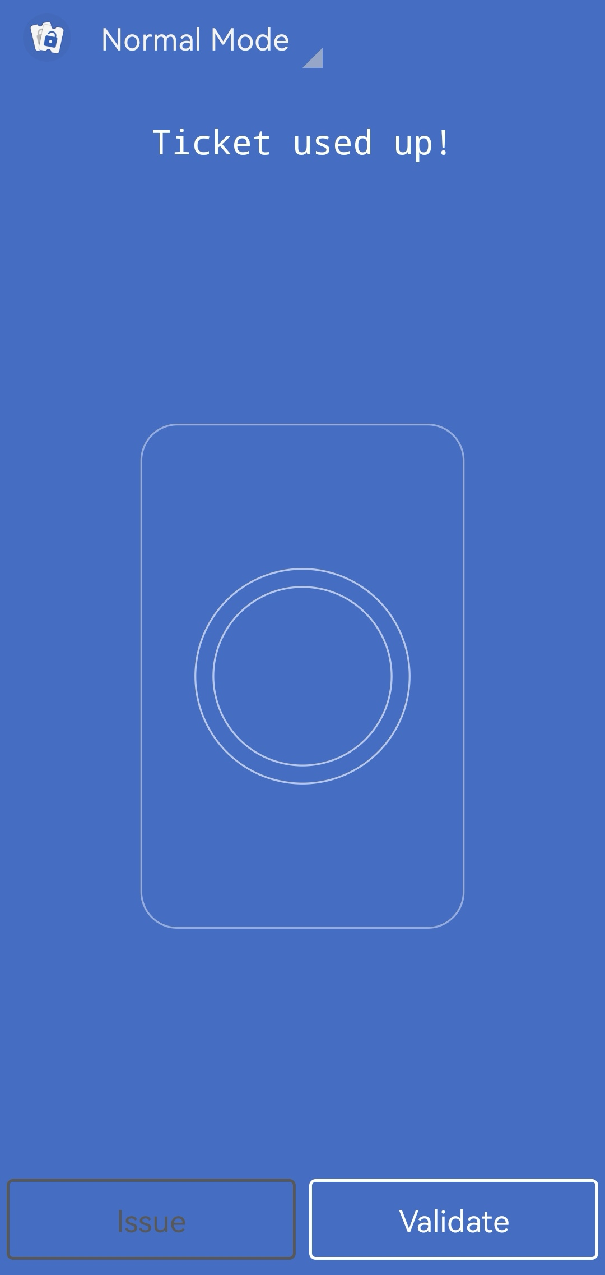

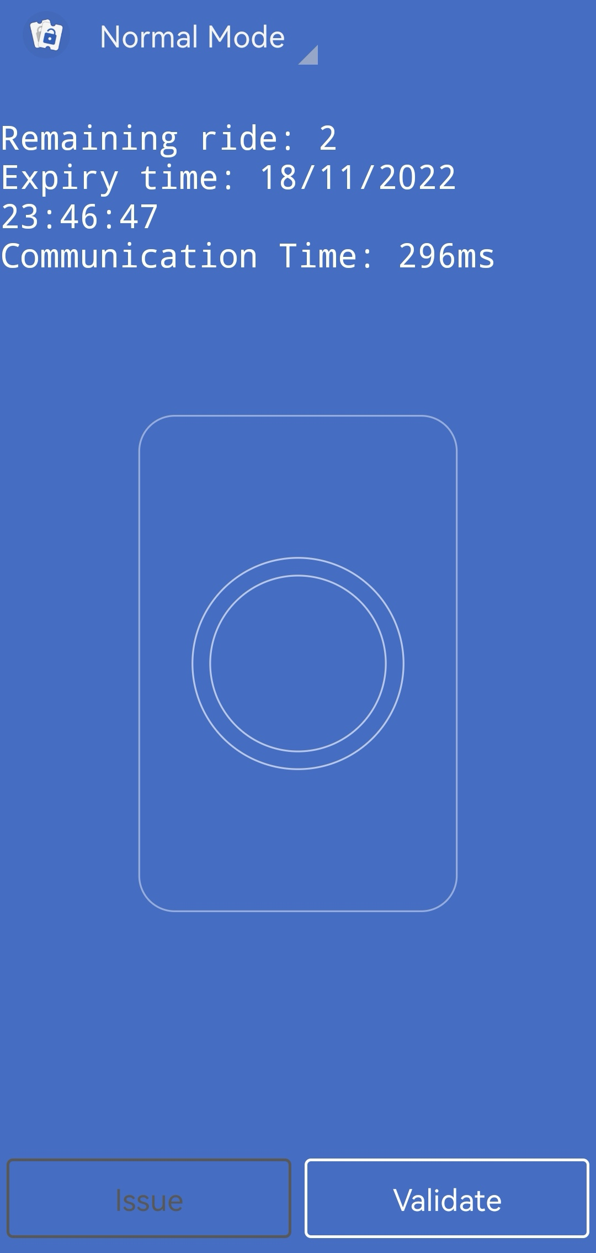
Using Ticket

Slide 12
Highlight
Realize ALL the Features / Requirements
Hide API master key right in the project and hard to find
Use PBKDF2WithHmacSHA512 as subkey hash function
Protect whole user memory from R/W without auth
Compare local secrets with cloud to ensure integrity

Slide 13
Questions?

