Slide 1
Book1
File created on: 1/22/2020 7:52:46 PM

Slide 2
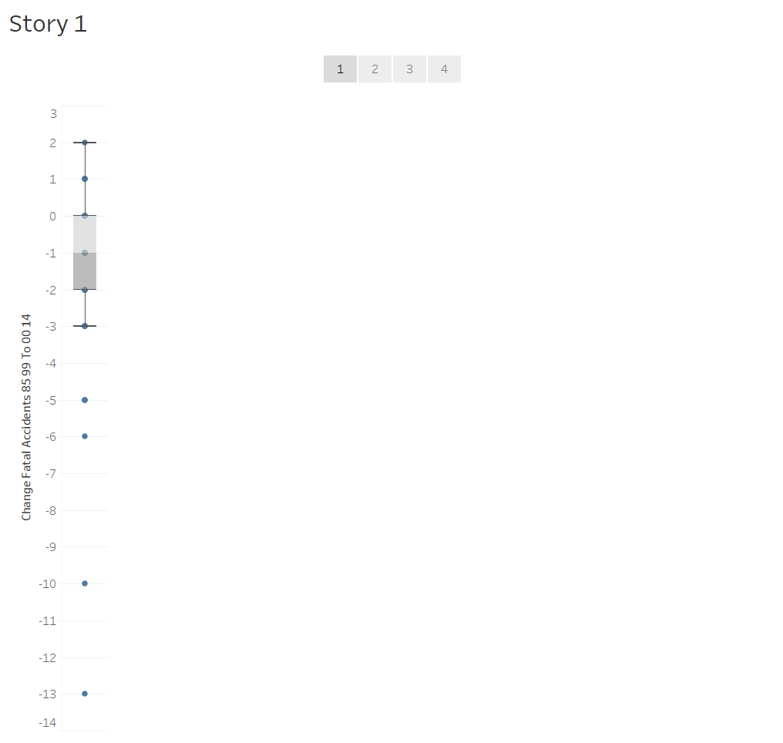

Slide 3
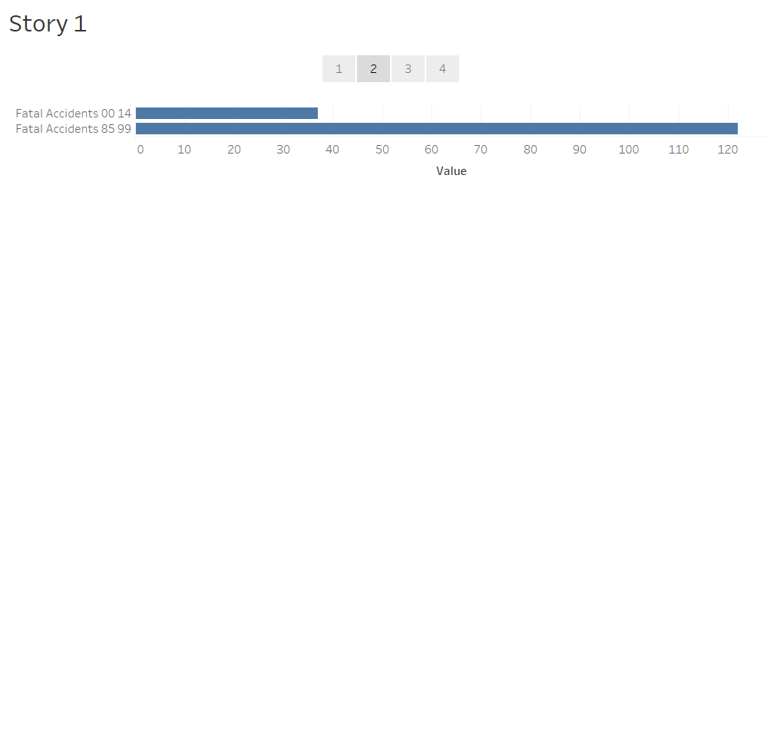

Slide 4
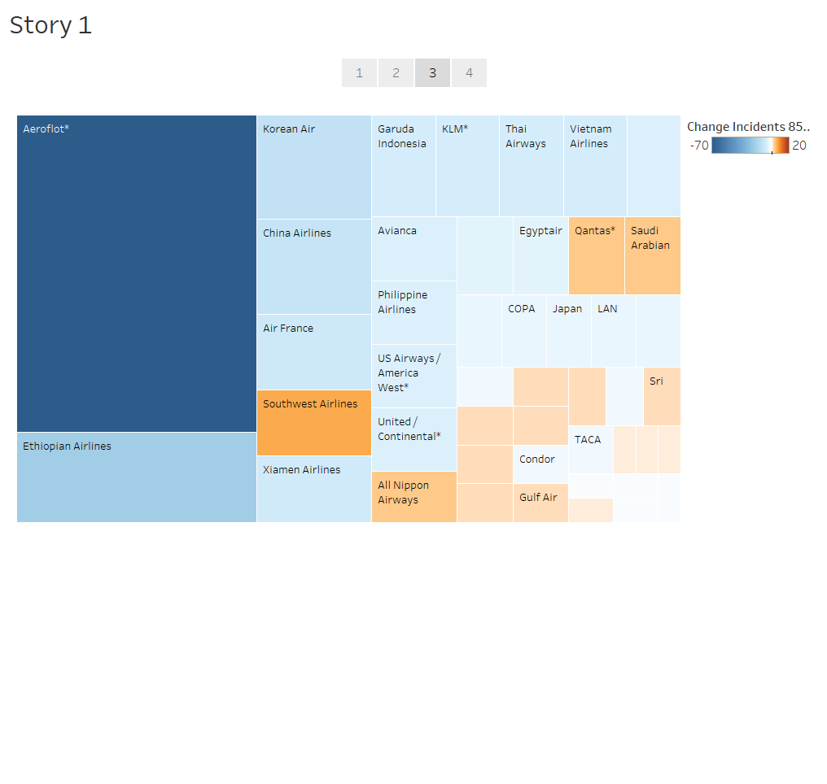

Slide 5
