Slide 1
Fatalities and ratios
File created on: 1/22/2020 7:56:48 PM

Slide 2
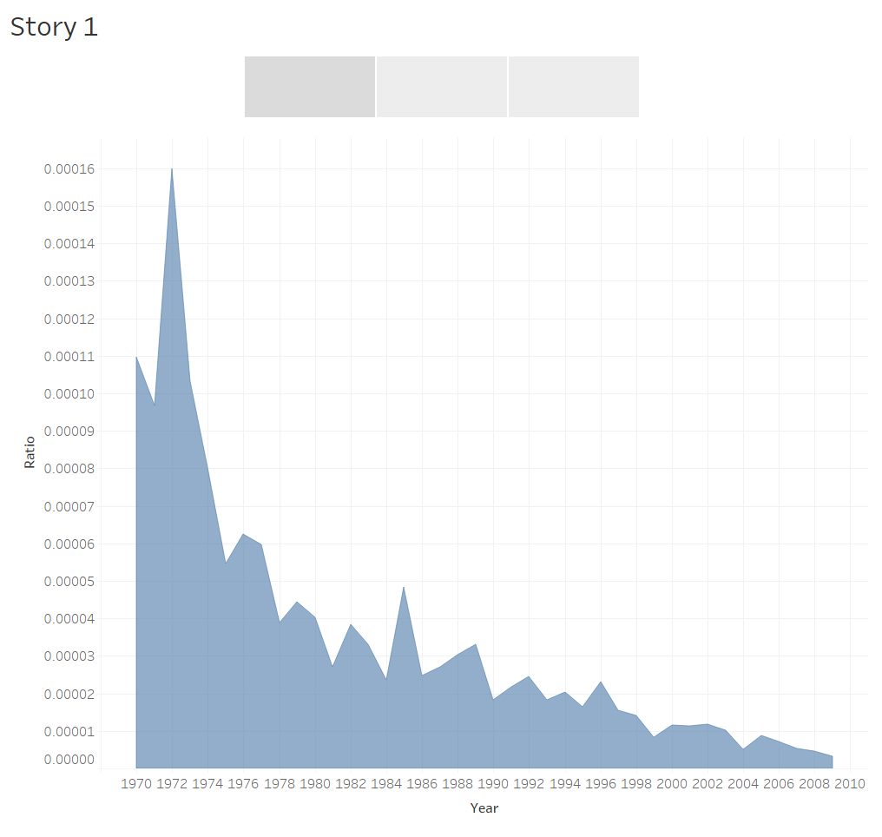

Slide 3
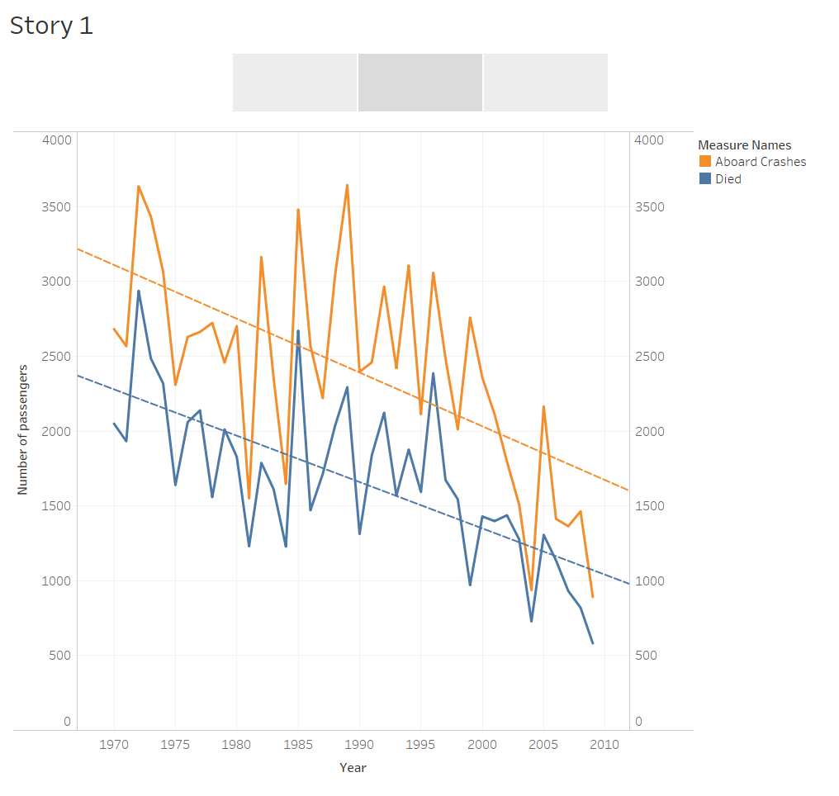

Slide 4
