Slide 1
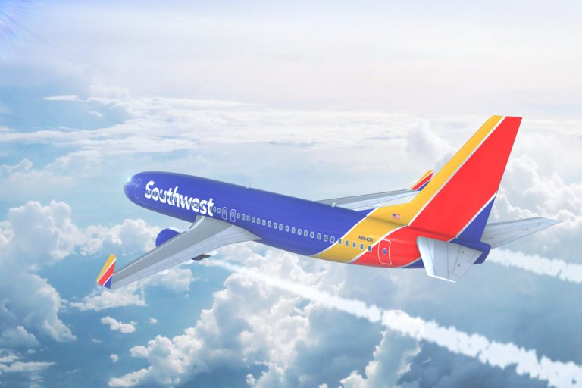
Airline Safety
Presented by Holly Erickson

Slide 2
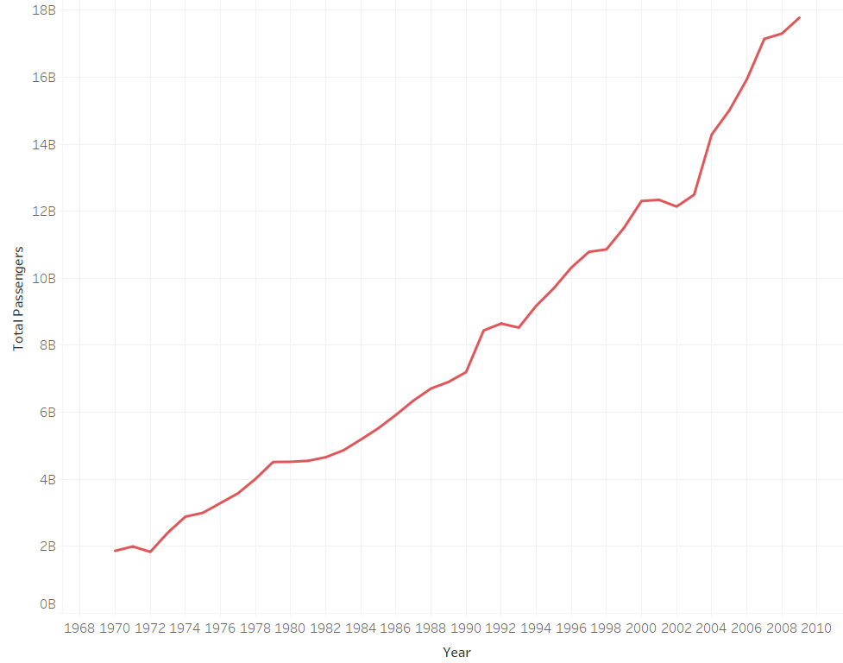

The number of people flying every year continues to grow...

Slide 3
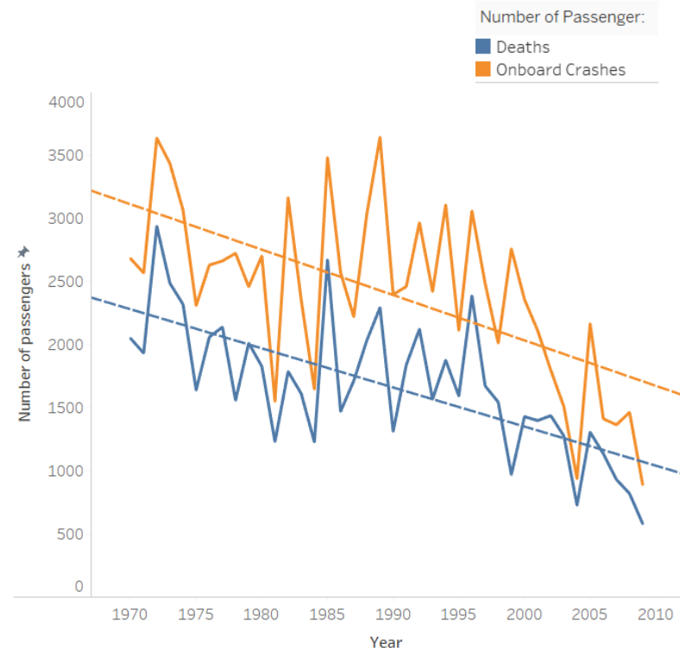
… while the number of deaths as well as number of people aboard crashes continues to trend downward.

Slide 4
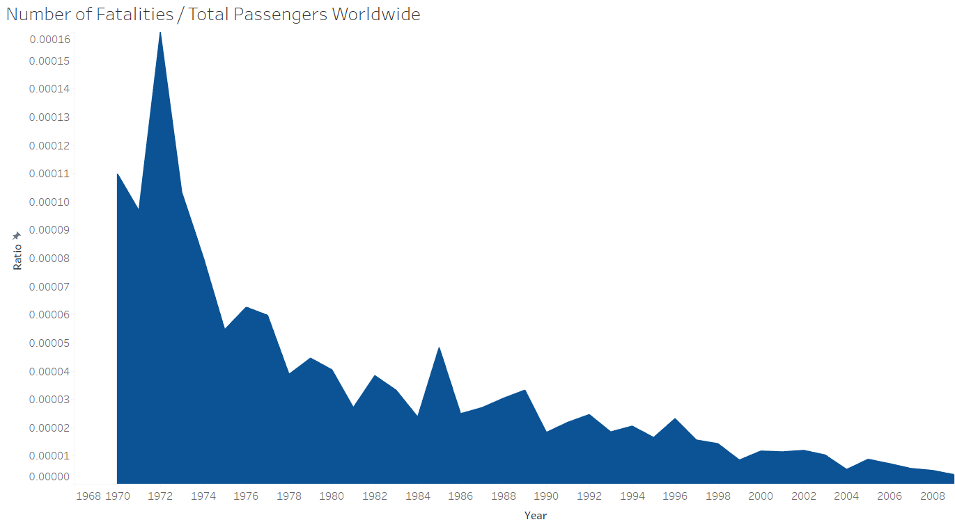

Slide 5
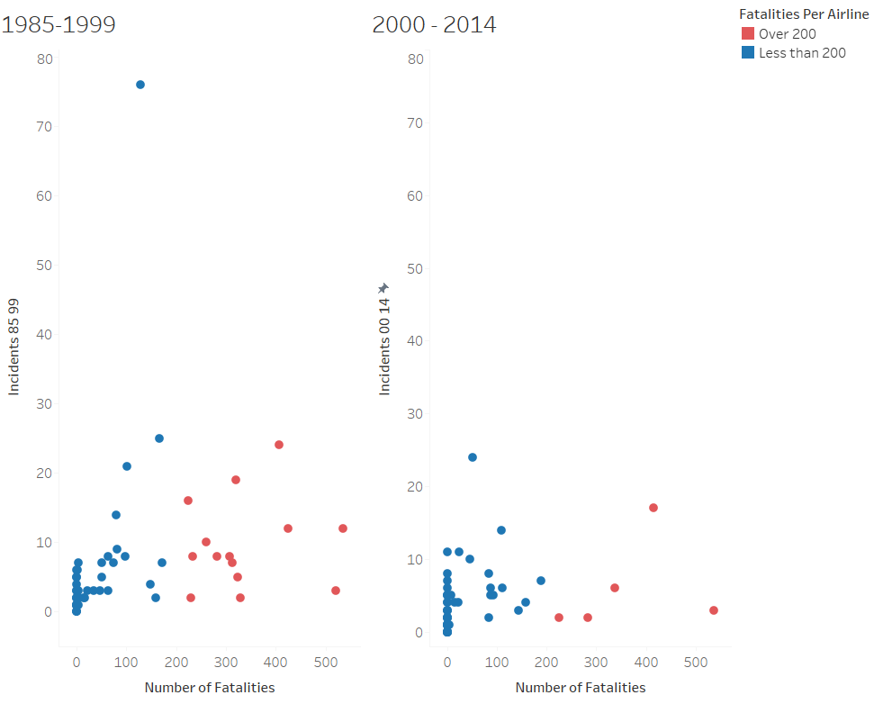

Slide 6
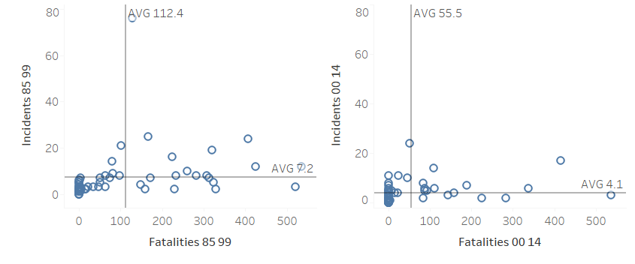

Slide 7
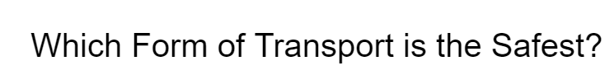


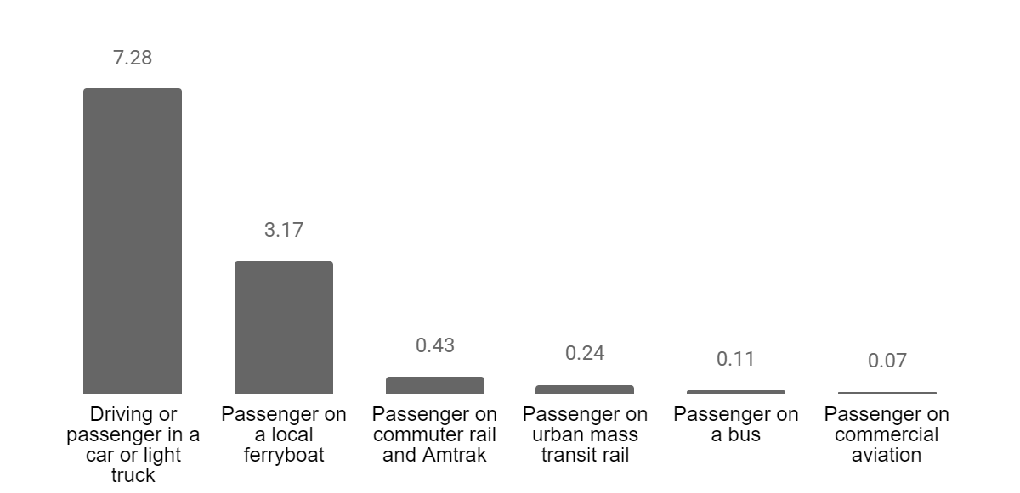
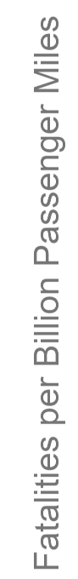

Slide 8
Introducing Our IOSA Certification Plan
This year we have committed to surpassing the benchmark for safety by obtaining the IOSA Certification.
This certificate is voluntary in the United States, but your safety is our priority.

Slide 9
Data Sources
Primary
https://github.com/fivethirtyeight/data/tree/master/airline-safety
Supplemental
https://data.worldbank.org/indicator/IS.AIR.PSGR
https://www.airlineratings.com/safety-rating-tool/
https://data.world/data-society/airplane-crashes
https://data.world/hhaveliw/airplane-crashes-1908-2009
http://faculty.wcas.northwestern.edu/~ipsavage/436.pdf

