Slide 1





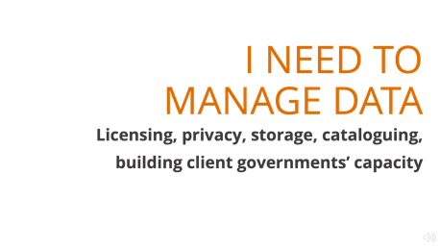
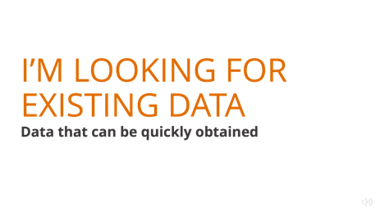
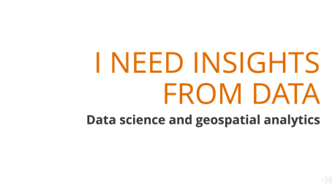
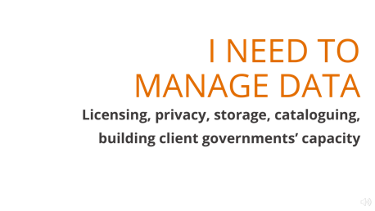

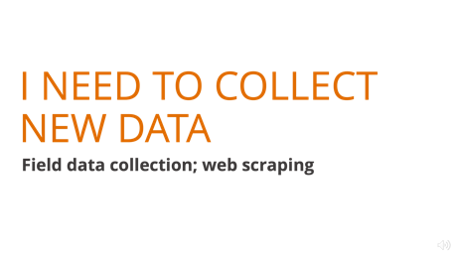

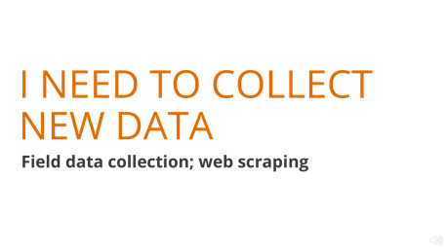

Slide 2
I’M LOOKING FOR EXISTING DATA
Data that can be quickly obtained

Slide 3
I’M LOOKING FOR EXISTING DATA
Data that can be quickly obtained
UNLICENSED DATA
Can’t find what you’re looking for? Request new data partnership, subscription, and/or purchase
WBG LIBRARY
CATALOGUES
DEVELOPMENT DATA HUB
SECTOR
COLLECTIONS
Manages WB data subscriptions and purchases
WB-managed data search portals
WB’s development data catalogue
Sector curated
data sets
DEVELOPMENT
DATA
PARTNERSHIP
WBG LIBRARY
Purchased data & subscriptions
DEVELOPMENT
DATA PARTNERSHIP
TRANSPORT
ENERGY
AGRICULTURE
Request new partnership
SUM4All Program; Road cost database (DEC)
Energy.info;
electrical grid maps
Living Standards & Measurement Study (DECDG)
Google, Facebook, etc.
COMPANY DATA
AG
OBSERVATORY
ITS ENTERPRISE
GFDRR
POVERTY
ENVIRONMENT
ESF
Disaster Risk Profiles
Data4Goals -
Micro Data Library
Wealth, ANS, Hidden Dimensions of Poverty
ESF Implementation Support Unit
3rd party data partnerships (e.g., Facebook, Waze)
Weather data subscriptions
WB corporate data
URBAN
SCCAO
SOCIAL DEVELOPMENT Indonesia
GENDER
HEALTH
SENSING + GEOSPATIAL
City Resilience Program
Climate Change Knowledge Portal
Curated gender data collection
Curated health data collection
GOST
ITS GEOLAB
Community Development and Early Childhood
Geospatial partnerships + subscriptions
Geospatial subscriptions + ESRI Living Atlas
Satellite, LIDAR, radar, street view, curated geospatial layers

Slide 4
I’M LOOKING FOR EXISTING DATA
Data that can be quickly obtained

Slide 5
I NEED TO COLLECT NEW DATA
Field data collection; web scraping

Slide 6
I NEED TO COLLECT NEW DATA
ITS GEOLAB
Interactive map data visualization
Field data collection; web scraping
LSMS
SURVEYS
Survey design/sampling/management (DECDG)
WB-supported field survey solutions
Field data collection; web scraping
DEC
ANALYTICS & TOOLS
DIME
SECTOR SERVICES
Manages subscription to commercial survey app
GEMS
TRANSPORT
Manages WB tablet survey application
Geospatial data collection training
RoadLab Pro, DRIVER (road crash reporting)
Apps and client training services
ITS INNOVATION
& TECH LAB
AG OBSERVATORY
In-house app development team (prototypes)
POVERTY EAP
SWIFT and EAP Poverty Portal tools to measure poverty
App–trend analysis & advanced analytics
NEW MOBILE APPS
ITS RAPID APP DEV TEAM
In-house app development team
(production)
GFDRR
Design and test new applications
Remote sensing and drone applications for community mapping
DEC
ANALYTICS & TOOLS
APIs
DIME
Design and use APIs to query data; web scraping
Design and use APIS to query data
Identifying and using web APIs to pull data
REMOTE SENSING
GOST
Manages remote
sensing partnerships + subscriptions
Remote sensing data procurement; drones

Slide 7
I NEED TO COLLECT NEW DATA
Field data collection; web scraping

Slide 8
I NEED TO MANAGE DATA
Licensing, privacy, storage, cataloguing, building client governments’ capacity

Slide 9
I NEED TO MANAGE DATA
ITS GEOLAB
Interactive map data visualization
Field data collection; Licensing, privacy, storage, cataloguing, building client governments’ capacity
DATA SHARING
ITS
INFRASTRUCTURE
LEGIA
Azure AD authentication advisory
Licensing advisory
Systems to support in-house collaboration on data analytics
LICENSING
LEGIA
DEVELOPMENT
DATA PARTNERSHIP
DEVELOPMENT DATA HUB
Open source and WB standard license procedures
Licensing advisory
Add data to the catalogue
Github repo
resources
PRIVACY & SECURITY
DIGITAL
DEVELOPMENT
OFFICE OF INFO SECURITY
DATA
PRIVACY OFFICE
WB Data Privacy Policy; data security classifications
Cybersecurity advisory (for clients)
Security advisory and accreditation
WB data privacy policy
DEC
DATA GROUP
DIME – BUREAUCRACY LAB
GOVERNMENT
CLIENTS
General data science training for gov
Conduct IE surveys in civil service orgs
Client capacity building resources
DATA STORAGE
ITS
INFRASTRUCTURE
ITS
ENTERPRISE
SOCIAL DEVELOPMENT Indonesia
GEMS
AWS and on-premise solutions
Azure and Data Bricks solutions
Geospatial data collection capacity building
Large data storage for in-house use
Basic app dev for clients

Slide 10
I NEED TO MANAGE DATA
Licensing, privacy, storage, cataloguing, building client governments’ capacity

Slide 11
I NEED INSIGHTS FROM DATA
Data science and geospatial analytics

Slide 12
I NEED INSIGHTS FROM DATA
UNIVERSITY
PARTNERSHIPS
WB DATA LAB
ITS
INFRASTRUCTURE
University partnerships on behalf of WB
Data science and geospatial analytics
Working with data science students
AWS and on-premise solutions
ITS
ENTERPRISE
ITS RESOURCES
GEOSPATIAL
ITS GEOLAB
KIDS
GEMS
GOST
Geospatial analytics
Interactive map data visualization
Remote sensing;
network modeling; machine learning
Azure solutions; data science portal
Server and data science environment resources
Static map data visualization
Government training on geo analytics
DEC
ANALYTICS & TOOLS
GFDRR
DEVELOPMENT DATA HUB
ITS RAPID
APP DEV TEAM
Risk modelling and machine learning for exposure mapping
SECTOR SERVICES
Geospatial research and indices
TRANSPORT
WB DATA LAB
RoadLab Pro, DRIVER, Road Safety Assessment, HDM5
Lab Lead connectors program
Apps developed and managed by GPs; Sector advisory to support data project
Simple chart / infographic generation
In-house web and mobil e app dev team
DATA VISUALIZATION
KIDS
DIME
DEC
ANALYTICS & TOOLS
ITS
INNOVATION
& TECH LAB
HEALTH
URBAN
WATER
Non-geospatial data storytelling
Simple chart generation
Micro-survey and bid data analytics for impact eval
Predictive data analytics/
mathematical models
City Resilience Program
Utilities, tariffs – IBNET;
Rural water and sanitation- SIASAR
Machine learning, NLP, mobile data analytics,
AI + block chain
SOCIAL DEVELOPMENT Indonesia
DEVELOPMENT
DATA PARTNERHSIP
ITS DATA
SCIENCE TEAM
BIG DATA ANALYTICS
Manipulating large non-geospatial datasets
ML algorithms and social media
Insights
DIY data science resources and
advisory
Private sector data analytics

Slide 13
I NEED INSIGHTS FROM DATA
Data science and geospatial analytics

