Slide 1
Matrix Approach to Simple Linear Regression
KNNL – Chapter 5

Slide 2
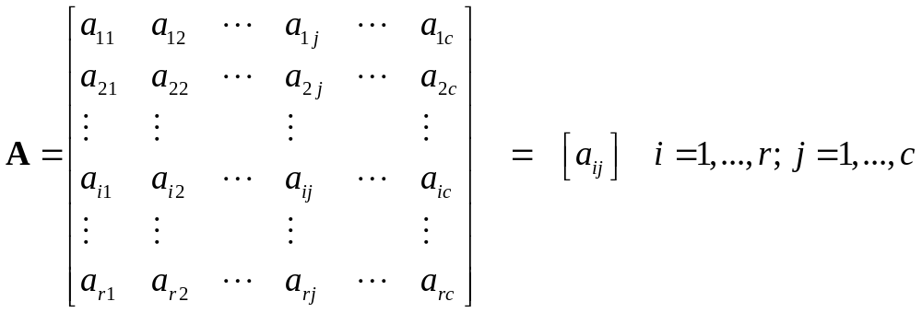
Matrices
Definition: A matrix is a rectangular array of numbers or symbolic elements
In many applications, the rows of a matrix will represent individuals cases (people, items, plants, animals,...) and columns will represent attributes or characteristics
The dimension of a matrix is it number of rows and columns, often denoted as r x c (r rows by c columns)
Can be represented in full form or abbreviated form:

Slide 3
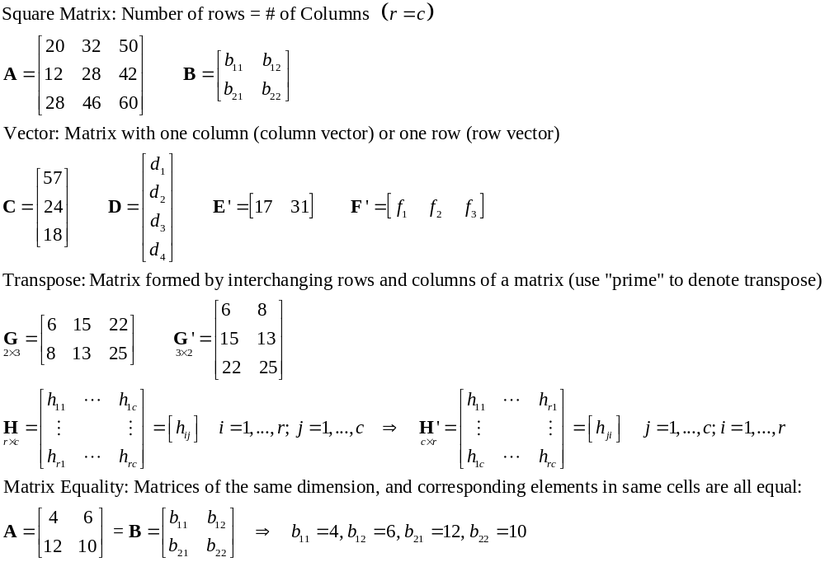
Special Types of Matrices

Slide 4
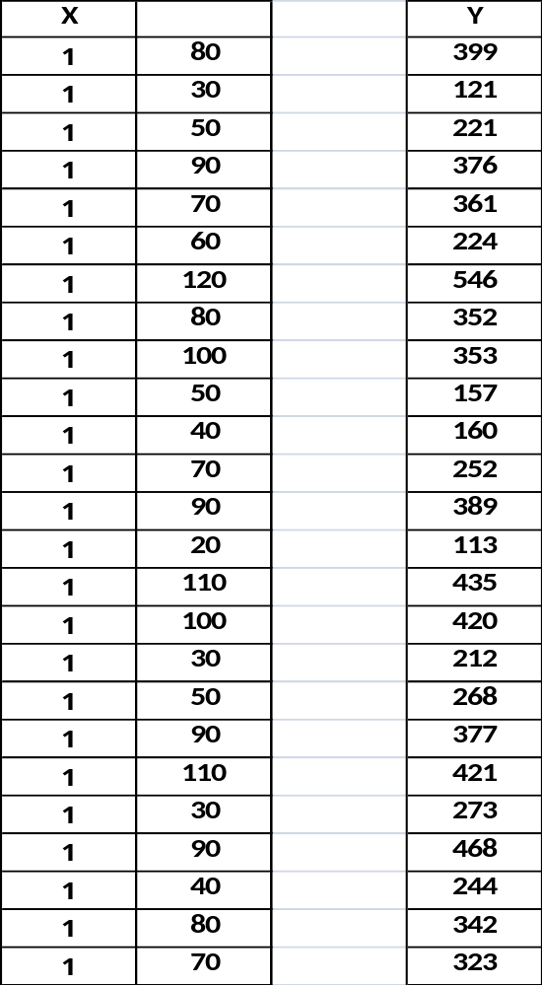
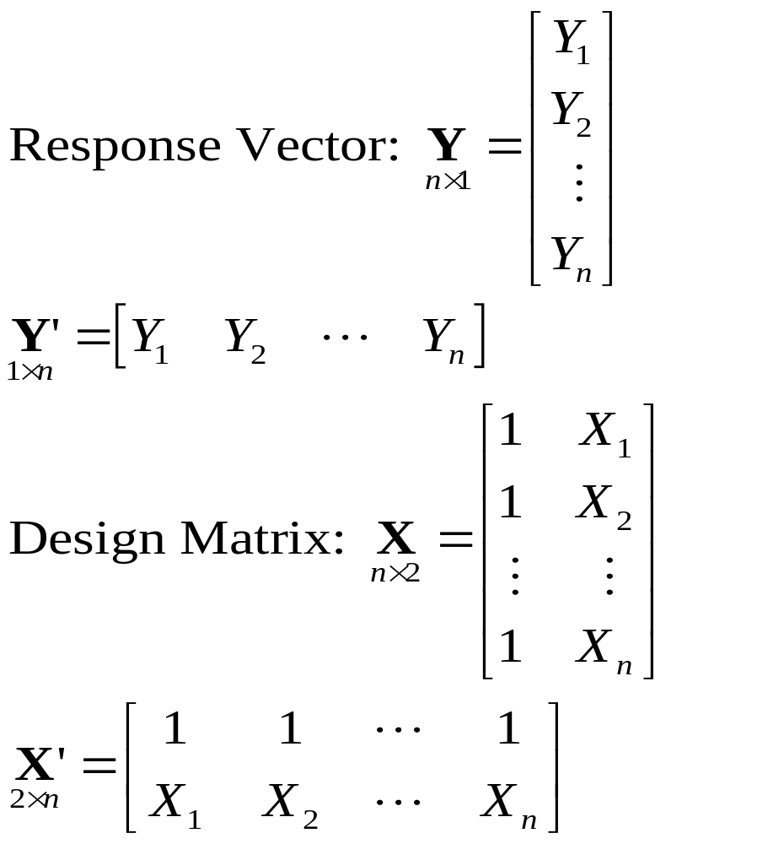
Regression Examples - Toluca Data

Slide 5
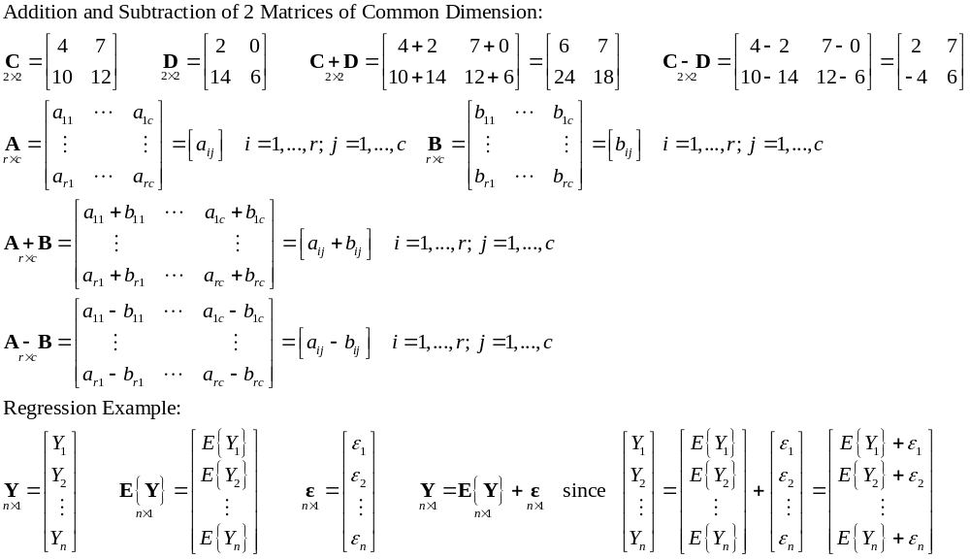
Matrix Addition and Subtraction

Slide 6
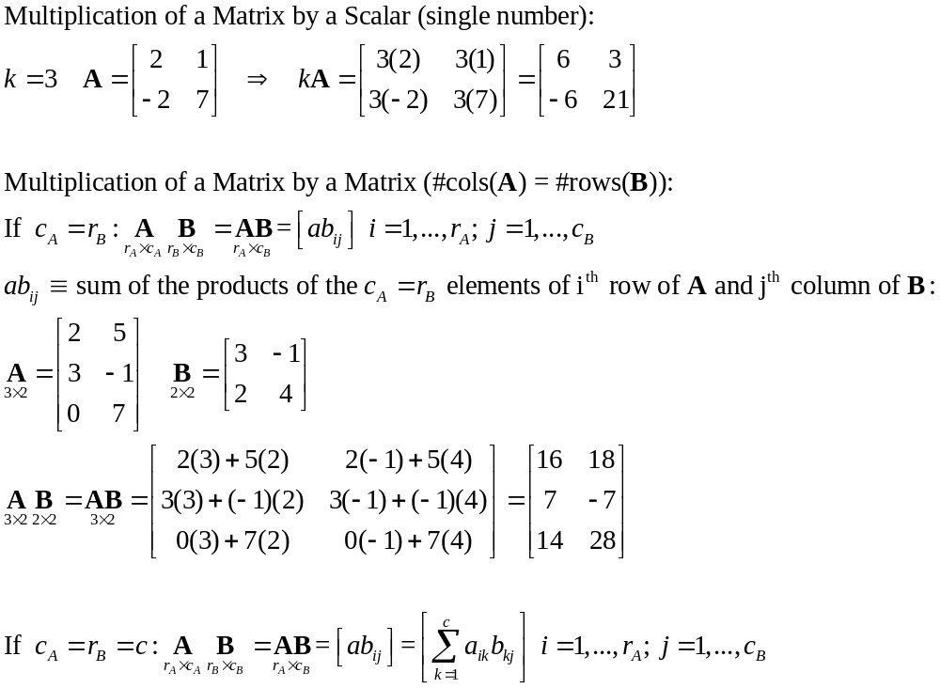
Matrix Multiplication

Slide 7
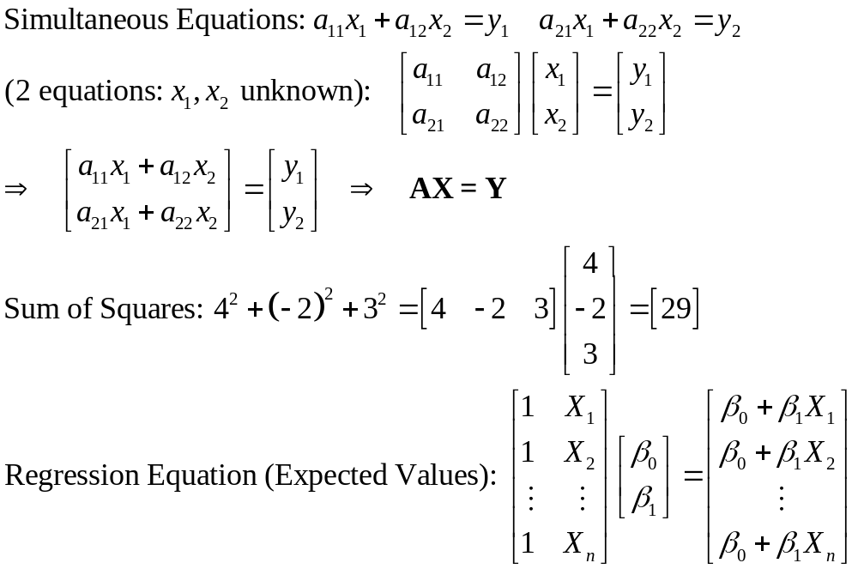
Matrix Multiplication Examples - I

Slide 8
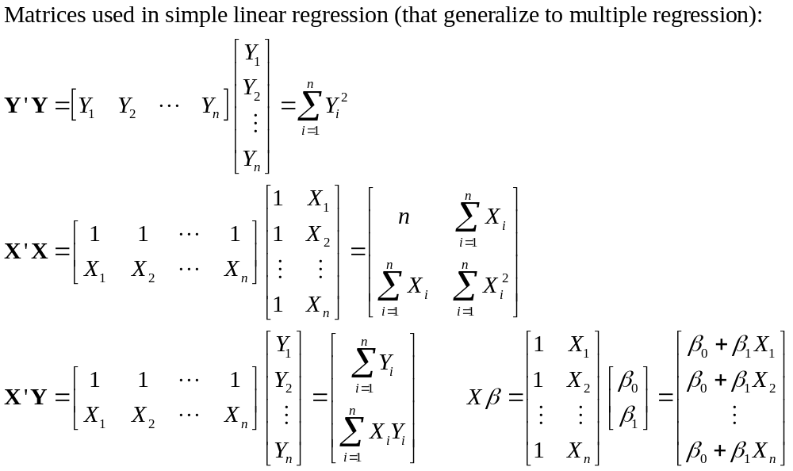
Matrix Multiplication Examples - II

Slide 9
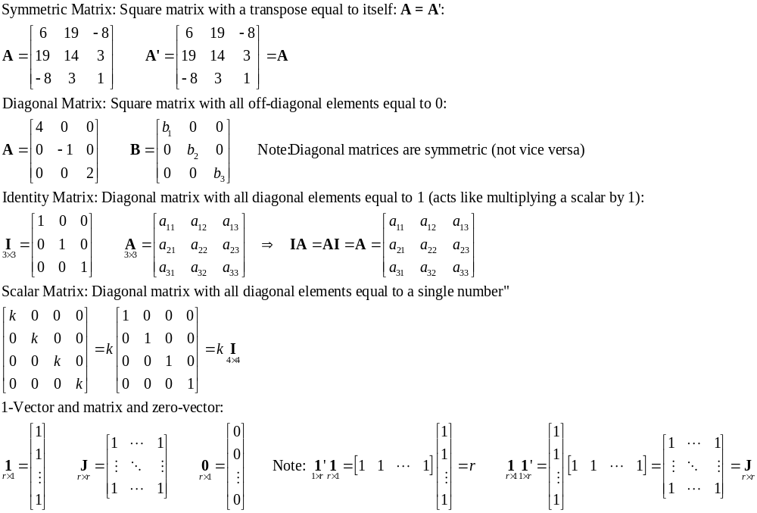
Special Matrix Types

Slide 10
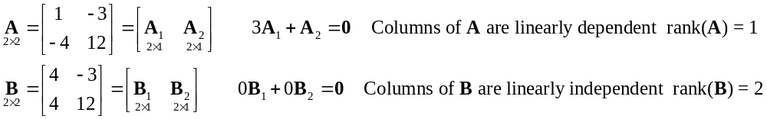
Linear Dependence and Rank of a Matrix
Linear Dependence: When a linear function of the columns (rows) of a matrix produces a zero vector (one or more columns (rows) can be written as linear function of the other columns (rows))
Rank of a matrix: Number of linearly independent columns (rows) of the matrix. Rank cannot exceed the minimum of the number of rows or columns of the matrix. rank(A) ≤ min(r_{A},c_{a})
A matrix if full rank if rank(A) = min(r_{A},c_{a})

Slide 11
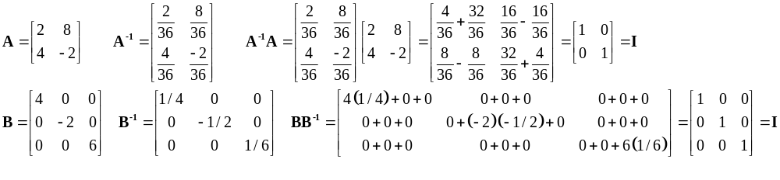
Matrix Inverse
Note: For scalars (except 0), when we multiply a number, by its reciprocal, we get 1: 2(1/2)=1 x(1/x)=x(x⁻¹)=1
In matrix form if A is a square matrix and full rank (all rows and columns are linearly independent), then A has an inverse: A⁻¹ such that: A⁻¹ A = A A⁻¹ = I

Slide 12
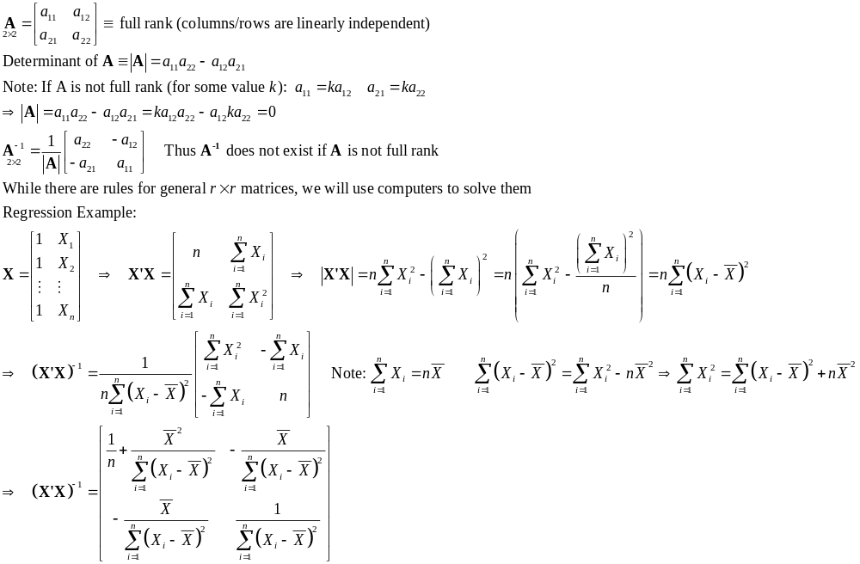
Computing an Inverse of 2x2 Matrix

Slide 13
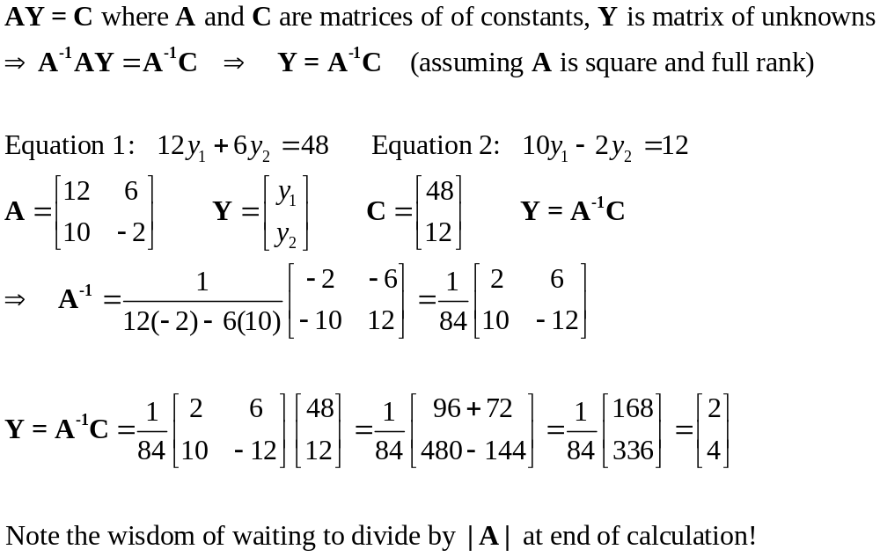
Use of Inverse Matrix – Solving Simultaneous Equations

Slide 14
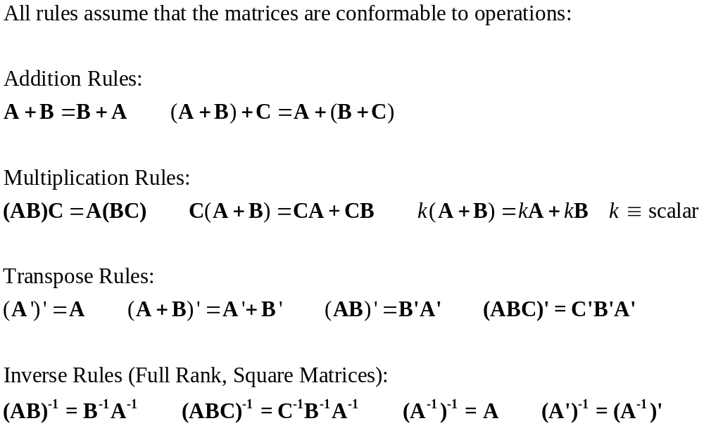
Useful Matrix Results

Slide 15
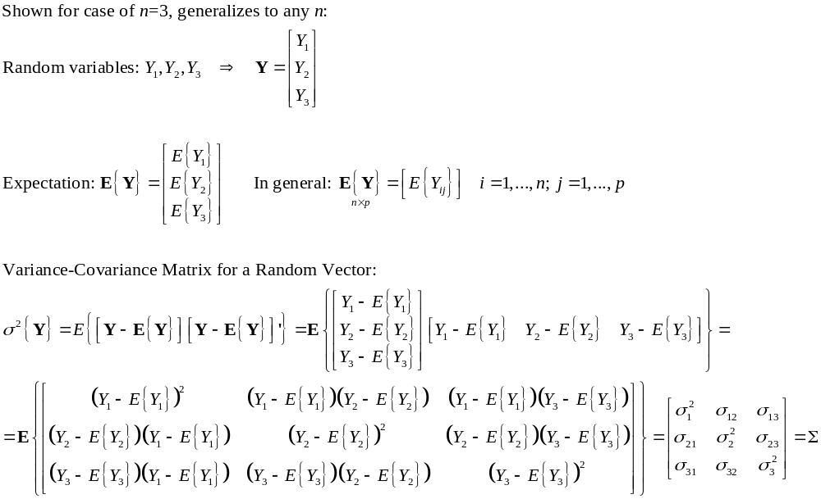
Random Vectors and Matrices

Slide 16
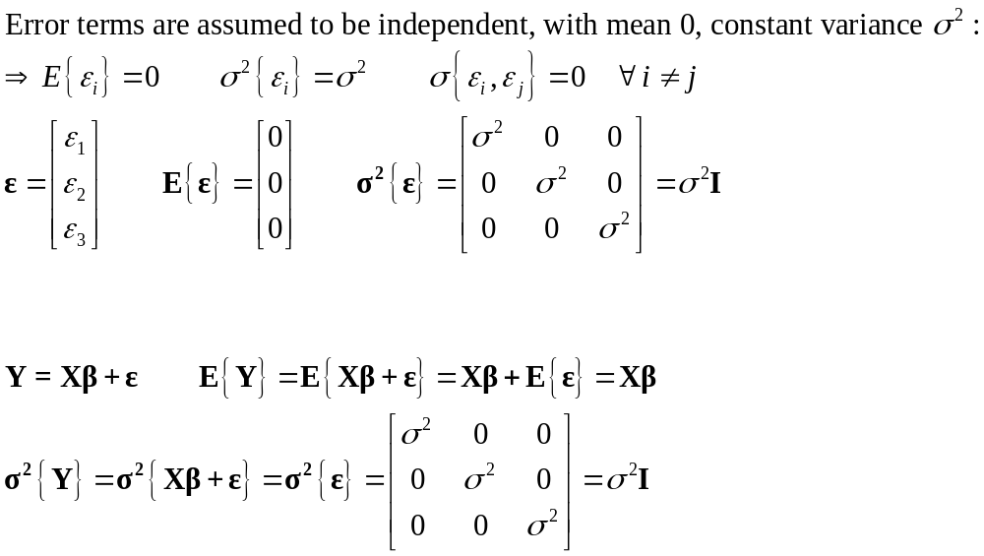
Linear Regression Example (n=3)

Slide 17
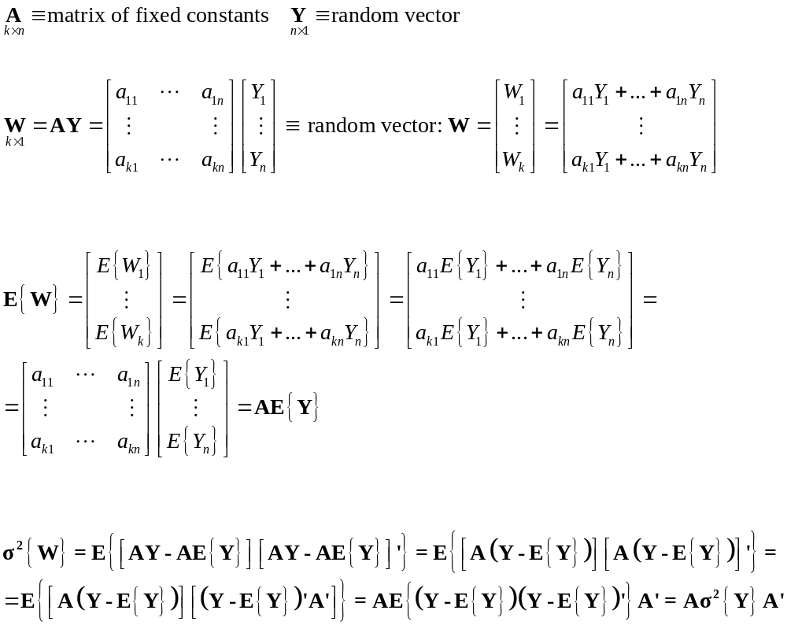
Mean and Variance of Linear Functions of Y

Slide 18
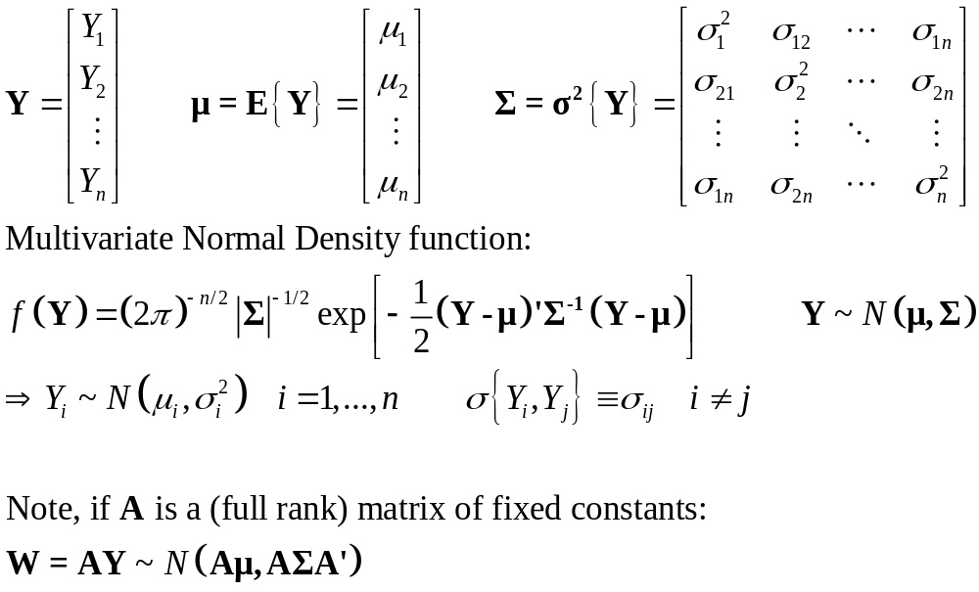
Multivariate Normal Distribution

Slide 19
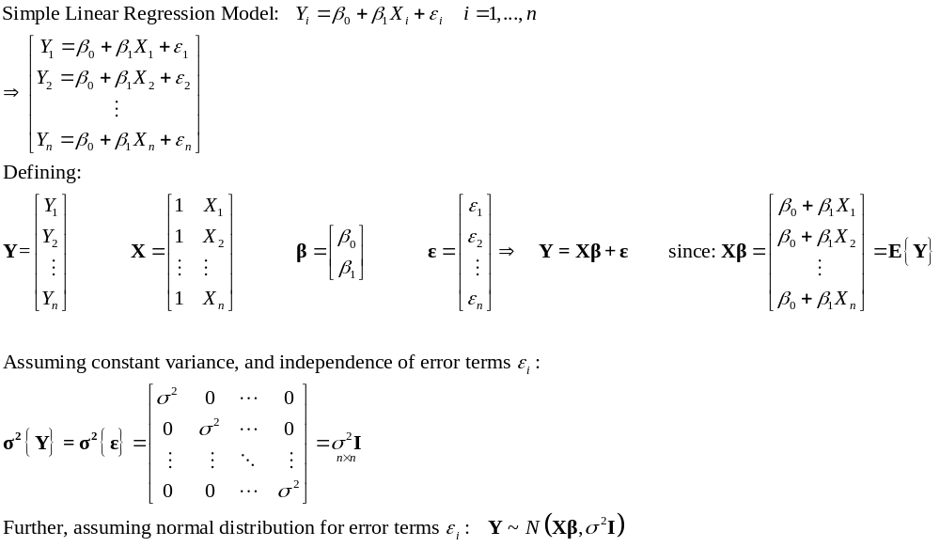
Simple Linear Regression in Matrix Form

Slide 20
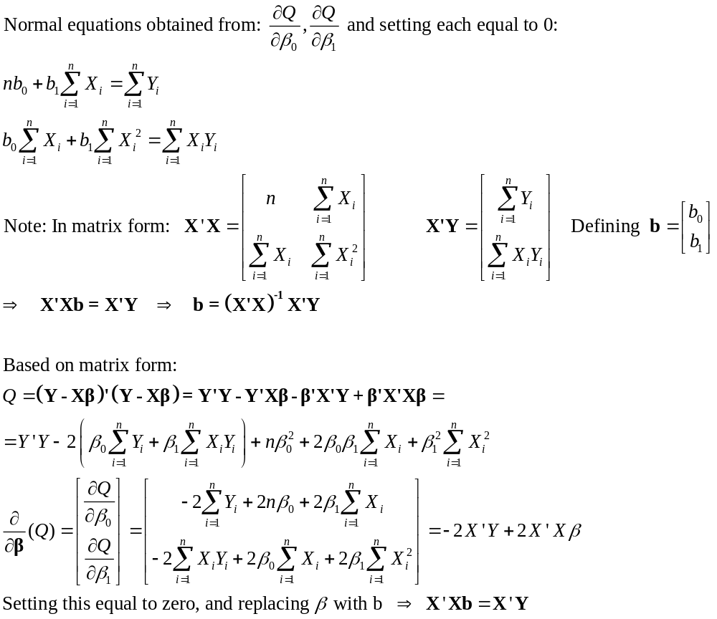
Estimating Parameters by Least Squares

Slide 21
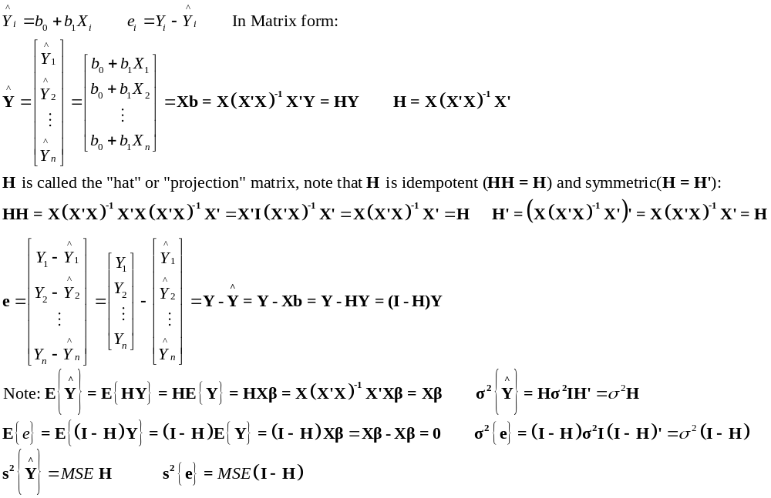
Fitted Values and Residuals

Slide 22
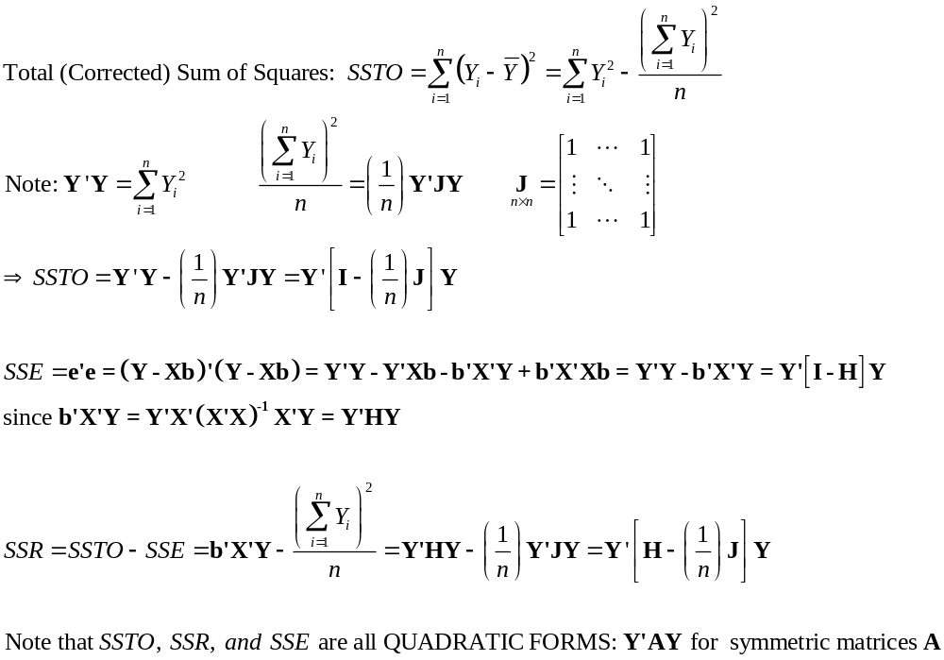
Analysis of Variance

Slide 23
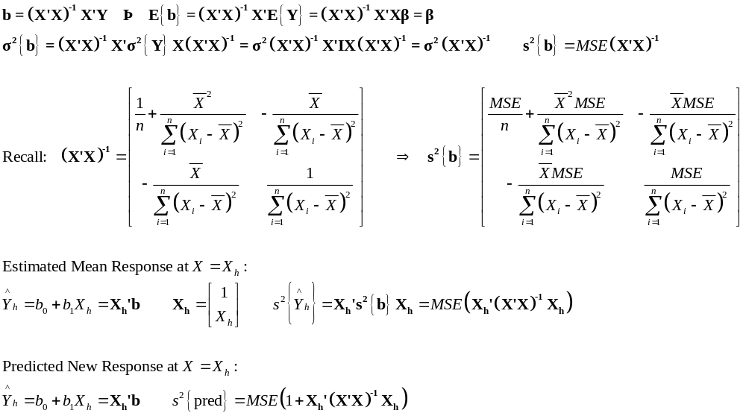
Inferences in Linear Regression

