Slide 1
Assumption: Report order is the same as ascending order in RSA listings
Revit, select element, Manage Tab, IDs of Selection (checked each of these Revit IDs to match to the respective RSA IDs and they follow in order of however they are entered into the reinforcement check report)
Also, this mapping seems to work because the coordinate planes are the same once the model is in RSA
Beam, Beam (1), 1, 528548
RSABeam9
Beam, Beam (2), 2, 528625 528650
RSABeam10, RSABeam11
Beam, Beam (3), 2, 528790 528821
RSABeam12, RSABeam13
Beam, Beam (4), 1, 585751
RSABeam14
Beam, Beam (5), 2, 585805 585845
RSABeam15, RSABeam16
Column, Column (1), 4, 527692 527796 527925 528004
RSAColumn1, RSAColumn2, RSAColumn3, RSAColumn4
Column, Column (2), 4, 528103 528211 528286 528353
RSAColumn5, RSAColumn6, RSAColumn7, RSAColumn8
Then Floors, RSAFloor17 (Level3), RSAFloor18 (Level2)

Slide 2
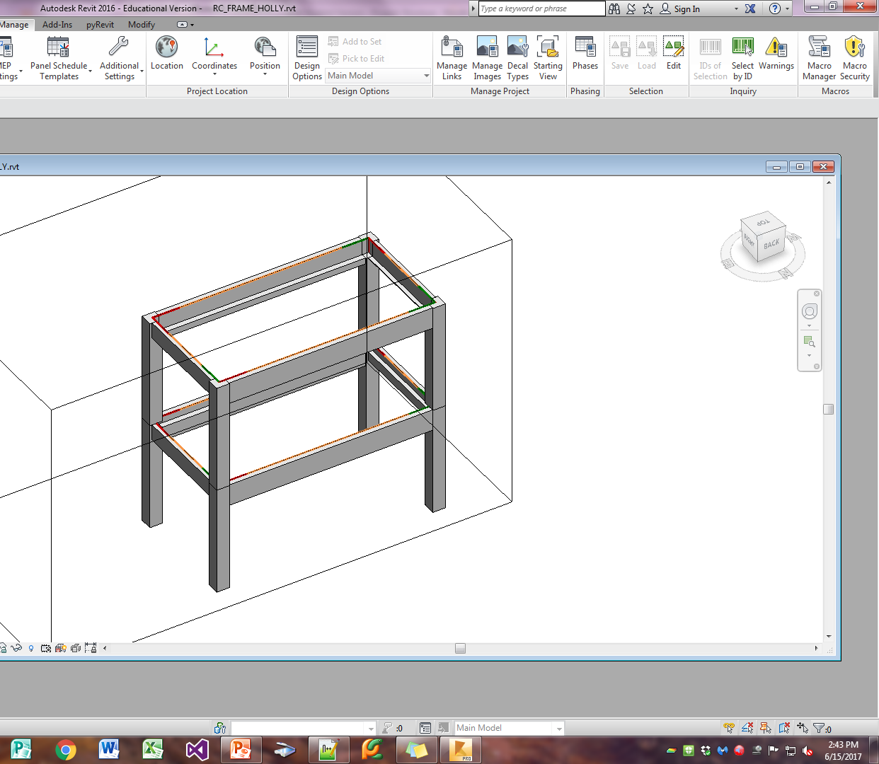
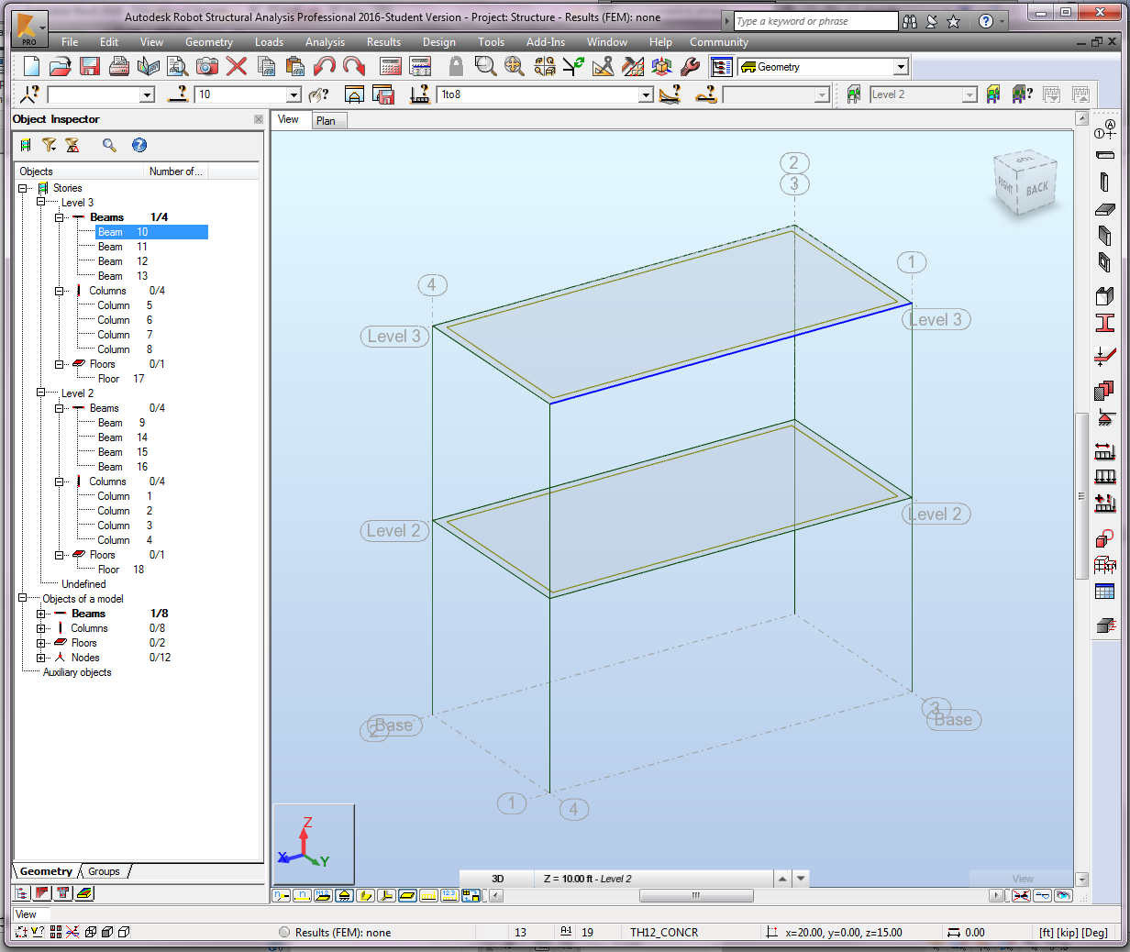
Frame Model to RSA Using Report Matches using increasing object order #s
11
12
17
13
6
10
5
7
8
15
14
16
18
9
2
4
1
When the process is repeated with the full model this was generated from using this same report...
3

Slide 3
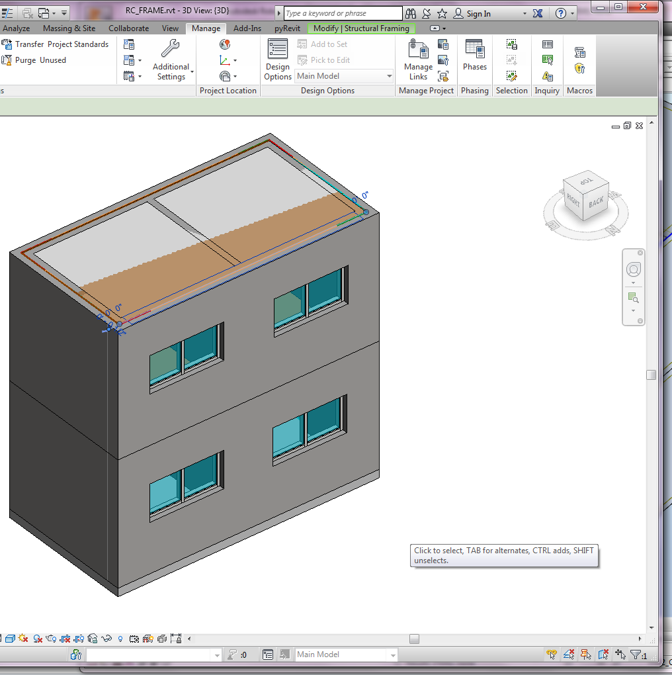
Original Full Model to RSA Using Report is different, except for columns
12
15
18
16
6
11
5
7
8
13
10
14
17
9
Columns matched, but not beams, so means the mapping and model will have to come through the other way (previous slide). Note: jumping back and forth between these two model versions being sent to RSA will cause tagging problems-needs to be a separate app instance when running.
2
4
1
3

Slide 4
But using close coordinates, we can map the RSA node sets from the skeleton version back to the respective element of the RSA full model version (which has walls too if needed):
Full Model (With Walls) |  | Frame Skeleton (Code Check)
Col1 | 0, 10.08, 0 | Col1 | 0, 10.0, 0
 | 0, 10.08, 10 |  | 0, 10.0, 10
Col2 | 0, 0, 0 | Col2 | 0, 0, 0
 | 0, 0, 10 |  | 0, 0, 10
Col3 | 20.08, 10.08, 0 | Col3 | 20.0, 10.0, 0
 | 20.08, 10.08, 10 |  | 20.0, 10.0, 10
Col4 | 20.08, 0, 0 | Col4 | 20.0, 0, 0
 | 20.08, 0, 10 |  | 20.0, 0, 10
Beam15 (=B12) | 0, 10.08, 20 | Beam12 (=B15) | 0, 10.0, 20
 | 0, 0, 20 |  | 0, 0, 20

