Slide 1
SecureVault
A multi-user encrypted document exchange on a server we don't trust
Shatha Abualrob 1231279 · Lara Daifallah 1230239 · Razan Shalabi 1230874
ENCS4320 Applied Cryptography · Birzeit University
Notes:
Introduce the team and the one-line goal: the server stores everything and learns nothing.

Slide 2
The problem
Layla shares her thesis with Omar through a server neither of them trusts
Users
Server
Attacker
Trusted machines. Only they know their password.
Honest-but-curious: follows the protocol, reads everything, can be stolen.
Owns the network: reads, changes, replays, registers accounts.
Out of scope: malware on the user's machine, coercion, traffic analysis, denial of service.
Notes:
Threat model: who the parties are and what the attacker can do. Say clearly what is out of scope.

Slide 3
Architecture
All cryptography happens on the client. The server only stores and relays bytes.
Client
Attacker proxy
Server
keys in memory only
encrypt · sign · verify
demo only
flip · rename · replay · swap
stores opaque bytes
checks signatures + nonces
TCP sockets · binary length-prefixed formats · every request signed with Ed25519 + timestamp + nonce
Notes:
Why sockets: the spec says the attacker controls the network, and with a real network our proxy really does.

Slide 4
Our decisions
Section 7, one choice each
1
2
3
4
Passwords
Documents
Public key
Key trust
Argon2id, 384 MiB
AES-256-GCM, new key each
X25519 + Ed25519
TOFU + safety number
5
6
7
8
MAC vs signature
Freshness
Architecture
Sessions
GCM tag + Ed25519
version · nonce · challenge
sockets + binary formats
no tokens, signed requests
Notes:
Overview. Each of the next slides is one decision: what we chose, what we rejected, and why.

Slide 5
Key hierarchy
Each layer only locks the one below it
password
Argon2id (salt) → master → HKDF
auth_key | enc_key
auth_key goes to the server · enc_key never leaves
private keys
X25519 + Ed25519, locked by enc_key
DEK
one random key per document, wrapped per recipient
document
AES-256-GCM, metadata as AAD
Password change = re-lock one 92-byte blob. Documents, grants and safety numbers stay the same.
Notes:
Why two keys from one password: the server holds auth_key. If it also opened the private keys, the server could read everything.

Slide 6
Passwords: Argon2id
Memory-hard: every guess needs 384 MiB, so GPUs can't run thousands in parallel
12,500 years
Measured work factor: 384 MiB, t=3, p=4 ≈ 0.47 s
16-byte random salt per user: public, only has to be unique
GPU bound: 3.4 GiB moved per guess → ~276 guesses/s
Library (our 30%): pure Python took 3.6 s for 8 KiB
Rejected: PBKDF2, bcrypt, scrypt
Limit: a top-1M password still falls in ~30 min
average to crack one 8-character password
(letters + digits) with our parameters, one GPU
1.4 hours
the same password with a bare SHA-256
Notes:
Arithmetic in Appendix A of the report. GPU numbers are assumptions; the Argon2id time was measured.

Slide 7
Documents: AES-256-GCM
Written by us, checked against NIST vectors
Why a nonce can never repeat
Metadata (name, type, size, time, owner, version) is the AAD: readable, not changeable
The tag is checked before anything is decrypted
AES-256 is above our 128-bit target on purpose: margin for many keys
Sped up 11x with GF(2⁸) lookup tables (≈105 KiB/s)
Rejected: CBC + HMAC, ChaCha20-Poly1305, CCM
Every document version gets a brand-new random 256-bit DEK, used exactly once. The same (key, nonce) pair cannot occur twice, even after a crash or a restart.
Notes:
If asked 'show me the code that stops a nonce repeating': client/secure_share.py, encrypt_document, os.urandom(32) for every document.

Slide 8
Curve25519 vs RSA-3072
Same 128-bit security, measured with OpenSSL (how many times slower RSA is)
Keys: 32 B vs 384 B
Signatures: 64 B vs 384 B
Why Curve25519: no invalid-curve checks, no per-signature random number (the PS3 bug)
Honest: RSA verification is as fast (small exponent 65537)
Notes:
Log scale. The verify bar is ~1x: we say this openly. It doesn't change the choice, because sign-up and sharing need keygen, agreement and signing.

Slide 9
Trusting a public key
What if the server hands Layla its own key instead of Omar's?
Layla's screen
1
First contact: the key is saved (TOFU)
5580 1411 5233 3811 2642
2
Both compare the number by phone / in person
20 digits from both names + both keys (SHA-256)
3
Sharing is blocked until verified
A swapped key → different numbers on the two screens → caught.
4
A changed key is blocked. No 'continue anyway'
Rejected: a CA on the server (it's the untrusted party), plain TOFU, long fingerprints. 20 digits ≈ 66 bits, too many to grind.
Notes:
This is the hardest problem in the spec. Explain what happens on first contact.

Slide 10
How the pieces fit together
Omar's client runs five checks, in order. Nothing is shown until all pass.
1
2
3
4
5
Grant matches
Unwrap
Decrypt
Signature
Freshness
same doc, version, owner, me
X25519 + HKDF + GCM
GCM tag over data + metadata
Ed25519, Layla's pinned key
version ≥ last seen
Authenticate before decrypting, and before showing anything
Sign the plaintext, then hide the signature inside the grant: third parties can verify, the server can't test guesses
Bind every context: recipient in the signature, both parties in the grant AAD, username in the key-blob AAD
Notes:
The spec says correct parts can fail in the wrong order. This slide is our answer.

Slide 11
Security properties
Each one, and the mechanism that provides it
Property | Mechanism
Confidentiality | AES-256-GCM, DEK wrapped with X25519 + HKDF
Integrity | GCM tag, checked before decryption
Origin | Ed25519 over the statement, pinned key
Non-repudiation | the same signature, checkable by anyone (prove)
Credentials | Argon2id 384 MiB + per-user salt
Freshness | signed timestamp + nonce, challenge, version
Metadata binding | metadata = AAD + hashed into the signature
A MAC can't give non-repudiation, however long its tag: Omar holds the same key, so he could have made it.
Notes:
Be ready to point to the file for each row.

Slide 12
We attacked our own system
attacks/attacker.py, a real proxy on the network, run live in the demo
flip one ciphertext byte
✓ document was modified
rename the file
✓ document was modified
replay yesterday's v1
✓ stale version
swap Omar's key
✓ safety numbers differ / Blocked
resend a captured request
✓ Request rejected
Notes:
Demo items 6, 7, 8 plus the MITM. Remember to set the attacker back to 'mode pass' between steps.

Slide 13
Why the defences are there
A deliberately weakened build: the attack works on it and fails on ours
Fixed nonce
No tag check
weak build
one known file reveals another file completely
weak build
"Transfer 100" becomes "Transfer 900"
our build
every document has a new key → garbage
our build
GCM tag fails → rejected
Notes:
python attacks/weakened_build.py. Nonce reuse: c1 xor c2 = p1 xor p2. No tag: CTR is malleable.

Slide 14
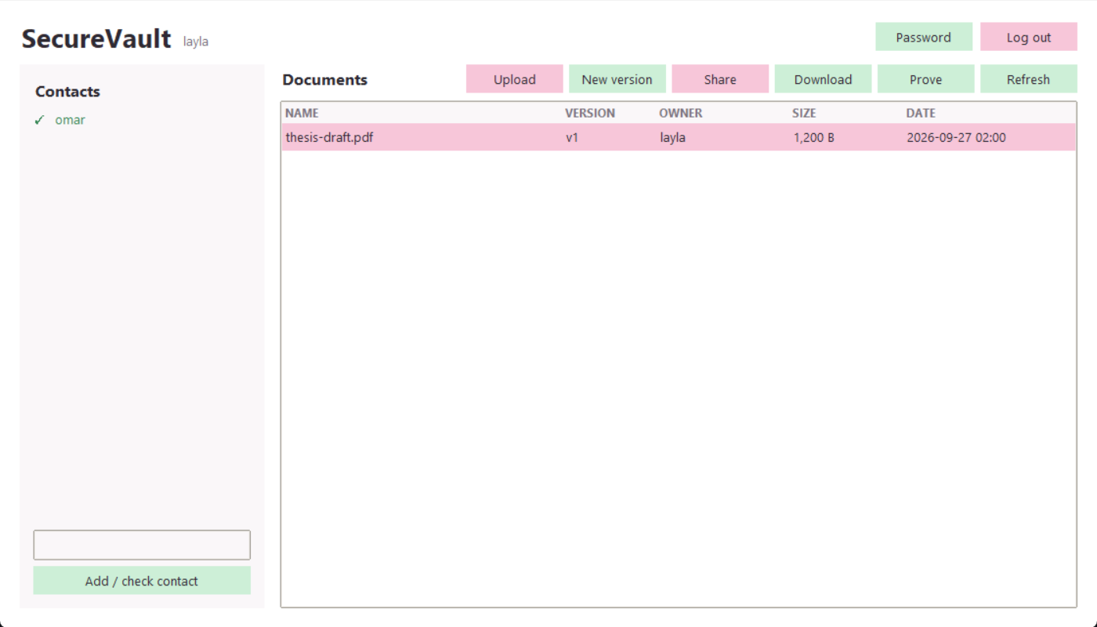
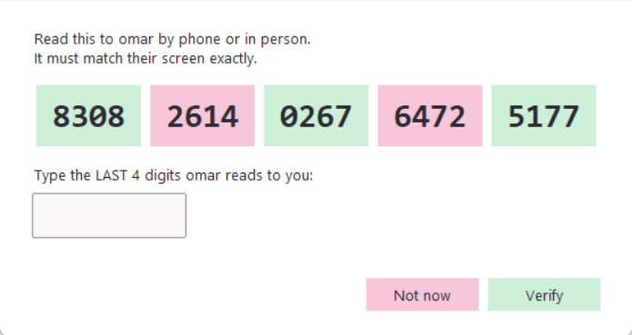
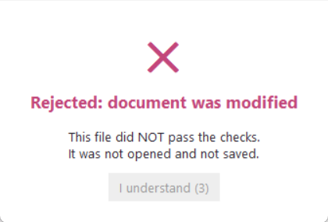
Graphical client & third-party proof
Bonus: interface choices that carry security weight
Safety number in big groups; to verify, type the last group you HEARD
A failure can't be closed for 3 s, and never offers "open anyway"
Share only lists verified contacts
prove + tools/verify_proof.py: anyone can check that Layla signed this file for Omar
Notes:
python client/gui.py. For non-repudiation: Omar runs prove, anyone runs tools/verify_proof.py with the proof and the file.

Slide 15
Showing it's correct
An implementation we can't show to be correct counts as not implemented
226
Official vectors: FIPS 180-4, NIST GCM, RFC 5869, 7748, 8032, 9106
Plus random cross-checks against the cryptography library: partial blocks, empty inputs, boundaries
System tests: formats, keys, sharing, server, client
The whole demo runs through the attacker over real sockets
70% rule: everything is ours except Argon2id
tests, all passing
Notes:
Run python -m pytest tests live if asked (about 2.5 minutes, or skip the 10 MB test).

Slide 16
What we don't stop
Honest limits, and what would fix them
Common passwords
Users who skip the number
fix: a strength check at sign-up
fix: UI that makes verifying hard to skip
Stolen DB → login as the user
Forgotten password → data lost
fix: signature-based login
fix: a printed recovery key
Metadata is visible
Not constant-time
fix: encrypt file names
fix: a compiled implementation
Notes:
An honest limitations section earns marks. Don't claim unconditional security.

Slide 17
Live demo & questions
server · attacker · Layla · Omar
Notes:
Four terminals: python server/server.py; python attacks/attacker.py; python client/client.py --port 5051 (x2). Follow the demo table in the README.

