Slide 1
Positive and Negative Relationships
K. Lakshmi Kalpana Roy
AP (AM & CS)
PSG College of Technology

Slide 2
Relationships in the network
Positive → Sharing on information, Friendship, Work Collaboration, etc.
Negative → Disagreement, Controversy, etc.
Annotate links → positive and negative links in the network → Aim : understand the tension between these two forces
The notion of Structural Balance

Slide 3
Positive and Negative Relationships
A social network on a set of people:
Everyone knows everyone else in the set (a clique)
Edges are labeled with either + or -, where + indicates friends, and - indicates enemies
Example : Team of classmates, A sports team, etc.

Slide 4
Structural Balance
Finding the balanced and unbalanced triangles
What happens if network has positive/negative edges?
What local configurations do we expect to see?
How does this impact the global structure of the network?

Slide 5
When looking a set of three people at a time in the network, how structural balance is exhibited?

Slide 6
Sources of instability in a configuration
Psychological “stress” or “instability” into the relationships

Slide 7
Balanced Triangles
A triangle with 1 or 3 ‘+’ edges → Balanced triangle
A triangle with 0 or 2 ‘+’ edges → Unbalanced triangle
Argument by structural balance theorists → As unbalanced triangles are sources of stress or psychological difference, people try to minimize them in their personal relationships, and hence they will be less abundant in real social settings than balanced triangles.
(Refer the figures in the previous two slides)

Slide 8
Structural Balance for Arbitrary Networks
How to extend structural balanced to networks of arbitrary number of nodes (i.e., N > 3)?
A labeled complete graph is balanced if every one of its triangles is balanced – that is, if it obeys the following:
Structural Balance Property : For every set of three nodes, if we consider the three edges connecting them, either all three of these edges are labeled +, or exactly one of them is labeled +.
It is a local property

Slide 9
Which one of the following networks satisfy the Structural Balance Property?

Slide 10
Characterizing the Structure of Balanced Networks
What does a balanced network (i.e., a balanced labeled complete graph) look like?
Check all triangles → they each obey the balance conditions
Consider A, B and C, D are two group of friends.
-ve relationship exists between them.
When is a network balanced?
One way → if everyone likes each other i.e. all triangles have three +
Two group of friends → how the groups are connected?

Slide 12
The Balance Theorem – Frank Harary (1953)
If a labeled complete graph is balanced, then either all pairs of nodes are friends, or else the nodes can be divided into two groups, X and Y , such that each pair of people in X likes each other, each pair of people in Y likes each other, and everyone in X is the enemy of everyone in Y .

Slide 13
Proof
If no negative edges, then the network is balanced.
Assume if there is atleast one negative edge, to show that:
Every two nodes in X are friends
Every two nodes in Y are friends
Every node in X is an enemy of every node in Y
Refer Textbook by Easley and Kleinberg for complete proof

Slide 14
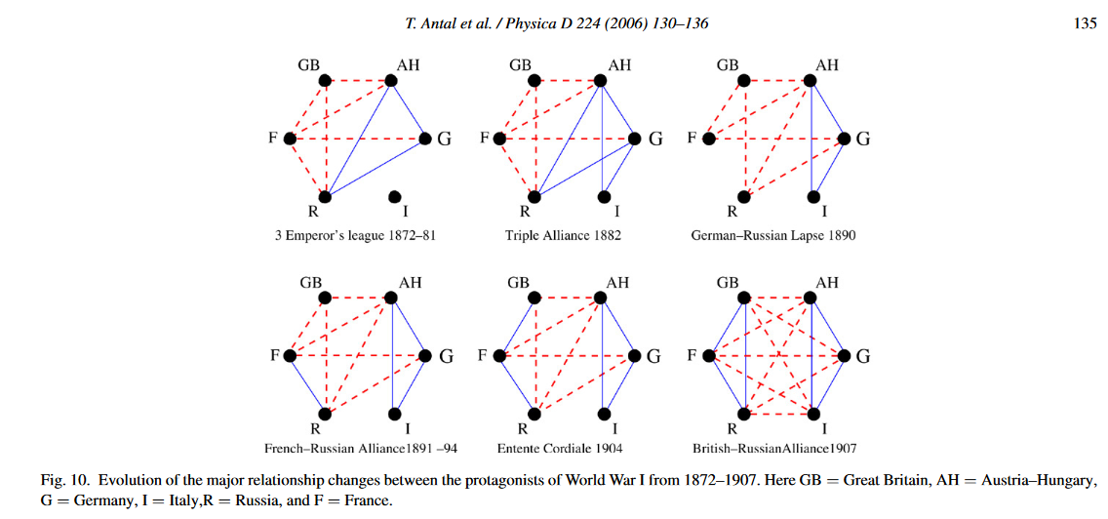
Applications of Structural Balance
International Relations
Trust, Distrust, and Online Ratings

Slide 15
A weaker form of structural balance
In a triangle with two positive edges, we have the problem of a person whose two friends don’t get along
In a triangle with three negative edges, there is possibility that two of the nodes will ally themselves against the third
Which of these factors are significantly stronger than the other?

Slide 16
Characterizing Weakly Balanced Network
A complete labeled graph is weakly balanced if the following property holds:
Weak Structural Balance Property: There is no set of three nodes such that the edges among them consist of exactly two positive edges and one negative edge.

Slide 17
Structural Balance in Arbitrary (Non-complete) Networks
How to define structural balance for the arbitrary network which is not complete?
Two ways:
Fill remaining edges with label to produce a signed complete graph which is balanced?
The other way → whether it is possible to divide the nodes into two sets, X and Y , so that all edges inside X and inside Y are positive, and all edges between X and Y are negative.

Slide 19
Characterizing Balance for General Networks.
If a signed graph contains a cycle with an odd number of negative edges, then it is not balanced.
If one of the nodes is placed in X , then following the set of friend/enemy relations around the cycle produces a conflict by the time we get to the starting node.

Slide 20
How to determine if a signed graph is balanced?

Slide 21
Claim: A signed graph is balanced if and only if it contains no cycle with an odd number of negative edges.
Proving the Characterization by identifying Supernodes
Find a division of the nodes into sets X and Y so that all edges inside X and Y are positive, and all edges crossing between X and Y are negative.
Producing such a partition into sets X and Y with these properties it is called a balanced division.

Slide 22
The procedure works in two main steps:
First step → to convert the graph to a
reduced form that only contains negative edges
Second step → to solve the problem on this reduced graph.
Blobs - supernodes

