Slide 1
Threat Modeling
Proactive approach that aims to identify vulnerabilities and weaknesses in systems, networks, or applications

Slide 2
What's the difference between a threat, risk, and vulnerability?
Threat
Any potential to exploit a vulnerability and affect the confidentiality, integrity, or availability of assets is considered a threat in cybersecurity. An attempted phishing attack through a targeted email is an example of an intentional threat. However, an employee accessing corporate assets from an unsecured, public Wi-Fi network is an unintentional threat.
Vulnerability
A vulnerability is a weakness in a system, software, hardware, application, or procedure that an attacker can exploit. Vulnerability management involves patching known vulnerabilities before they can be exploited. An unpatched flaw can allow a threat actor to gain access to assets, install malware, damage data, or expose sensitive information to the public.
Risk
Risk in cybersecurity is the likelihood of a threat exploiting a vulnerability and the potential damage it could cause. Since it is impossible to eliminate risk, risk management aims to reduce an organization's cyber risk to a manageable level. Proactively patching vulnerabilities and mitigating threats are vital steps in this process.

Slide 3
How can we find security issues in our applications and systems?
Some Approaches
• Static analysis of code
• Fuzzing or other dynamic testing
• Penetration testing
• Production bug reports
• Incident response

Slide 4
WHY Threat Model?
Improve efficiency
Think about security issues early
Invest effort more wisely
Understand requirements better
Bring security and development together
Shared, maintainable, understanding of risks
Avoid writing bugs into the code
Avoid costs of rework
Improved stakeholder confidence

Slide 5
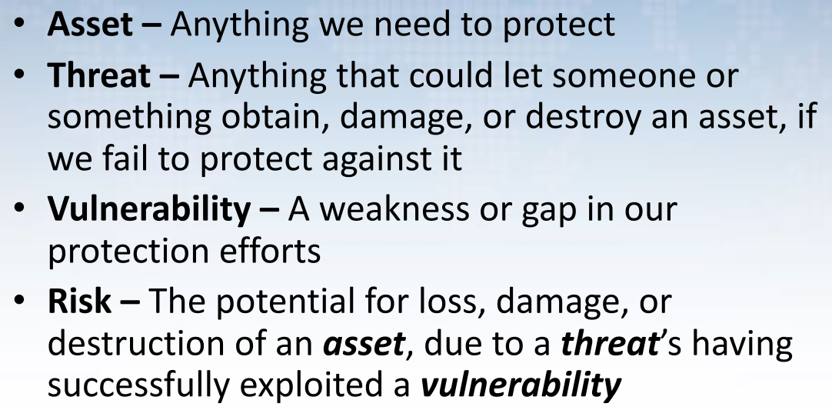
Terms of Reference

Slide 6
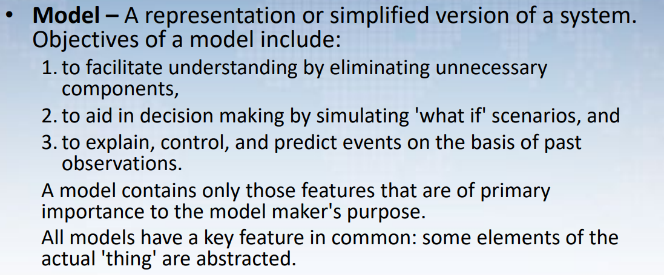
Terms of Reference

Slide 7
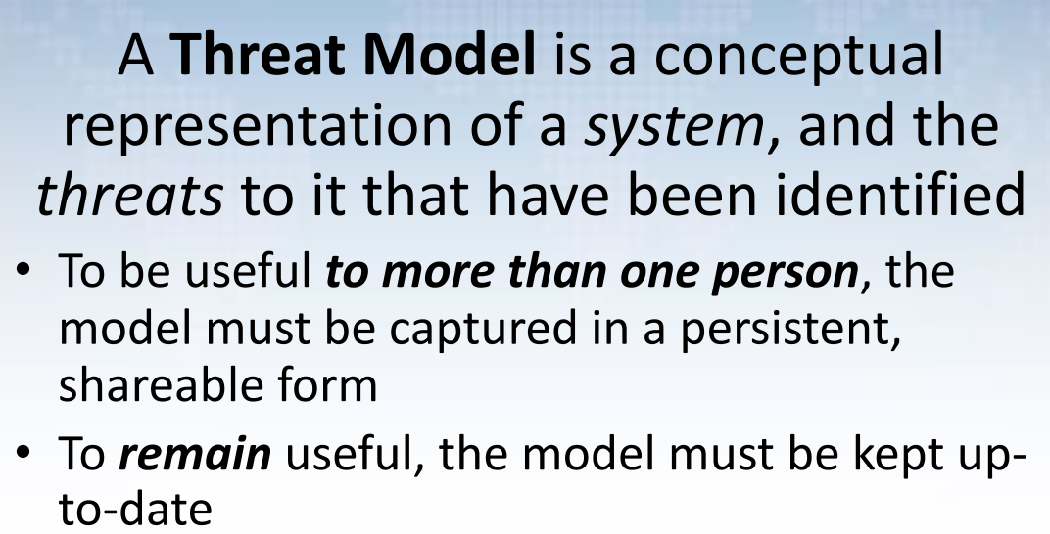
WHAT Is a Threat Model?

Slide 8
The threat-modeling process
1. Assemble the threat-modeling team.
2. Decompose the application.
-DFD, Activity Diagram
3. Determine the threats to the system.
- STRIDE, Threat trees
4. Rank the threats by decreasing risk.
- DREAD
5. Choose how to respond to the threats.
6. Choose techniques to mitigate the threats.
7. Choose the appropriate technologies for the identified techniques.

Slide 9
WHAT Should Be in a Threat Model?
Description of the system
List of assumptions
List of threats
Decision on how to address each threat
Validation approach

Slide 10
WHO Should Create the Model?
All system stakeholders should take part
Security ”experts” play advisory role only
Assign lifecycle roles:
– Owner (Accountable)
– Maintainer (Responsible)

Slide 11
WHEN to Create a Model?
As early as possible
Existing system without a Threat Model
Start NOW
Use Incremental Threat Modelling approach
Review Threat Model every update cycle
Do the proposed changes affect the model?
If ‘yes,’ include model update efforts in the cycle

Slide 12
Shostack’s Four Questions
What are we building?
What can go wrong?
What are we going to do about it?
How good a job did we do with 1 – 3?
TM- continuous process done when.
A new feature is released
A security incident occurs
There are infrastructure changes.

Slide 13

HOW Do I Build a Threat Model?

Slide 14
Threat Modelling Approaches
Think like an attacker
Focus on assets
Focus on what’s being built

Slide 15
DFD (Data Flow Diagram)
Software models for threat modeling usually focus on data flows and boundaries
Developed in the early 70s, and still useful
Simple: easy to learn, sketch
Threats often follow data
Abstracts programs into:
– Processes: your code
– Data stores: files, databases, shared memory
– Data flows: connect processes to other elements
– External entities: everything but your code & data Includes people & cloud software
– Trust boundaries (now made explicit)

Slide 16
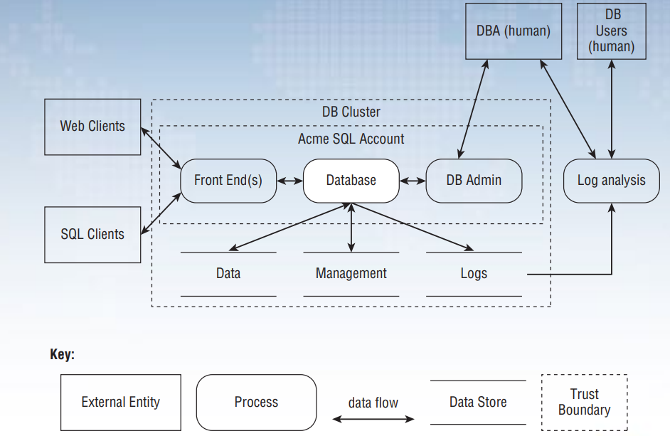

Slide 17
Identifying Threats
Method #1: Threat lists
Start with laundry list of possible threats
Identify the threats that apply to your app
Method #2: STRIDE
Categorized list of threat types
Identify threats by type/category
Optionally draw threat trees
Root nodes represent attacker's goals
Trees help identify threat conditions

Slide 18
What Can Go Wrong?
STRIDE mnemonic
– Spoofing
– Tampering
– Repudiation
– Information Disclosure
– Denial of Service
– Elevation of Privilege

Slide 19
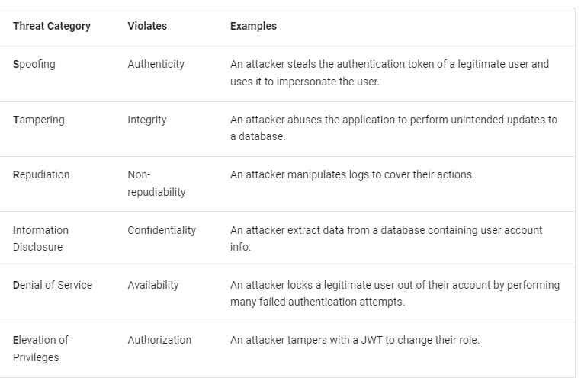

Slide 20
Relevant Threats
Spoofing
Can an attacker upload data on our behalf?
How do we authenticate to the destination before uploading?
Tampering / Information Disclosure
Can an attacker sniff data, or tamper with it?
Repudiation
Can the DWH claim we didn’t send that data?
Or sent data exceeding our quota?
Denial of Service
Is there an availability SLA for uploads?
Privacy
Can our data aggregation be reverse engineered?
Are we required to notify users a third party is involved?

Slide 21
Threat Tree :Example 1
Theft of
Auth Cookies
Obtain auth cookie to spoof identity
OR
AND
AND
Unencrypted
Connection
Eavesdropping
Cross-Site
Scripting
XSS
Vulnerability
Cookies travel over unencrypted HTTP
Attacker uses sniffer to monitor HTTP traffic
Attacker possesses means and knowledge
Application is vulnerable to XSS attacks
Notes:
This is a simple threat tree. In real life, threat trees are numerous and sometimes much more complex

Slide 22
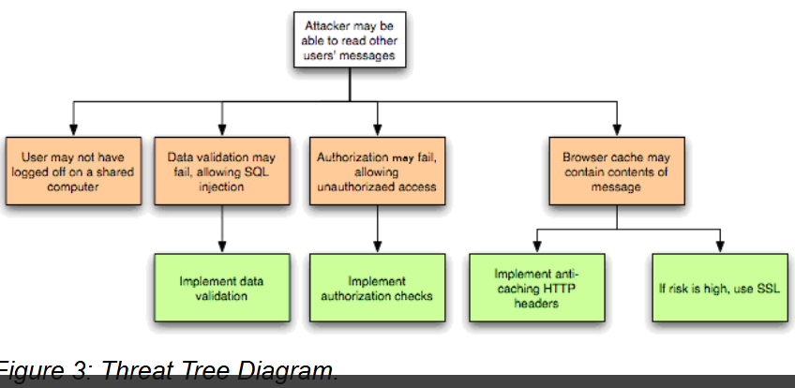

Slide 23
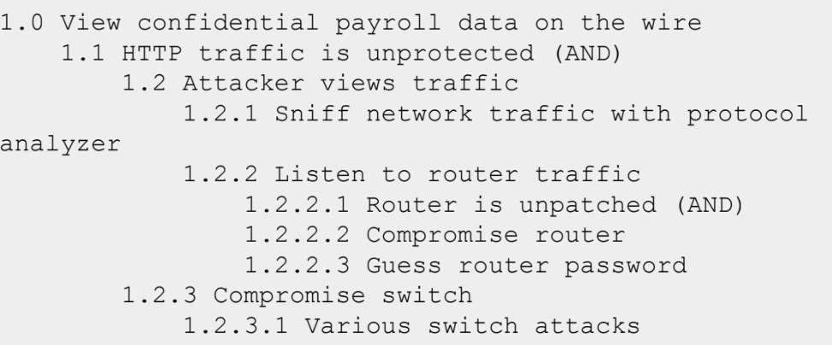
Threat Tree: Example 2

Slide 24
Rating Threats
Simple model
DREAD model (Meier et al., 2003)
Greater granularization of threat potential
Rates (prioritizes) each threat on scale of 1-10
Developed and widely used by Microsoft
Risk = Probability * Damage Potential
1-10 Scale
1 = Least probable
10 = Most probable
1-10 Scale
1 = Least damage
10 = Most damage
Notes:
Simple model does not directly take into account factors such as whether the attack requires a timing window (e.g., the fact that a stolen authentication cookie is valid for a finite period of time)

Slide 25
DREAD
D
Damage potential
What are the consequences of a successful exploit?
R
Reproducibility
Would an exploit work every time or only under certain circumstances?
E
Exploitability
How skilled must an attacker be to exploit the vulnerability?
A
Affected users
How many users would be affected by a successful exploit?
D
Discoverability
How likely is it that an attacker will know the vulnerability exists?
rank these factors on a scale from 0-10 and calculate the sum of these values. If the resulting value is higher, the risk of a potential attack on the organization is greater and we need to employ mitigation strategies immediately.

Slide 26
Damage potential:
The organization measures the amount of damage that a threat actor can cause as the damage potential on the following scale:
0 – Indicates no damage caused to the organization
5 – Information disclosure said to have occurred
8 – Non-sensitive user data has been compromised
9 – Non-sensitive administrative data has been compromised
10 – The entire information system has been destructed. All data and applications are inaccessible

Slide 27
Reproducibility:
Reproducibility indicates if it’s simple to replicate an attack. These are again plotted on a scale of 0 – 10.
0 – Difficult to replicate the attack
5 – Complex to replicate the attack
7.5 – Easy to replicate the attack
10 – Very easy to replicate the attack

Slide 28
Exploitability:
Different vulnerabilities in an organization can be exploited by using different tools and skills, as indicated by their ratings. They are rated as follows:
2.5 – Indicates that advanced programming and networking skills needed to exploit the vulnerability
5 – Available attack tools needed to exploit the vulnerability
9 – Web application proxies are needed to exploit the vulnerability
10 – Indicates the requirement of a web browser needed to exploit the vulnerability

Slide 29
Affected Users:
Calculate the number of users who will be affected by an attack to determine the potential impact of the attack. This is again rated on a scale of 1 – 10.
0 – no users affected
2.5 – Indicates chances of fewer individual users affected
6 – Few users affected
8 – Administrative users affected
10 – All users affected
Discoverability:
On a scale of 1 – 10, this factor rates the discoverability of a vulnerability.
0 – Indicates it’s hard to discover the vulnerability
5 – HTTP requests can uncover the vulnerability
8 – Vulnerability found in the public domain
10 – Vulnerability found in web address bar or form

Slide 30
Overall Threat Rating
The overall threat rating is calculated by summing the scores obtained across these five key areas. The risk severity categories for a threat are as follows:
Critical (40–50): Critical vulnerability; address immediately.
High (25–39): Severe vulnerability; consider for review and resolution soon.
Medium (11–24): Moderate risk; review after addressing severe and critical risks.
Low (1–10): Low risk to infrastructure and data.

Slide 31
Rating Example
Threat #1: Malicious user views confidential on-the-wire payroll data.
8 Damage potential: Reading others' private payroll data is no joke.
10 Reproducibility: It is 100 percent reproducible.
7 Exploitability: Must be on subnet or have compromised a router.
10 Affected users: Everyone, including Jim the CEO, is affected by this!
10 Discoverability: Let's just assume it'll be found out!
Risk_{DREAD}: (8+10+7+10+10) / 5 = 9
One a scale of one to ten, 9 is a serious issue. This threat should be addressed as soon as possible, and the solution should not go live until the threat is correctly mitigated.

Slide 32
Choose how to respond to the threats
Do nothing.
Inform the user of threat.
Remove the problem.
Fix the problem.

Slide 33
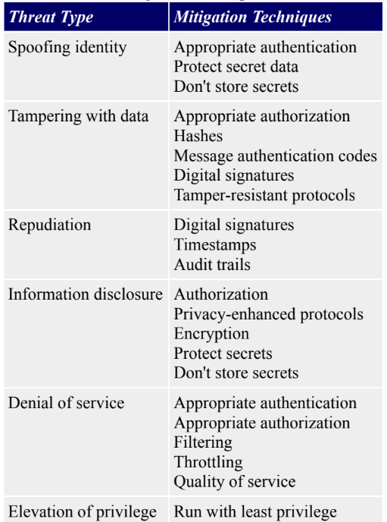
Threat Type Mitigation Techniques

Slide 34
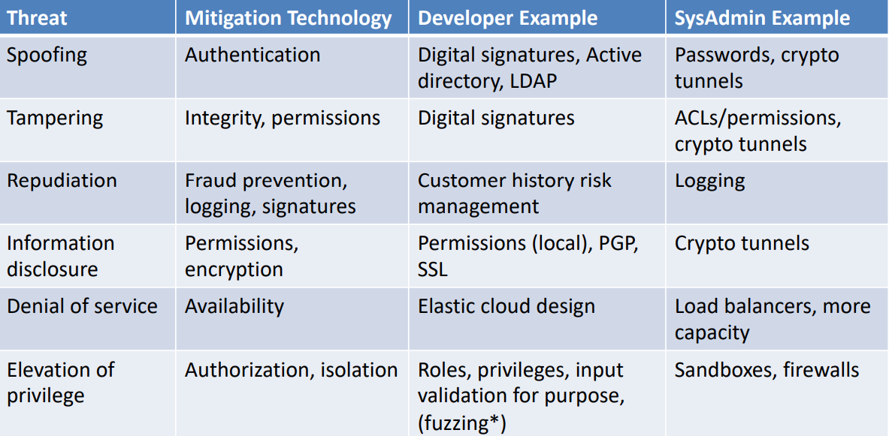
Technical Mitigations
* Fuzzing/fault injection is not a mitigation, but a testing technique

Slide 35
How to measure the effectiveness of threat modeling?
Two ways to measure effectiveness are:
Common Vulnerability Scoring System (CVSS). CVSS produces standardized scores for application vulnerabilities, IT systems and elements, and IoT devices; the scores can be calculated with a free online tool. For additional perspective, scores can be compared against a database of existing scores crowdsourced from similar enterprises.
The Exploit Prediction Scoring System (EPSS) is a framework designed to predict the likelihood of a vulnerability being exploited in the wild. It is an open-source initiative developed by the FIRST (Forum of Incident Response and Security Teams), with the goal of helping organizations prioritize vulnerabilities based not only on their severity (such as CVSS scores) but also on the probability of them being actively exploited.
https://www.cvedetails.com/

Slide 36
Penetration testing. Sometimes referred to as "ethical hacking," penetration testing is the process of staging dummy attacks on a system to measure its strengths and weaknesses. Pen tests may require a good deal of time-consuming data analysis, so organizations should be wary of running too many tests, or tests on assets that are not sufficiently high-risk to justify the cost.

Slide 37
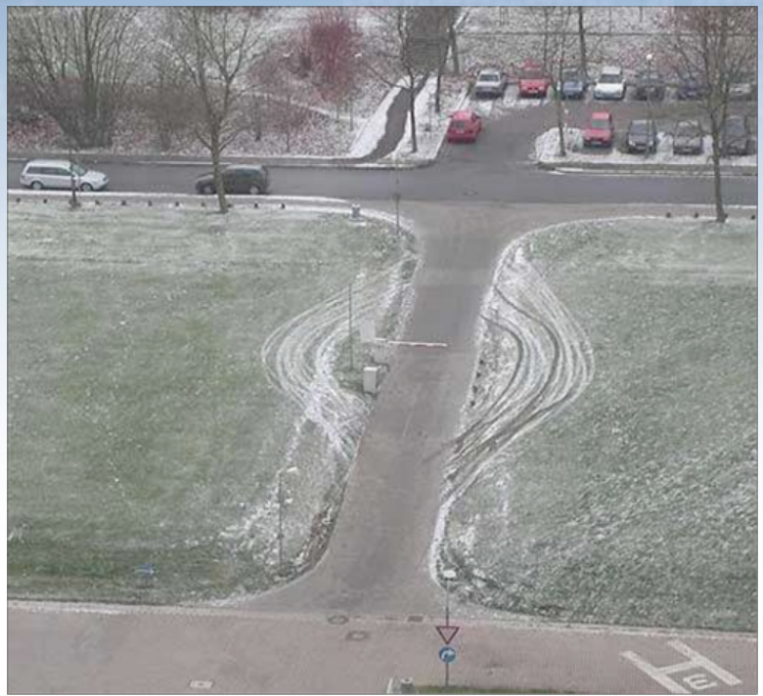
Attackers Respond to Our Defenses

Slide 38
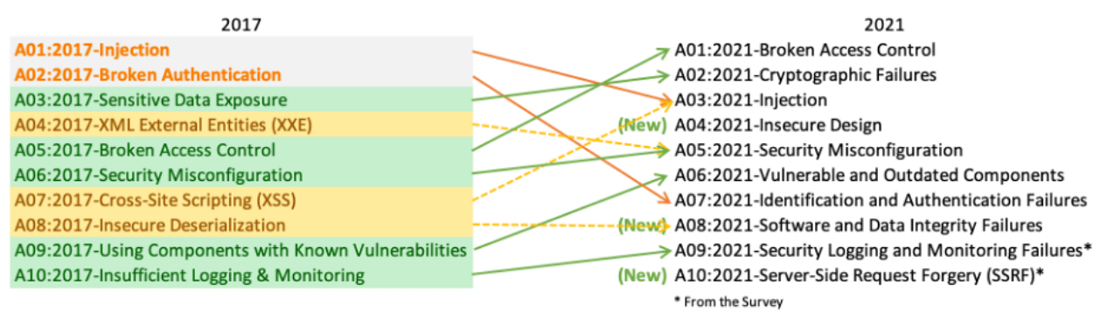
OWASP Top Ten Web Application Security Risks

Slide 39
https://cheatsheetseries.owasp.org/cheatsheets/File_Upload_Cheat_Sheet.html

Slide 40
References
https://www.cisco.com/site/us/en/learn/topics/security/what-is-threat-management.html
https://www.eccouncil.org/threat-modeling/
https://owasp.org/www-community/Threat_Modeling_Process

