Slide 1
MindLAMP App Instructions For Participants

Slide 2
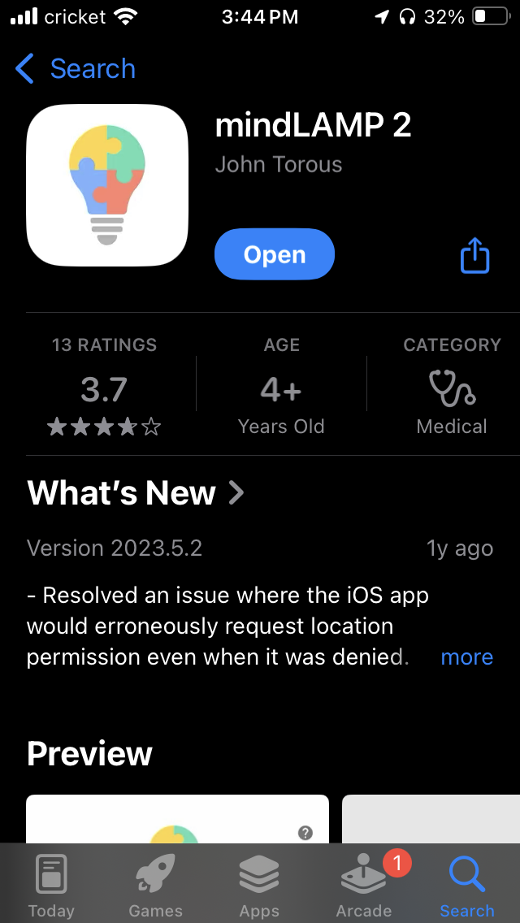
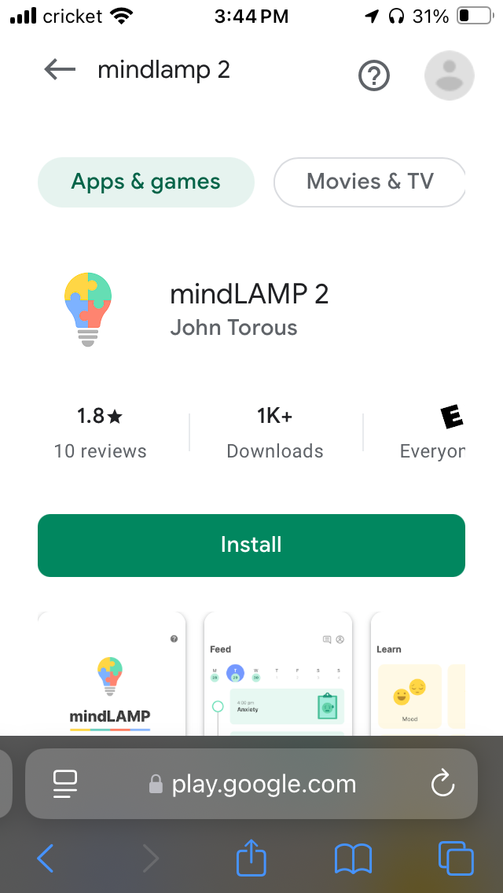
Step 7
Download mindLAMP 2 app on the app store
Then click on the sign-in link from the email
Or go to next slide to see sign-in instructions

Slide 3
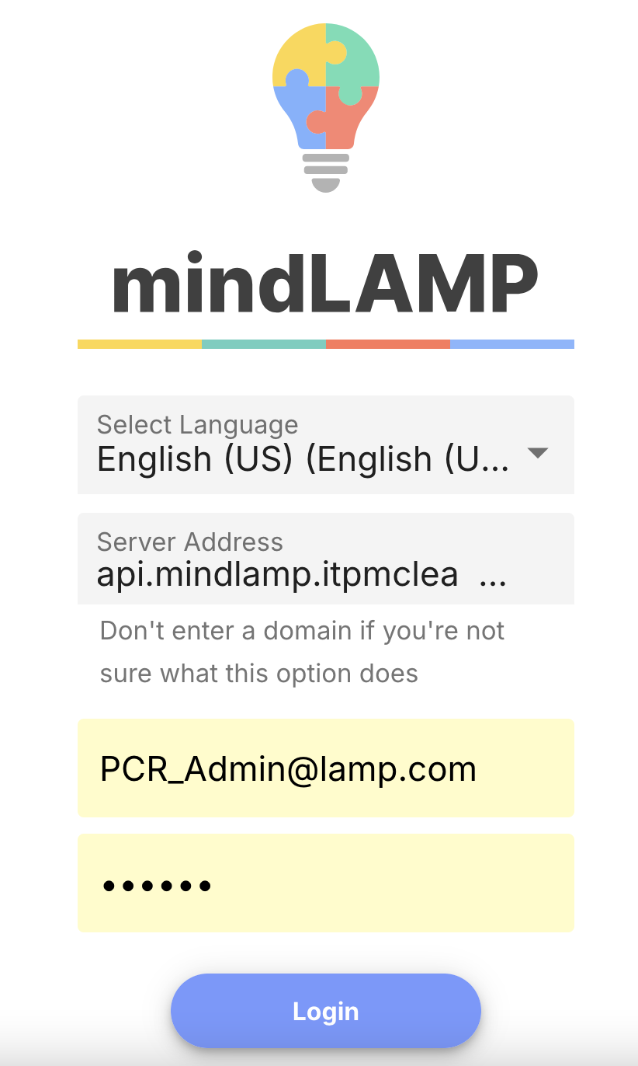
Step 1
Open app
Enter in server address api.mindlamp.itpmclean.org
Enter in username (in this email, something like: m5@lamp.com)
Enter in password (from this email, soemthing like: xX30jw)

Slide 4
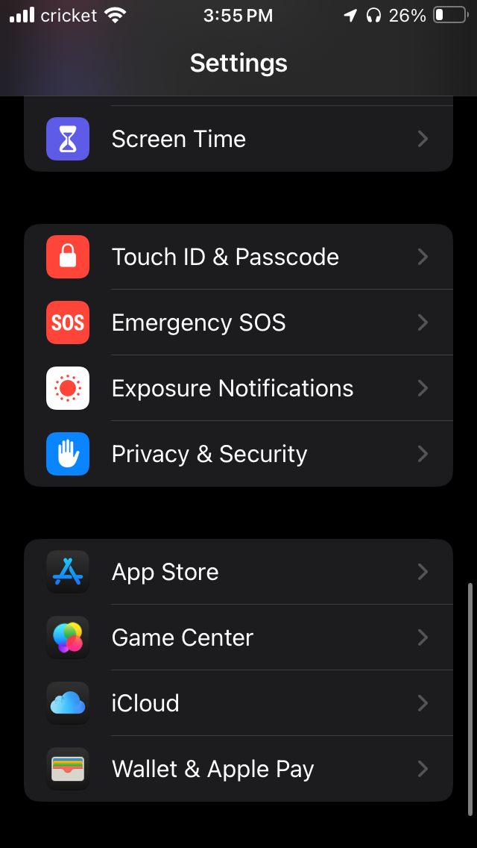
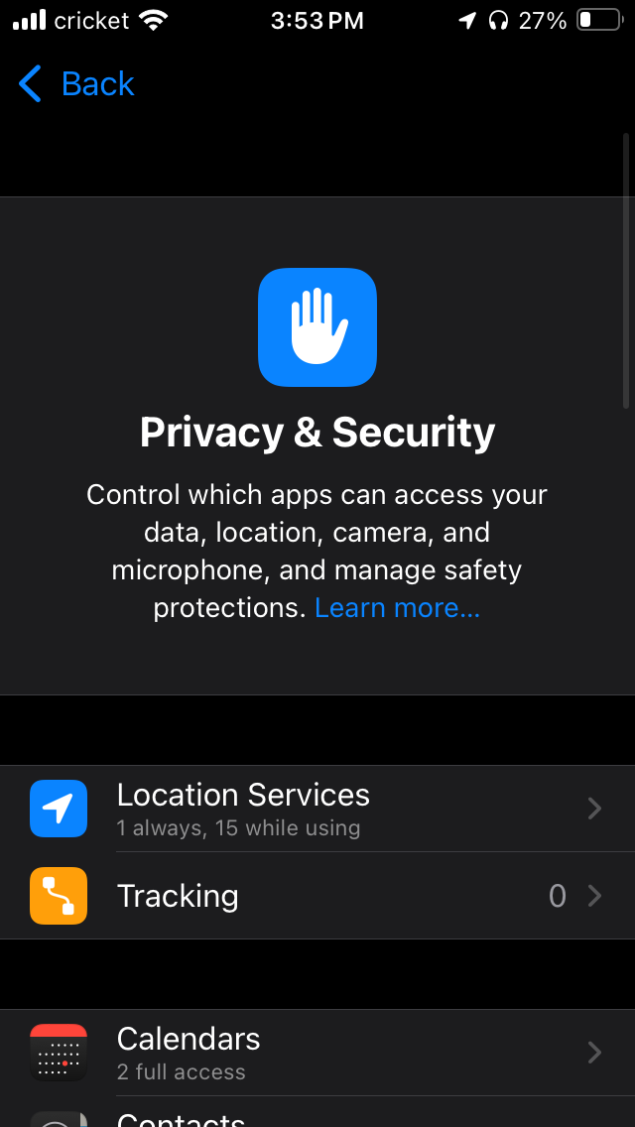
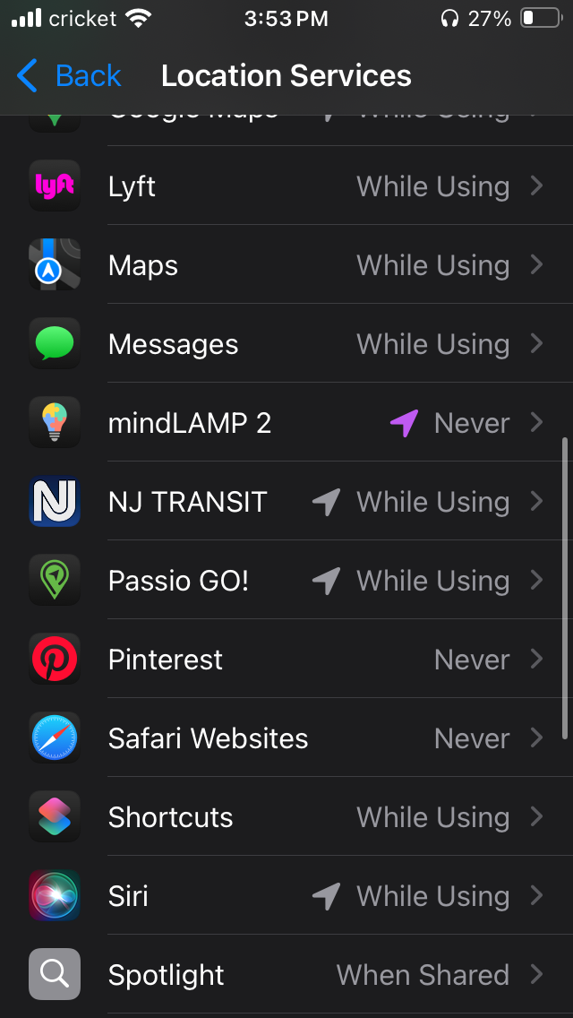
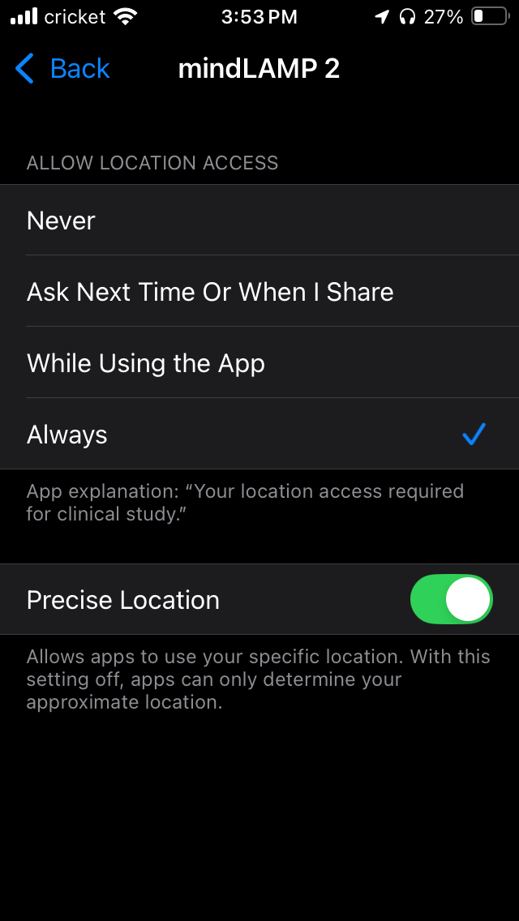
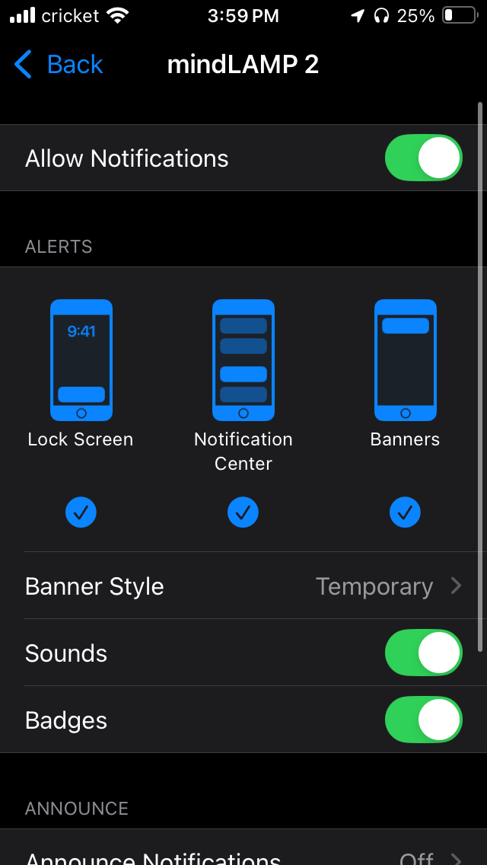
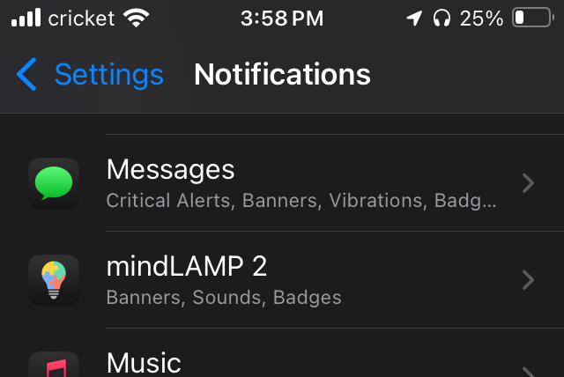
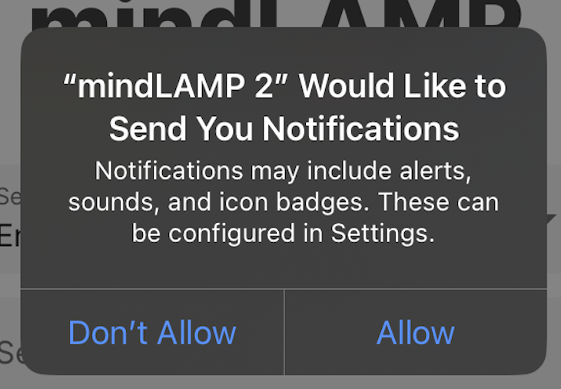


Step 9 - iOS
Set Location Services to “Always” on their phone settings
Ensure that notifications and GPS location tracking are enabled.

Slide 5
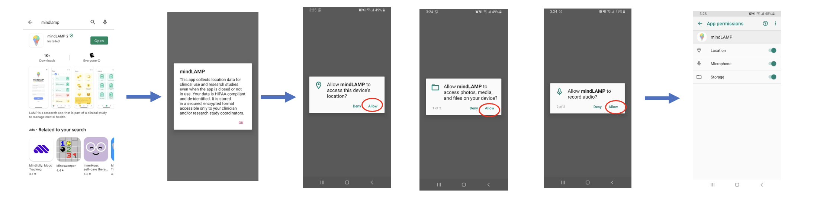
Step 9 - Android
Set Location Services to “Always” on their phone settings
Ensure that notifications and GPS location tracking are enabled.

Slide 6
App Instructions

Slide 7
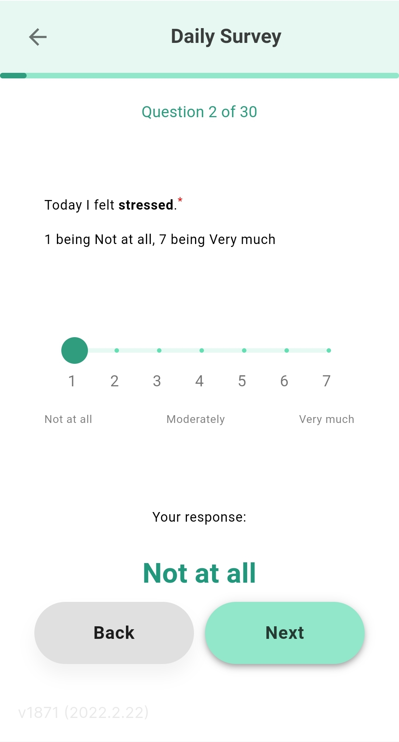
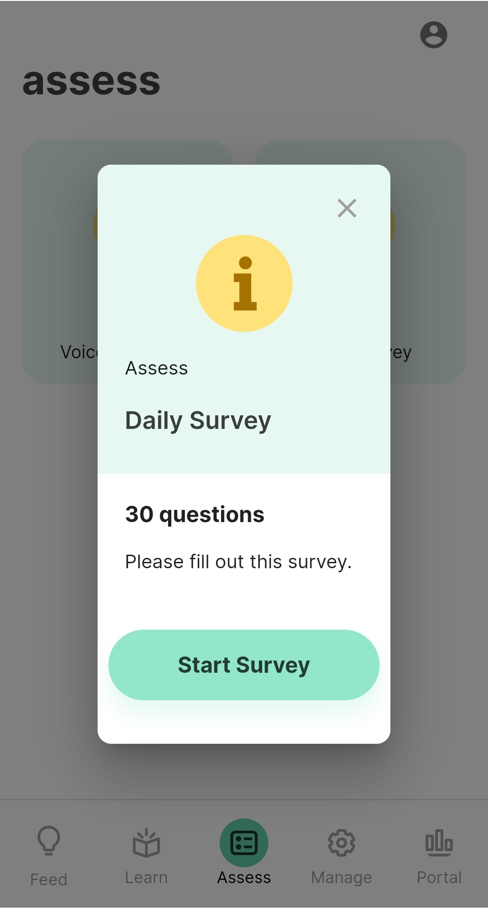
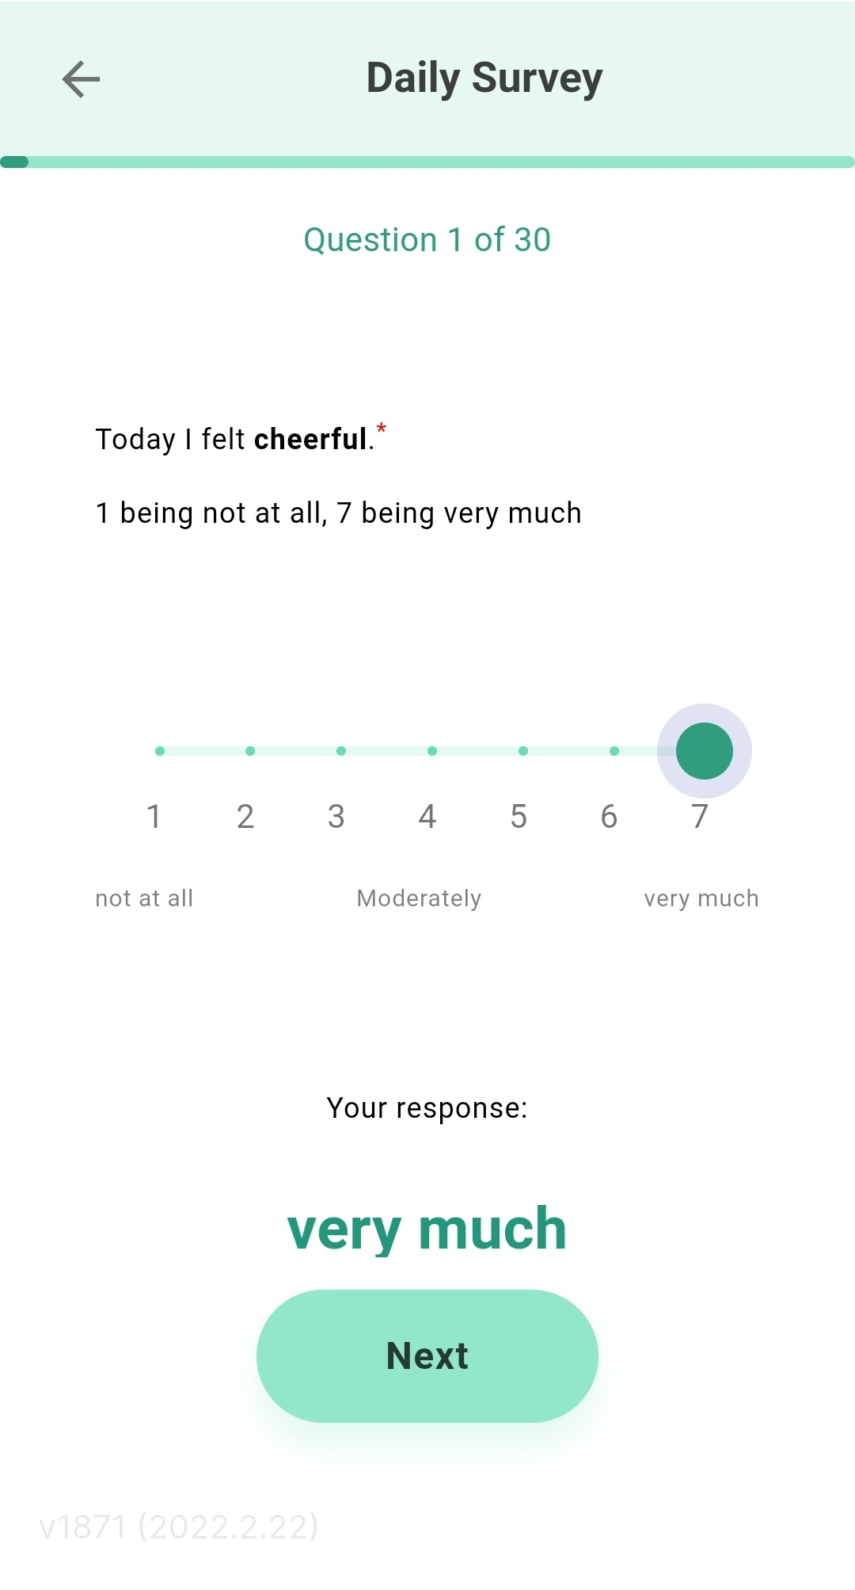
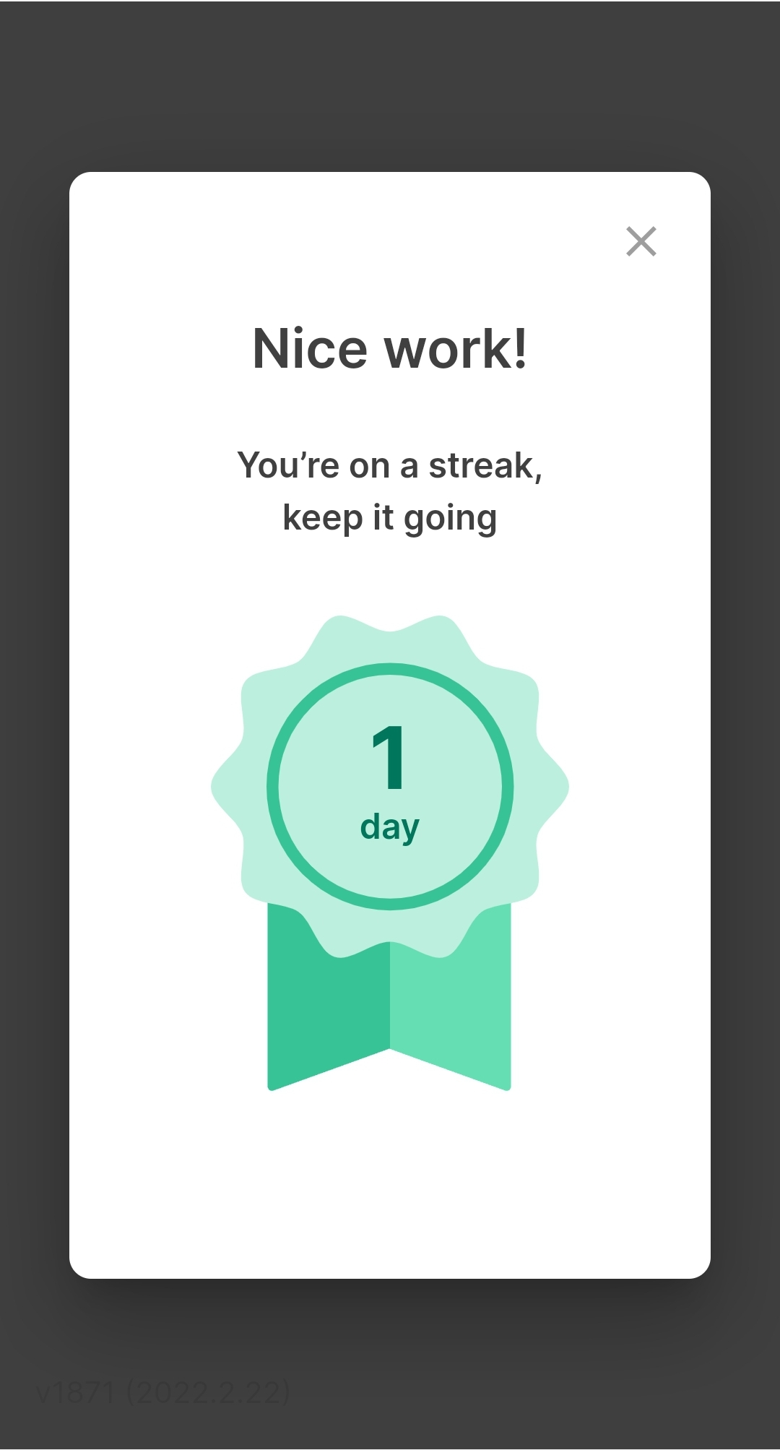
MindLAMP App Flow
Daily Survey
Use slider to indicate your answer to the question
Then select “Next”

