Slide 1


// LYRAOS
01
LyraOS
student-owned academic load, planning, and recovery
Making academic pressure visible before crisis mode.
CORE PROMISE
load becomes visible
plans become executable
drift becomes recoverable
A planning and recovery workspace for students when deadlines, sessions, and real life collide.
Ambiguous activity becomes a question for the student, not a silent decision.
lyraos // university reviewer deck // student-owned load + recovery

Slide 2
// LYRAOS
02
The Student Problem
Calendars store intent. Students need help when intent meets pressure.
The stressful moment is not ?I have work.? It is ?I cannot see what is now dangerous.?
What students feel
What tools show
What disappears
too many moving deadlines
unclear first move
one slip compounds
lists
dates
resources
where time went
which work drifted
what recovery is safe
Lyra makes the collision legible early enough to recover.
lyraos // university reviewer deck // student-owned load + recovery

Slide 3
// LYRAOS
03
The Missing Layer
Academic tools each hold part of the picture.
Baseet / LMS
Calendar
Task app
LyraOS
courses
deadlines
resources
availability
constraints
intentions
manual plans
load shape
session history
recovery
Lyra sits above commitments and helps turn academic structure into student-owned next actions.
lyraos // university reviewer deck // student-owned load + recovery

Slide 4
// LYRAOS
04
What Lyra Does
A practical loop that stays editable and confirmation-first.
1. capture load
2. see pressure
3. plan work
4. run session
5. recover
6. calibrate
Internal invariant: intention -> execution -> interruption -> drift -> recalibration
lyraos // university reviewer deck // student-owned load + recovery

Slide 5
// LYRAOS
05
Day-0 Value
Before personalization, the week can already become understandable.
1. Fast structure
2. Less manual entry
3. Pressure clarity
Brain dump messy tasks.
Preview before anything is written.
Student confirms the plan.
Moodle now.
Baseet later.
Provider data enters as context.
what is due
what is big
what is uncertain
what can move
The first useful promise: ?this finally explains my week.?
lyraos // university reviewer deck // student-owned load + recovery

Slide 6
// LYRAOS
06
Pressure Map
A visible shape of academic load, not a panic board.
VISIBLE ACADEMIC LOAD
RANGES
3 deadlines cluster within 48 hours.
2 imported items need coverage confirmation.
Visible load is 9-14 hours: a range, not a fake exact number.
uncertainty is visible
TRUST STATES
source confidence is named
RECOVERY OPTIONS
student chooses the next move
lyraos // university reviewer deck // student-owned load + recovery

Slide 7
// LYRAOS
07
The Recovery Moment
The wedge is the rescue hand when pressure compounds.
Missed plan
Pressure changed
Lyra asks
Student decides
block slipped
time compressed
done / partial / split?
state changes only by choice
Recovery language names the next safe move, not the student as the problem.
lyraos // university reviewer deck // student-owned load + recovery

Slide 8
// LYRAOS
08
Calibration Prompts
Small prompts now. Stronger guidance only after confirmed patterns.
Context prompt
Confirmation prompt
Future experiment
?This week is more compressed than usual.?
?This estimate may need buffer.?
?Done, partial, skipped, or adjusted??
?Continue, pause, or split??
try a smaller scope
move one block earlier
measure outcome
Guidance earns authority through confirmation and repeated evidence.
lyraos // university reviewer deck // student-owned load + recovery

Slide 9
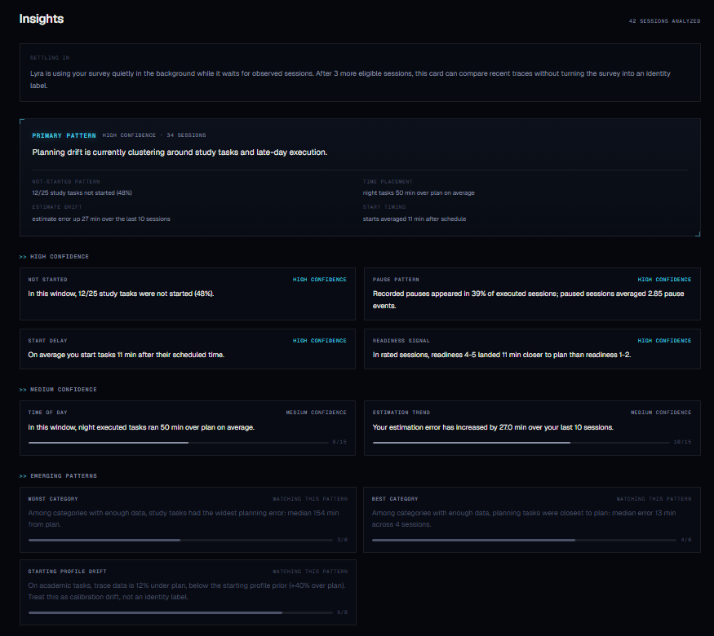
// LYRAOS
09
Insights: Legibility Compounds
The first retained value signal is seeing where time actually goes.
Current loop
session history -> bounded patterns -> confidence tiers
Early user sentence
?I became more conscious of where my time was going.?
What improves with users
confirmed patterns can become weak, testable priors
lyraos // university reviewer deck // student-owned load + recovery

Slide 10
// LYRAOS
10
The Instrument Built Itself Through Reality
Every collision removed a weaker abstraction.
Manual tracking
Integrations
Passive activity
too much friction
context, not truth
less friction, more ambiguity
Personalization
Interventions
Two-app flow
must not become labels
can change later behavior
kills adoption
Each contact with reality made Lyra more constrained, and therefore more general.
lyraos // university reviewer deck // student-owned load + recovery

Slide 11
// LYRAOS
11
Baseet Module
Academic structure in. Student recovery out.
Baseet contributes
Lyra converts into
Boundary
courses
deadlines
resources
submission context
visible load
plan candidates
session prompts
recovery choices
provider signals are candidates
student confirmation resolves action
Baseet is one academic module over the LyraOS core, not the whole system.
lyraos // university reviewer deck // student-owned load + recovery

Slide 12
// LYRAOS
12
Core Engine
Provider-agnostic planning and recovery.
obligations ? intentions ? session history ? interruptions ? drift ? recovery ? confirmation ? calibration
Academic module
Calendar module
Work module
Baseet / Moodle / LMS
Google Calendar now
Jira / Linear / Notion later
Simple translation: planned work meets actual execution, then recovery becomes easier.
lyraos // university reviewer deck // student-owned load + recovery

Slide 13
// LYRAOS
13
Architecture: Evidence Before Claims
Capability and authority stay separate.
Inputs
Provider-blind facts
Evidence gates
ClaimCompiler
Student surface
tasks
deadlines
sessions
obligations
activity
context
clean data
exposure
provenance
allowed copy
min samples
pressure
insights
recovery
A surface can only say what the evidence boundary permits.
lyraos // university reviewer deck // student-owned load + recovery

Slide 14
// LYRAOS
14
Student-Owned Consequences
Useful inference stays inside the student workflow.
Lyra can surface
Lyra asks before
University pilot view
compressed weeks
stale sessions
uncertain sources
repair candidates
marking work done
changing task state
using provider progress
treating resources as covered
aggregate feedback
approved exports
cohort-level learnings
Personal detail stays in the student workspace. Pilot learning is aggregate and approved.
lyraos // university reviewer deck // student-owned load + recovery

Slide 15
// LYRAOS
15
Research Rigor
Research improves instrumentation accuracy without turning students into labels.
Priors
Confirmed use
Clean data
cold-start estimates from literature
student choices beat passive guesses
unknown and repaired traces stay marked
Exposure aware
Falsifiable
Weak clusters
prompts can change future behavior
hypotheses need kill criteria
planning priors, not identities
Signals earn authority through evidence, confirmation, and clean-data rules.
lyraos // university reviewer deck // student-owned load + recovery

Slide 16
// LYRAOS
16
LyraSim
Pre-scale stress testing for ambiguous academic traces.
Scenarios
Failure classes
Scale discipline
idle resource open
background video fakeout
multi-device upload collision
reverse provider progress
duplicate deadlines
provider overclaiming
clean-data contamination
unsafe mutation
missing recovery option
prompt spam
deterministic replay
CI checks
kill switches
browser smoke
student feedback
Broad scale is earned by product seams and real feedback, not by confidence alone.
lyraos // university reviewer deck // student-owned load + recovery

Slide 17
// LYRAOS
17
Current Value vs Future-Gated Value
The vision is sequenced, not hand-waved.
Current / dogfooded
Future-gated
brain dump onboarding
task planning + timers
missed-plan recovery
calendar + deadline views
Moodle context
Pulse pressure map
Insights
live Baseet module
provider progress candidates
session-continuity estimates
hypothesis-based prompts
AI over evidence packets
adaptive scheduling experiments
Future features stay confirmation-first, low-authority, and student-controlled.
lyraos // university reviewer deck // student-owned load + recovery

Slide 18
// LYRAOS
18
Data Access Model
The access boundary is simple enough to explain.
Student workspace
University / Baseet pilot
Research/export layer
personal pressure map
plans + sessions
confirmations
recovery choices
own history
export / delete / disconnect
aggregate pilot feedback
course/week workload patterns
approved cohort summaries
explicit consent
pseudonymized or aggregated
prompt-history aware
no raw private activity reports
Reviewer takeaway: private help for students, aggregate learning for the pilot.
lyraos // university reviewer deck // student-owned load + recovery

Slide 19
// LYRAOS
19
Pilot Plan
Small, useful, easy to narrow.
Start with
Success looks like
Narrow when
opt-in student cohort
Baseet-oriented demo group
student-facing surfaces
deadlines + pressure map
students plan earlier
recover faster
understand where time goes
prompts feel supportive
prompts add stress
provider context misleads
recovery feels wrong
boundaries feel unclear
The pilot is designed to learn quickly and stay containable.
lyraos // university reviewer deck // student-owned load + recovery

Slide 20
// LYRAOS
20
The Ask
Review Lyra as a student-owned academic load and recovery pilot.
Let students test whether academic pressure becomes easier to see, plan, and recover from.
Next step
Run a small Baseet-oriented demo cohort around the pressure map, recovery loop, and confirmation-first workflow.
If one thing sticks: Lyra turns study drift into a recoverable next action.
lyraos // university reviewer deck // student-owned load + recovery

