Slide 1


TITLE
LyraOS
Student-owned academic load and recovery workspace
Make academic pressure visible early enough to recover.
Pilot ask
A small opt-in Baseet-oriented demo cohort.
The pitch is simple: help students see the week, choose the next move, and recover before pressure compounds.
LyraOS / reviewer pitch
01

Slide 2
PROBLEM
Maya opens Lyra Sunday night
She has work. The hard part is knowing what is now dangerous.
8:45 PM
9:10 PM
10:30 PM
10:32 PM
3 deadlines
one late start
pressure changed
next move
Two close together, one vague.
The first block slips.
The plan no longer matches the week.
Done, partial, split, or adjust?
The first value is not automation. It is making the recovery path visible at the moment of drift.
LyraOS / reviewer pitch
02

Slide 3
FIRST VALUE MOMENT
From messy week to explainable pressure
Lyra is a web app today. Baseet is the academic module/provider adapter for the pilot.
1. Brain dump
2. Import context
3. See the week
Paste messy tasks and deadlines.
Baseet / Moodle-style structure reduces manual entry.
The pressure map explains what needs attention first.
Baseet is replaceable with Moodle, Canvas, or similar systems. Lyra is the planning and recovery layer above them.
LyraOS / reviewer pitch
03

Slide 4
PRODUCT HERO
Pressure Map
The week becomes a shape a student can act on.
VISIBLE ACADEMIC LOAD
Ranges
uncertainty is visible
Visible load is 9-14 hours: a range, not fake precision.
Trust states
3 deadlines cluster within 48 hours.
2 imported items need coverage confirmation.
source confidence is named
Recovery options
the next move is selectable
This slide is the reviewer proof: useful without pretending to know more than the evidence supports.
LyraOS / reviewer pitch
04

Slide 5
RECOVERY
The recovery prompt is the wedge
The product becomes useful when a plan slips.
Lyra asks
Missed block
Pressure updates
Done, partial, split, or adjust?
Maya does not finish the planned session.
The remaining week gets tighter.
The student stays in command. Lyra makes the next safe action easier to choose.
LyraOS / reviewer pitch
05

Slide 6
DAY TO DAY
How Lyra helps without becoming heavy
Three repeated moments, not another complex workflow.
Plan
Run sessions
Recover
turn obligations into realistic blocks
track what actually happened
repair study drift with confirmation
The loop is intentionally small: plan -> session -> recovery -> better estimates.
LyraOS / reviewer pitch
06

Slide 7
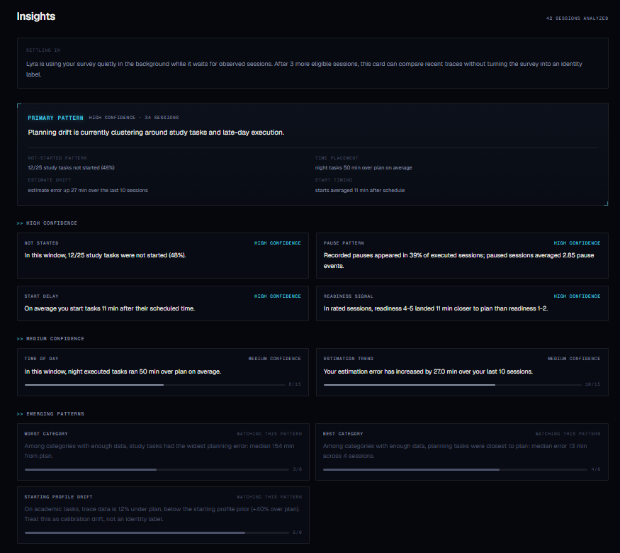
INSIGHTS
Insights make time legible
See where time goes
Students can see where plans actually drift.
Spot repeated patterns
Late starts, underestimates, and missed windows become visible.
Improve estimates
Confirmed use makes future planning less guessy.
LyraOS / reviewer pitch
07

Slide 8
BASEET
Why Baseet matters
Baseet is the academic structure provider for this pilot.
Baseet provides
Lyra adds
Pilot result
courses, deadlines, resources, and academic context
load clarity, planning, sessions, and recovery prompts
students get a practical workspace around existing academic data
At another university, the same role could be filled by Moodle, Canvas, Google Calendar, or another provider.
LyraOS / reviewer pitch
08

Slide 9
UNIVERSITY VALUE
What the university learns
The pilot produces aggregate learning about workload shape, not individual behavior reports.
Course workload realism
Deadline clustering
Recovery friction
Timing
Where estimated work diverges from student-reported recovery difficulty.
Which weeks compress student load beyond realistic recovery.
Which kinds of academic pressure create the most unresolved drift.
When pressure peaks across the pilot.
The value to the university is better pilot instrumentation for academic load and support design.
LyraOS / reviewer pitch
09

Slide 10
BUILT THROUGH REALITY
Built while using it under pressure
The system became sharper because reality kept breaking simpler assumptions.
The current prototype emerged through rapid iteration under real academic pressure.
friction
integrations
ambiguity
intervention
adoption
manual tracking was too heavy
context was not truth
passive activity needed confirmation
nudges affect later behavior
two-app flow kills momentum
Invariant that survived: intention -> execution -> interruption -> drift -> recalibration.
LyraOS / reviewer pitch
10

Slide 11
SUCCESS METRICS
Pilot success is measured, not guessed
Surveys are primary. Dashboard signals explain what happened.
Primary survey targets
Supporting dashboard metrics
planning clarity improves
recovery prompts are useful
students understand where time goes
workflow is low-friction
students trust confirmations
activation
weekly active use
recovery prompt completion
reduced unresolved stale sessions
settings/export discoverability
A good pilot proves usefulness and trust before expansion.
LyraOS / reviewer pitch
11

Slide 12
ASK
The ask
Run a small opt-in Baseet-oriented demo cohort.
Let students test whether academic pressure becomes easier to see, plan, and recover from.
Pilot scope
pressure map
recovery loop
student confirmations
survey + dashboard readout
This is not institution-wide deployment. It is a contained test of the first value moment.
LyraOS / reviewer pitch
12

Slide 13
BACKUP / ACCESS
BACKUP
Data Access Model
Student workspace
University pilot summaries
Research/export
personal pressure map
plans and sessions
confirmations
recovery choices
own history
aggregate feedback
course/week workload patterns
approved cohort summaries
explicit consent
pseudonymized or aggregated
approved exports
The pilot boundary is a product feature, not an afterthought.
LyraOS / reviewer pitch
13

Slide 14
BACKUP / MECHANICS
BACKUP
How It Works
Providers
Provider-blind facts
Evidence gates
Student surfaces
Baseet / Moodle / Calendar
obligations, dates, context
confidence, provenance, exposure
pressure, recovery, insights
Internal claim boundaries keep surfaces aligned with evidence quality.
LyraOS / reviewer pitch
14

Slide 15
BACKUP / RESEARCH
BACKUP
Research Rigor
Research priors
Confirmed use
Clean data
start estimates before enough data
student choices calibrate the system
repaired and unknown traces stay marked
Exposure aware
Falsifiable
prompts can change later behavior
hypotheses need kill criteria
Signals earn authority through confirmation and repeated evidence.
LyraOS / reviewer pitch
15

Slide 16
BACKUP / LYRASIM
BACKUP
LyraSim
Scenario families
What it catches
Limit
idle resource open
background video fakeout
multi-device collision
reverse provider progress
duplicate deadlines
provider overclaiming
clean-data contamination
unsafe mutation
missing recovery option
prompt spam
It validates boundaries; students validate experience.
LyraSim is a pressure harness before Baseet-scale exposure.
LyraOS / reviewer pitch
16

Slide 17
BACKUP / ROADMAP
BACKUP
Current vs Future-Gated
Current / dogfooded
Future-gated
brain dump onboarding
task planning and timers
missed-plan recovery
calendar and deadline views
Moodle context
Pulse pressure map
Insights
live Baseet module
provider progress candidates
session-continuity estimates
hypothesis-based prompts
AI over evidence packets
adaptive scheduling experiments
Future features stay confirmation-first and student-controlled.
LyraOS / reviewer pitch
17

Slide 18
BACKUP / SUPPORT
BACKUP
Student Support Integration
If drift repeats
Support options
Pilot boundary
Lyra can offer student-controlled links to support resources.
academic advising, counseling, disability/accessibility services.
No automatic staff alert in the demo cohort.
Support integration should increase agency, not remove it.
LyraOS / reviewer pitch
18

Slide 19
BACKUP / READINESS
BACKUP
Technical Readiness / Scale
Infra
Tests
Kill switches
Verification
FastAPI, Next.js, Supabase, Redis
deterministic harness and backend checks
safe mode and feature suppression
browser smoke and scoped rollout
Scale comes after product value, containment, and feedback.
LyraOS / reviewer pitch
19

Slide 20
BACKUP / EVIDENCE
BACKUP
Repo-Grounded Evidence
Product surfaces
Safety boundaries
Validation
Pressure Map
Insights
Today / sessions
Moodle / calendar context
Authority map
provider adapter contract
output surfaces
exposure ledger
LyraSim
research contracts
browser smoke
multi-user tests
The backup exists to answer depth questions without cluttering the pitch.
LyraOS / reviewer pitch
20

