Slide 1


TITLE
LyraOS
Student-owned academic load, planning, and recovery
Load becomes visible. Plans become executable. Drift becomes recoverable.
Core promise
A workspace that helps students see the week, choose the next move, and recover before pressure compounds.
The pilot tests the first useful surface of a bigger planning and recovery layer.
LyraOS / university reviewer pitch
01

Slide 2
STUDENT STORY
Maya opens Lyra Sunday night
She has deadlines. What she needs is reality contact.
8:45 PM
9:10 PM
10:30 PM
10:32 PM
Deadline cluster
Plan meets reality
The week changed
Recovery choice
Three items land close together.
The first block slips.
The old plan is now fiction.
Record done, partial, split, or adjust.
Lyra turns academic drift into a concrete next interaction.
LyraOS / university reviewer pitch
02

Slide 3
MISSING LAYER
Existing tools store pieces. Lyra shows the collision.
This is the layer between academic structure and actual execution.
LMS / Baseet
Calendar
Task tools
LyraOS
deadlines
resources
course structure
availability
time blocks
intentions
checklists
load
execution
drift
recovery
Lyra helps students maintain contact between intention, time, action, and consequence.
LyraOS / university reviewer pitch
03

Slide 4
FIRST VALUE MOMENT
From messy week to explainable pressure
A web app today. Baseet is one academic provider module for the pilot.
Provider context
Optional brain dump
Pressure map
Baseet or Moodle reduces manual entry.
Useful when work is messy or outside the provider.
The week becomes understandable enough to act on.
Brain dump stays valuable, but Baseet should make the academic module lighter to use.
LyraOS / university reviewer pitch
04

Slide 5
PRODUCT HERO
Pressure Map
The first moment where the week becomes visible.
VISIBLE ACADEMIC LOAD
Ranges
Visible load is 9-14 hours: a range, not fake precision.
uncertainty is visible
Trust states
3 deadlines cluster within 48 hours.
2 imported items need coverage confirmation.
source confidence is named
Recovery options
the next move is selectable
This is the aha: the student can finally see why the week feels compressed.
LyraOS / university reviewer pitch
05

Slide 6
RECOVERY
When plans drift, Lyra keeps continuity
Most tools go stale when plans fail. Lyra makes drift the next interaction.
Student choices
Missed session
Recovery prompt
mark done
mark partial
split remaining work
adjust session duration
Maya did not finish the planned block.
Choose how the session should be recorded.
The value is not magic mutation. The value is a clear user decision at the moment of drift.
LyraOS / university reviewer pitch
06

Slide 7
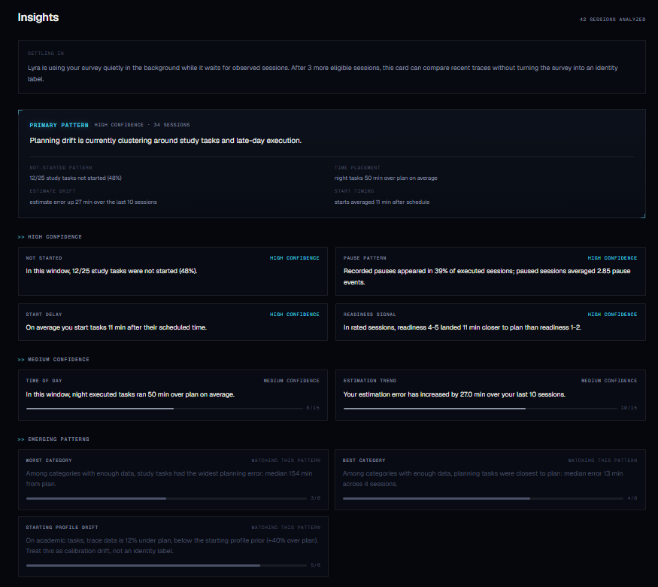
INSIGHTS
A mirror with memory
"It made me more aware of where my time is being spent."
What it reveals
where plans drift repeatedly
What compounds
confirmed patterns make planning less fictional
LyraOS / university reviewer pitch
07

Slide 8
PROVIDER LAYER
Why Baseet matters
Baseet is the academic structure provider for this pilot.
Provider systems
Lyra layer
Plugin path
organize courses, deadlines, resources, and context
turns context into planning, execution, and recovery
the same adapter idea can fit Moodle, Canvas, Calendar, or future systems
Provider systems organize context. Lyra helps students act on it.
LyraOS / university reviewer pitch
08

Slide 9
COMPOUNDING VALUE
Lyra improves because reality leaves traces
The compounding signal is confirmed use, not hidden interpretation.
Observe
Confirm
Calibrate
sessions, estimates, deadline pressure, and recovery choices
students resolve ambiguity through small decisions
future plans become less fictional over time
The deeper product: make intention-versus-execution visible, repairable, and eventually learnable.
LyraOS / university reviewer pitch
09

Slide 10
REALITY CONTACT
Built Through Reality
The current prototype emerged through rapid iteration under real academic pressure.
Real use kept breaking simpler assumptions.
friction
integrations
ambiguity
intervention
adoption
manual tracking was too heavy
context was not truth
passive activity needed confirmation
prompts change later behavior
two-app flow kills momentum
Invariant that survived: intention -> execution -> interruption -> drift -> recalibration.
LyraOS / university reviewer pitch
10

Slide 11
UNIVERSITY VALUE
What the university learns
Aggregate pilot learning about workload shape and support design.
Workload realism
Deadline clustering
Recovery friction
Timing
where student-reported recovery difficulty appears
which weeks compress load beyond realistic recovery
which pressure patterns create unresolved drift
when pressure peaks across the pilot
The university gets better instrumentation for academic load.
LyraOS / university reviewer pitch
11

Slide 12
SUCCESS METRICS
Pilot success is measured, not guessed
Surveys are primary. Dashboard signals explain what happened.
Primary survey targets
Supporting dashboard metrics
planning clarity improved
pressure map helped prioritize
recovery prompt was useful
workflow felt low-friction
student would keep using Lyra during deadline-heavy weeks
activation and weekly active use
pressure map revisit rate
recovery prompt completion
reduced unresolved stale sessions
export and settings discoverability
A good pilot proves usefulness and trust before expansion.
LyraOS / university reviewer pitch
12

Slide 13
ASK
The ask
Run a small opt-in Baseet-oriented demo cohort.
Let students test whether academic pressure becomes easier to see, plan, and recover from.
Pilot scope
pressure map
recovery loop
student confirmations
survey and dashboard readout
This is a contained test of the first value moment, not broad deployment.
LyraOS / university reviewer pitch
13

Slide 14
BACKUP / ACCESS
BACKUP
Data Access Model
Student workspace
University pilot summaries
Research/export
personal pressure map
plans and sessions
confirmations
recovery choices
own history
aggregate feedback
course/week workload patterns
approved cohort summaries
explicit consent
pseudonymized or aggregated
approved exports
Private help for students, aggregate learning for the pilot.
LyraOS / university reviewer pitch
14

Slide 15
BACKUP / ARCHITECTURE
BACKUP
Evidence Before Claims
Inputs
Provider-blind facts
Evidence gates
Claim boundary
Student surfaces
tasks
deadlines
sessions
obligations
activity
context
confidence
provenance
exposure
allowed wording
min evidence
pressure
insights
recovery
A student surface can only say what the evidence boundary permits.
LyraOS / university reviewer pitch
15

Slide 16
BACKUP / RESEARCH
BACKUP
Research Rigor
Research priors
Confirmed use
Clean data
cold-start estimates
student choices calibrate
unknown traces stay marked
Exposure aware
Falsifiable
prompts can change behavior
hypotheses need kill criteria
The goal is accurate instrumentation, not labels.
LyraOS / university reviewer pitch
16

Slide 17
BACKUP / STRESS HARNESS
BACKUP
LyraSim And Edge Cases
Stress scenarios
Anomaly families
Purpose
idle resource open
background video fakeout
multi-device collision
duplicate deadlines
sessions far above baseline
sessions far below baseline
single outlier inflating averages
provider progress ambiguity
surface failures early
keep prompts useful
protect clean calibration
Dogfooding, user feedback, and LyraSim all reduce surprise before a larger pilot.
LyraOS / university reviewer pitch
17

Slide 18
BACKUP / ROADMAP
BACKUP
Current vs Future-Gated
Current / dogfooded
Future-gated
Support path
brain dump onboarding
task planning and timers
missed-plan recovery
deadline views
Moodle context
Pulse pressure map
Insights
live Baseet module
provider progress candidates
session-continuity estimates
hypothesis-based prompts
AI over evidence packets
adaptive scheduling experiments
student-selected resources
academic advising links
counseling or accessibility links
Future features stay confirmation-first and student-controlled.
LyraOS / university reviewer pitch
18

Slide 19
BACKUP / READINESS
BACKUP
Technical Readiness / Scale
Infra
Tests
Kill switches
Feedback
FastAPI, Next.js, Supabase, Redis
deterministic harness and backend checks
safe mode and feature suppression
dogfooding and user surveys
Scale readiness is product value plus containment plus feedback.
LyraOS / university reviewer pitch
19

Slide 20
BACKUP / EVIDENCE
BACKUP
Repo-Grounded Evidence
Product surfaces
Boundary docs
Validation
Pressure Map
Insights
Today / sessions
Moodle / calendar context
Authority map
provider adapter contract
output surfaces
exposure ledger
LyraSim
research contracts
browser smoke
multi-user tests
The backup slides answer depth questions without cluttering the pitch.
LyraOS / university reviewer pitch
20

