Slide 1
Middle Project：Cifar100
汇报人：031804103-陈翰泽
汇报日期：2020.10.15

Slide 2
Background：Cifar100
This dataset is just like the CIFAR-10, except it has 100 classes containing 600 images each. There are 500 training images and 100 testing images per class.

Slide 3
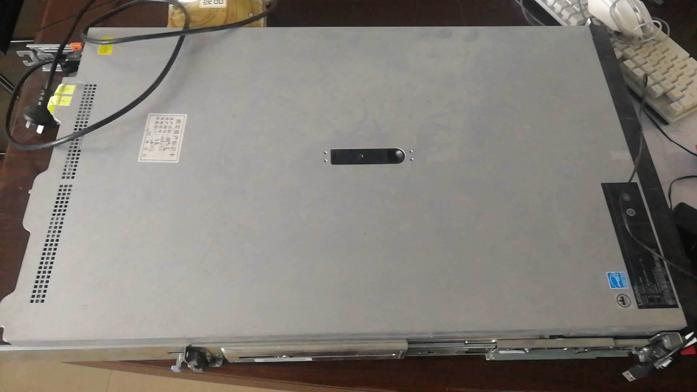


Challenge
Personal Computer(PC) have limited total compute and memory capabilities
Low accuracy

Slide 4
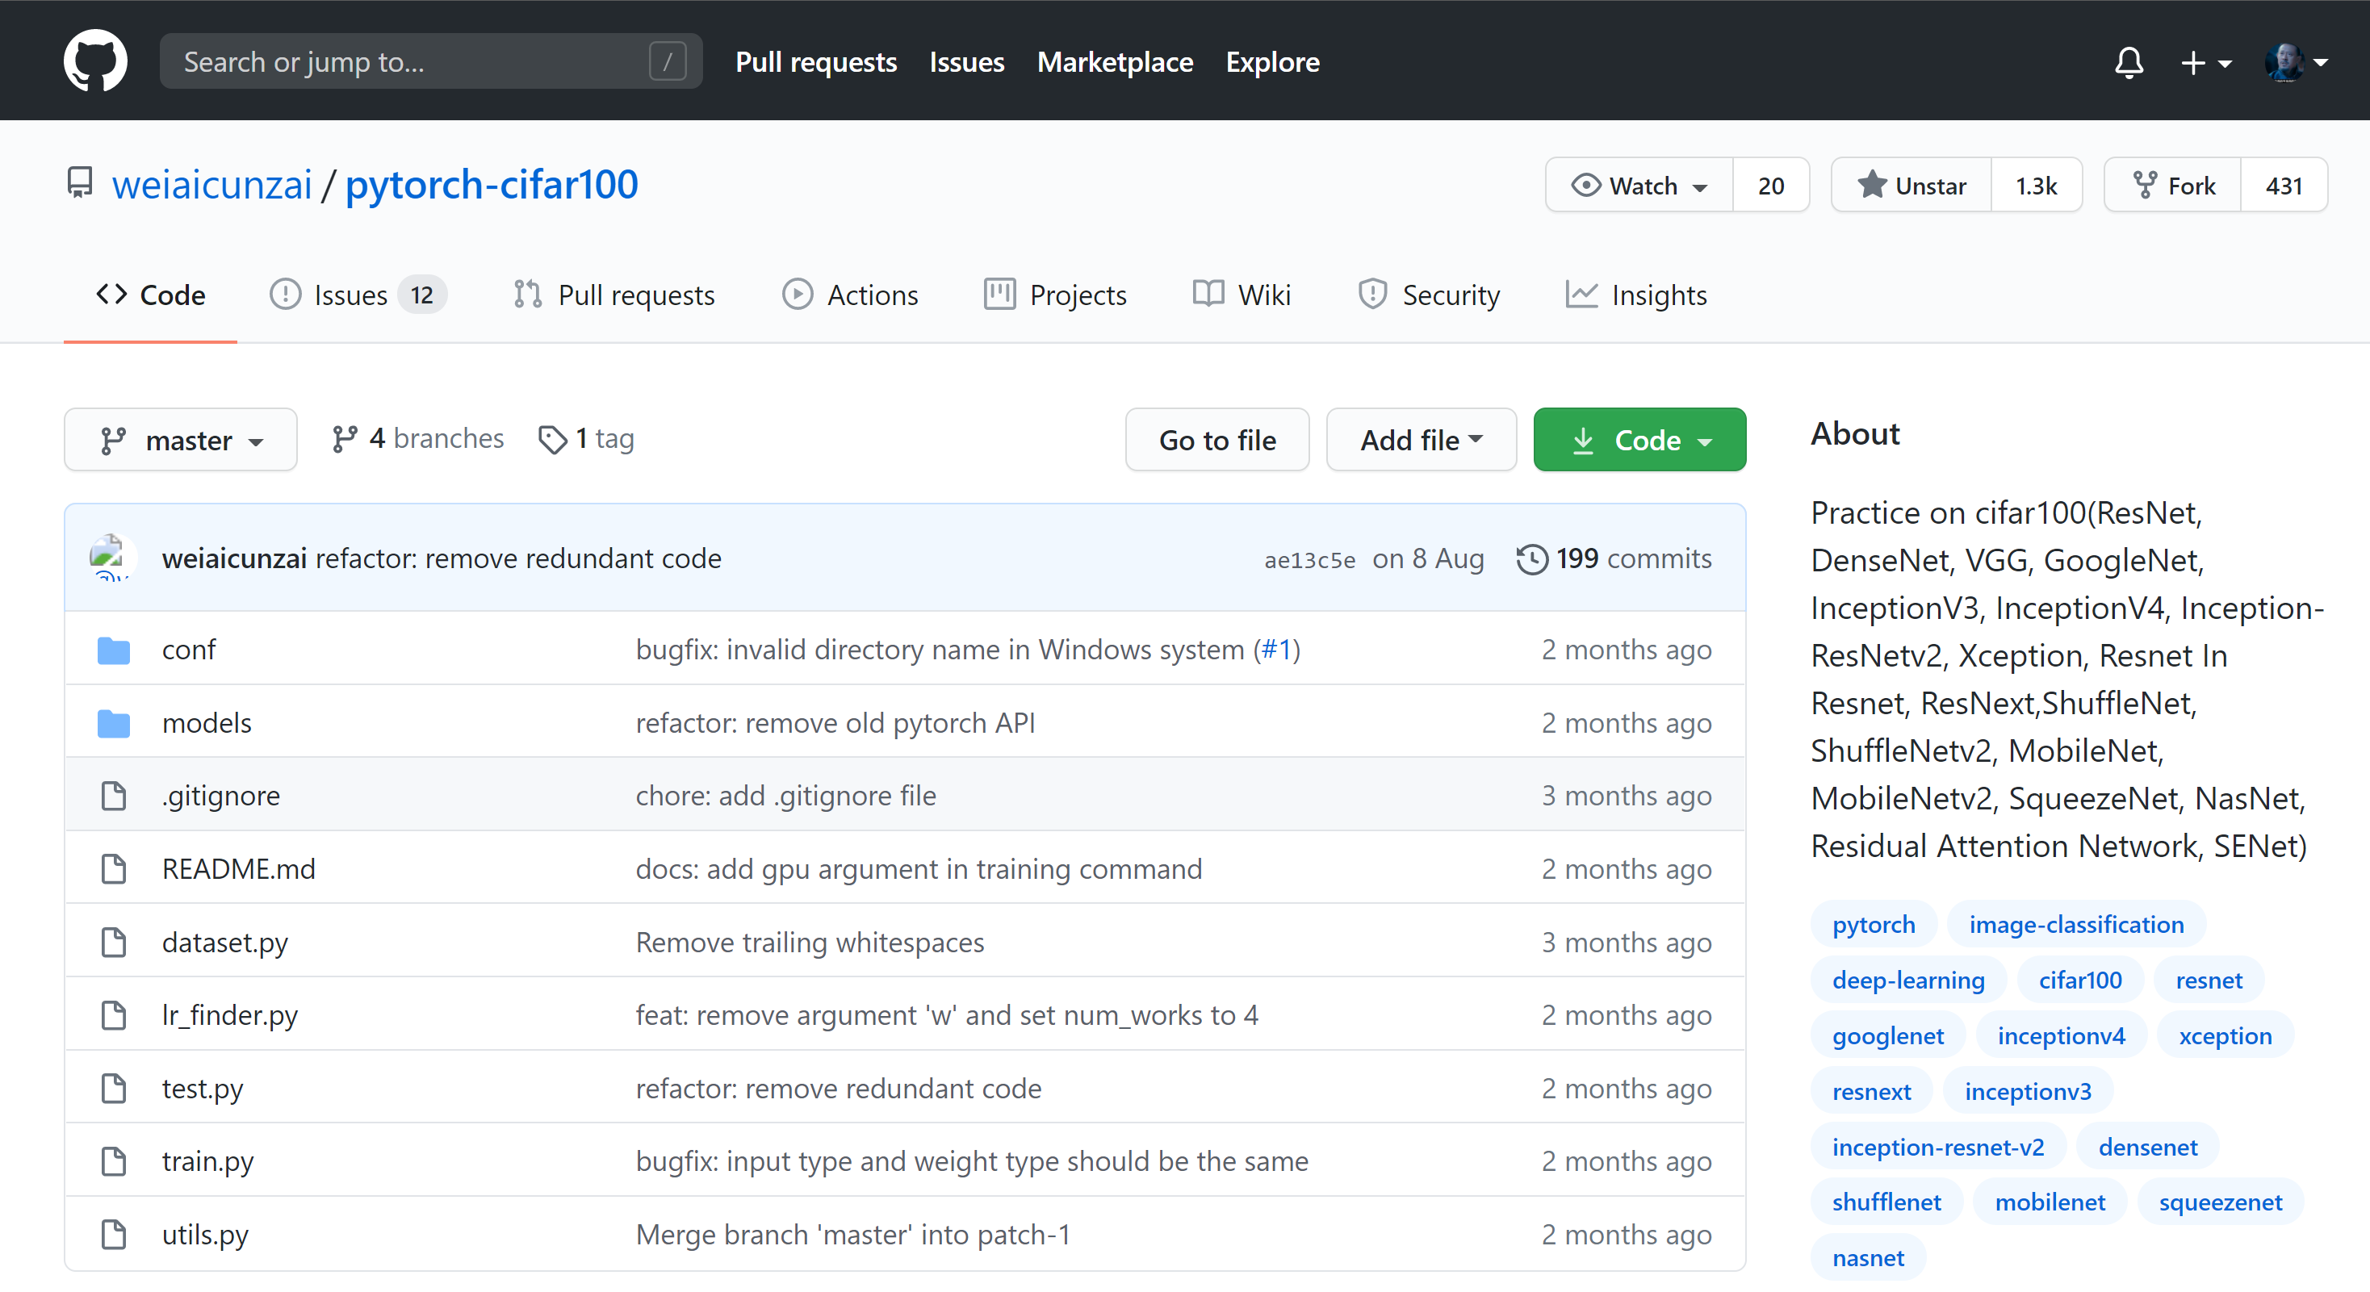
My Solution：Pytorch-cifar100

Slide 5
My Solution：Pytorch-cifar100
Squeezenet
Mobilenet
Mobilenetv2
Shufflenet
Shufflenetv2
Vgg11
Vgg13
Vgg16
Vgg19
Densenet121
Densenet161
Densenet201
Googlenet
Inceptionv3
Inceptionv4
Inceptionresnetv2
Xception
Resnet18
Resnet34
Resnet50
Resnet101
Resnet152
Preactresnet18
preactresnet34
Preactresnet50
Preactresnet101
Preactresnet152
Resnext50
Resnext101
Resnext152
Attention56
Attention92
Seresnet18
Seresnet34
Seresnet50
Seresnet101
Seresnet152
Nasnet

Slide 6
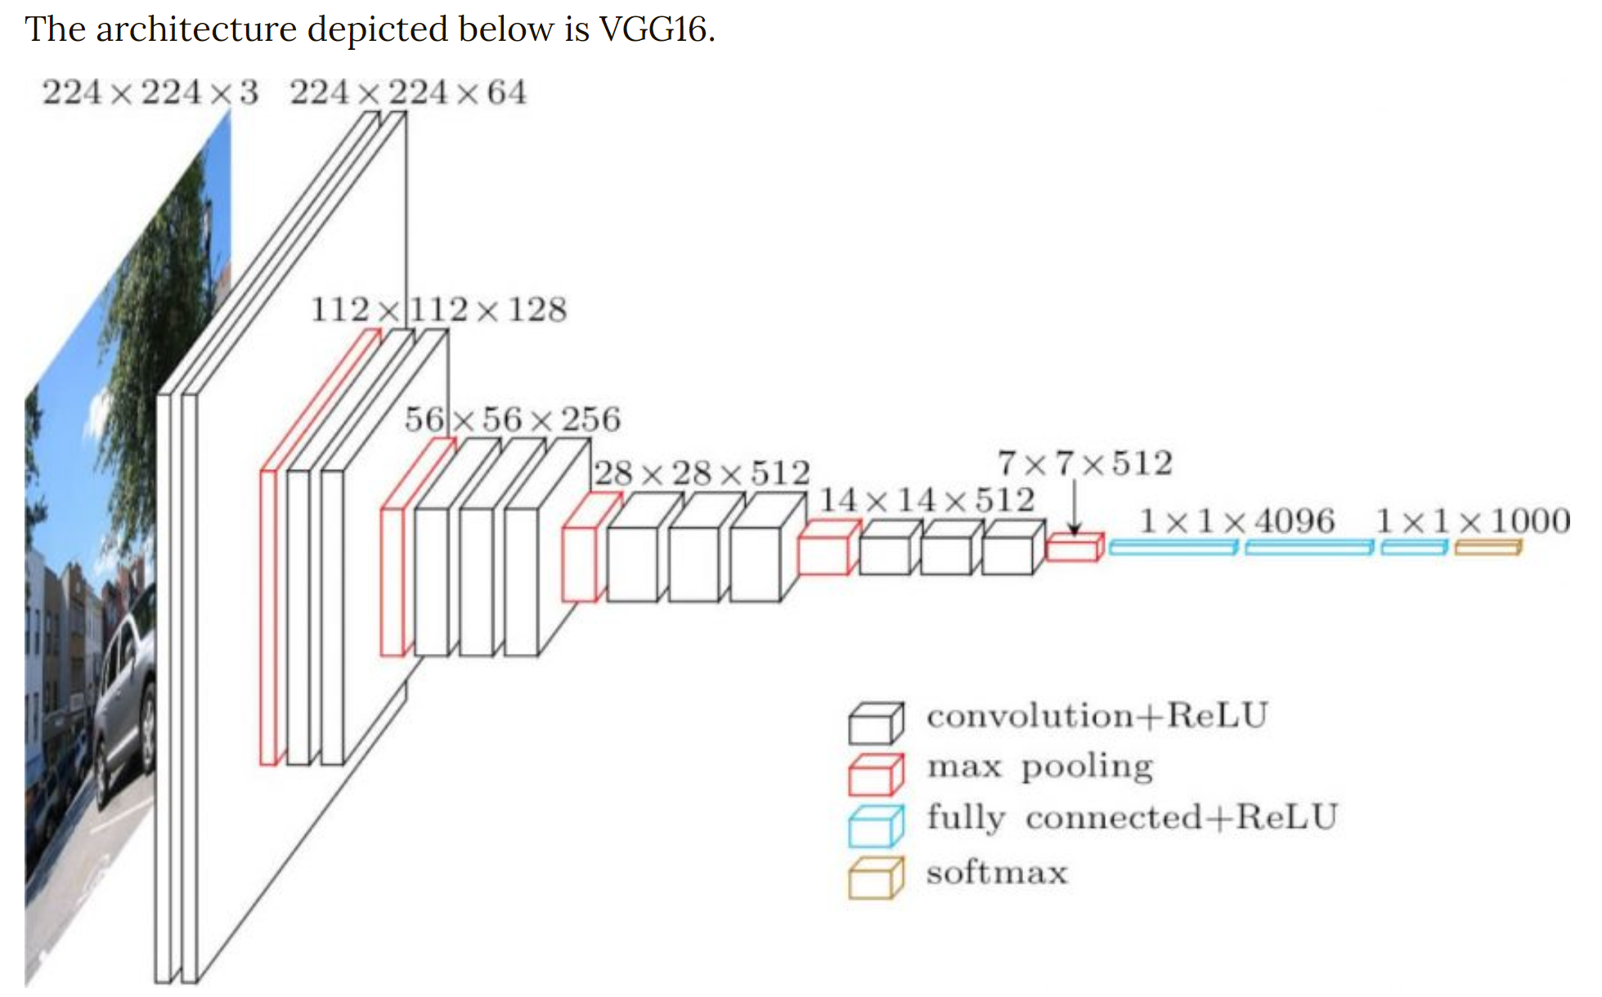
Architecture:VGG-16

Slide 7
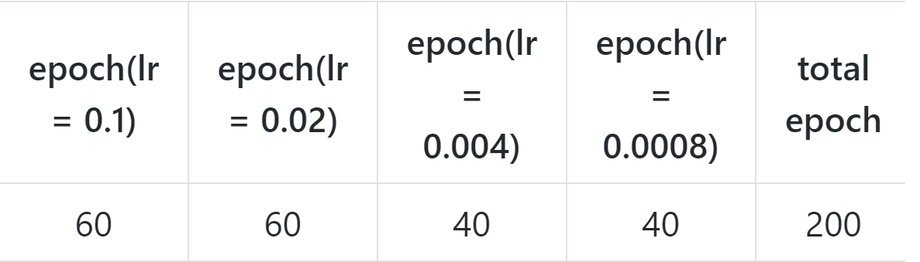
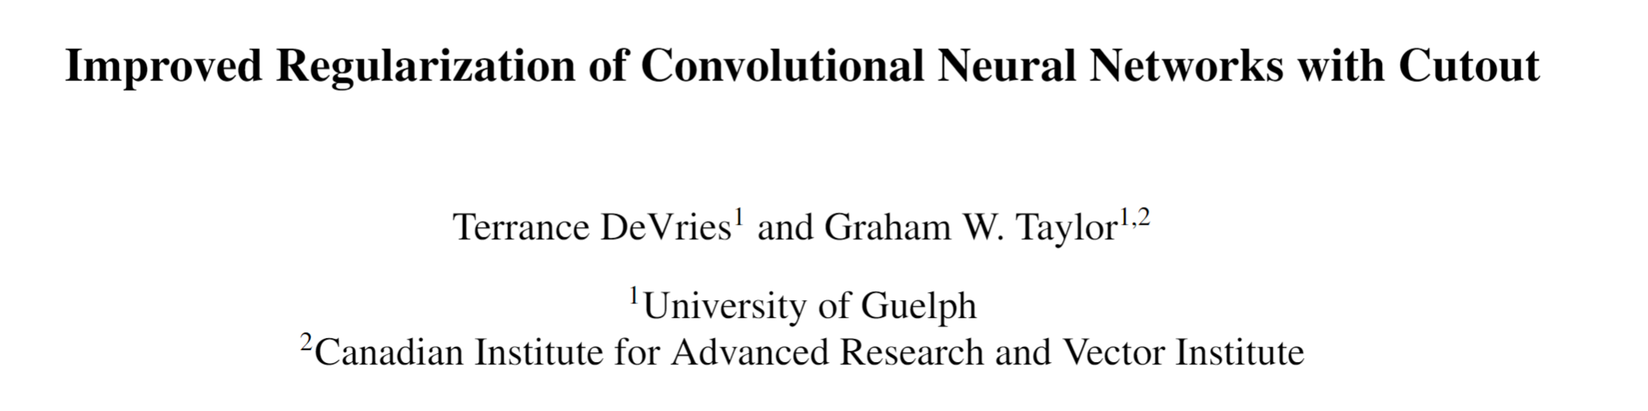
Configuration
CPU : intel 8265U
Host Memory : 16GB
GPU : Nvidia MX
Vedio Memory：2GB
Batch_size：128

Slide 8
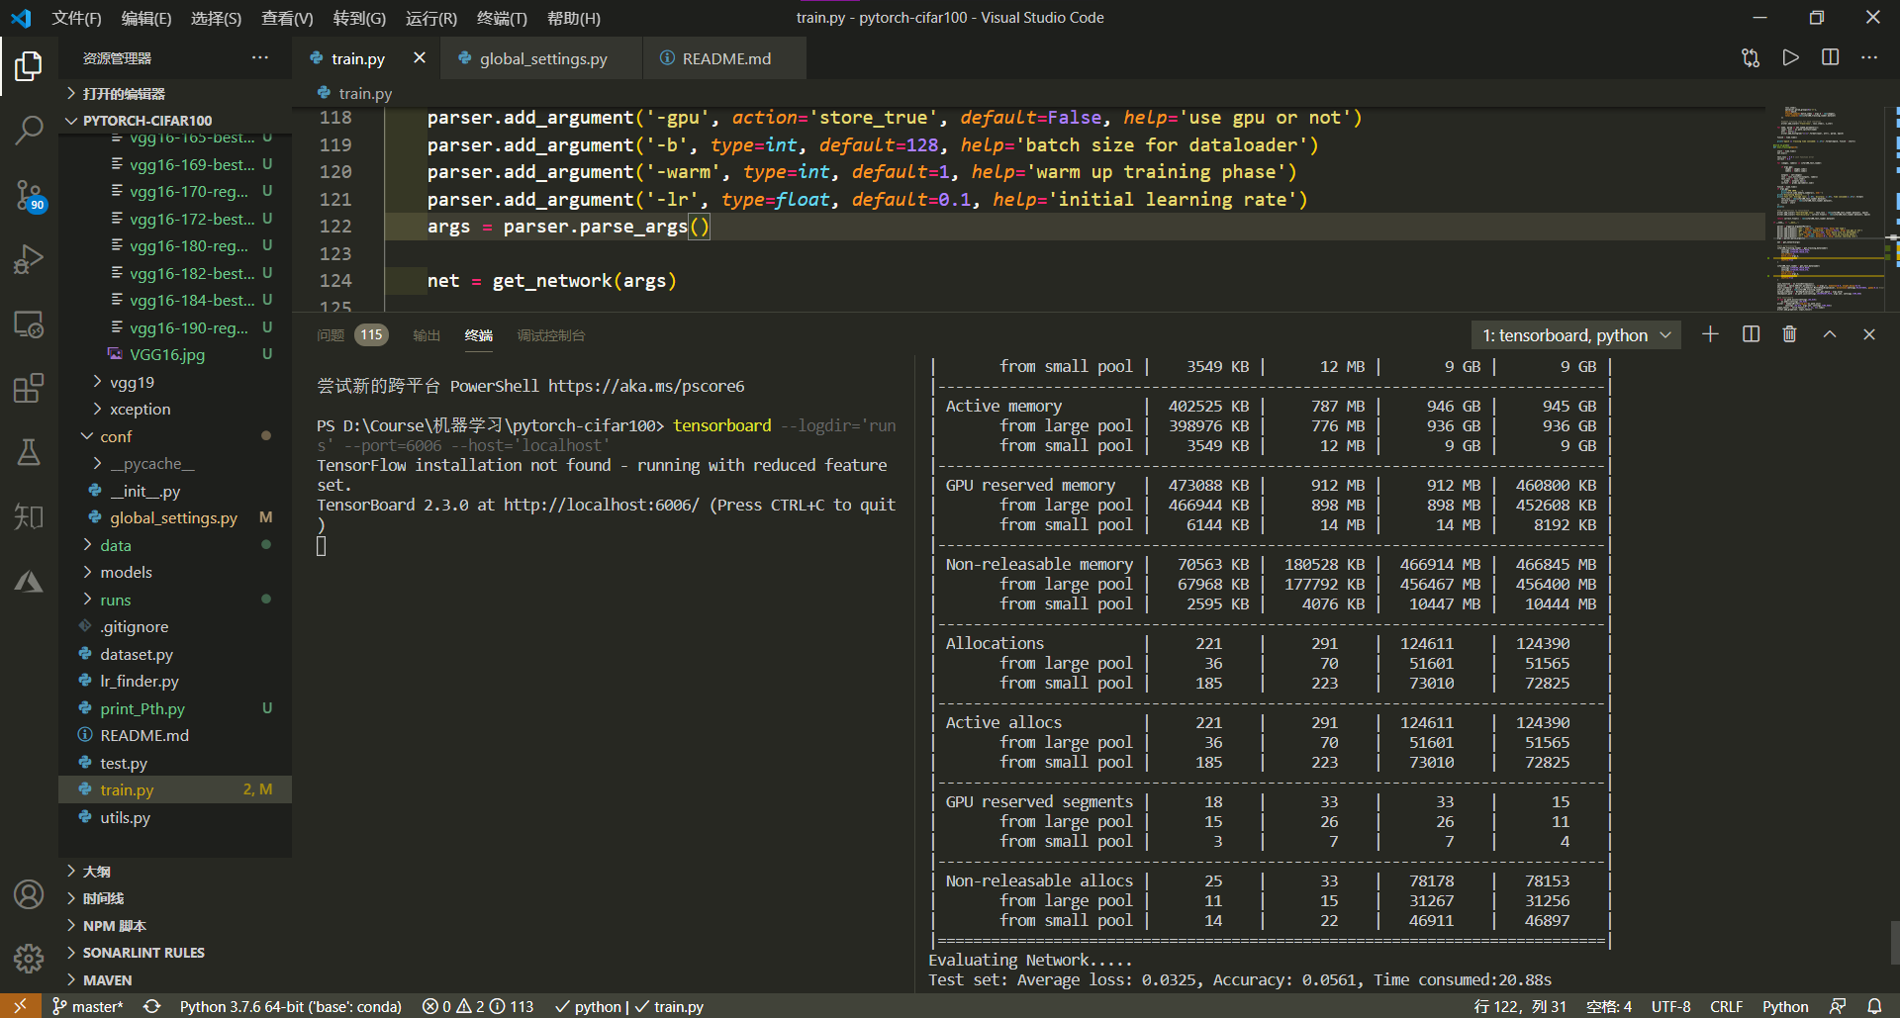
Alchemy(炼丹)

Slide 9
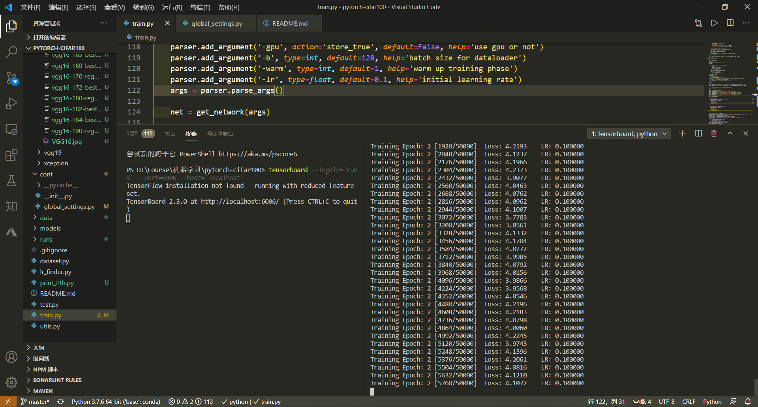
Alchemy(炼丹)

Slide 10
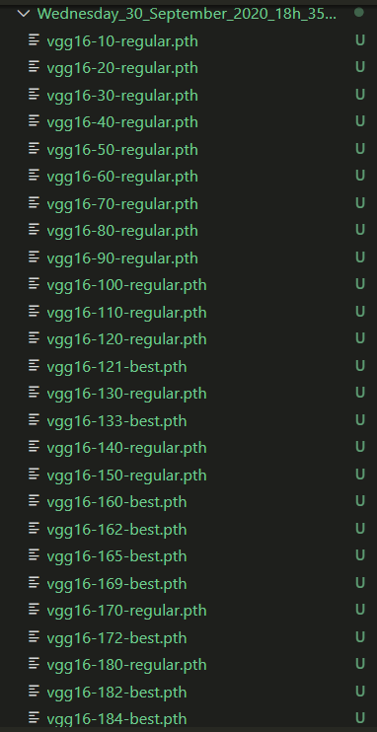
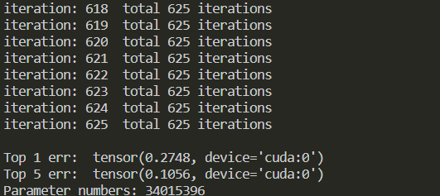
Alchemy(炼丹)
ACC = 0.7252

Slide 11
THANKS
2020.10.15

