Slide 1
mognus
There Is one mongus among us

Slide 2
Please clap

Slide 3
Consumer value brought in Q3
The lack of a game where people are in a spaceship and there is one murderer in the spaceship has been a pain point for customers
Refactoring the gameplay flow to allow for such a mode of gameplay will drive customer valuations and bring in revenue
GOAL → Make A MONGUS an important part of the business rather than an afterthought

Slide 4
New Opportunities
Due to COVID-19
Next slide

Slide 5
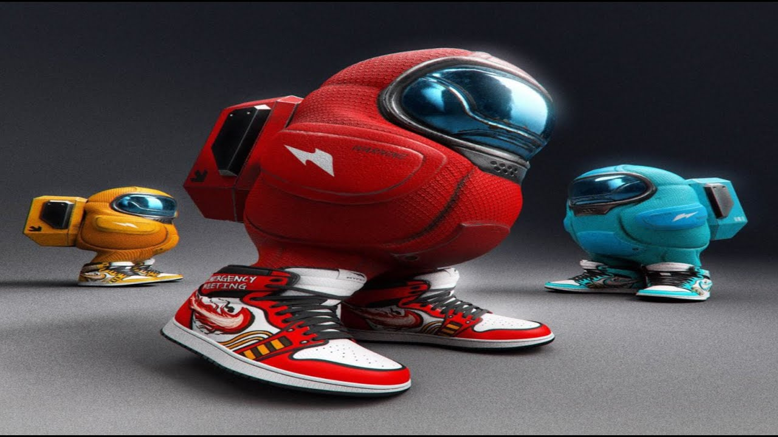
Concept art

Slide 6
Why will this be fun?
In the ancestral environment, social deduction was an important part of survival
Enemies would form coalitions and if they were more powerful than your coalition then they would outcompete you, thereby stealing your food, mates, etc.
Hence, humans have finely honed instincts for determining who on the spaceship may or may not be part of their coalition. This game appeals to such instincts
Hanson, Simler (2018)

Slide 7
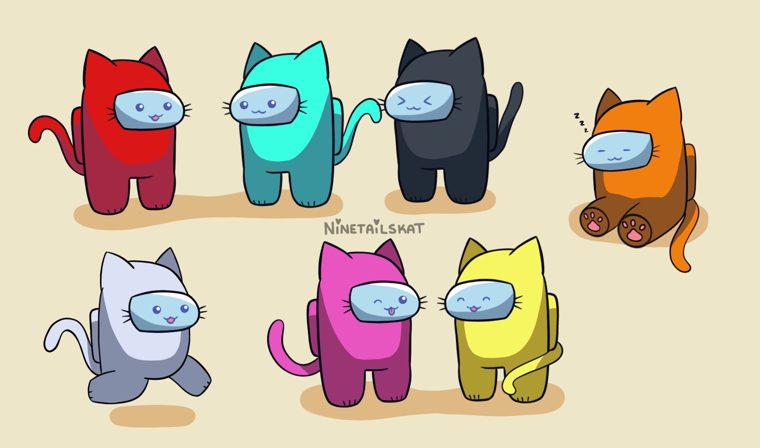
Cat tax (also coffee interlude)

Slide 8
Other games in the genre
Will Wright’s SPORE (2008)
Kirby’s Dream Land (1992)
Team Cherry’s Hollow Knight (2017)
This seems superficially similar to Innersloth’s Among Us (2018) but there are significant differences in the concept, such as

