Slide 1
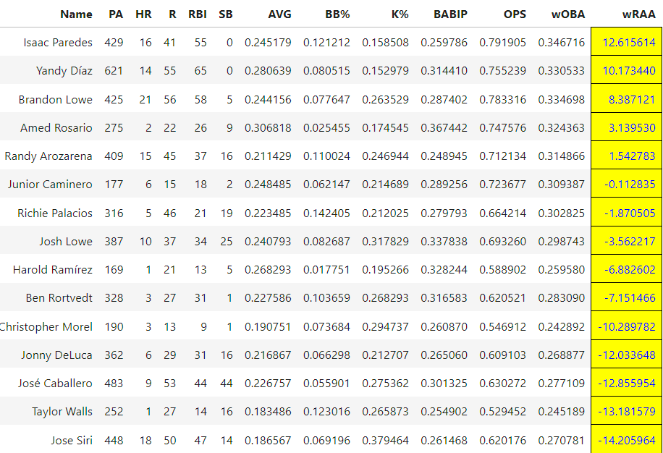
Team
TBR
ARI
ATL
BAL
BOS
CHC
CHI
CIN
CLE
COL
DET
HOU
KCR
LAA
LAD
MIA
MIL
MIN
NYM
NYY
OAK
PHI
PIT
SDP
SEA
SFG
STL
TEX
TOR
WSH
MLB Performance Evaluation
A statistical analysis of team & player performances for all 30 MLB teams, including an organizational financial assessment.
Team Performance
Player Performance
Financial Assessment
Previous Research
Hitters sorted by weighted runs above average (wRAA). Follow this link to read about acquisition recommendations for underperforming hitters by one of our contributors, Patrick Holsey:
Rays Replacement Candidates
Previous
1
Next

Slide 2
Content Description
Team Performance Evaluation
Allows the user to sort hitting or pitching metrics by team roster and export to excel or pdf
Provides player acquisition recommendations on team level based on comparable salary levels to underperforming players
Allows positional and lineup reconstruction with projected team record
Player Performance Evaluation
Allows the user to select an individual player to review current performance indicators
Provides suitable replacements with higher/lower performance marks within a suitable salary range
Allows mix-and-match of replacement players to current roster based on the “best-case, worst-case” optimization approach and export to excel or pdf
Overall Financial Assessment
Provides current valuation, revenue, and payroll of selected team
Allows export to excel or pdf
Provides comparison of selected team to other local professional teams and competitors in the MLB
Allows the user to tune underlying factors via connected sliders for updated projections (ex. lowering ticket price increases concessions price)

Slide 3

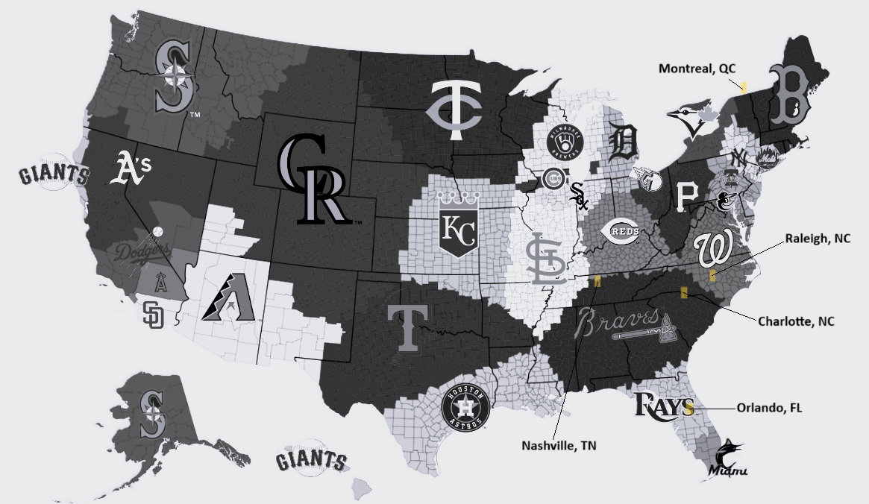
Previous Research
Relocation Assessment
Provides team fanbase map and highlights candidate cities for relocation
Links to previous research and assessments completed on selected team
Provides links to statistical and financial references for users to verify and complete their own studies
Links to recent news articles for selected team
Click city candidates for more information
Click here for methodology and results
Click here for future recommendations

