Slide 1
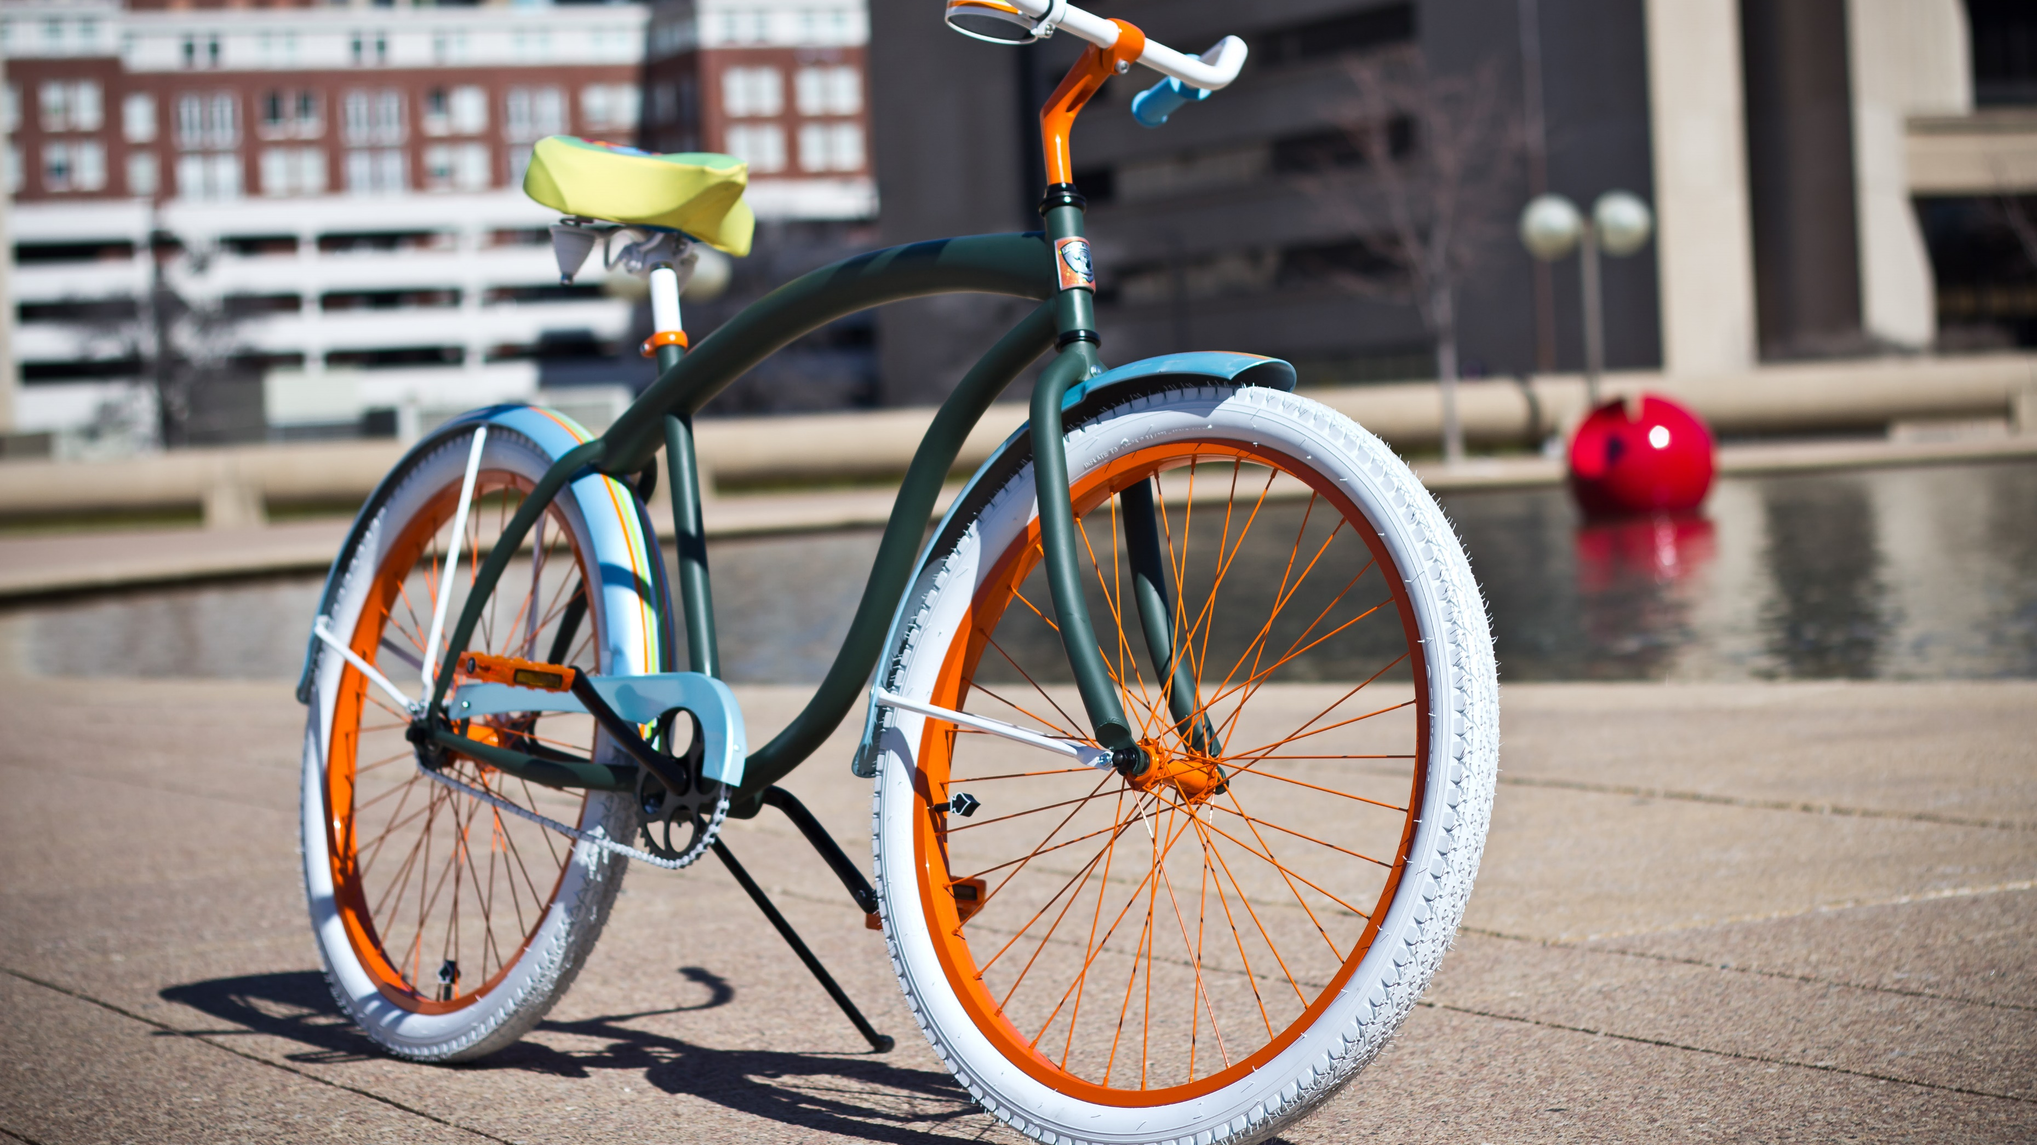
Bike Sharing Data Exploration
Northeastern, ALY 6015
6/23/2020
g. Holt Williams &
Aniruddha Sanjay Pazare
This Photo by Unknown Author is licensed under CC BY-SA

Slide 2

Pertinent Questions
How is ridership, by segment, impacted over different sized time periods?
What Information about the two groups is discernable from the patterns of the data?
Which time periods (Hour, weekday, Month, Season, Year) have the largest impact on ridership?

Slide 3
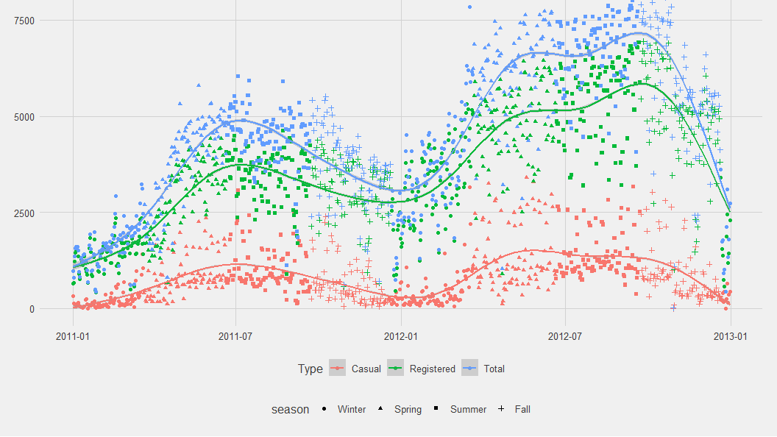
Data
Capital Bike Share data from 2011 to the end of 2012, segmented into Casual, Registered, and Total users. The data is recorded hourly and the set includes weather data.
Source: https://archive.ics.uci.edu/ml/datasets/bike+sharing+dataset

Slide 4
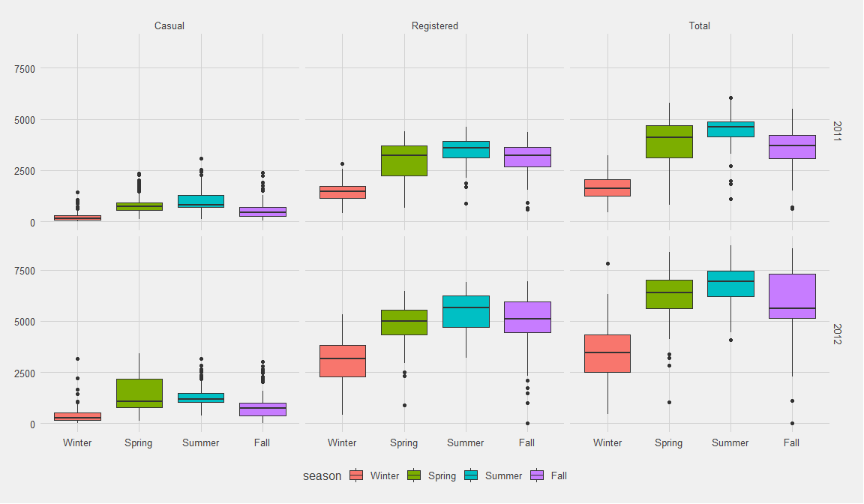
Seasonal Variations: by year

Slide 5
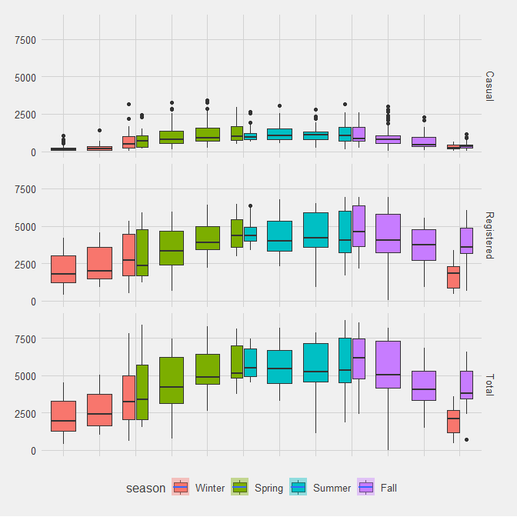
Monthly Variations
Key Takeaways:
Overall trend is similar
Registered Winter December values are significantly low

Slide 6
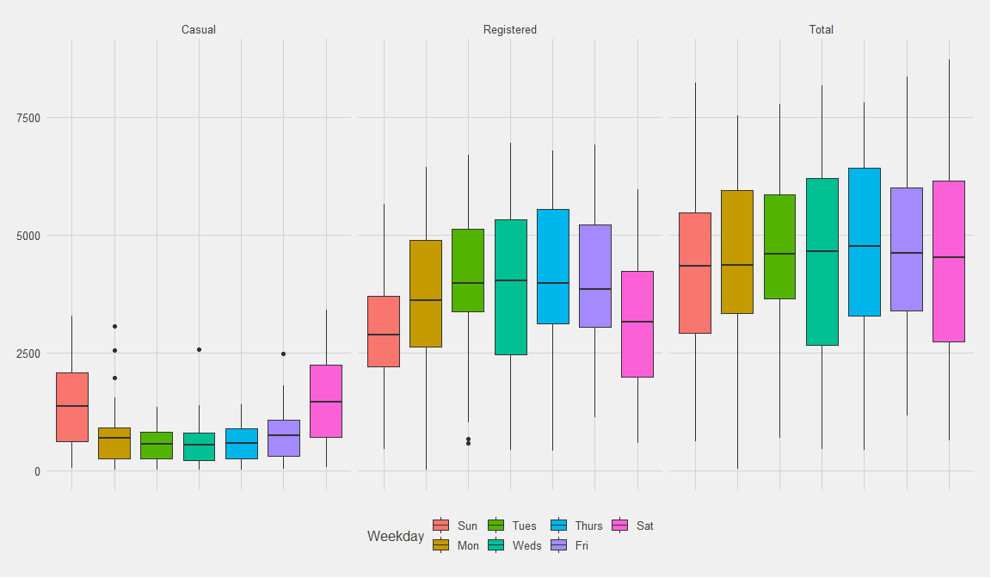
Weekday Variations
Discernable population differences:
Casual Ridership Spikes on weekends
Registered Ridership is about average Monday through Friday and low on the weekends

Slide 7
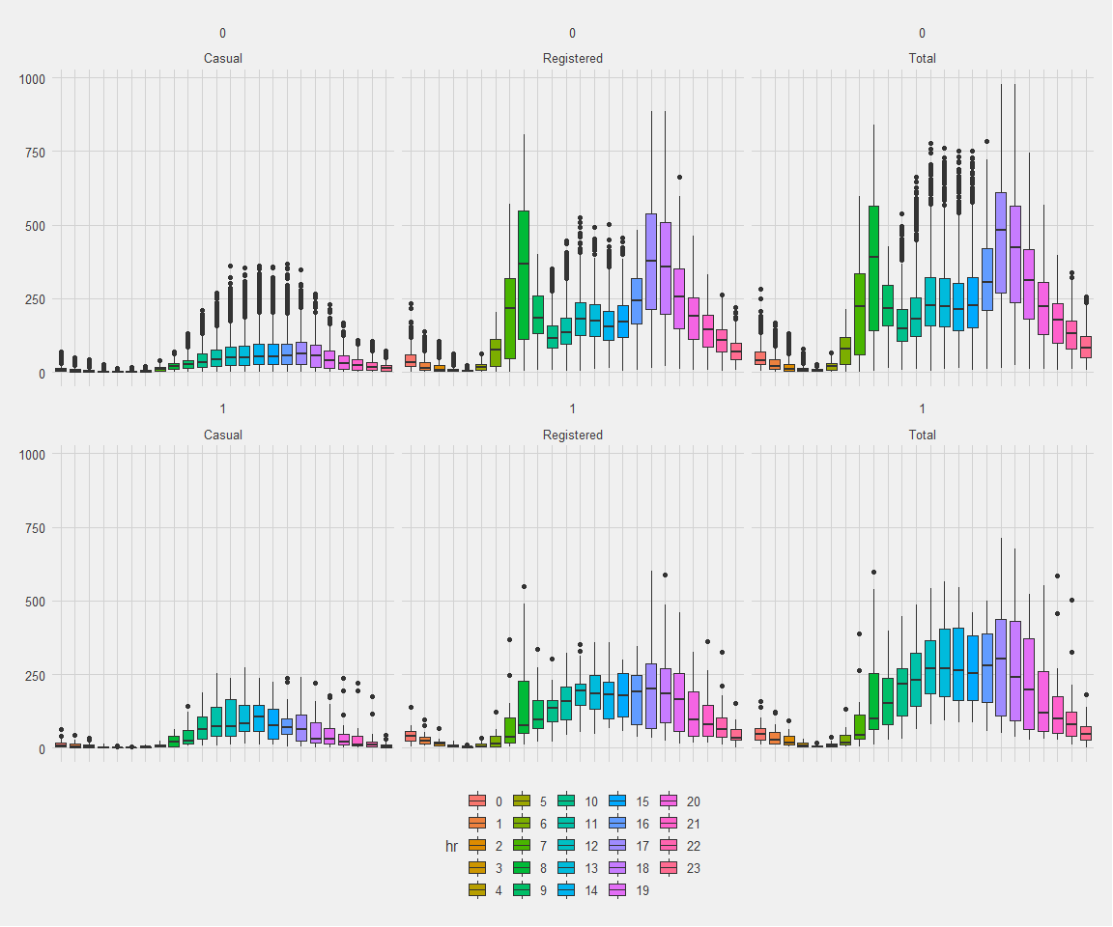
Hourly Variations
Hourly Variations By Holiday
Registered Users Spike during work commute time frames, which is not as present during Holidays
Casual Ridership is on average higher in the late morning through Mid-afternoon on Holidays

Slide 8
Sample Visualization Code

Slide 9
Modelling: Time Variables
All = Count ~ Year + Season + Month + Weekday + Hour
Model |  | R^2 | AIC | BIC
ALL | Casual | 0.540 | 171,402 | 171,759
ALL | Registered | 0.656 | 205,338 | 205,695
ALL | Total | 0.652 | 211,824 | 212,182
Year | Casual | 0.020 | 184,454 | 184,477
Year | Registered | 0.064 | 222,641 | 222,665
Year | Total | 0.063 | 228,962 | 228,985
Season | Casual | 0.083 | 183,317 | 183,356
Season | Registered | 0.049 | 222,927 | 222,965
Season | Total | 0.066 | 228,906 | 228,945
Month | Casual | 0.105 | 182,902 | 183,003
Month | Registered | 0.052 | 222,884 | 222,984
Month | Total | 0.075 | 228,752 | 228,853
Weekday | Casual | 0.092 | 183,140 | 183,202
Weekday | Registered | 0.016 | 223,533 | 223,595
Weekday | Total | 0.001 | 230,077 | 230,139
Hour | Casual | 0.314 | 178,304 | 178,498
Hour | Registered | 0.513 | 211,354 | 211,548
Hour | Total | 0.501 | 218,034 | 218,228
Example Interpretation from the Hour Model:
Note Hour 24 is the reference point
Type | Model | Estimate | P-Value
… | … | … | …
Registered | hr9 | 144 | 4.6E-147
Registered | hr10 | 83 | 8.29E-51
Registered | hr11 | 104 | 7.08E-79
… | … | … | …
“The model predicts 144 more riders in hour 9 (9am) compared to hour 0 (12am) at a 95% confidence level”

Slide 10
Modelling Code
#Nest test<- long%>%group_by(Type)%>%nest() #Define Model ALL_model <- function(df) { lm(Count ~ Year+season+Month+Weekday+hr, data = df) } #Use Model test <- test%>% mutate(ALL_model = map(data, ALL_model)) #Retrieve Data test %>% mutate(glance = map(ALL_model, broom::glance)) %>% unnest(glance, .drop = TRUE)%>%select(r.squared,adj.r.squared, AIC, BIC)
test %>% mutate(tidy = map(ALL_model, broom::tidy)) %>% unnest(tidy, .drop = TRUE)%>%select(term,estimate, p.value)

Slide 11

References
Web Source: http://archive.ics.uci.edu/ml/datasets/Bike+Sharing+Dataset
[1] Dua, D. and Graff, C. (2019). UCI Machine Learning Repository [http://archive.ics.uci.edu/ml]. Irvine, CA: University of California, School of Information and Computer Science.
[2] Fanaee-T, Hadi, and Gama, Joao, 'Event labeling combining ensemble detectors and background knowledge', Progress in Artificial Intelligence (2013): pp. 1-15, Springer Berlin Heidelberg

